Slide 1
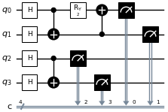





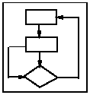
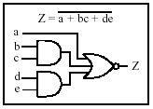
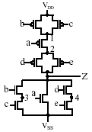
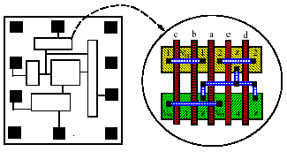
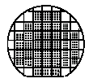
Quantum program
Classical support for quantum computing
Gate-based Quantum computer
Simulation
Optimization
Transpilation
Visualization
Analogous to the classical digital design flow
System spec
VHDL Design
RTL Synthesis
Circuits
Physical Design
Fabrication
module fz(a,b,c,d,e,Z);
input a,b,c,d;
output Z;
assign Z = ~(a|(b&C));
endmodule
Notes:
As the quantum computer becomes more and more capable, there is a growing need of classical software support for the design of quantum computers, whether it is simulating the quantum algorithms, optimizing the quantum circuits, transpiling quantum programming models, or visualizing quantum operations.
(click) This is like how we count on CAD software to design classical computers. We have hardware programming models, RTL synthesis software, circuit modeling, physical design algorithms, and so on so forth to help us manage the complexity of circuit designs.
Without these software, electronic products would not even be possible, and that is the same for the future of quantum computers.

