Slide 1


Reliability-Oriented Broadcast Electrode-Addressing for Pin-Constrained Digital Microfluidic Biochips
Tsung-Wei Huang, Tsung-Yi Ho, and Krishnendu Chakrabarty
Department of Computer Science and Information Engineering
National Cheng Kung University, Tainan Taiwan
Department of Electrical and Computer Engineering
Duke University, Durham, NC

Slide 2
Outline
Introduction
Problems
Algorithm
Experimental results
Conclusion

Slide 3
Outline
Introduction
Problems
Algorithm
Experimental results
Conclusion

Slide 4

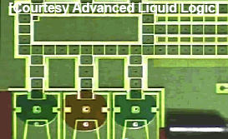
Digital Microfluidic Biochips (DMFBs)
Digital Microfluidic Biochips
Droplets: biological sample carrier; basic units to perform the laboratory procedures on DMFBs
2D microfluidic array: set of electrodes for biological reactions
Reservoirs/dispensing ports: for droplet generation
Optical detectors: detection of reaction result
Droplets
Optical detector
2D microfluidic array
Electrodes
Reservoirs/Dispensing ports
Schematic view of a DMFB (Duke Univ.)

Slide 5
Droplet Movement on DMFBs
Droplet movements are controlled by electrical manipulation
Control electrodes (cells)
Hydrophobic insulation
Ground electrode
Top plate
Droplet
Droplets
Bottom plate
Side view
Droplet
Spacing
Control electrodes
Reservoir/Dispensing port
Top view
High voltage to generate an electric field

Slide 6
Pin Assignment for Droplet Control
Dedicated pin to identify the control signal
Direct-addressing method
Dedicated control pin for each electrode
Maximum freedom of droplets
High demanded control pins
1
2
3
4
5
6
7
8
9
10
11
12
13
14
15
16
17
18
Control pins: 24
19
20
21
22
23
24
For large arrays (e.g., > 100 x 100 electrodes)
Too many control pins ⇒ high fabrication cost
Wiring plan is not available
PCB design: 250 um via hole, 500 um x 500 um electrode
Via Holes
Wires
Notes:
To control the movements of droplets, each electrode is assign a dedicate pin to

Slide 7
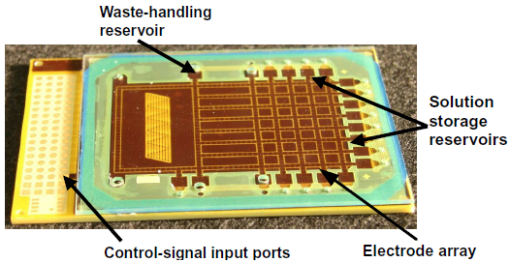
Pin-Constrained DMFBs (PDMFBs)
Broadcast-addressing algorithm_{*[1]}
A control pin is shared by multiple electrodes
Control signal/pin sharing
Flexible for pin-constrained DMFBs (PDMFBs)
Feasible for large design
Low pin-count demand reduces product cost
Control signal sharing
1
2
3
4
1
2
7
8
9
10
14
12
13
14
15
13
8
7
2
1
4
3
2
1
*[1]: T. Xu and K. Chakrabarty, DAC’08
Control pins: 24 -> 15
A fabricated PDMFB for PCR_{*[2]}
- over 1000 electrodes
- only 64 signal ports
*[2] Advanced Liquid Logic, inc.
Notes:
In this algorithm, a control pin is shared

Slide 8
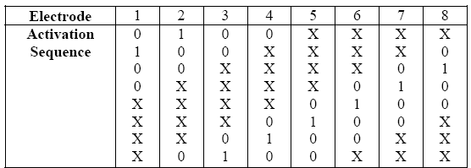
Broadcast Electrode Addressing (1/2)
Broadcast-addressing
Droplet-controlling information is stored in the form of electrode actuation sequences:
“1” – actuated
“0” – de-actuated
“X” – can be either “0” or “1”
Actuation
sequence
Example: A droplet routed counterclockwise on a loop of electrodes

Slide 9
Broadcast Electrode Addressing (2/2)
By carefully replacing these don’t care terms “X” with “1”, or “0”, multiple actuation sequences can be merged to an identical outcome
Assign a single control pin to multiple electrodes
Compatible graph
1
8
2
Actuation
sequence
1
0
0
0
7
3
0
0
1
0
6
4
0
1
0
0
0
0
1
0
5
4 pins
1
Minimum Clique Partition
8
2
7
3
compatible
6
4
5

Slide 10
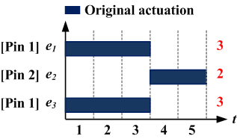
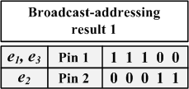
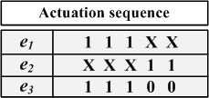
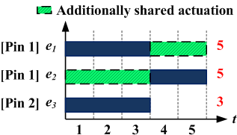
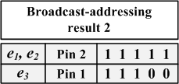
Problem of Broadcast Addressing
Additionally shared actuations
Replacement of don’t care “X” with “1”
Different addressing results lead to different actuation demands
Low actuation demand
Result 1
Result 2
High actuation demand
Uncareful broadcast addressing may cause excessive electrode actuations！

Slide 11
Influence of Excessive Actuations (1/2) – Trapped Charge
Trapped-charge problem (TC problem)
A possibility for each actuation that charge becomes trapped in the insulator
A high number of actuations substantially intensifies the TC problem
Electrowetting force is proportional to (V_{a} - V_{t})²
V_{a}
Insulator
V_{t}
+ + + +
Trapped charge
Electrode
Faults and Errors
Irreversible charge concentration
Electrode malfunction
Stuck droplet
Erroneous assay outcome
System/Chip
reliability degradation
Resolution: Minimize the number of actuations of each electrode

Slide 12
Influence of Excessive Actuations (2/2) – Residual Charge
Residual-charge problem (RC problem)
A possibility for each actuation that charge accumulates in electrodes
Excessive actuations may lead to prolonged actuation durations
Prolonged actuations of electrodes incur the RC problem
Faults and errors
Ambiguous droplet movements
Unstable droplet controls
Undesirable splitting
Erroneous assay outcome
?
Unexpected movement
(e.g., split or stuck)
Droplet
Residual charge
- - - -
System/Chip
reliability degradation
Resolution: Lengthen the grounding time after a long actuation duration
Notes:
So we introduce the concept of grounding vector

Slide 13
Avoidance of RC Problem by Grounding Vectors (GV)
Grounding vectors (GVs)
A control signal grounding all electrodes by additional one time step
GV function f(r): every maximally “r” actuations should be followed by at least “f(r)” grounding time steps
RC problem
e₁
e₂
e₃
0 | 1 | 1 | X | X | 0 | 1 | 1 | X | X
0 | X | X | 1 | 1 | 0 | X | X | 1 | 1
0 | 1 | 1 | 0 | 0 | 0 | 1 | 1 | 0 | 0
p₁
p₁
p₂
0 | 1 | 1 | 1 | 1 | 0 | 1 | 1 | 1 | 1
0 | 1 | 1 | 1 | 1 | 0 | 1 | 1 | 1 | 1
0 | 1 | 1 | 0 | 0 | 0 | 1 | 1 | 0 | 0
p₁
p₂
(a) Sequence matrix (10 time steps)
(b) f(4) = 2
3 GV insertions
No GV insertion
p₁
p₁
p₂
0 | 1 | 1 | 1 | 1 | 0 | 0 | 1 | 1 | 1 | 1 | 0 | 0
0 | 1 | 1 | 1 | 1 | 0 | 0 | 1 | 1 | 1 | 1 | 0 | 0
0 | 1 | 1 | 0 | 0 | 0 | 0 | 1 | 1 | 0 | 0 | 0 | 0
p₁
p₂
p₁
0 | 1 | 1 | 0 | 0 | 0 | 1 | 1 | 0 | 0
0 | 0 | 0 | 1 | 1 | 0 | 0 | 0 | 1 | 1
0 | 1 | 1 | 0 | 0 | 0 | 1 | 1 | 0 | 0
(c) 2 pins (13 time steps)
(d) 2 pins (10 time steps)
Solution of (d) is more desirable (less impact on assay time-to-response)
Notes:
We can insert GV in the activation sequence to avoid the RC problem

Slide 14
Preservation of Critical Operations
Critical operations
Operations that require precise timing control
Operations that are highly-sensitive to timing condition
Operations that have been associated a specific/certain number of time steps for reliable execution
E.g., incubation*, PCR looping, and dispensing
Antibody
Magnetic bead
magnet
Incubation*
630 time
steps
Incubation by shuttling
the droplet from t₁~t₂
Well-mixed blood cell
and magnetic bead
Grounding vectors (GVs) cannot be inserted within critical operations
*R. Sista et al., LOC’08

Slide 15
Problem Formulation
Input
A set of electrodes with the corresponding actuation sequences and specifications of P_{max} and f(r)
Constraints
Pin constraint:
Resulted pin count cannot exceed P_{max}
Broadcast-addressing (BA) constraint:
A set of electrodes can be addressed together iff their corresponding actuation sequences are mutually compatible
Residual-charge-avoidance (RCA) constraint
Every r maximally continuous actuations should be followed by f(r) GVs
Critical-operation-preservation (COP) constraint
GVs cannot be inserted within critical operations
Objective
Minimize the number of actuations of each electrode
Minimize the number of inserted GV

Slide 16
Outline
Introduction
Problems
Algorithm
Experimental results
Conclusion

Slide 17
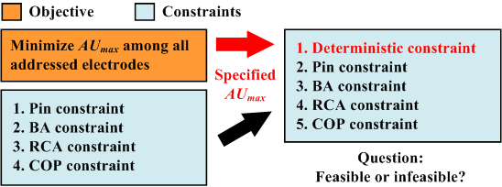
Algorithm - Motivation
Motivation
Let L denotes the length of actuation sequences
An obvious observation that AU_{max}* is within 0 ~ L
Algorithm flow
Transform the original optimization problem into a deterministic problem
Iteratively search AU_{max} from 0 ~ L to examine the feasibility
*AU_{max}: maximum value among all numbers of actuations of each electrode

Slide 18
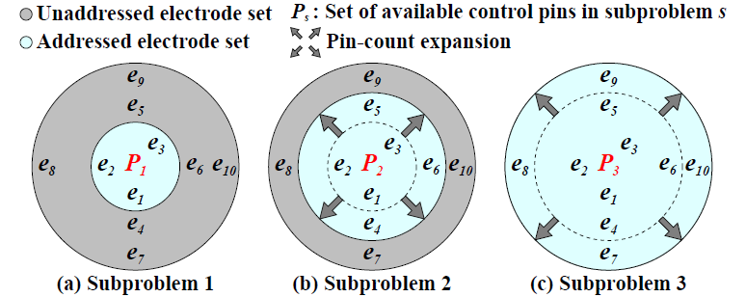
Concept of the Proposed Algorithm (1/5)
Solving the deterministic problem
Decompose the original problem into several manageable subproblems
Progressively solve all subproblems *
*Huang et al., ICCAD’10

Slide 19
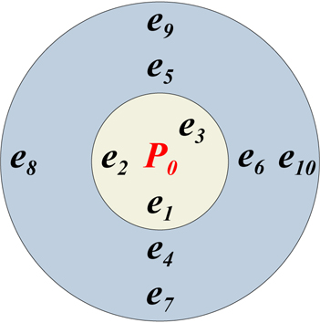
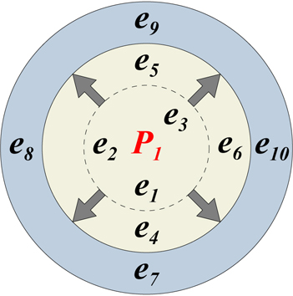
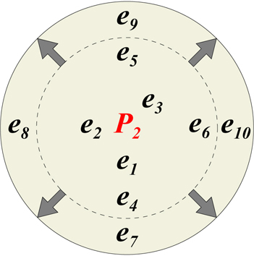
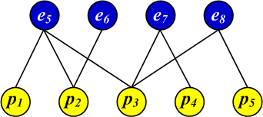
Concept of the Proposed Algorithm (2/5)
Progressive addressing framework
Reduces the design complexity by deriving several addressing subproblems
Iteratively selects a maximum non-compatible electrode group (from unaddressed electrode set)
Facilitates the matching formulation
Minimizes the pin count
Minimum-Weight Maximum-Bipartite Matching
Unaddressed electrodes
* Progressively includes a unaddressed electrode group
for addressing
* Iterations end until all electrodes are addressed
Existing pins
Objective in each subproblem iteration:
Maximizes the number of using existing pins for addressing → maximum matching value
Minimizes the numbers of required AUs and inserted GVs → minimum matching cost

Slide 20
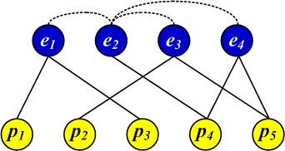
Concept of the Proposed Algorithm (3/5)
Solving the subproblem
Each subproblem corresponds to a matching problem
Select a mutually-incompatible electrode group from unaddressed electrodes
Addressing can be formulated to a bipartite-matching problem
Solution: Select mutually-incompatible electrodes
Randomly selected electrode set
No intra-compatibility edge
Difficult problem formulation
Simple bipartite-matching formulation

Slide 21
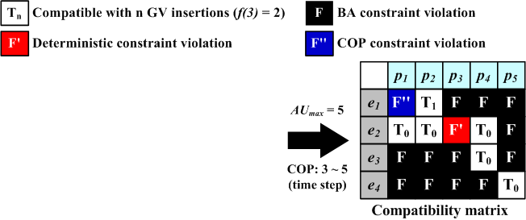
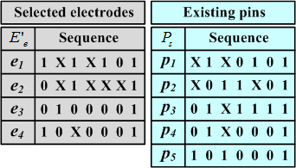
Concept of the Proposed Algorithm (4/5)
Matching graph construction
Insert an edge if it meets all the following constraints:
Deterministic constraint
Broadcast-addressing (BA) constraint
Residual-charge-avoidance (RCA) constraint
Critical-operation-preservation (COP) constraint
1
2
3
4
1
2
3
4
5
e₂ with p₃ → 0111111 (AU > AU_{max} (5))
e₁ with p₁ → 11100101 (COP constraint violation)

Slide 22
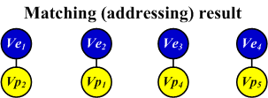
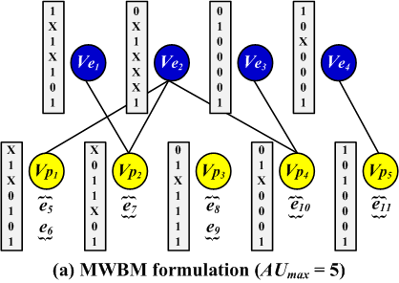
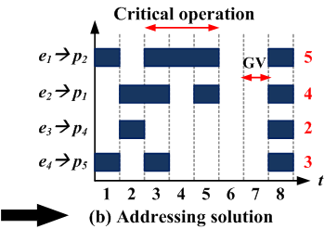
Concept of the Proposed Algorithm (5/5)
Minimum-Weight Maximum-Bipartite (MWMB) Matching
Construct a weighted bipartite graph to solve the problem
Key ideas
Minimize the number of pins by matching value
Minimize AU_{k} and the number of inserted grounding vectors by cost

Slide 23
Outline
Introduction
Problems
Algorithm
Experimental results
Conclusion

Slide 24
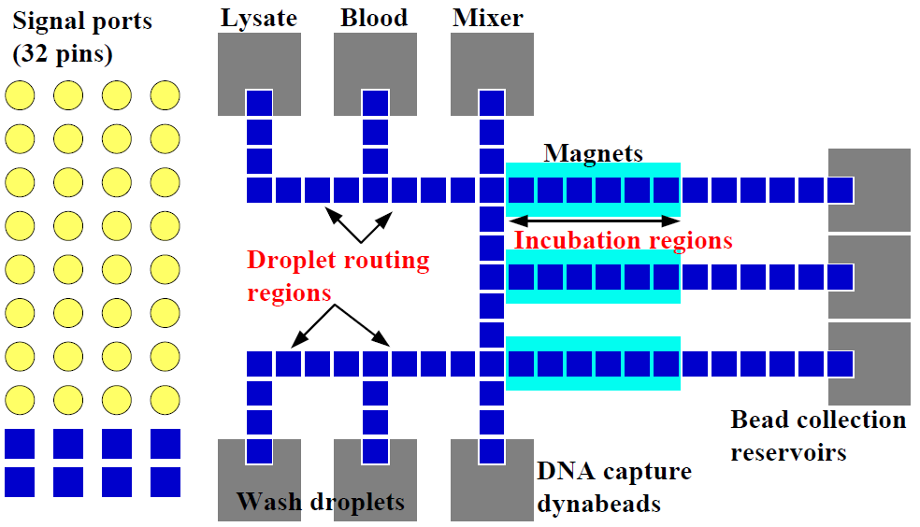
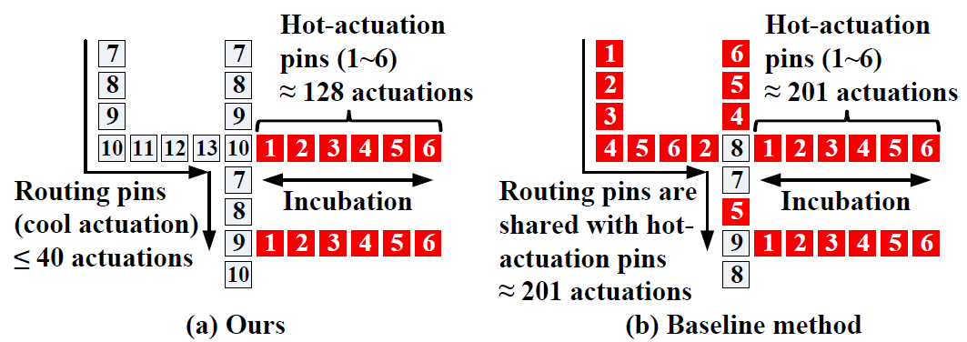
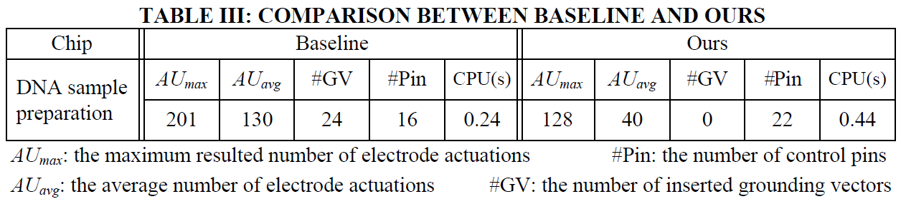
Experimental results (1/2)
DNA sample preparation
86 electrodes
Limited number of 32 signal ports
Rarely actuated
Hot actuated

Slide 25
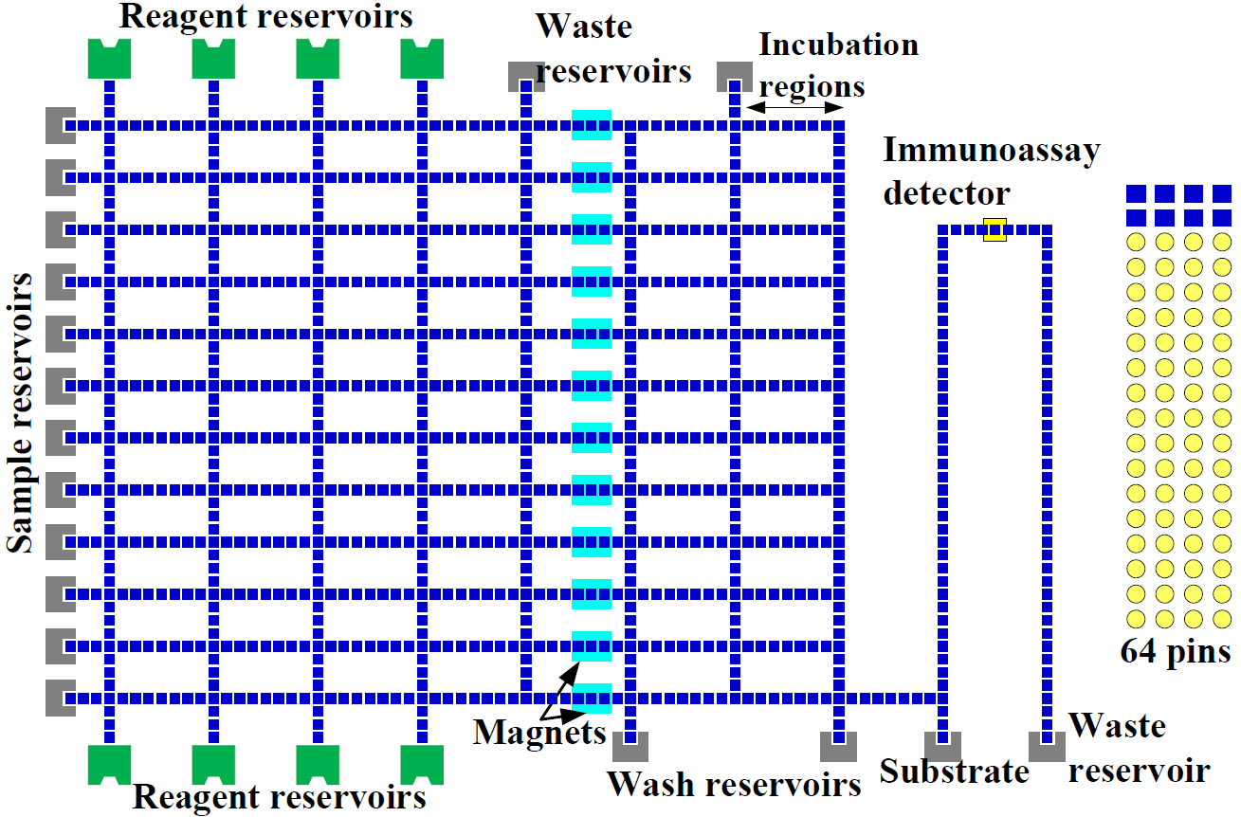
Experimental results (2/2)
n-plex immunoassay
1140 electrodes
Limited number of 64 control pins

Slide 26
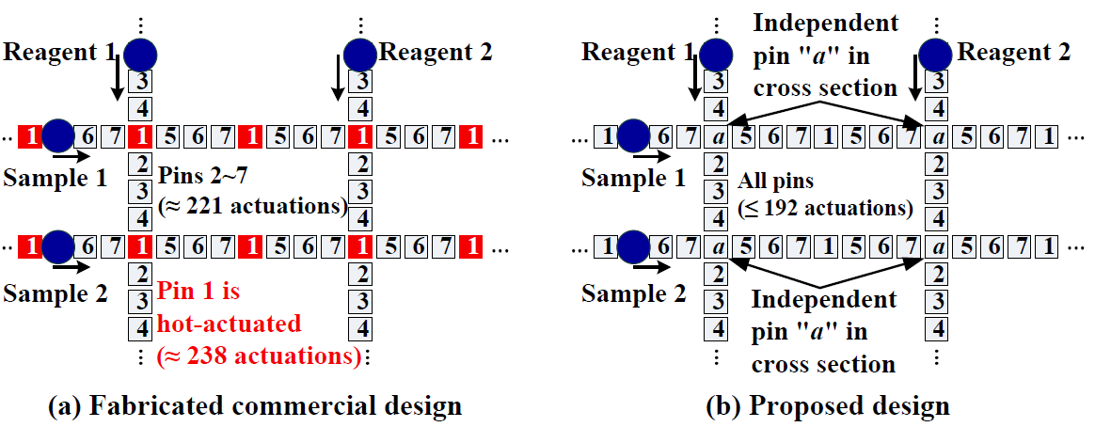
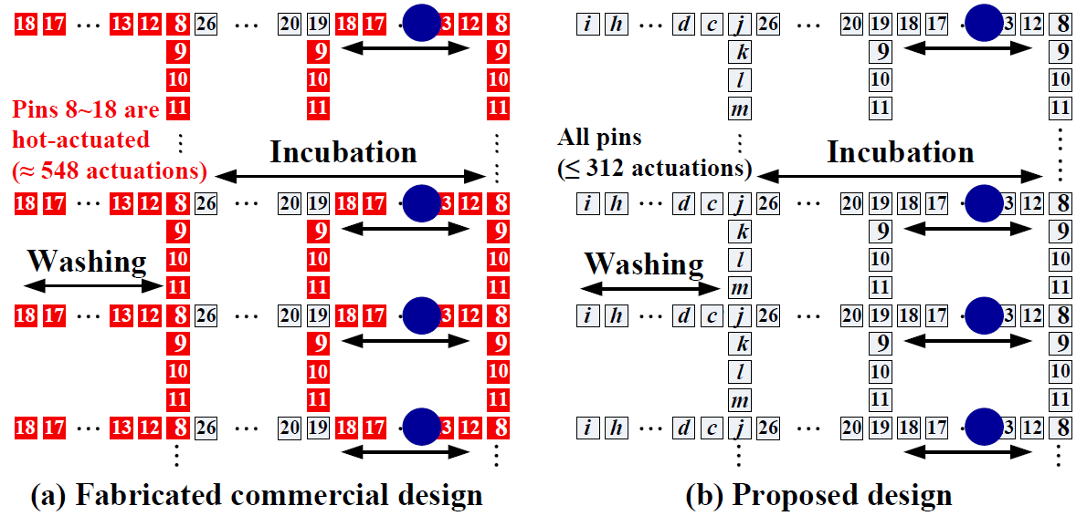
Experimental results (2/2)
Routing region
Reaction region
Excessively actuated
Controlled together

Slide 27
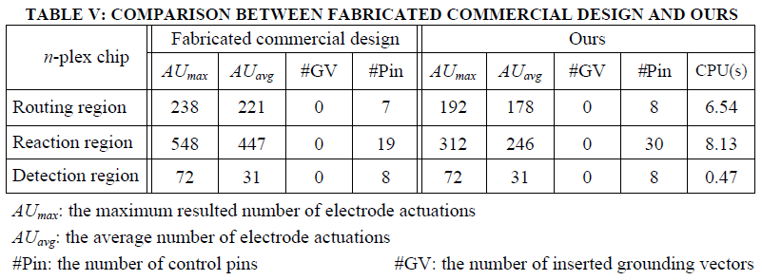
Experimental results (2/2)

Slide 28
Outline
Introduction
Problems
Algorithm
Experimental results
Conclusion

Slide 29
Conclusion
We have presented a novel matching-based broadcast electrode-addressing algorithm for PDMFBs to deal with the involved reliability problem in pin-constrained designs.
We have identified the causes of reliability degradation and introduced a new and practical formulation of reliability-oriented electrode-addressing.
Two commercial PDMFBs of point-of-care testing have been used to evaluate the effectiveness of our addressing algorithm on preventing pin-constrained design from reliability degradation.

Slide 30
Thank You!

