Slide 1
UI-Timer: An Ultra-Fast Clock Network Pessimism Removal Algorithm
Tsung-Wei Huang, Pei-Ci Wu, and Martin D. F. Wong
Department of Electrical and Computer Engineering (ECE)
University of Illinois at Urbana-Champaign (UIUC), IL, USA
2014 IEEE/ACM International Conference on Computer-Aided Design
Notes:
ECE Main Slide

Slide 2
Outline
Introduction
Static timing analysis (STA)
Importance of clock network pessimism removal
Problem formulation
2014 TAU timing analysis contest
Experimental result
Conclusion

Slide 3
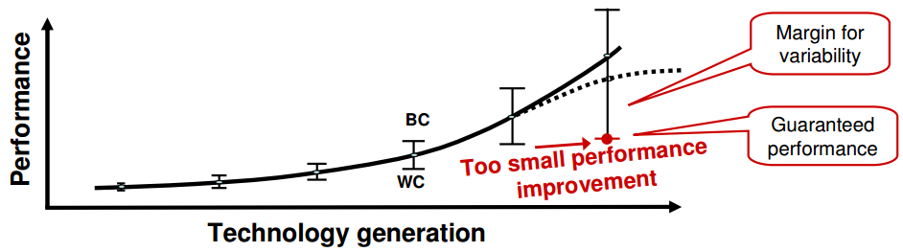
Static Timing Analysis (STA)
Static Timing analysis
Verify the expected timing characteristics of integrated circuits
Keep track of path slacks and identify the critical path with negative slack
Increasing significance of variance
On-chip variation such as temperature change and voltage drop
Perform dual-mode (min-max) conservative or pessimistic analysis
Degrades the quality of signoff timing report

Slide 4

Timing Test and Verification of Setup/Hold Check
Sequential timing test
Setup time check
“Latest” arrival time (at) v.s. “Earliest” required arrival time (rat)
Hold time check
“Earliest” arrival time (at) v.s. “Latest” required arrival time (rat)
Earliest rat
(hold test)
Latest rat
(setup test)
Passing (positive slack)
Failing
Failing
time
Hold violation ☹
No violation ☺
Setup violation ☹

Slide 5
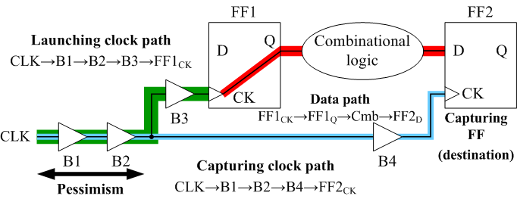
Clock Network (Common Path) Pessimism
Common path pessimism (CPP)
Simultaneous min-max variation along the common clock paths
Impossible in reality
Unnecessary pessimism is included into the path slack
Test marking failing might be passing in actuality

Slide 6
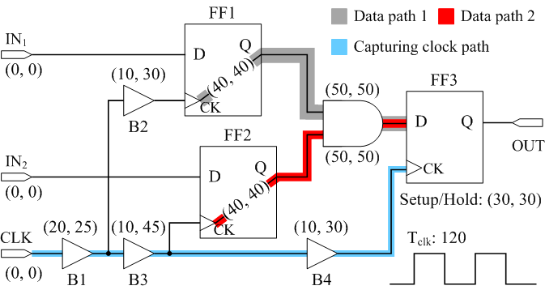
Example – Data Path Slack with CPPR Off
Pre common-path-pessimism-removal (CPPR) slack
Data path 1: ((120+(20+10+10))-30) – (25+30+40+50) = -15 (critical)
Data path 2: ((120+(20+10+10))-30) –(25+45+40+50) = -30 (critical)

Slide 7
Example – Data Path Slack with CPPR On
Post common-path-pessimism-removal (CPPR) slack
Data path 1: ((120+(20+10+10))-30) – (25+30+40+50)+5 = -10 (critical)
Data path 2: ((120+(20+10+10))-30) –(25+45+40+50)+40 = 10
+5
CPP1
CPP 2
+40

Slide 8
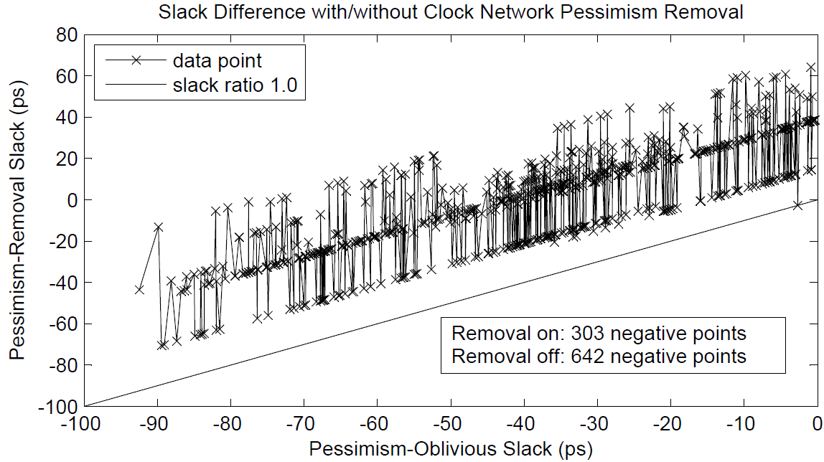
Impact of Clock Network Pessimism – (I)

Slide 9

Importance of Clock Network Pessimism Removal
Over-pessimistic timing report
Report failure paths but in actuality passing
Mislead designer into an inaccurate timing result
Decrease the productivity and legality of turnaround
Most critical pre-CPPR path(s) could be positive post-CPPR path(s)
Mislead CAD tools and result in wastage of optimization efforts
Leaving performance on Table
Increasing significance in deep sub-micro era
Industry people seek novel ideas for CPPR algorithm
2014 TAU CAD Contest on CPPR
Worldwide teams participated in the contest
1st place winner – UI-Timer

Slide 10
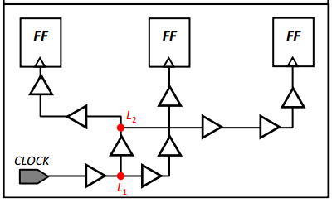
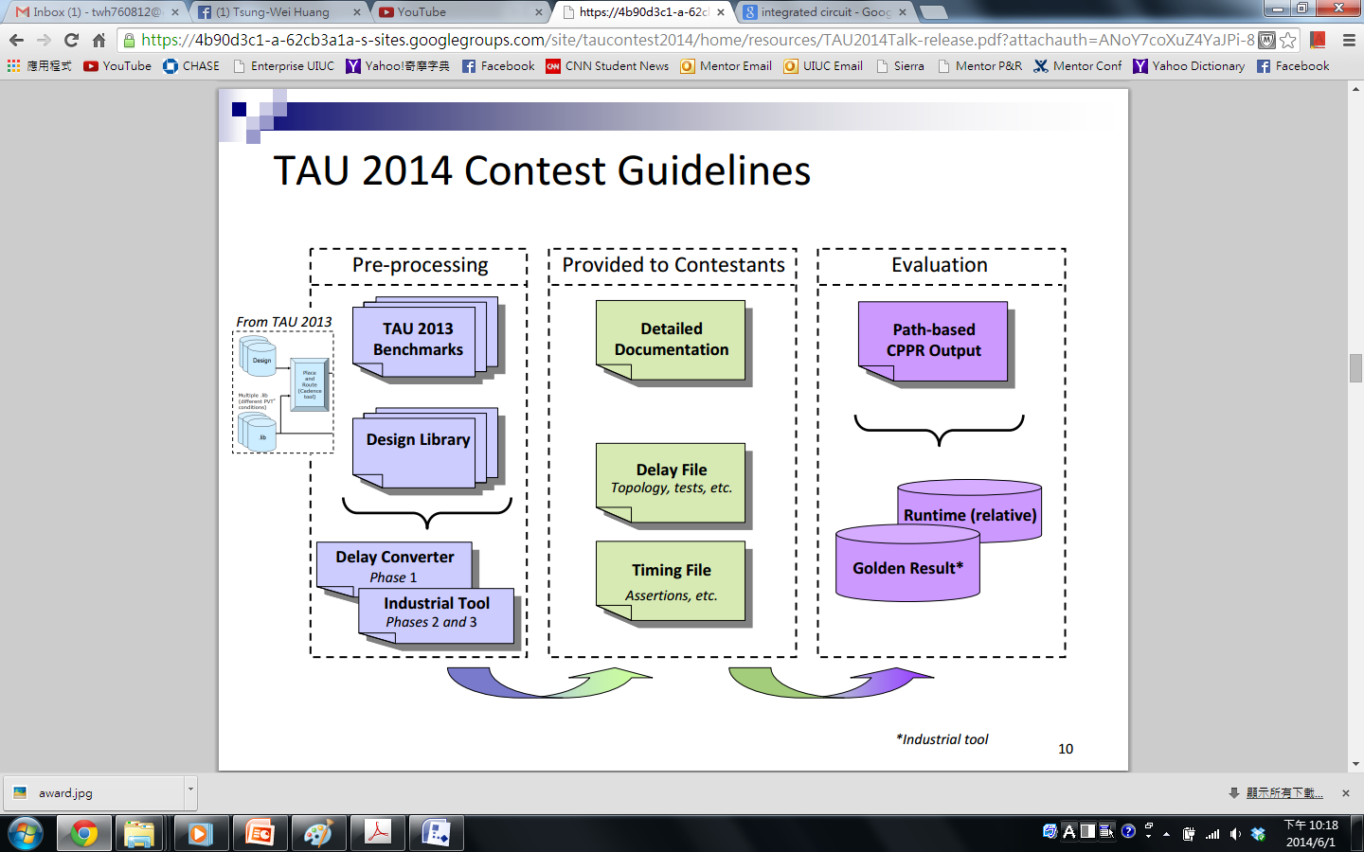
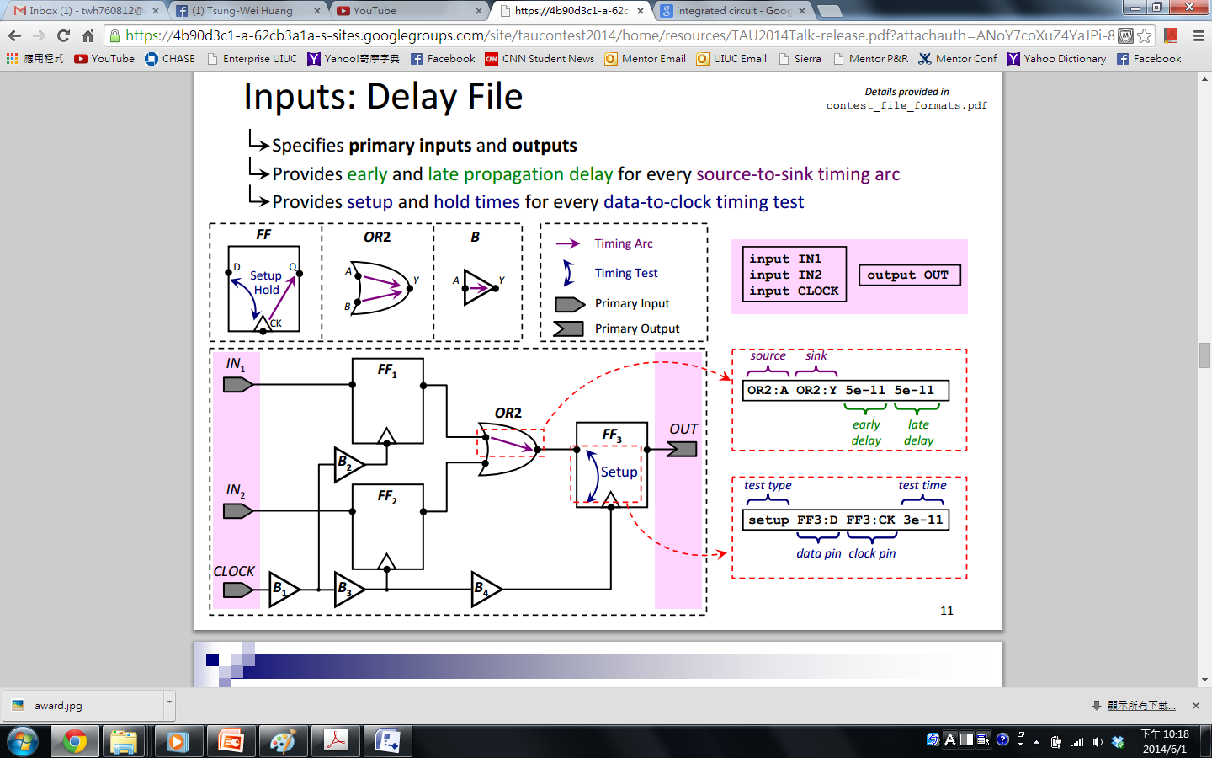
Problem Formulation
Input file
Delay file for circuit topology and tests
Timing file for assertion and clock properties
Goal
Identify the top k critical paths with CPPR (i.e., post-CPPR critical paths)

Slide 11
Algorithm - Overview
Step 1: look-up-table preprocessing
Tabulate the common path for quick pessimism lookup
Step 2: pessimism-free graph formulation
Facilitate the search on true post-CPPR slack
Step 3: path extraction
Search the top k critical paths in the pessimism-free graph

Slide 12
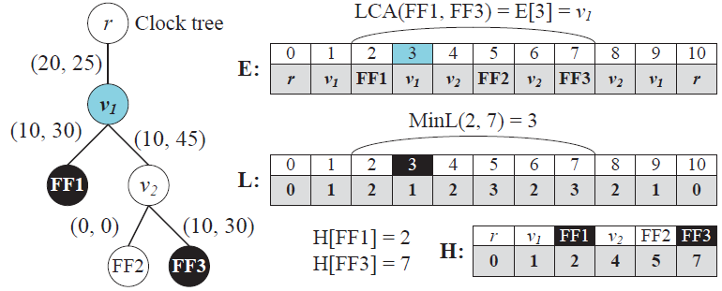
Algorithm – Step 1: Lookup Table Preprocessing
Pessimism incurs on a clock re-converging node
Equivalently finding the lowest common ancestor (LCA) in the clock tree
Range minimum query with dynamic programming
O(nlogn) preprocessing and O(1) per LCA query

Slide 13
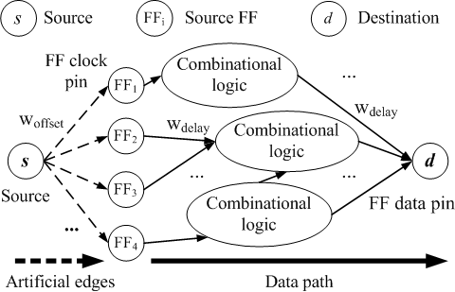
Algorithm – Step 2: Pessimism-Free Graph Formulation
Pessimism-free graph formulation
Isolate the constant part of numerical slack value
Offset weight for required arrival time and common-path pessimism
Facilitate the search
The cost of path is equivalent to post-CPPR slack
Constant per test
slack_{hold} = at_{d}^{early} – rat_{t}^{early} + CPP_{d}^{s}
slack_{setup} = rat_{t}^{late} – at_{d}^{late} + CPP_{d}^{s}
Constant per test
W_{hold}^{offset} = – rat_{t}^{early} + CPP_{d}^{s}
W_{setup}^{offset} = rat_{t}^{late} + CPP_{d}^{s}
Pessimism-free graph

Slide 14
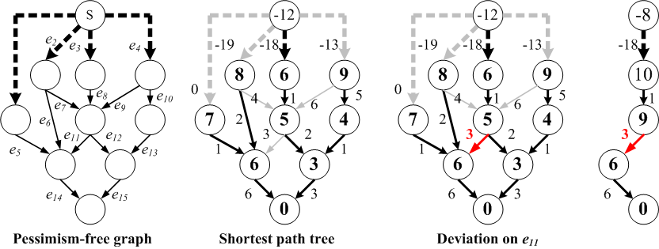
Algorithm – Step 3: Extraction of Top k Critical Paths (I)
O(N) explicit path representation
Path = <v₁, v₂, v₃, … v_{n}> or <e₁, e₂, e₃, … e_{m}>
O(1) implicit path representation
Path = <e_{i}>
Referencing to the shortest path tree
=> edge as “Deviation”

Slide 15
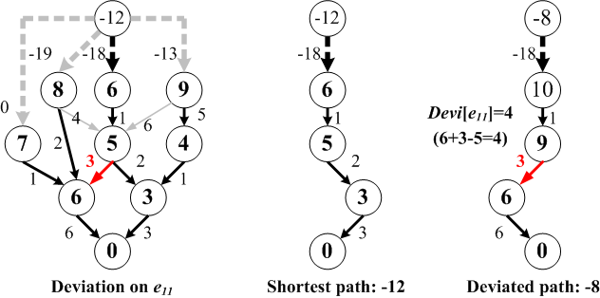
Algorithm – Step 3: Extraction of Top k Critical Paths (II)
Deviation cost
dist[v]: the shortest path distance from node v to the target
devi[e]: the distance loss by deviating on the edge “e”
head[e] = v, tail[e] = u
devi[e] = dist[v] + w_{e} – dist[u]
Intuition: distance loss
u
e
v
devi[e] = dist[v] + w_{e} – dist[u]
(always non-negative!)

Slide 16
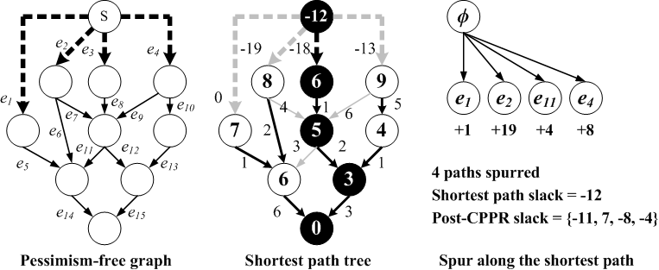
Algorithm – Step 3: Extraction of Top k Critical Paths (III)
Spur procedure
Growth of the prefix tree (neighboring expansion)
Take a path p and generate all other paths deviated from this path p
Mark the deviation cost

Slide 17
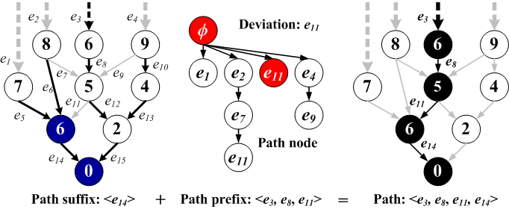
Algorithm – Step 3: Extraction of Top k Critical Paths (IV)
Suffix Tree
Shortest path tree rooted at destination node (static)
Prefix Tree
Tree order of non-suffix-tree nodes (path deviation)

Slide 18
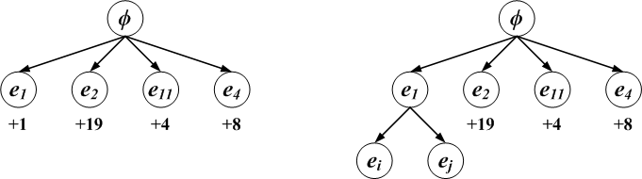
Algorithm – Step 3: Extraction of Top k Critical Paths (V)
Priority search
Pick up a prefix-tree node with the minimum cost
Recover the path and mark it as the current most critical path
Perform the spur operation on this path
Repeat until the top k critical paths have been found
Optimality
Analogy to typical graph search
Iterative expansion from the frontier node with the least cost
Spur

Slide 19
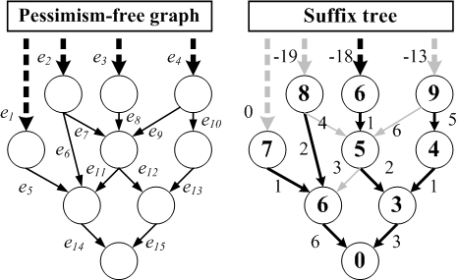
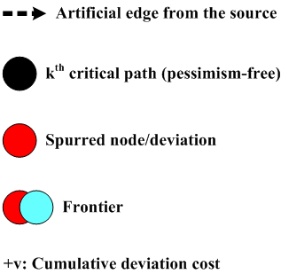
Algorithm – Exemplification (I)
Build the suffix tree
Find the shortest distances of all nodes to the target

Slide 20
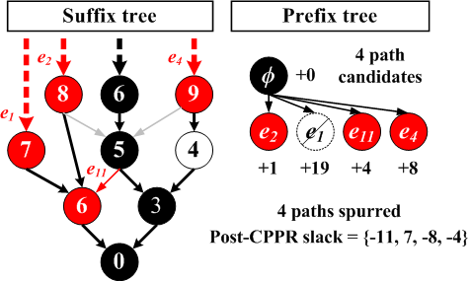
Algorithm – Exemplification (II)
Perform the spur procedure
Spur along the first critical path (k=1)

Slide 21
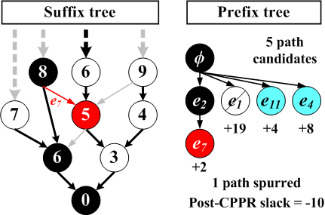
Algorithm – Exemplification (III)
Perform the spur procedure
Spur along the second critical path (k=2)

Slide 22
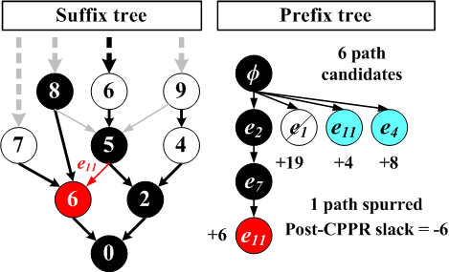
Algorithm – Exemplification (IV)
Perform the spur procedure
Spur along the third critical path (k=3)

Slide 23
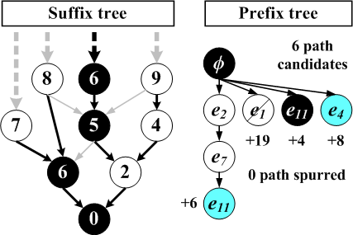
Algorithm – Exemplification (V)
Perform the spur procedure
Spur along the forth critical path (k=4)

Slide 24
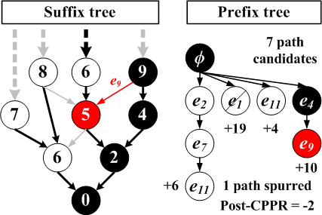
Algorithm – Exemplification (VI)
Perform the spur procedure
Spur along the sixth critical path (k=6)

Slide 25
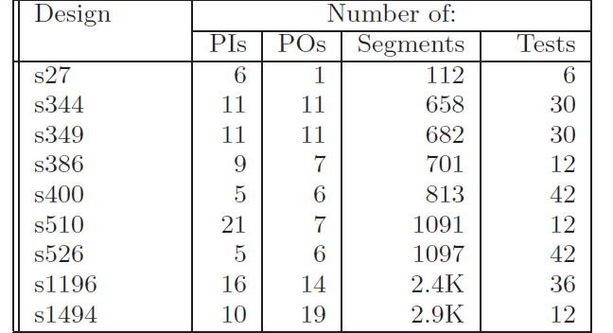
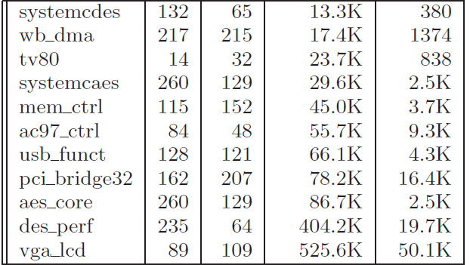
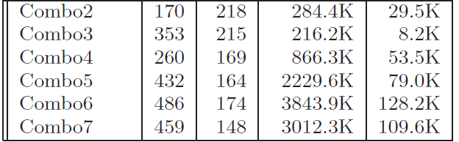
Experimental Results – (I)
Sequential circuits
(6-42 tests)
Environment
C++ implementation
Ubuntu 10.4 Linux system
4 Intel i7 cores and 8GB memory
Benchmark from TAU 2014 Contest
Sequential circuits
Open core circuits
Combo series
Baseline timers
LightSpeed (2nd place timer)
iTimerC (3rd place timer)
Open core
(380-50K tests)
Combo series
(8K-110K tests)

Slide 26
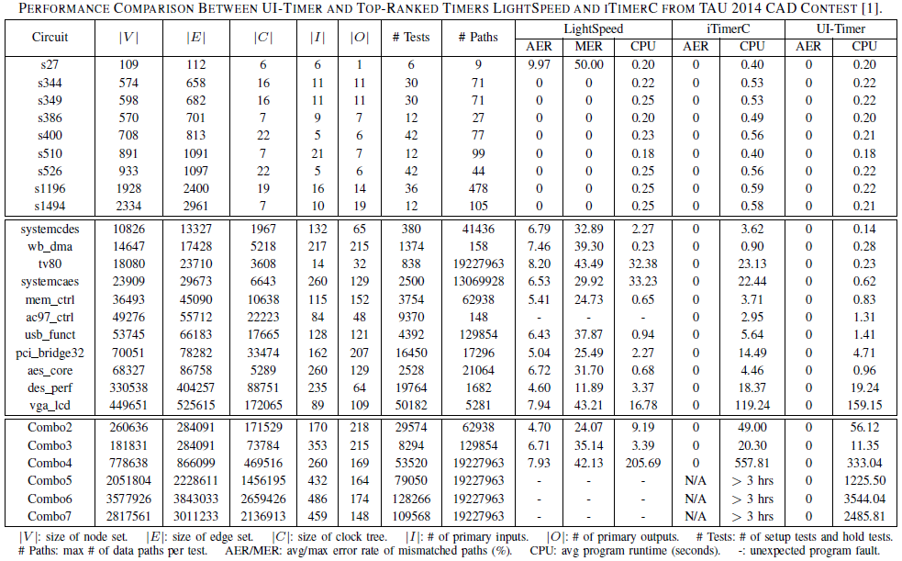
Experimental Results – (II)

Slide 27
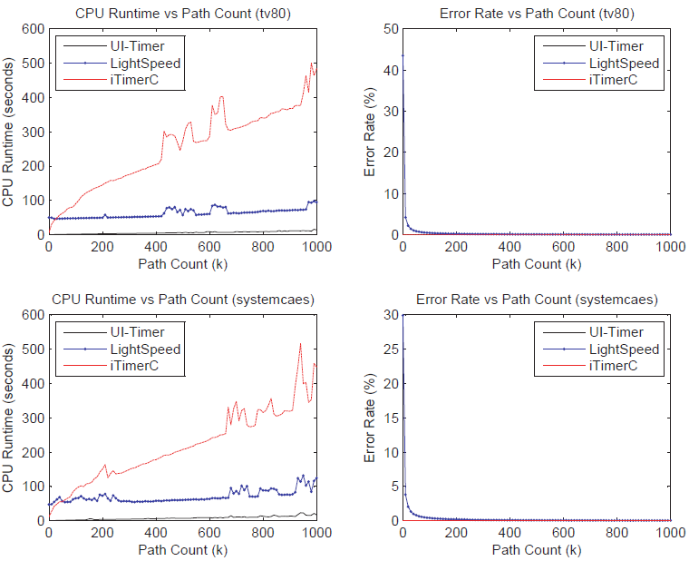
Experimental Results – (III)
Circuits
tv80
systemcaes
Runtime plot
1st: UI-Timer
2nd: LightSpeed
3rd: iTimerC
Accuracy plot
1st: UI-Timer
2nd: iTimerC
3rd: LightSpeed

Slide 28
Conclusion
A fast and exact algorithm for CPPR
Lookup table for clock network pessimism
Efficient data structure for path representation
Evaluation
1st place timer in TAU 2014 CAD contest for timing analysis
Handled million-scale graph within 1 hr
Other timers either crashed or ran over 3 hrs
Future work
Incremental timing and CPPR
Distributed computing for path-based analysis

