Slide 1
UI-Route: An Ultra-Fast Incremental Maze Routing Algorithm
Tsung-Wei Huang, Pei-Ci Wu, and Martin D. F. Wong
Department of Electrical and Computer Engineering (ECE)
University of Illinois at Urbana-Champaign (UIUC), IL, USA
2014 IEEE/ACM System Level Interconnect Prediction Workshop
Notes:
ECE Main Slide

Slide 2
Outline
Introduction
Problem formulation
Algorithm
Experimental result
Remark

Slide 3
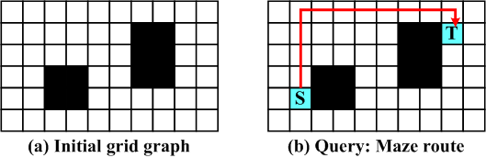
Introduction
Maze routing
Trace a shortest connection between two specified grid points
A primary problem in many science/engineering disciplines
Electronic-design-automation (EDA) applications
IC routing (e.g., global/detailed routing)
PCB routing (e.g., escape routing)
FPGA routing (e.g., negotiation-based routing)
Source
Target
Blocked node
Unblocked node

Slide 4
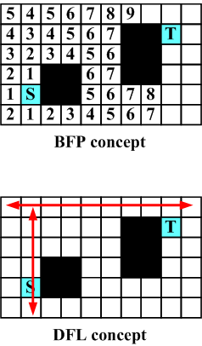
Existing Approaches
Breadth-first-propagation (BFP) style
Maintain the optimal substructure of shortest path
Search from nodes having shortest routes already
Optimal and complete but slow
Lee’s algorithm, A* search, etc.
Depth-first-line-search (DFL) style
Neglect the optimal substructure of shortest path
Search in greedy manner
Suboptimal and incomplete but fast
Hightower’s algorithm, Soukup’s algorithm, etc.

Slide 5
Motivation
Pros and cons between BFP and DFL variants
BFP variants are optimal and complete but usually slow
DFL variants trade optimality and completeness for speedup
A common shortcoming of existing approaches
Focus on a single route query at one time
However, practical applications require incremental processing
Route queries
Graph updates
Deal with each route query independently
Overlapped and redundant search efforts ☹
No reutilization of search knowledge ☹
Runtime and speedup bottleneck ☹
Unknown acceleration challenges

Slide 6
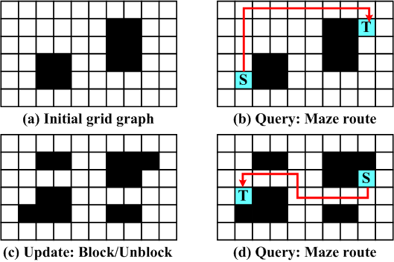
Problem Formulation
Incremental maze routing problem
Solve route queries subject to graph updates
Query (S, T): Find the shortest connection between S and T
Update (x, y): Block/Unblock the grid node at (x, y)
Goal
Optimality
Completeness
Speedup
*Optimality: the route is the shortest
*Completeness: find a route if exists

Slide 7
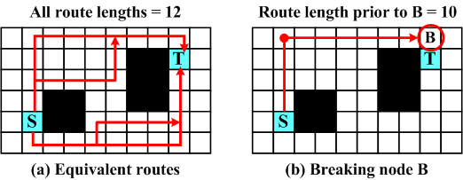
Algorithm – Breaking the Equivalent Routes
Definition 1: Given two distinct grid nodes g₁ and g₂, two routes r₁ from g₁ and r₂ from g₂ are equivalent, if they have identical route lengths
Definition 2: Given two distinct grid nodes g₁ and g₂, g₂ is a breaking node from g₁ if g₂ has a neighbor n such that g₂ is a must intermediate on the optimal route from g₁ to n
B is a breaking node from the left red dot

Slide 8
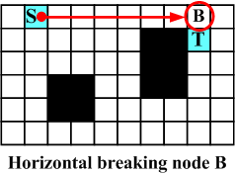
Algorithm – Horizontal Breaking (I)
Horizontal Breaking: Given a node g and its present direction d in horizontal, the node g_{H} is a horizontal breaking node from g if g_{H} is reachable from g by heading along direction d and is the nearest such node to satisfy one of the following conditions
g_{H} is blocked or out of boundary
g_{H} has a vertically adjacent neighbor whose optimal route from g must pass g_{H}
B is a horizontal breaking node from S
Concept behind
A dimensional rephrase of definition 2
Online definition with respect to present search direction

Slide 9

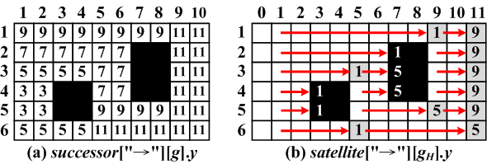
Algorithm – Horizontal Breaking (II)
Uniform grid graph
Totally six cases of horizontal breaking nodes from either direction
Table lookup
Successor table maps grid nodes to horizontal breaking nodes
Satellite table keeps track of the furthest mapping
Both tables can be filled out
in recursive manner!

Slide 10
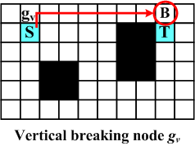
Algorithm – Vertical Breaking
Vertical Breaking: Given a node g and its present direction d in vertical, the node g_{V} is a vertical breaking node from g if g_{V} is reachable from g and is the nearest such node to satisfy the following condition
At least a horizontal breaking node of cases 3-6 (blocked nodes and out-of-boundary nodes) exists from g_{V}
g_{V} is a vertical breaking node from S
Concept behind
Constitute the definition 2 with horizontal breaking nodes
Online definition with respect to present search direction

Slide 11
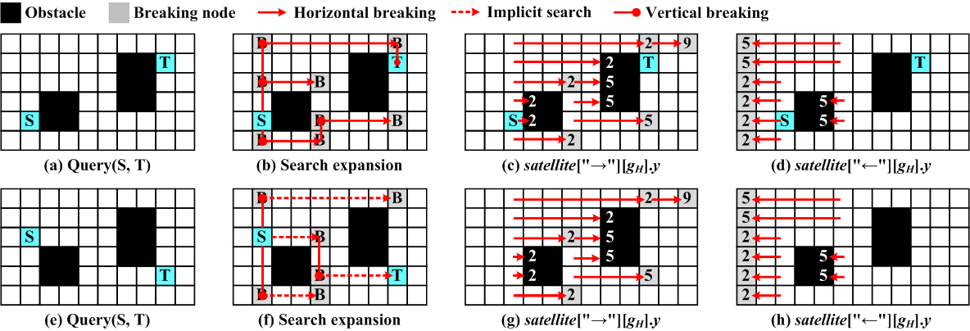
Algorithm – Route Query
Research route over horizontal/vertical breaking nodes
Each horizontal expansion traces the horizontal breaking nodes
Each vertical expansion traces the vertical breaking nodes
Update the table if necessary
Framed in generic A* search – Optimality and Completeness

Slide 12
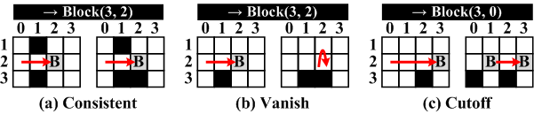
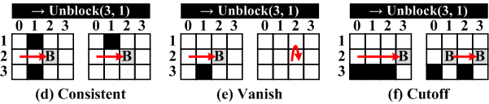
Algorithm – Graph Update
Graph update can be quickly reflected on satellite table
Satellite table states one-to-one mapping
Shrink the satellite field of the horizontal breaking
Graph update operations
Block a grid node
Case 1: Consistent
Case 2: Vanish
Case 3: Cutoff
Unblock a grid node
Case 1: Consistent
Case 2: Vanish
Case 3: Cutoff
Shrink the satellite field

Slide 13
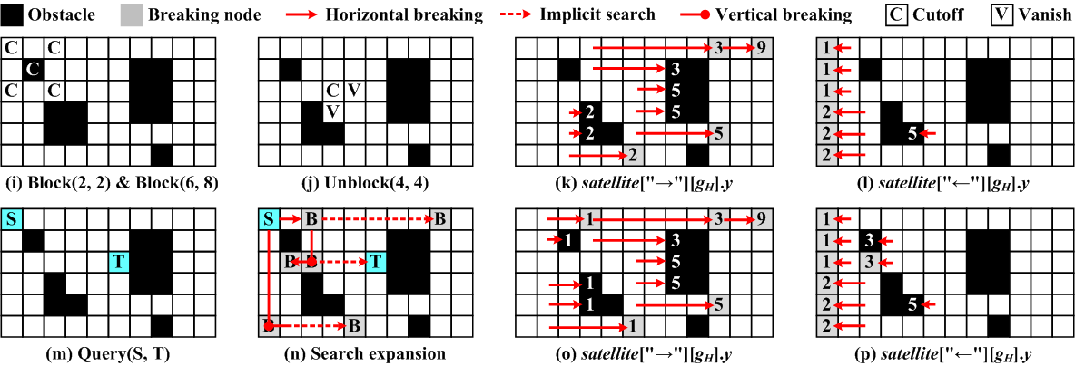
Algorithm – Graph Update
Graph update example
Examine the three cases per grid update
Examination takes constant time
Shrink the satellite field if necessary
Incrementally fill in the tables in the next route query

Slide 14
Experimental Results – (I)
UI-Route is implemented in C++ language on a 2.67GHz 64-bit Linux machine with 8GB memory
Benchmarks from ISPD placement contests
Scale the layout into a grid graph with maximum dimension being 2048
Randomly generate 1000 route queries subject to graph updates
Simulate the rip-up and reroute procedure
Baseline
Lee’s algorithm
A* search algorithm
Soukup’s algorithm

Slide 15
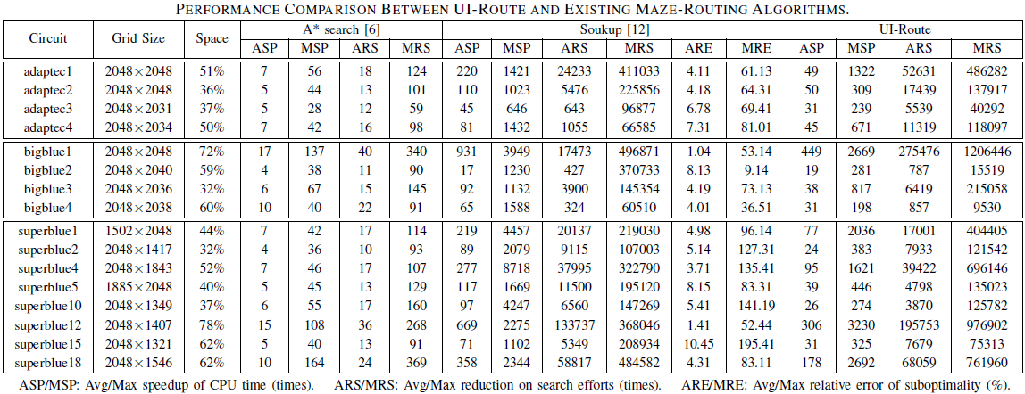
Experimental Results – (II)
Performance comparison
Only measure the runtime taken on search
Storage initialization is not included

Slide 16
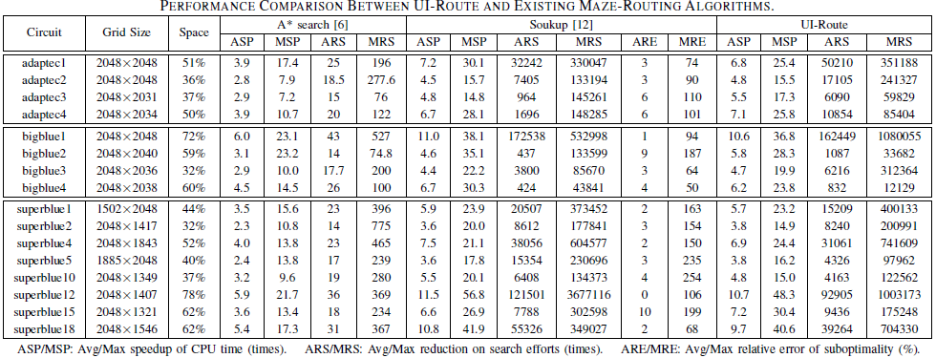
Experimental Results – (III)
Runtime value including storage initialization
Naïve initialization prior to each search
Clear the all data structure (e.g., queue, distance table, etc.)

Slide 17
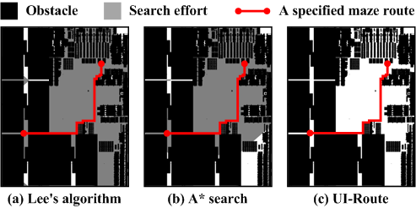
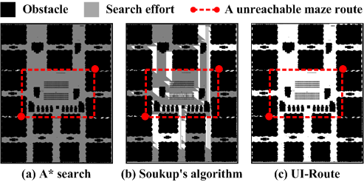
Experimental Results – (IV)
Snapshot 1
Lee’s algorithm
A* search
UI-Route
Snapshot 2
A* search
Soukup’s algorithm
UI-Route
A* search has x0.4 speedup
UI-Route has x6.0 speedup
Soukup has x1.5 speedup
UI-Route has x9.0 speedup

Slide 18
Concluding Remark
An incremental maze routing algorithm is introduced
Incremental processing of route queries and graph updates
Reutilization of search knowledge among routing queries
Reduce overlapped search efforts for speedup
Ease of coding, simple data structure, orthogonal to many routers
Take-home message
UI-Route is superior when the grid graph is highly sparse
Clever data structure matters (binary heap v.s. array heap)
Non-algorithmic speedup technique contributes to further speedup
Future work
Apply to weighted grid graph

