Slide 1

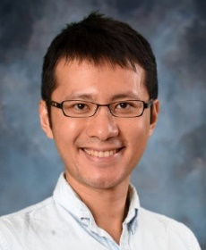

OPEN PH.D./POSTDOC POSITIONS
Department of ECE/CS
https://tsung-wei-huang.github.io/
Assistant Professor
Dr. Tsung-Wei Huang received his PhD from the Department of ECE at the University of Illinois at Urbana-Champaign (UIUC). He was a Research Assistant Professor in the ECE Department and CSL at UIUC. He has published more than 40 papers and patents, and created many successful open-source research projects that are widely used in both academic and industrial tools.
Research interests/topics
Software and Computer Systems
Parallel/Distributed Systems
Machine Learning Frameworks
Electronic Design Automation
Programming Language/Model
Minimum Requirement
Strong motivation and research interest
Good communication and writing skills
Willing to collaborate with people
C++/Python programming experience
Experience with Linux systems
Why Join us?
Our group is very supportive for each other. We solve real-world problems that matter to the society. When you start with real problems, you will find plenty of research challenges and topics worth a MS/PhD thesis. Specifically, you will learn:
How to become a good programmer
How to become an independent researcher
How to apply ECE/CS knowledge to solve practical problems
Your graduate life is much more than just research. In Utah, you can enjoy a variety of outdoor activities such as camping, hiking trails, rock hounding, fishing, skiing and more.
Email me (twh760812@gmail.com) your CV if you are interested.

