Slide 1
Project of Chord Implementation
張琮渝 Chang, Tsung-Yu

Slide 2
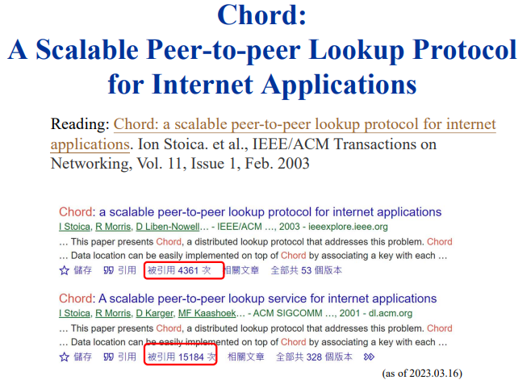

Slide 3
Basic introduction of chord
One sentence to describe Chord: Given a key, it maps the key onto a node. Distributed Hash Table (DHT)!!!!
Chord uses consistent hashing to make sure that keys are uniformly distributed to every node. Node’s id: hashed by IP. Key’s id: hashed by key.
Each node maintains only O(logN) routing information about other nodes. Resolve all lookups via O(logN) messages to other nodes.

Slide 4
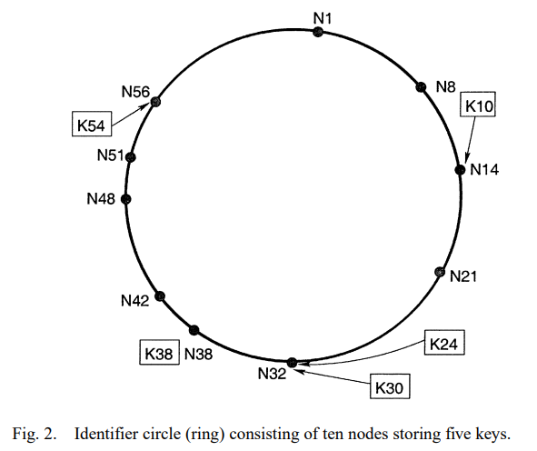
How are the keys stored?
Key K is assigned to node N when node N is the successor node of key K.
When a node N’ joins the chord ring, certain keys previously assigned to the successor of N’ must be reassigned. The similar reassignment occurs when a node leave the chord ring.

Slide 5
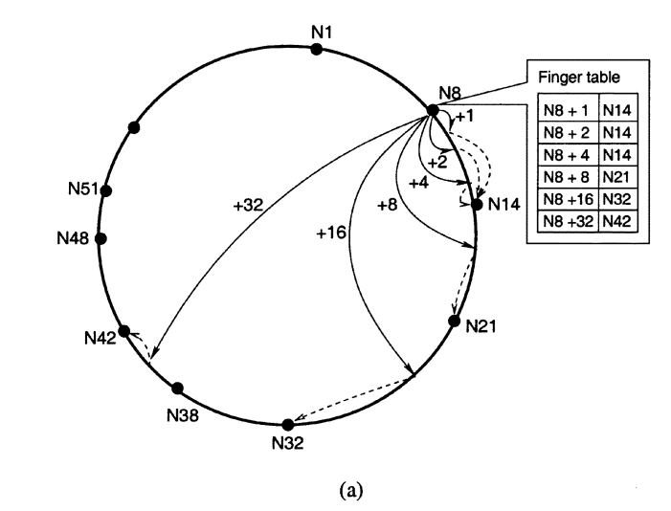
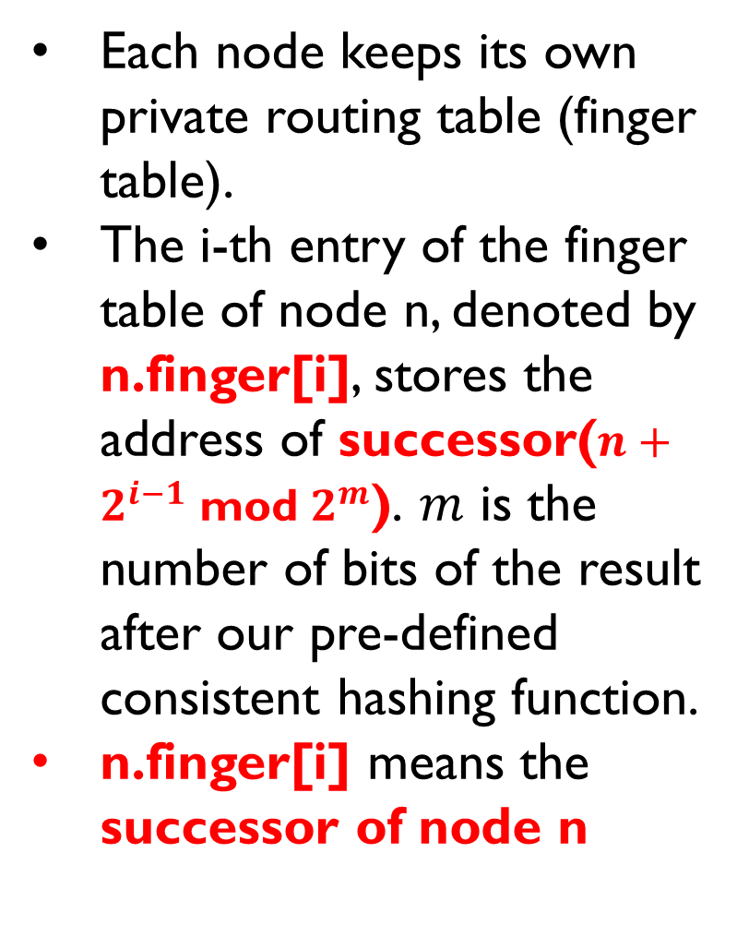
Routing table (Finger table)
Each node keeps its own private routing table (finger table).
The i-th entry of the finger table of node n, denoted by n.finger[i], stores the address of successor($n+2^{i−1}$ mod $2^{m}$). $m$ is the number of bits of the result after our pre-defined consistent hashing function.
n.finger[i] means the successor of node n

Slide 6
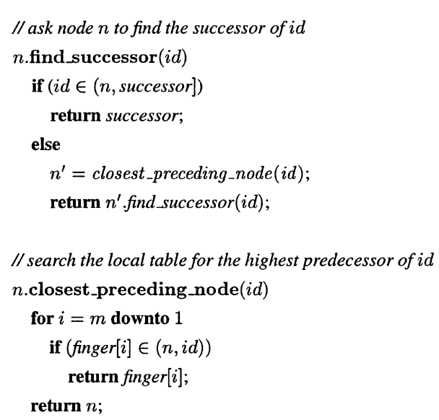





Pseudo code
id
n
finger[i]

Slide 7
nodes join
In Chord, every node run “stabilization” protocol (including several function introduced in the following slides) periodically in the background to ensure that every node’s maintain the up-to-date successor information. (Note that keeping the up-to-date successor information for each node is the most primary thing since it’s related to the correctness of the Chord.)

Slide 8
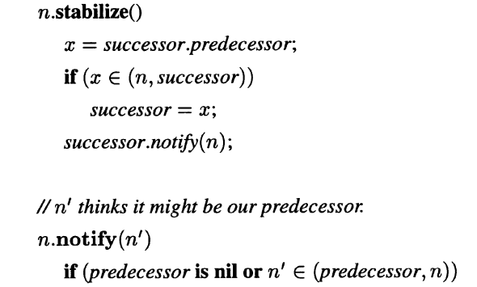
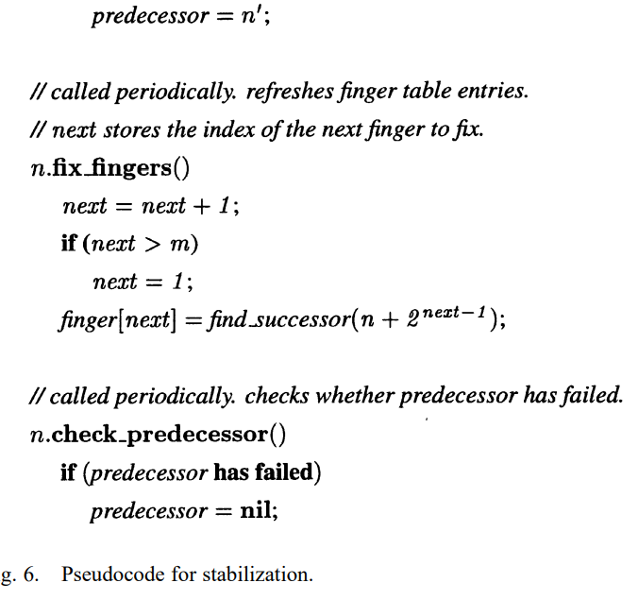

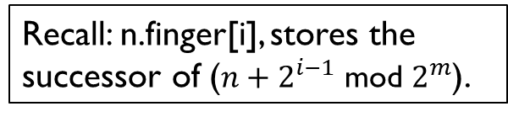


n
x
successor
Recall: n.finger[i], stores the successor of ($n+2^{i−1}$ mod $2^{m}$).
stabilize(), fix_fingers(), check_predecessor() are called periodically to ensure the correctness of the Chord when nodes may join and leave.

Slide 9
Other issues...
Nodes may fail: Each node should maintain a “successor list” in case it’s successor failed to increase the robustness of the Chord.
Data migration: Chord needs to automatically perform data migration when a new node is added to ensure that the client can find the data right node.

Slide 10
How to start the code
docker-compose up --build -d
docker exec -it chordimplementation-chord-1 sh
-----NOW, WE’RE INSIDE THE CONTAINER-----

Slide 11
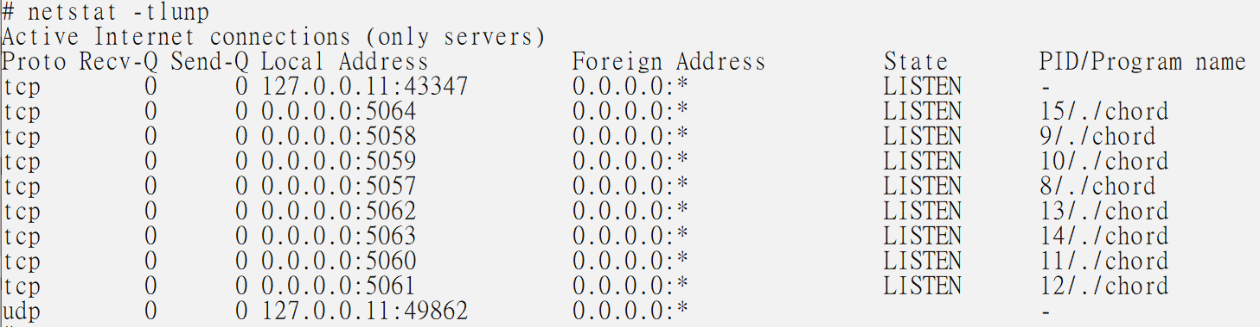
3. type “netstat -tlunp”, and you’ll see
In this project, each process listen on a unique port(5057-5063) represents a “node” in the chord ring. These processes will collaborate with each other to maintain the DHT (Distributed Hash Table).

Slide 12
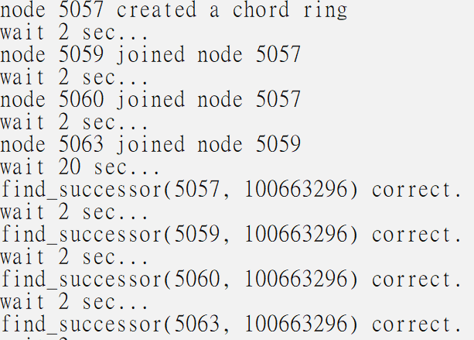
4. cd ../test_scripts
There’re 3 python programs for testing. They are test_part_1.py, test_part_3-1.py, test_part_3-2.py. You can execute these files to test the accuracy of the chord ring.
5. python3 test_part_1.py

