Slide 1
I2C/Smbus Trace Logger for UEFI BIOS/Coreboot development
Peter CH Wu
AATI

Slide 2
Motivation & Goal
To output debug trace:
Legacy UART may not be available
SPI trace logger is a rework-free solution but requires SPI software sequencing control
Skylake does not support SPI software sequencing control.
➔ We need alternative rework-free solution for in-field debugging.

Slide 3
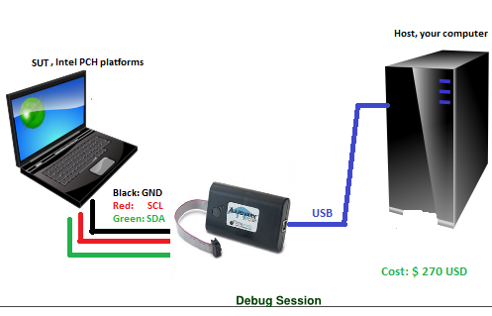
Framework
I2C/Smbus trace logger

Slide 4
Build the env.
On SUT,
UEFI BIOS source:
Modify function call DebugPrint ( IN UINTN ErrorLevel,
IN CONST CHAR8 *Format, ... ) to redirect the message to smbus device(slave address: 0x10).
Find DebugPrint in your target plaform dsc file:
DebugLib|IntelFrameworkModulePkg/Library/PeiDxeDebugLibReportStatusCode/PeiDxeDebugLibReportStatusCode.inf
Coreboot source:
Modify int do_printk(int msg_level, const char *fmt, ...) to redirect the debug message to smbus device(slave address: 0x10)

Slide 5
Build the env.
On SUT,
For performance, you may need to buffer entire string instead of sending it char by char. And send the string in SMBUS block protocol. SMBUS is not fast(100KHz).

Slide 6
Build the env.
On Host,
Install Null-modem emulator to create com to com communication.
com0com-2.2.2.0-x64-fre-signed.exe
On my computer, it creates COM 14 and COM 16.
Run aai2c_slave.exe
Run putty and open COM 16 @ 115200,8,n,1.
For aai2c_slave.exe source, you can find it on below link.
https://github.com/tsunghowu/aai2c_slave_redirect_to_COM_port.git

Slide 7
Enjoy…

