Slide 1
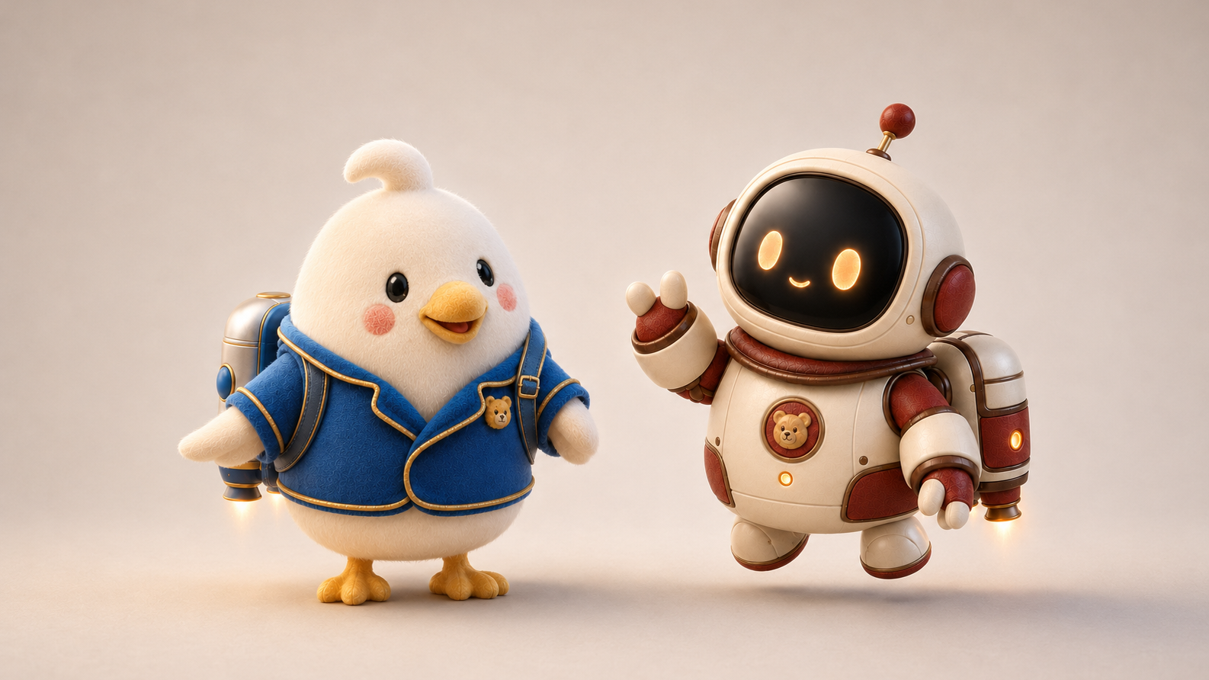


ENT207TC · DIGITAL STARTUP LAB
One playable idea.
Built, tested and improved in 60 minutes.
BOT THE CREATOR
Design before polish.
01
Notes:
Open with one promise: by the end of this hour, each group will have a playable web game and evidence for one improvement. Do not explain design thinking yet. Ask students to judge the activity by what they learn from another person's behaviour, not by polish.

Slide 2

YOUR MISSION
Make one tiny game for one real person.
One laptop per group · 6–8 people · shared decisions
01
Choose a player
20:00
02
Choose one action
A playable prototype,
not a finished product.
03
Choose what success feels like
02
Notes:
Form groups quickly. Recommended group size is five or six, giving roughly 40–48 published games across 240 students. Assign one laptop as the build device. Everyone else remains active as user advocate, interaction designer, prompt lead, tester, or reporter.

Slide 3
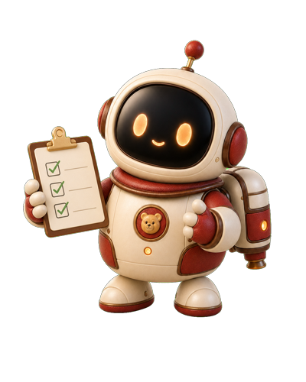
BEFORE TOUCHING AI
Four decisions. Five minutes.
Write one short answer for each.
WHO
FEEL
Who is this for?
What should they feel?
DO
WIN
What do they do again and again?
How do they know it worked?
03
Notes:
Keep this brisk. The questions quietly establish user, intended experience, core loop, and success condition. If a group debates visual style first, redirect them to WHO and DO. A useful answer is specific enough that a stranger could test it.

Slide 4
PROMPT SPRINT · 2 MINUTES
Write alone. Then combine the strongest parts.
Build a [TYPE OF GAME]
Everyone writes.
One person types.
for [ONE SPECIFIC PLAYER]
who should feel [ONE FEELING].
No committee prompt.
They repeatedly [CORE ACTION] and win when [SUCCESS].
04
Notes:
Ask every student to draft independently before the group merges ideas. This prevents the loudest voice from owning the first concept. Give a hard two-minute timer. The group may combine parts, but should end with one coherent prompt rather than a list of features.

Slide 5
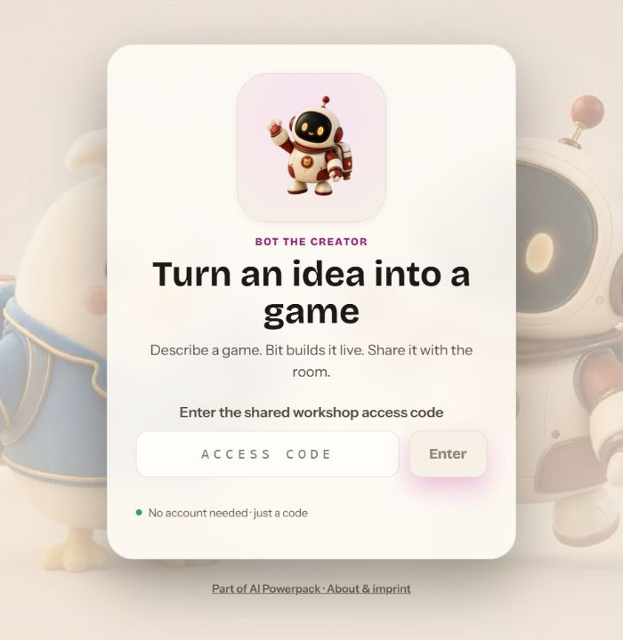
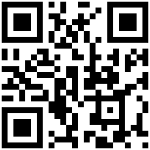
JOIN THE WORKSHOP
botthecreator.com
ACCESS CODE
ENT207TC
Use the group's laptop.
Phones are optional for testing and voting.
Optional
05
Notes:
Have each group open the site on one laptop and enter ENT207TC. Do not display or share the teacher host code. Phones are not required for the build. Keep the QR secondary so the room does not fragment into 240 individual sessions.

Slide 6

BUILD · 20 MINUTES
Smallest playable thing.
20:00
1
Make the core action work.
2
Play early. Prompt from what breaks.
3
Stop adding features at 05:00.
PLAYABLE > PRETTY
06
Notes:
Start a visible 20-minute timer. Encourage groups to run the game as soon as the first playable version appears. At five minutes remaining, announce a feature freeze: only repair the core action, instructions, controls, or feedback. If generation is slow, groups refine the prompt and test the last working version.

Slide 7
PEER TEST · 8 MINUTES
Do not explain the game.
Watch what another person actually does.
03
02
03
MIN
MIN
MIN
PLAY
OBSERVE
DECIDE
A neighbouring group plays silently.
Where do they hesitate, fail or smile?
Choose one improvement only.
Evidence is a behaviour you saw, not an opinion you heard.
07
Notes:
Pair neighbouring groups. The creator group must stay quiet during the first play. Testers should think aloud only if that is natural; creators watch behaviour. After play, allow one factual question. Each group records one observed behaviour and one chosen change.

Slide 8

IMPROVE · 10 MINUTES / PUBLISH · 5 MINUTES
Change one thing that the evidence earned.
BEFORE
AFTER
What happened?
→
What changed?
“The player did not notice the goal.”
“The goal is visible before play starts.”
Publish only the group's best working version.
08
Notes:
Require one evidence sentence before the group edits. A change can be wording, control placement, visual feedback, difficulty, pacing, or a bug fix. Discourage broad redesign. After the change is tested, publish the best working version and give it a clear title.

Slide 9
GALLERY VOTE · 5 MINUTES
Three tokens. Reward what works.
Open Class Gallery · play first · vote second
3
MOST FUN
BEST FEEL
TOKENS
FUNNIEST
BEST REMIX*
1 vote per game
*Only if remix is used today
09
Notes:
From the host screen, open voting. Student browsers will show a voting banner on their next poll, but the gallery does not open automatically; tell students to open Class Gallery. Each browser has three tokens and can vote once per game. Best Remix may be ignored in this session. Totals are visible during voting, so frame this as recognition rather than ranking.

Slide 10
DEBRIEF · 2 MINUTES
You just did design thinking.
01
02
03
04
UNDERSTAND
→
MAKE
→
OBSERVE
→
IMPROVE
a person
a prototype
real behaviour
one decision
The code was the prototype. The behaviour was the evidence.
What changed after somebody else played?
10
Notes:
Reveal the label now. Ask two groups for a 20-second answer: what behaviour did you observe, and what did you change? Connect their answers to understand, make, observe, improve. Close by distinguishing a prototype from a product: the goal was learning, not completeness.

Slide 11
FACILITATOR APPENDIX · HIDDEN
Host sequence
Open privately: botthecreator.com/host
00
05
10
30
Brief + group setup
Four decisions + prompt sprint
Build
Peer test
38
48
53
58
Improve
Publish
Open voting
Debrief
Never display the teacher access code.
Notes:
Teacher-only slide. Sign in to /host before class and keep it on the teaching computer. Verify the active workshop is empty, generation works, and gallery publishing is enabled. Do not put the host code in slides, chat, or student instructions.

Slide 12
FACILITATOR APPENDIX · HIDDEN
What voting does
Useful behaviour to announce out loud
1
Browsers notice the phase on the next ~10-second poll.
2
A banner appears; the gallery does not open itself.
3
Each browser receives 3 tokens and 1 vote per game.
4
Vote totals are visible. Present honors, not a league table.
Notes:
Teacher-only slide. With 240 students, ask one person per group to keep the build laptop open while others can use phones for gallery play and voting. Voting is lightweight classroom recognition. If totals distract the room, shorten voting and move directly to selected examples.

Slide 13

FACILITATOR APPENDIX · HIDDEN
Remix: pilot, do not improvise at scale
Use 6–10 devices only after a rehearsal.
1
Host starts remix and the play-first lock.
2
Each tester receives somebody else's game.
3
The remix saves as a new version; the owner keeps final say.
Notes:
Teacher-only slide. Do not use remix with the full cohort until tested with a small set of devices. Confirm no participant receives their own game, the 60-second play-first lock is understandable, and remix submission creates a new version instead of overwriting the original.

Slide 14

FACILITATOR APPENDIX · HIDDEN
Fallback ladder
Keep the learning goal alive if the technology slows down.
A
Slow generation
B
Publish fails
Refine the prompt; test the last working build.
Swap laptops and test by screen sharing.
C
Gallery overload
D
Service unavailable
Teacher selects 6–8 games for whole-room play.
Paper-test the core loop: action, feedback, win.
Notes:
Teacher-only slide. The invariant is evidence-led iteration. If the service is unavailable, groups can still define the loop, simulate it with paper or people, observe confusion, and revise one rule. Capture promising prompts for a later rerun.

