Slide 1
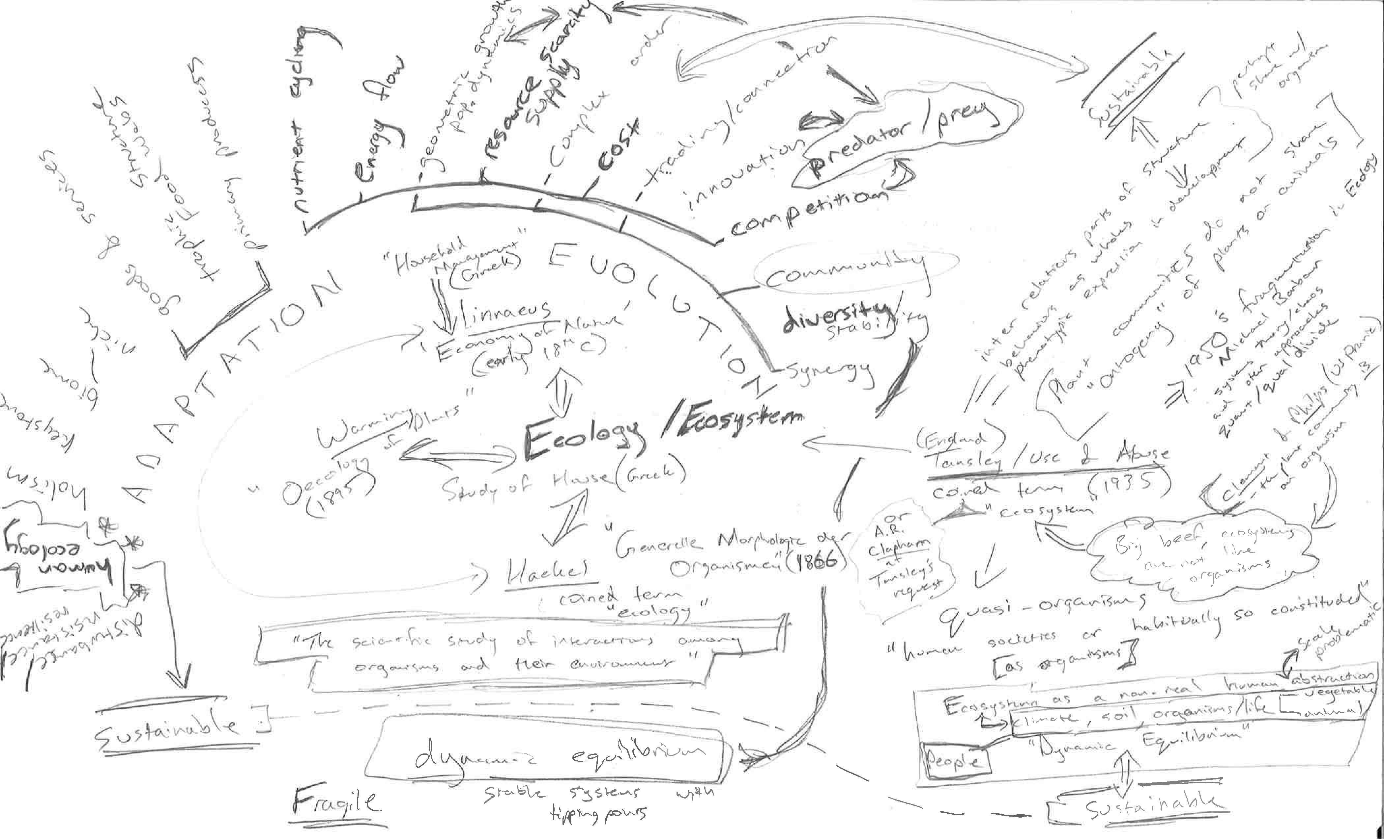
Information in the Ecosystem:
Exploring (open) data and its socio-environmental agency
Timothy B Norris Data Curation Fellow University of Miami Libraries <tnorris@miami.edu> | Todd Suomela Data Curation Fellow University of Alberta Libraries <suomela@ualberta.ca>
AAG Annual Meeting
San Francisco, CA
March 29th 2016

Slide 2
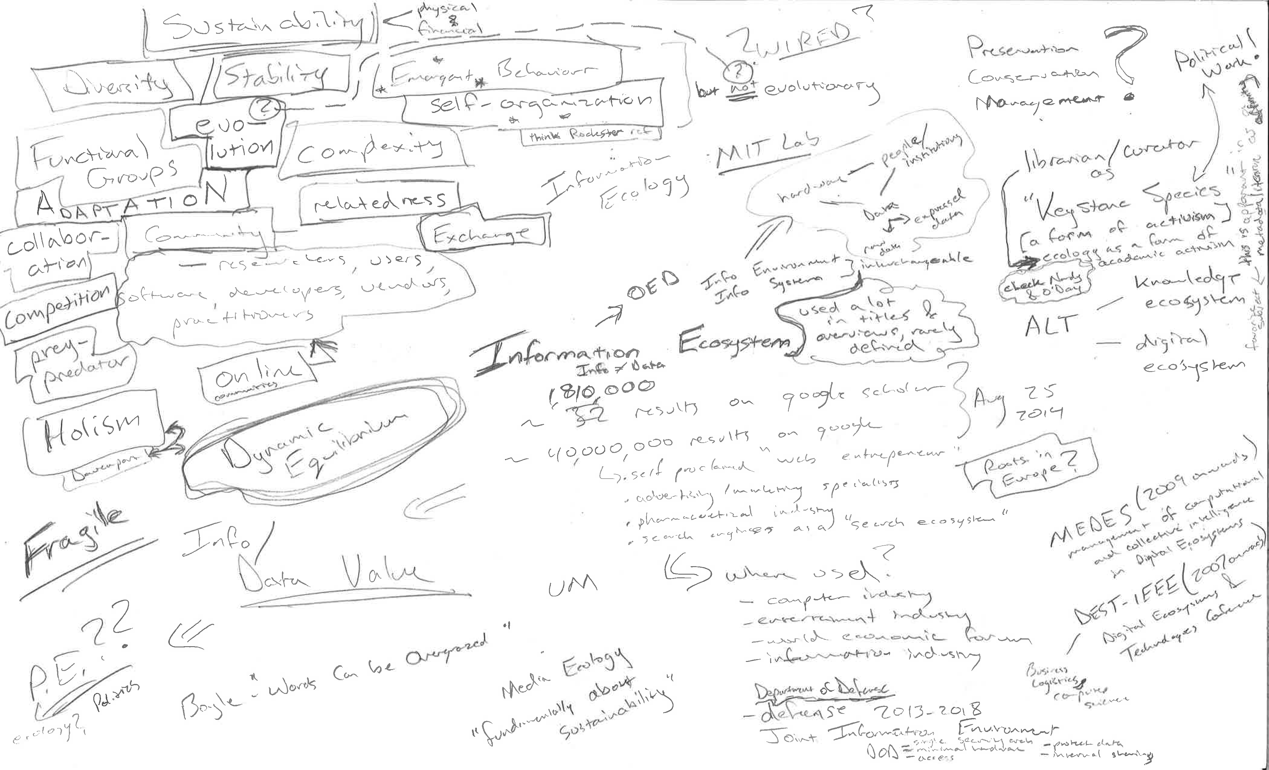

Slide 3
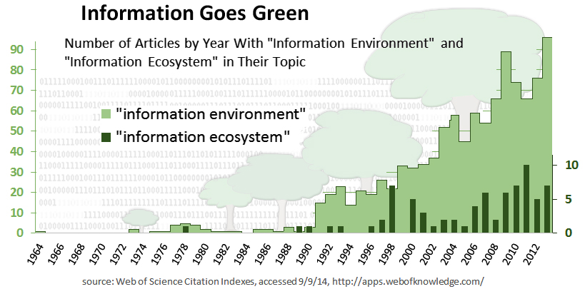
Information Goes Green
Web of Science Citation Indexes, accessed 09/19/14, http://apps.webofknowledge.com
http://connect.clir.org/blogs/tim-norris/2014/09/18/morality-in-information-ecosystems

Slide 4
A way forward
Background thinking on data and ecosystems
Seeds of the information ecosystem
Information ecology: two emergent programs
Parallel developments in other ‘ecologies’
A critique of the information ecosystem
then a few suggestions

Slide 5
Useful generalizations
WISDOM
applied knowledge
“Information is not knowledge.
Knowledge is not wisdom.
Wisdom is not truth.
Truth is not beauty.
Beauty is not love.
Love is not music.
Music is THE BEST.”
― Frank Zappa
KNOWLEDGE
organized information
INFORMATION
linked elements
DATA
abstracted elements
WORLD

Slide 6
Data Levels (as described by NASA)
Data level | Description
Level 0 | Reconstructed, unprocessed instrument and payload data at full resolution, with any and all communications artefacts (e.g., synchronization frames, communications headers, duplicate data) Removed.
Level 1a | Reconstructed, unprocessed instrument data at full resolution, time-referenced, and annotated with ancillary information, including radiometric and geometric calibration coefficients and geo-referencing parameters computed and appended but not applied to Level 0 data.
Level 1b | Level 1A data that have been processed to sensor units
Level 2 | Derived geophysical variables at the same resolution and location as Level 1 source data.
Level 3 | Variables mapped on uniform space-time grid scales, usually with some completeness and consistency
Level 4 | Model output or results from analyses of lower-level data (e.g., variables derived from multiple measurements).
https://earthdata.nasa.gov/user-resources/standards-and-references
http://science.nasa.gov/earth-science/earth-science-data/data-processing-levels-for-eosdis-data-products/
Notes:
Do an excercise – the referenced link in the kitchin book is outdated and broken – have them spend one minute trying to find the updated link (search skills)

Slide 8
Key debates in Ecology
Evolution / Competition / Cooperation
diversity / stability [ keystone species ]
stable / chaos [ dynamic equilibrium ]
holism / reductionism [ back to Clements 1936 and Gleason 1939 ]
organismic / mechanistic [ broader than ecology ]
Ecology as Science / Ecology as Social Movement
management / science “everything is inter-related”
“sustainability”

Slide 9
Ecologies Google n-grams
https://books.google.com/ngrams/graph?content=political+ecology%2Chuman+ecology%2Cinformation+ecology%2Cdeep+ecology%2Clandscape+ecology%2Cecosystem+ecology%2Cagroecology%2Cindustrial+ecology%2Curban+ecology&year_start=1900&year_end=2000

Slide 10
Ecosystems Google n-grams
https://books.google.com/ngrams/graph?content=political+ecosystem%2Chuman+ecosystem%2Cinformation+ecosystem%2Clandscape+ecosystem%2Cagroecosystem%2Cindustrial+ecosystem%2Curban+ecosystem%2Ccultural+ecosystem&case_insensitive=on&year_start=1900&year_end=2000

Slide 11
Early Antecedents of “Information Ecosystems”
1922 Noosphere Chardin
1931 Library as an Organism Ranganathan
1950 s– 1960s Cybernetics and Information Science
Quant / Qual split Ecology Barbour (1996)
Human and Cultural Ecology
The Information Environment
1989 Information Ecology (info management) Harris

Slide 12
Two Programs of Information Ecology
Davenport and Prusak (1997)
Information Ecology: mastering the information and knowledge environment
New York, Oxford University Press
Managerial – “information ecologist”
Identify Hardin as “ecologist” p. 28
Ecology is “... the science of understanding and managing whole environments” p 10
* Purpose to “build a more competitive, creative, and practical information environment.” p 14
Nardi and O’Day (1999)
Information Ecologies: using technology with heart
Cambridge, MIT Press
Anthropology (UI)
‘ecologies‘/ ecosystems??
Relationships, LIBRARIANS as keystone species, diversity, emergence
Co-evolution between people, tools and machines
Purpose?
Both attempt to give technology systems human “context”

Slide 13
Parallel developments
Cognitive Ecology Connections between environment and mind
Cognition more than information processing
Mutual dependence between technology, people, and information.
Media Ecology Media as environment, “medium is the message”
co-evolution of humans and communication tools
Political Ecology Explicit links between human political/economic systems and natural ecosystems
Justice, sustainability, conservation, extraction

Slide 14
Critique of “Information Ecosystems”
The attempt for human context is important
The relationship between information science and biological diversity
The “greening” of the information industry?
Are emergent properties truly emergent or human made?
Are human created phenomena natural? “Naturally occurring data”?
Is a human community an ecosystem? What about morality?
How is Nature made visible?
Big Data as pollution? “Data is like oil”?

Slide 15
Ways forward: ‘ecologies’ and ecosystems?
“data assemblages”? Other terms? Kitchin (2014)
Explicit links to environment Mosco (2014)
Sustainable resource management Farb (2006)
Ostrom (2006)
Boyle (2003)
Stiglitz (1999)
Open data? / Data commons?

Slide 16
Thanks
Information in the Ecosystem
living communities
Ecosystem
information
non-living environment
Timothy B Norris Data Curation Fellow University of Miami Libraries <tnorris@miami.edu> | Todd Suomela Data Curation Fellow University of Alberta Libraries <suomela@ualberta.ca>
AAG Annual Meeting
San Francisco, CA
March 29th 2016

Slide 17
Ecologies Google n-grams
https://books.google.com/ngrams/graph?content=political+ecology%2Chuman+ecology%2Cinformation+ecology%2Cdeep+ecology%2Clandscape+ecology%2Cecosystem+ecology%2Cagroecology%2Cindustrial+ecology%2Curban+ecology&year_start=1900&year_end=2000

Slide 18
Ecosystems Google n-grams
https://books.google.com/ngrams/graph?content=political+ecosystem%2Chuman+ecosystem%2Cinformation+ecosystem%2Clandscape+ecosystem%2Cagroecosystem%2Cindustrial+ecosystem%2Curban+ecosystem%2Ccultural+ecosystem&case_insensitive=on&year_start=1900&year_end=2000

Slide 19
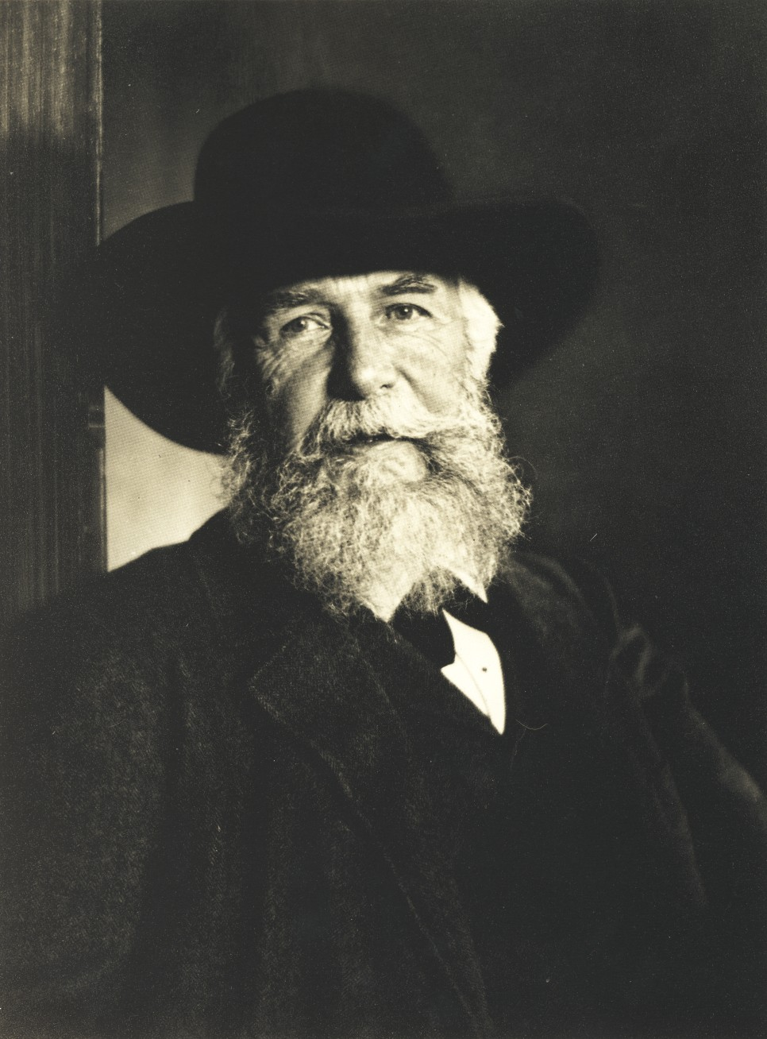
Ernst Haeckel

Slide 20
Traces on the Rhodian Shore
• What is nature’s influence on man?
• What is man’s influence on nature?
• Is there a grand purpose in these relationships?
Stated in a more ecological sense:
• What is the influence of the non-living environment on living organisms?
• What is the influence of living organisms on the non-living environment?
Glacken, C. J. (1967). Traces on the Rhodian Shore [Book]. Berkeley: University of California Press.

Slide 21
Two conceptions
Information Environment
Ecosystem
Human communities
living communities
information
information
non-living environment
technology

