Slide 1
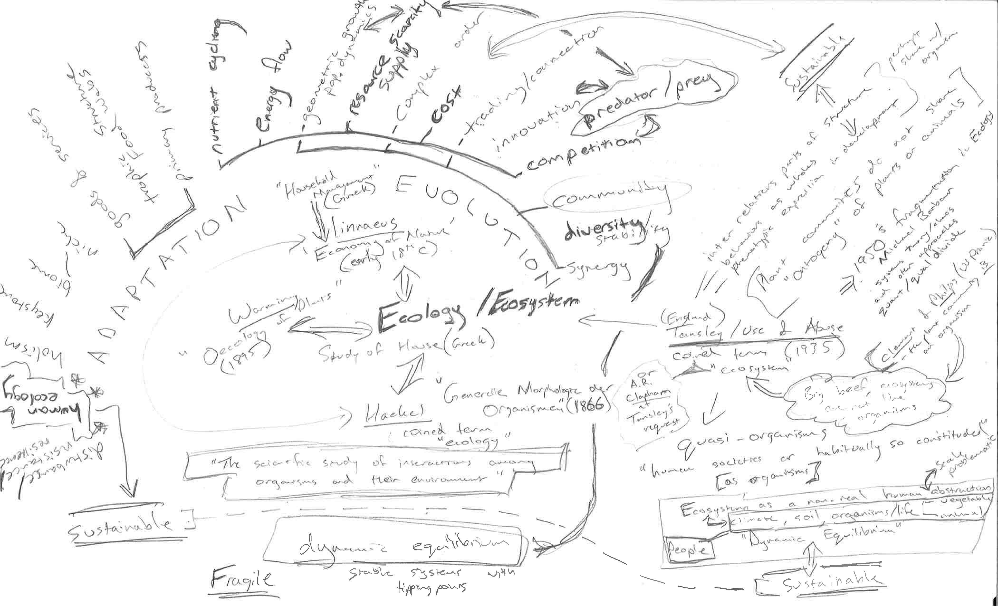
Information in the Ecosystem:
Exploring open data and its socio-environmental outcomes
Timothy B Norris Data Curation Fellow University of Miami Libraries <tnorris@miami.edu> | Todd Suomela Data Curation Fellow University of Alberta Libraries <suomela@ualberta.ca>
AAG Annual Meeting
San Francisco, CA
March 29th 2016

Slide 3
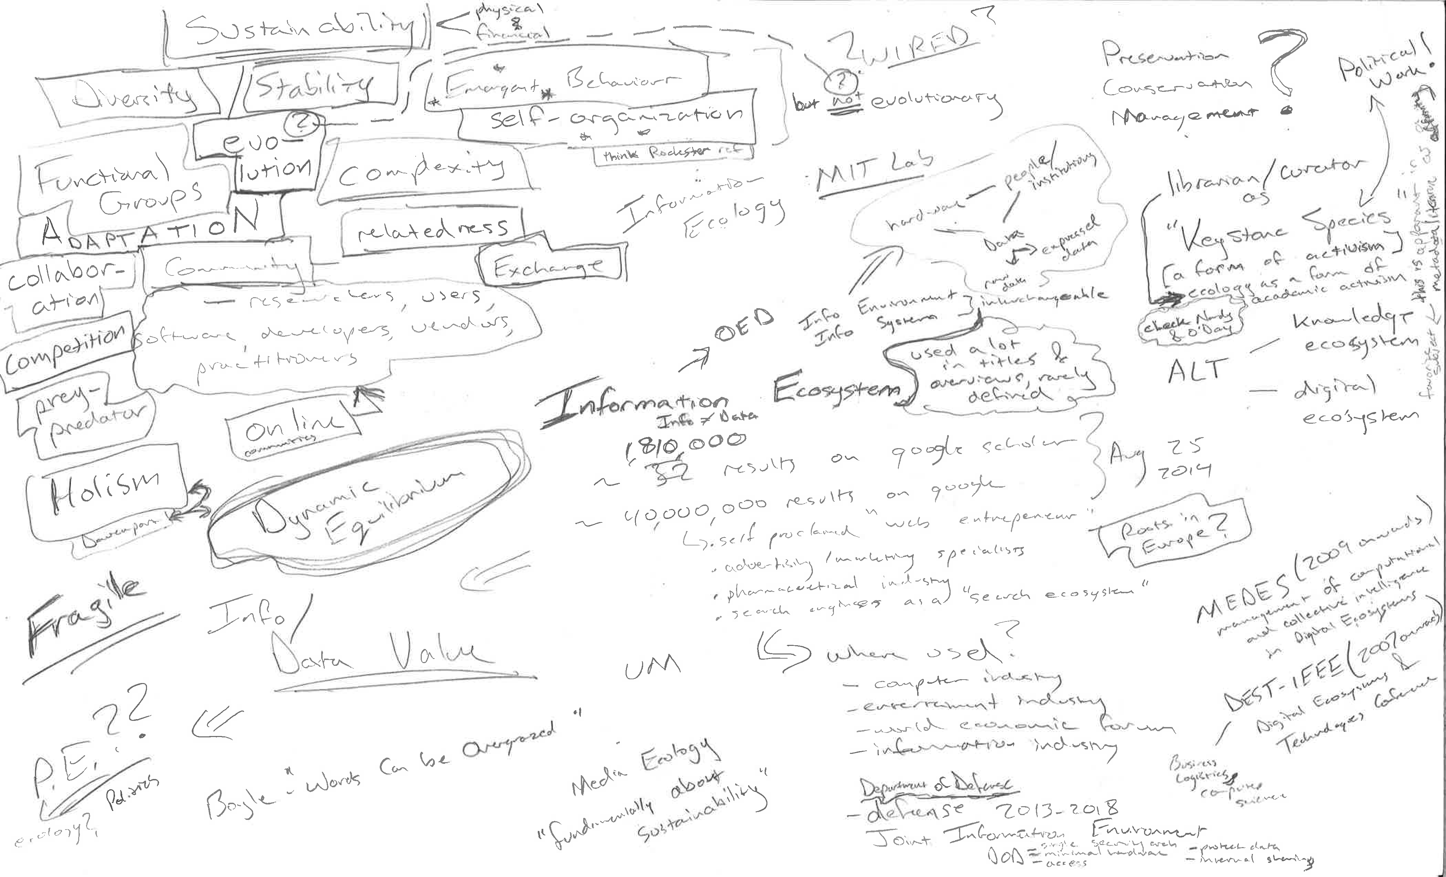

Slide 4
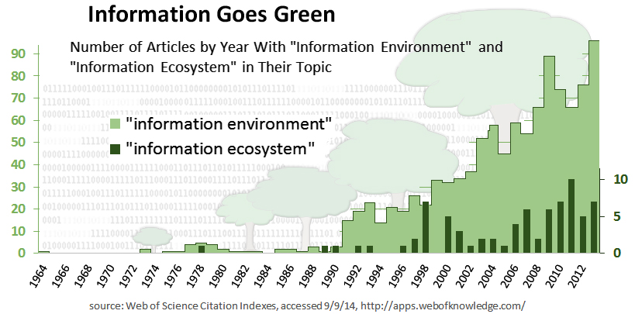
Information Goes Green
Web of Science Citation Indexes, accessed 09/19/14, http://apps.webofknowledge.com

Slide 5
Ecologies Google n-grams
https://books.google.com/ngrams/graph?content=political+ecology%2Chuman+ecology%2Cinformation+ecology%2Cdeep+ecology%2Clandscape+ecology%2Cecosystem+ecology%2Cagroecology%2Cindustrial+ecology%2Curban+ecology&year_start=1900&year_end=2000

Slide 6
Ecologies Google n-grams
https://books.google.com/ngrams/graph?content=political+ecology%2Chuman+ecology%2Cinformation+ecology%2Cdeep+ecology%2Clandscape+ecology%2Cecosystem+ecology%2Cagroecology%2Cindustrial+ecology%2Curban+ecology&year_start=1900&year_end=2000

Slide 7
Ecosystems Google n-grams
https://books.google.com/ngrams/graph?content=political+ecosystem%2Chuman+ecosystem%2Cinformation+ecosystem%2Clandscape+ecosystem%2Cagroecosystem%2Cindustrial+ecosystem%2Curban+ecosystem%2Ccultural+ecosystem&case_insensitive=on&year_start=1900&year_end=2000

Slide 8
Ecosystems Google n-grams
https://books.google.com/ngrams/graph?content=political+ecosystem%2Chuman+ecosystem%2Cinformation+ecosystem%2Clandscape+ecosystem%2Cagroecosystem%2Cindustrial+ecosystem%2Curban+ecosystem%2Ccultural+ecosystem&case_insensitive=on&year_start=1900&year_end=2000

Slide 9
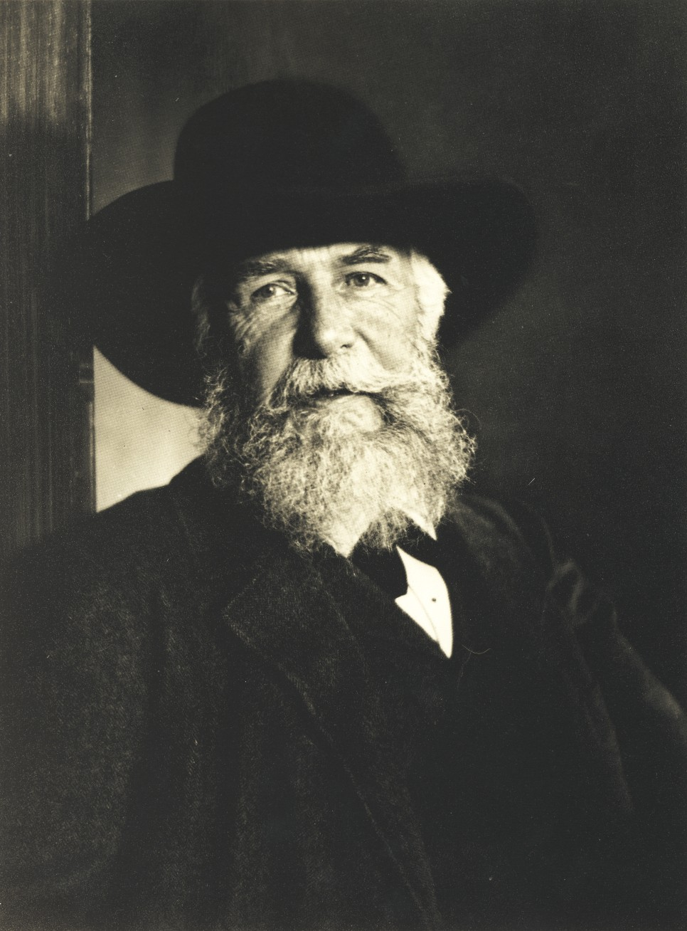
Ernst Haeckel

Slide 10
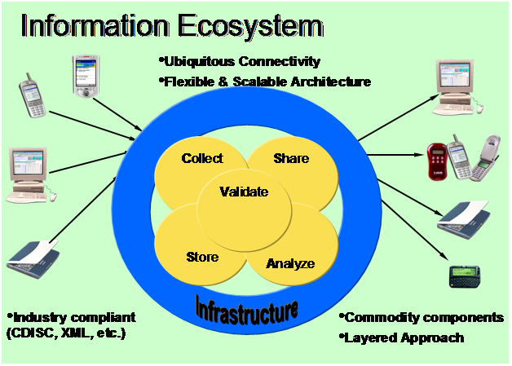

Slide 11
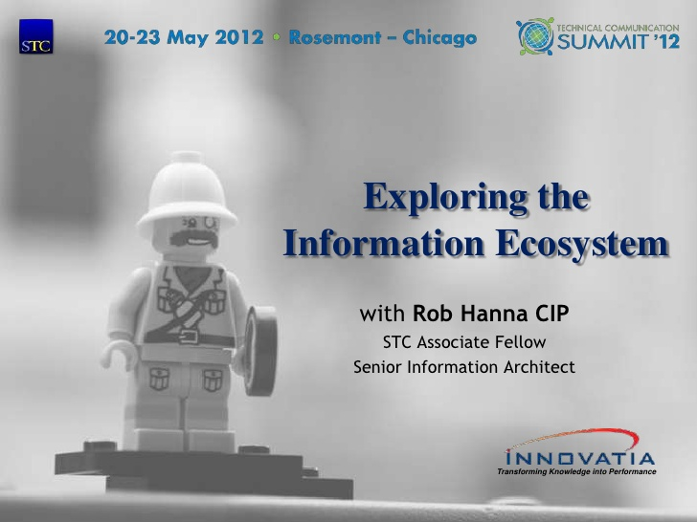

Slide 12
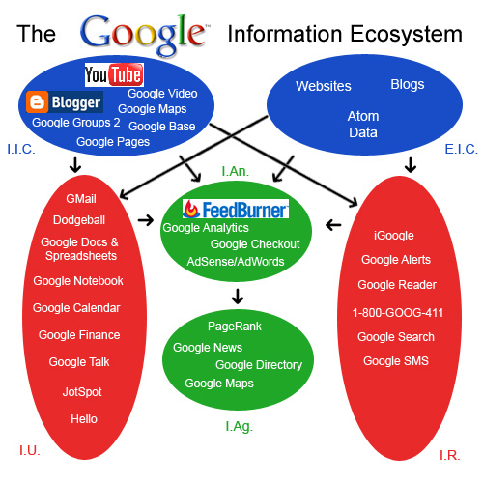

Slide 13
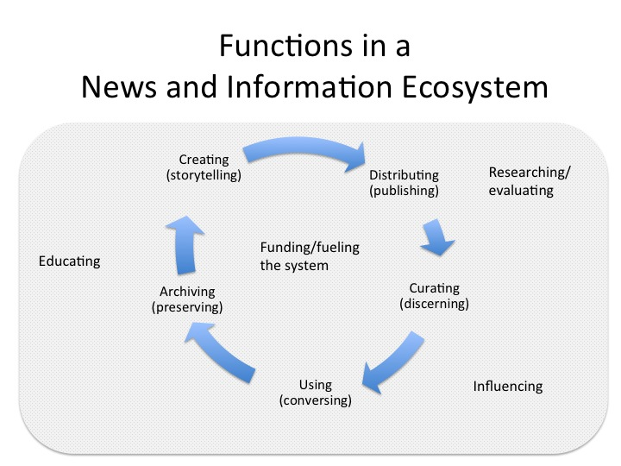

Slide 14
