Slide 1
Forecasting the 2023 NCAA Basketball Tournament
Final Project Presentation | MSDS 565, Spring 2023
20 March 2023
Authors: Aleesa Mann and Cyruss Tsurgeon

Slide 2
Agenda
Introduction – Problem Understanding and Definition
Dataset and Features – Data Collection and Preparation
Methods – Data Understanding using EDA
Experiment and Results – Model Building
Experiment and Results – Model Evaluation
Conclusions – Communication (and Deployment)
Questions

Slide 3
Introduction

Slide 4
Introduction – Problem Understanding
predict the winner of every individual game of NCAA College Basketball Tournaments
according to the AGA, up to 70 million brackets in 2017^{[1]}; an estimated 45 million people in 2022^{[2]}
Source : [1] David Purdum (2017) | [2] American Gaming Association (2022)

Slide 5
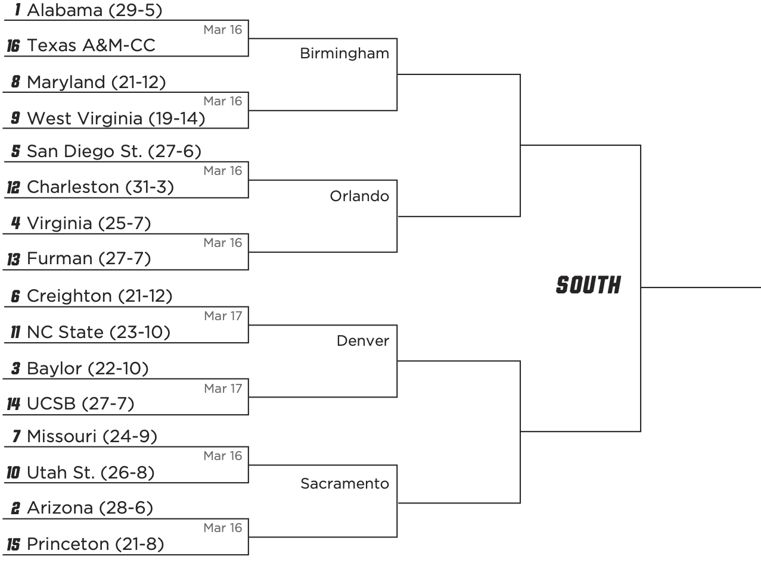
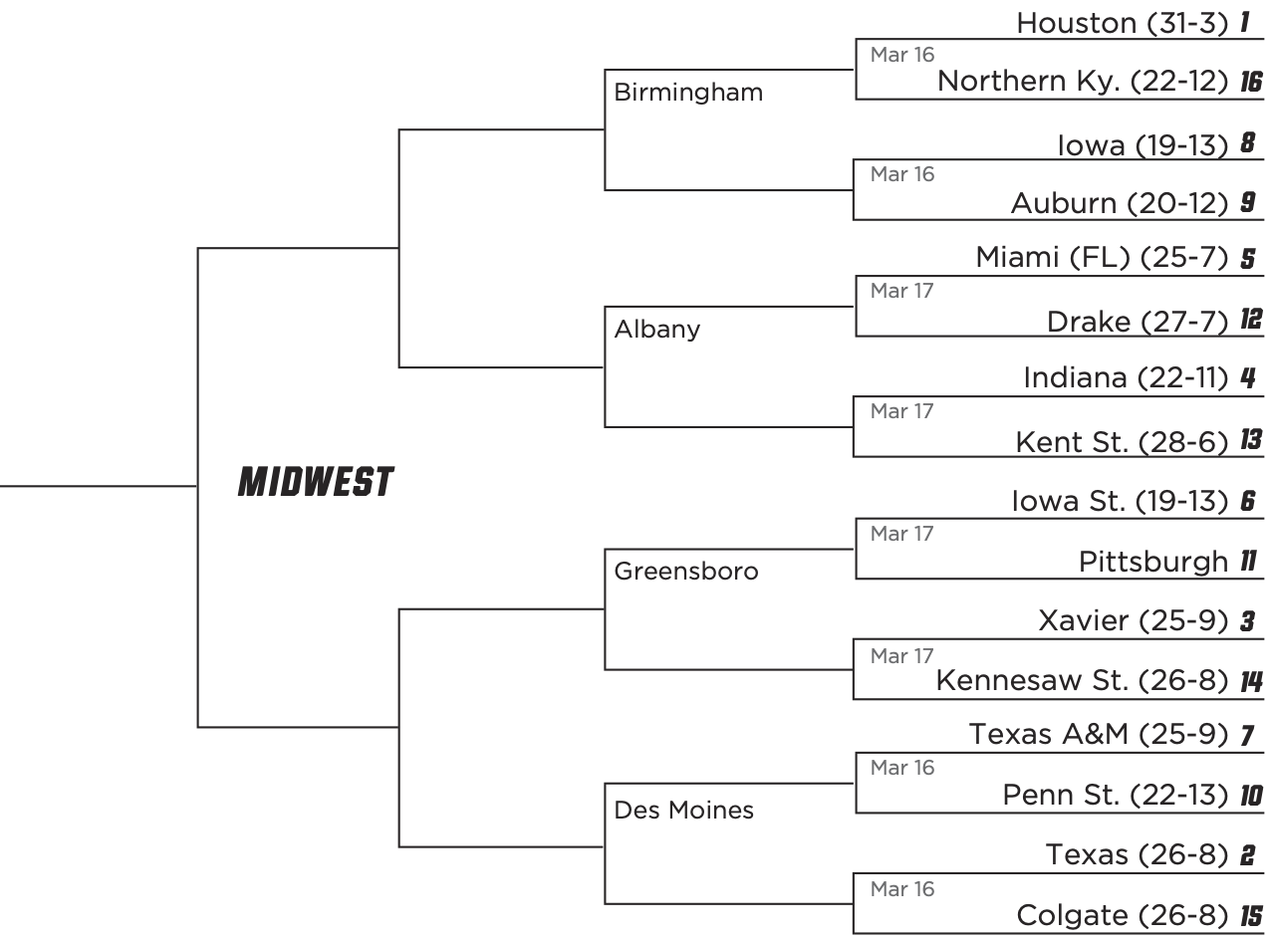
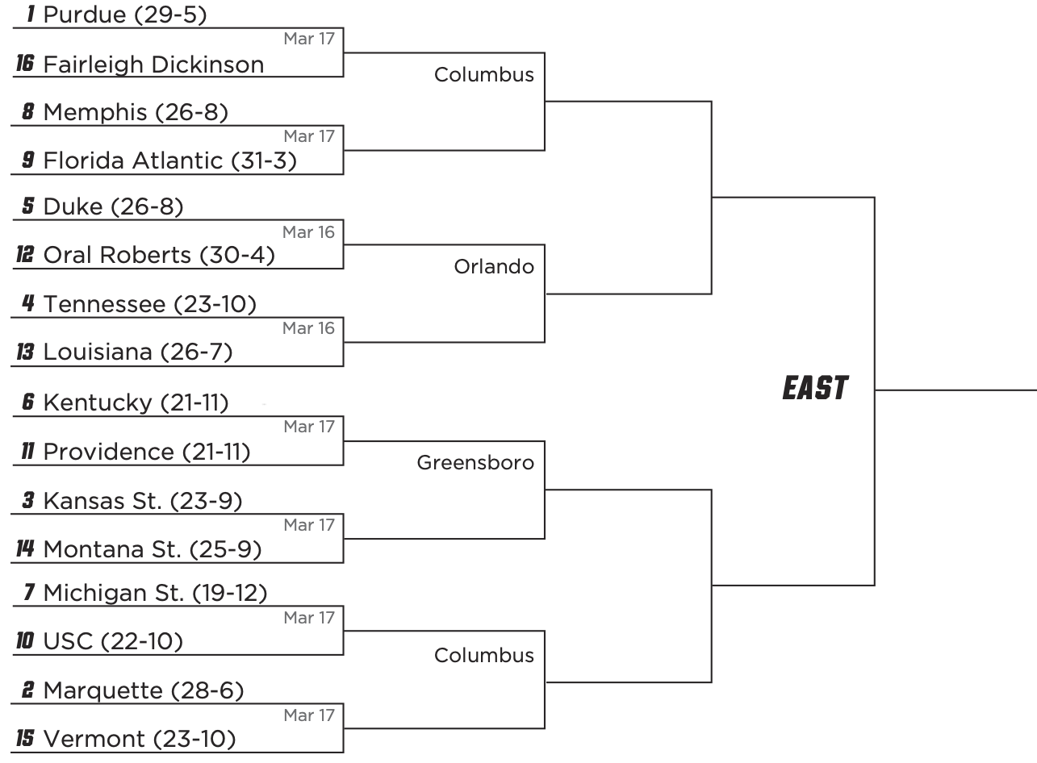
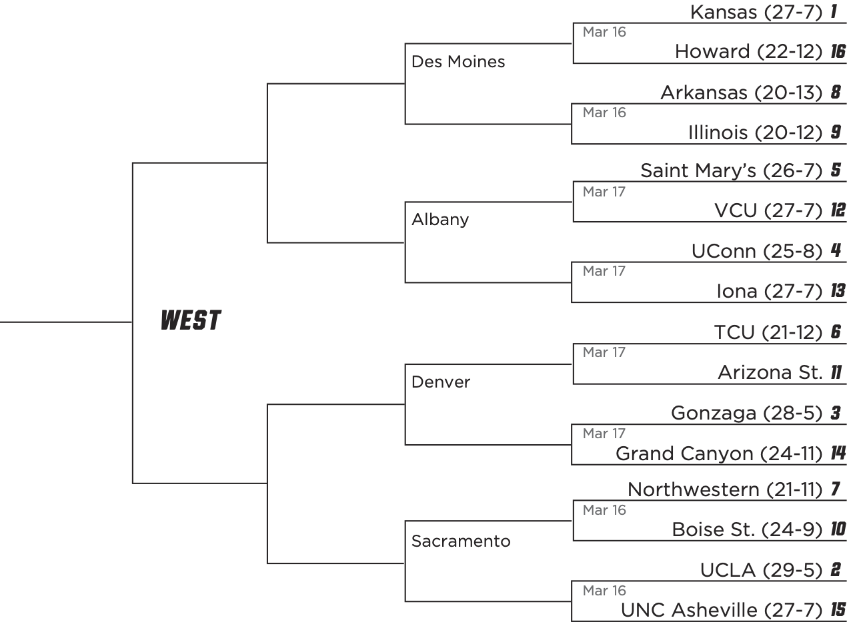
How the brackets work.
1 Alabama
1 Houston
1 Houston

Slide 6
How the brackets work.
Round 1
1 Alabama
Round 2
1 Purdue 58
16 Texas A&M-CC
1 Alabama
Sweet 16
16 FDU 63
8 Maryland
8 Maryland
9 West Virginia
1 Alabama
Elite 8
5 San Diego St
5 San Diego St
12 Charleston
5 San Diego St
4 Virginia
13 Furman
13 Furman
Final 4
1 Alabama
1 Alabama
6 Creighton
3 Baylor
11 NC State
6 Creighton
3 Baylor
3 Baylor
14 UCSB
7 Missouri 63
3 Baylor
15 Princeton 78
7 Missouri
15 Princeton
2 Arizona 55
10 Utah St
7 Missouri
15 Princeton 59
2 Arizona
15 Princeton
15 Princeton

Slide 7
Introduction – Problem Understanding
predict the winner of every individual game of NCAA College Basketball Tournaments
according to the AGA, up to 70 million brackets in 2017^{[1]}; an estimated 45 million people in 2022^{[2]}
no one has ever completed a 'perfect bracket’
Source : [1] David Purdum (2017) | [2] American Gaming Association (2022)

Slide 8
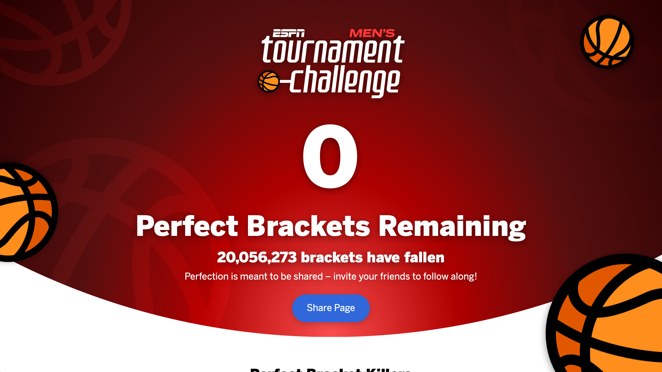
Perfect brackets

Slide 9
Introduction – Problem Understanding
predict the winner of every individual game of NCAA College Basketball Tournaments
according to the AGA, up to 70 million brackets in 2017^{[1]}; an estimated 45 million people in 2022^{[2]}
no one has ever completed a 'perfect bracket’
odds of completing a 'perfect bracket' are 2⁶³ or 1 in 9,223,372,036, 854,775,808 - 1 in 9.2 quintillion ^{[3]}
streak of correct bracket picks is at 49 games ^{[4]}
used provided data and competitive structure of the Kaggle 2023 March Machine Learning Mania competition^{[5]}
Source : [3] Daniel Wilco (2023) | [4] Brian Budzynski (2022) | [5] J. Sonas, et al (2023)

Slide 10
Introduction – Problem Definition
millions of brackets predicting Champion for 63 tournament games
more complex task with an objective to predict the outcome of a hypothetical matchup between each team against all other teams
363 men teams, thus 363 * 362/2 = 65,703 combinations
361 women teams, thus 361 * 360/2 = 64,980 combinations
final submission file must have 65,703 + 64,980 = 130,683 predictions
additional complexity to submit a probability for each outcome
Source : J. Sonas, et al (2023)

Slide 11
Introduction – Problem Definition
we simplified our problem definition for this project
we divided our problem into men’s and women’s predictions for each of us to tackle, and we combined our results.
Goal: Predict the probability of all possible matchup between the 64 teams selected for the 2023 College Basketball Tournament (64 * 63/2 = 2,048 predictions)
Source : J. Sonas, et al (2023)

Slide 12
Introduction – Related Work
in 2012, Chris Wright provided a statistical analysis of predictors for March Madness ^{[6]}
in 2014, Alex Tran and Adam Ginzberg reported nearly all of the game statistics were useless except for FG%, FT%, and 3PT% ^{[7]}
in 2014, Levi Franklin found margin of victory, seeding, and previous tournament performance were useful features ^{[8]}
in 2018, Cody Kocher and Tim Hoblin found that the correlation between the statistical variables used for analysis tended to be high among several variables^{[9]}
Source : [6] Chris Wright (2012) | [7] Tran and Ginzberg (2014) | [8] Levi Franklin (2014) | [9] Kocher and Hoblin (2018)

Slide 13
Dataset and Features

Slide 14
Dataset and Features – Data Section 1 Main Files
Seasons : Season, DayZero, RegionW, RegionX, Region Y, Region Z
Teams : TeamID, TeamName, FirstD1Season, LastD1Season
Regular Season Detailed Results : Season, DayNum, WTeamID, WScore, LTeamID, LScore, WLoc, NumOT, WFGM, WFGA, WFGM3, WFGA3, WFTM, WFTA, WOR, WDR, WAst, WTO, WStl, WBlk, WPF
Tourney Detailed Results : Season, DayNum, WTeamID, WScore, LTeamID, LScore, WLoc, NumOT, WFGM, WFGA, WFGM3, WFGA3, WFTM, WFTA, WOR, WDR, WAst, WTO, WStl, WBlk, WPF
Tourney Seeds : Season, Seed, TeamID
Sample Submission : ID, Pred (e.g. 2018_3181_3314,0.516)

Slide 15
Dataset and Features – Data Section 2 Extra Files
Cities : CityID, City, State
Game Cities : Season, DayNum, WTeamID, LTeamID, CRType, CityID
Compact Season Results : Season, DayNum, WTeamID, WScore, LTeamID, LScore, WLoc, NumOT
Compact Tourney Results : Season, DayNum, WTeamID, WScore, LTeamID, LScore, WLoc, NumOT
Compact Secondary Tourney Results : Season, DayNum, WTeamID, WScore, LTeamID, LScore, WLoc, NumOT, SecondaryTourney
Tourney Slots : Season, Slot, StrongSeed, WeakSeed

Slide 16
Dataset and Features – Data Section 3 Supplements
Team Coaches : Season, TeamID, FirstDayNum, LastDayNum, CoachName
Conferences : ConfAbbrev, Description
Team Conferences : Season, TeamID, ConfAbbrev
Conference Tourney Games : ConfAbbrev, Season, DayNum, WTeamID, LTeamID
Secondary Tourney Teams : Season, SecondaryTourney, TeamID
Massey Ordinals : Season, RankingDayNum, SystemName, TeamID, OrdinalRank
Team Spellings : TeamNameSpelling, TeamID
Seed Round Slots : Seed, GameRound, GameSlot, EarlyDayNum, LateDayNum

Slide 17
Methods

Slide 18
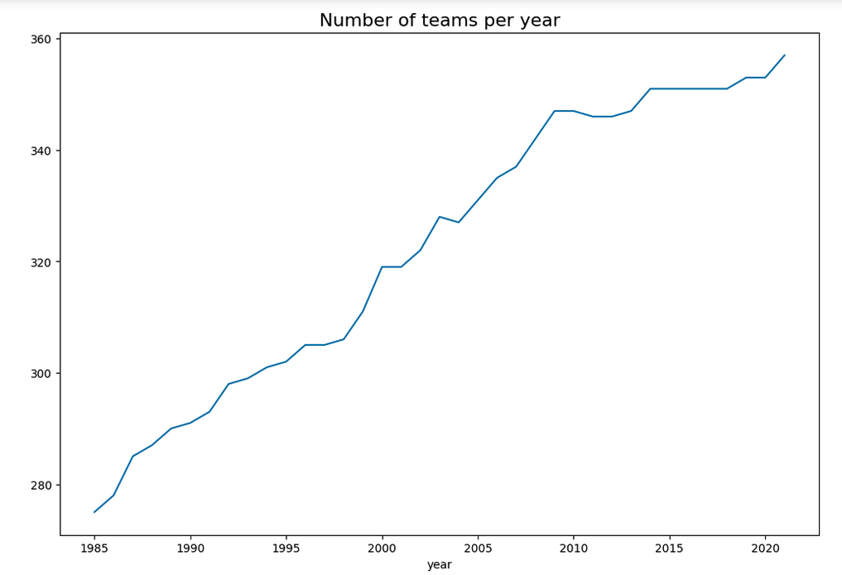
Methods – Data Understanding using EDA

Slide 19
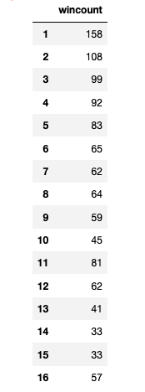
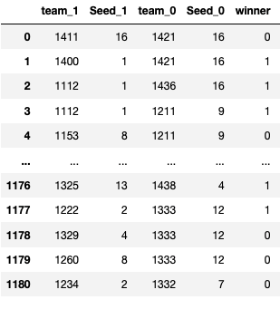
Methods – Data Understanding using EDA
Number of tournament wins by seed
(for years 2003 - 2021):
In this dataset, if you look at at the seeds for team_1 and team_0, and you were to guess that team_1 won every time they had a lower seed number (which is a higher ranking) than team_0, then you would be right 33% of the time. We want our models to perform better than that.

Slide 20
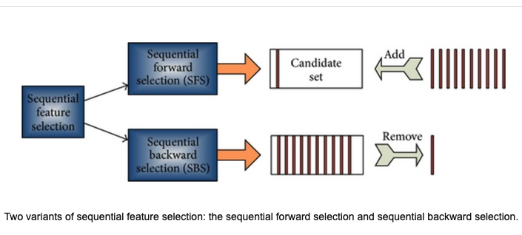
Methods – Data Understanding using EDA
For feature selection, we used the scikit learn Sequential Feature selector and forward selection and time series cross validation to reduce the feature set.
Source : [10] Zhang, et al. (2013)

Slide 21
Experiments

Slide 22
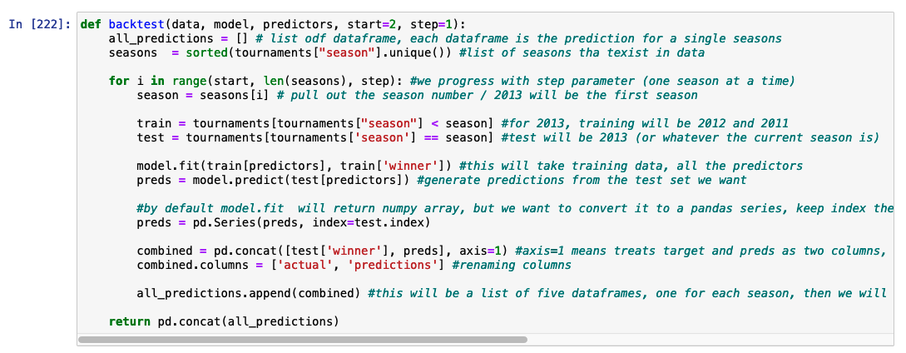
Experiment – Testing and Training Split
Because this is a time series dataset, we had to make sure our training dataset was entered into the model sequentially.

Slide 23
Experiment – Model Building
Model | # Features | Tuning
SVM | 19 | kernel = 'linear', probability = True
KNN | 19 | k = 5
GNB | 19
DT | 19 | max_depth = 5
RF | 19 | n_estimators = 10
MLP | 19 | alpha = 1, max_iter = 1000

Slide 24
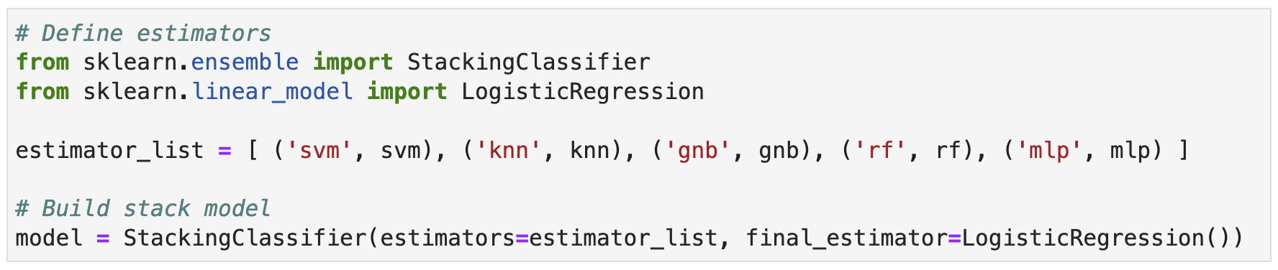
Experiment – Model Building
Built stacked model using 5 or 6 trained models as estimators; and using Logistic Regression as algorithm

Slide 25
Results

Slide 26
Results – Model Evaluation
Model | # Features | Tuning | Accuracy
SVM | 15 | Linear Kernel | .69
 | 10 | Linear Kernel | .69
 | 10 | RBF Kernel | .71
Ridge Regression | 15 | Alpha = 1 | .70
 | 15 | Alpha = 1 | .70
 | 10 | Alpha = 0.01 | .69
Logistic Regression | 15 | Data Scaling | .70
 | 10 | Data Scaling | .70

Slide 27
Results – Model Evaluation
Model | # Features | Tuning | Accuracy
SVM | 10 | RBF Kernel | .66
Ridge Regression | 10 | Alpha = 0.01 | .69
Logistic Regression | 10 | Scaling Data | .64
Smaller feature sets performed better
All models performed similarly (which may be due to the small data set size)
SVM with radial basis function kernel, which may be because it can better pick up nonlinearity in data by projecting the data into more dimensions
Ridge Regression performed best in testing data

Slide 28
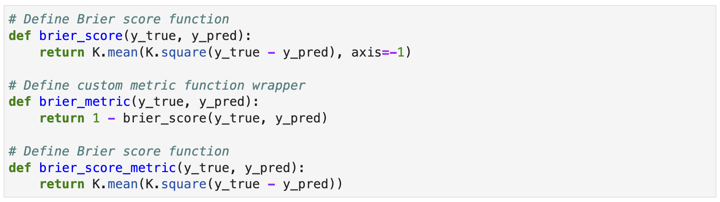
Results – Model Evaluation
Scikit Learn Metrics
Brier Score Metric

Slide 29
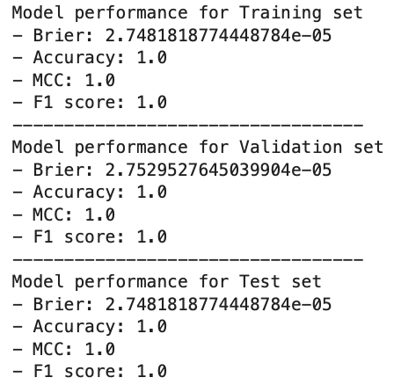
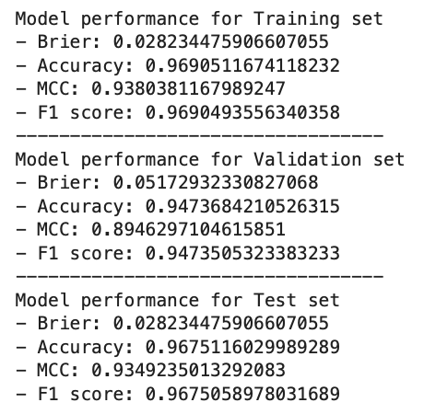
Results – Model Evaluation
Support Vector Machine (SVM) Model K-Nearest Neighbor (KNN) Model

Slide 30
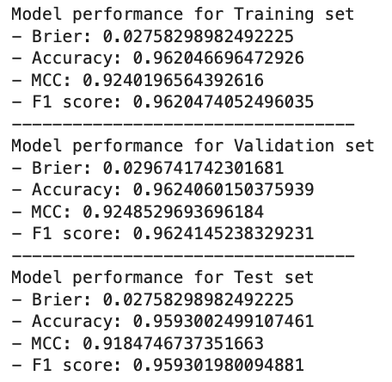
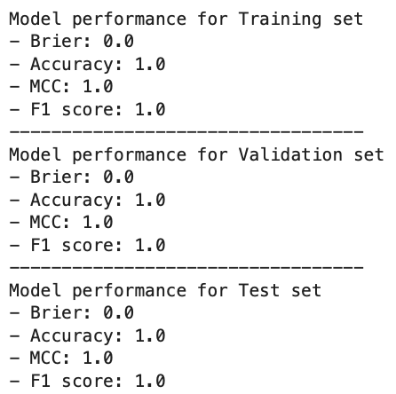
Results – Model Evaluation
Gaussian Naive Bayes (GNB) Model Decision Tree (DT) Model

Slide 31
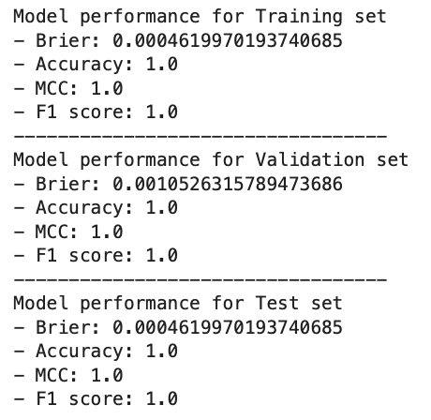
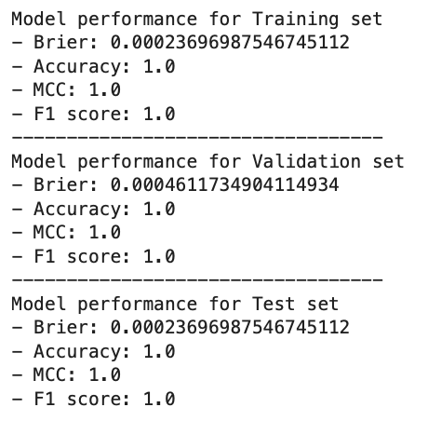
Results – Model Evaluation
Random Forest (RF) Model Multilayer Perceptron (MLP) Model

Slide 32
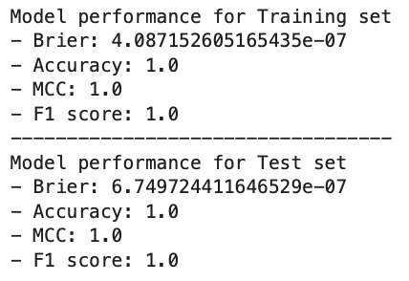
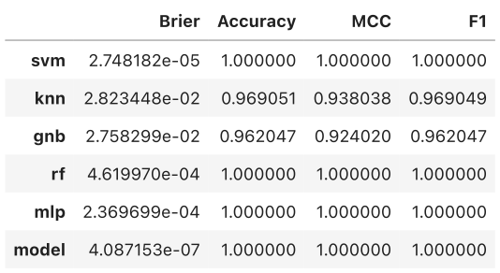
Results – Model Evaluation
Stacked Model
Summary Table

Slide 33
Conclusions

Slide 34
Conclusions – Communication (and Deployment)
Using the sequential features selector across the RidgeRegression, Logistic Regression, and SVM models, there were some variables that appeared in more often in the selection processes, in particular, seed_1 - the seed number for team 1 - was used in all eight models.
.
This means this variable has significant weight in determining the outcome and should be considering in future predictive modeling that undertakes this task of tournament prediction.

Slide 35
Conclusions – Communication (and Deployment)
There needs to be a way to account for the randomness of the matchups, what kind of metric can be used for this? (i.e. a player is hurt, team’s lack of sleep due to travel schedule, etc.)
.
Especially considering this is a single-elimination tournament, which means any aberration in performance could mean a top team losing or a bottom team winning..
.
This type of unpredictability is the ‘madness’ of March Madness.

Slide 36
Conclusions – Communication (and Deployment)
This project was fun, but very challenging. Trying to accurately predict outcomes that show so much unpredictability proved to be very difficult.
.
One learning point from this project was that we should have provisioned our time at the onset (to allow sufficient time for model and hyperparameter tuning)..
.
Another learning point, feature engineering is very important. It would have been better to establish ‘hot team’ and ‘tried team’ features - for streaking teams; bring in time-series.

Slide 37
Conclusions – Communication (and Deployment)
I think using a convoluted neural network model with transfer learning from regular season data might be a better approach.
.
The brier score metric was new for us, fully understanding this metric and using this metric to optimize model may also prove to be a smarter tactic.

Slide 38
References
1. David Purdum (2017). ESPN – 70 million brackets, $10.4 billion in bets expected for March Madness. American Gaming Association. https://www.americangaming.org/new/espn-70-million-brackets-10-4-billion-in-bets-expected-for-march-madness/ accessed: 18 March 2023.
2. American Gaming Association (2022). 2022 March Madness Wagering Estimates. American Gaming Association. https://www.americangaming.org/resources/march-madness-2022/ accessed: 18 March 2023.
3. Daniel Wilco (2023). The absurd odds of a perfect NCAA bracket. https://www.ncaa.com/news/basketball-men/bracketiq/2023-03-16/perfect-ncaa-bracket-absurd-odds-march-madness-dream accessed: 18 March 2023.
4. Brian Budzynski (2022). Who picked the best March Madness bracket of all time? https://www.wavy.com/sports/ncaa-bastketball/who-picked-the-best-march-madness-bracket-of-all-time/ accessed: 18 March 2023.
5. Jeff Sonas, Last-Place Larry, Maggie, and Will Cukierski (2023). March Machine Learning Mania 2023. Kaggle. https://kaggle.com/competitions/march-machine-learning-mania-2023 accessed: 18 March 2023.

Slide 39
References
6. Chris Wright (2012). Statistical Predictors of March Madness: An Examination of the NCAA Men’s’ Basketball Championship. Thesis for Pomona College Economics Department.
7. Alex Tran and Adam Ginzberg (2014). Making Sense of the Mayhem: Machine Learning and March Madness. Stanford CS229 Final Project paper December 2014.
8. Levi Franklin (2014). Predicting March Madness: Winning the Office Pool. Stanford CS229 Final Project paper December 2014.
9. Cody Kocher and Tim Hoblin (2018). Predictive Model for the NCAA Men’s Basketball Tournament. Ball State Undergraduate Mathematics Exchange vol 12(1) 15-23.
10. Zhang, Yudong & Wang, Shuihua & ji, Genlin. (2013). A Rule-Based Model for Bankruptcy Prediction Based on an Improved Genetic Ant Colony Algorithm. Mathematical Problems in Engineering. 2013. https://www.hindawi.com/journals/mpe/2013/753251/

Slide 40
Questions?

