Slide 1
Personal Health Companion
Mission and Outcome
From Data Capture to Actionable Health Decisions
Mission: convert fragmented personal health inputs into secure, structured, and usable insights.
Current outcome: users can onboard, upload records, set goals, and track daily behavior in one workflow.
Delivery status: core platform is live across Phases 1-4 with controlled AI augmentation.
Notes:
Speaker cue: Lead with value delivered, not architecture.

Slide 2
Personal Health Companion
Why This Matters
Business Value
Before: health data was scattered, hard to interpret, and easy to ignore.
Now: the app creates one user-owned flow for profile, documents, goals, and daily progress.
Result: higher adherence potential, clearer progress visibility, and a stronger personalization foundation.
Notes:
Speaker cue: Frame as reduction in friction and increase in user trust.

Slide 3
Personal Health Companion
What Is Live Today
Production-Ready Capabilities
Secure auth, protected routes, and owner-scoped data access.
Profile onboarding and document extraction review workflows.
Goals model and daily report tracking with reusable defaults.
Confidence/confirmation gating and AI retry path for parse quality.
Notes:
Speaker cue: This is the headline slide for stakeholders asking what users can do now.

Slide 4
Personal Health Companion
Delivery by Phase
Execution Progress
Phase 1: secure foundation and critical user journeys.
Phase 2: extraction pipeline with deterministic baseline and AI-assisted path.
Phase 3: goals and progress scaffolding for measurable outcomes.
Phase 4: daily reporting maturity, UX polish, and parse-mode transparency.
Notes:
Speaker cue: Keep this concise and momentum-focused.

Slide 5
Personal Health Companion
System Flow
How Value Is Produced End-to-End
1. User authenticates and completes profile baseline.
2. User provides inputs through documents and daily reports.
3. System parses inputs via heuristic default or optional AI mode.
4. Confidence and confirmation gates protect data quality before progress impact.
5. Structured outputs connect into goals and progress views.
Notes:
Speaker cue: Emphasize human-in-the-loop trust design.

Slide 6
Personal Health Companion
Risk and Control Posture
Top Risks and Mitigations
AI config risk is mitigated by deterministic fallback and explicit mode controls.
Parse trust risk is mitigated by confidence scoring and confirmation gates.
Environment drift risk is mitigated by migration discipline and deployment runbook.
Notes:
Speaker cue: Show that risk is managed by design.

Slide 7
Personal Health Companion
Next 30/60 Days
Execution Plan
30 days: harden preview/prod rollout and add parse quality telemetry.
30 days: expand regression tests for mode switching and daily-report reliability.
60 days: improve AI operational defaults and add outcome KPI dashboards.
60 days: run structured UAT and prepare release signoff package.
Notes:
Speaker cue: Focus on quality scaling and adoption measurement.

Slide 8
Personal Health Companion
Decisions and Asks
Leadership Alignment Needed
Approve reliability and telemetry as next release priority.
Confirm preview-first deployment gate before production promotion.
Align on success KPIs: active reporting rate, confirmation rate, AI retry success, and time-to-insight.
Notes:
Speaker cue: End with specific decisions to maintain momentum.

Slide 9
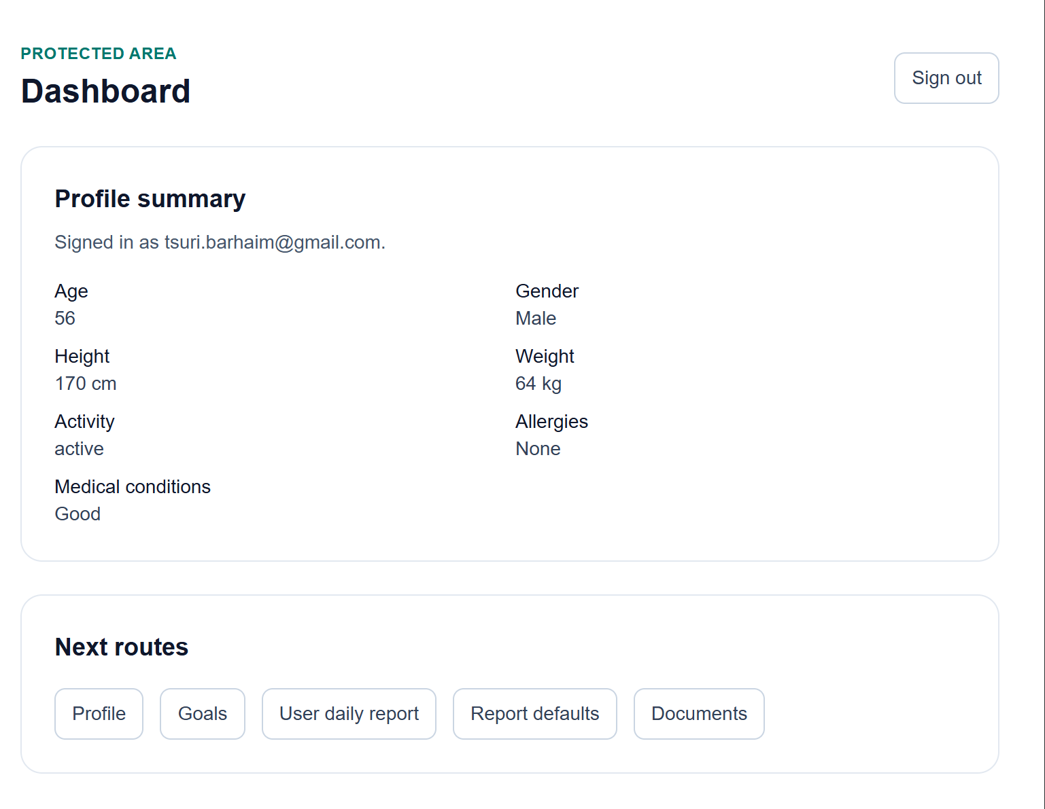
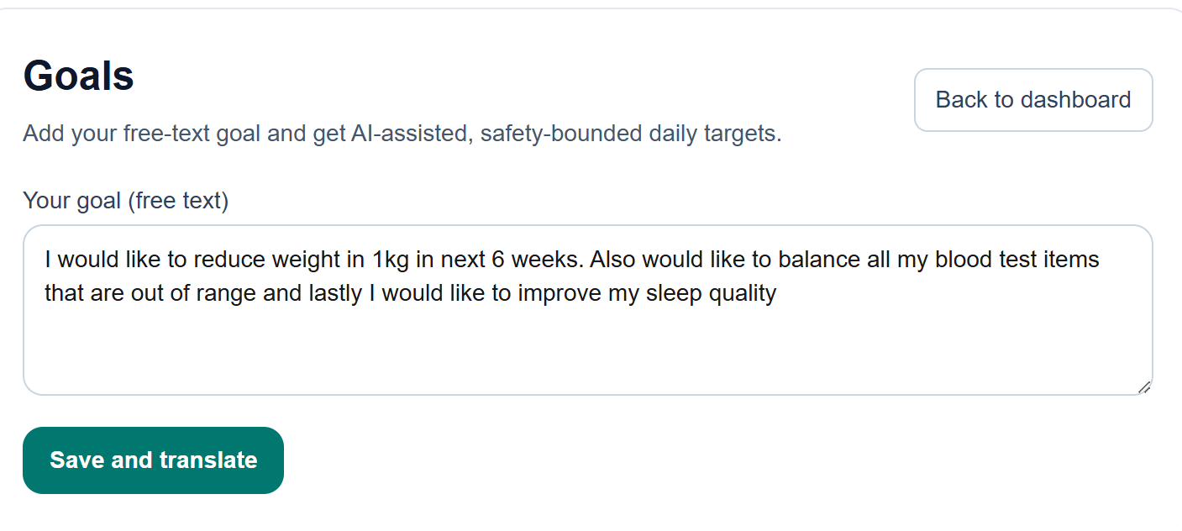
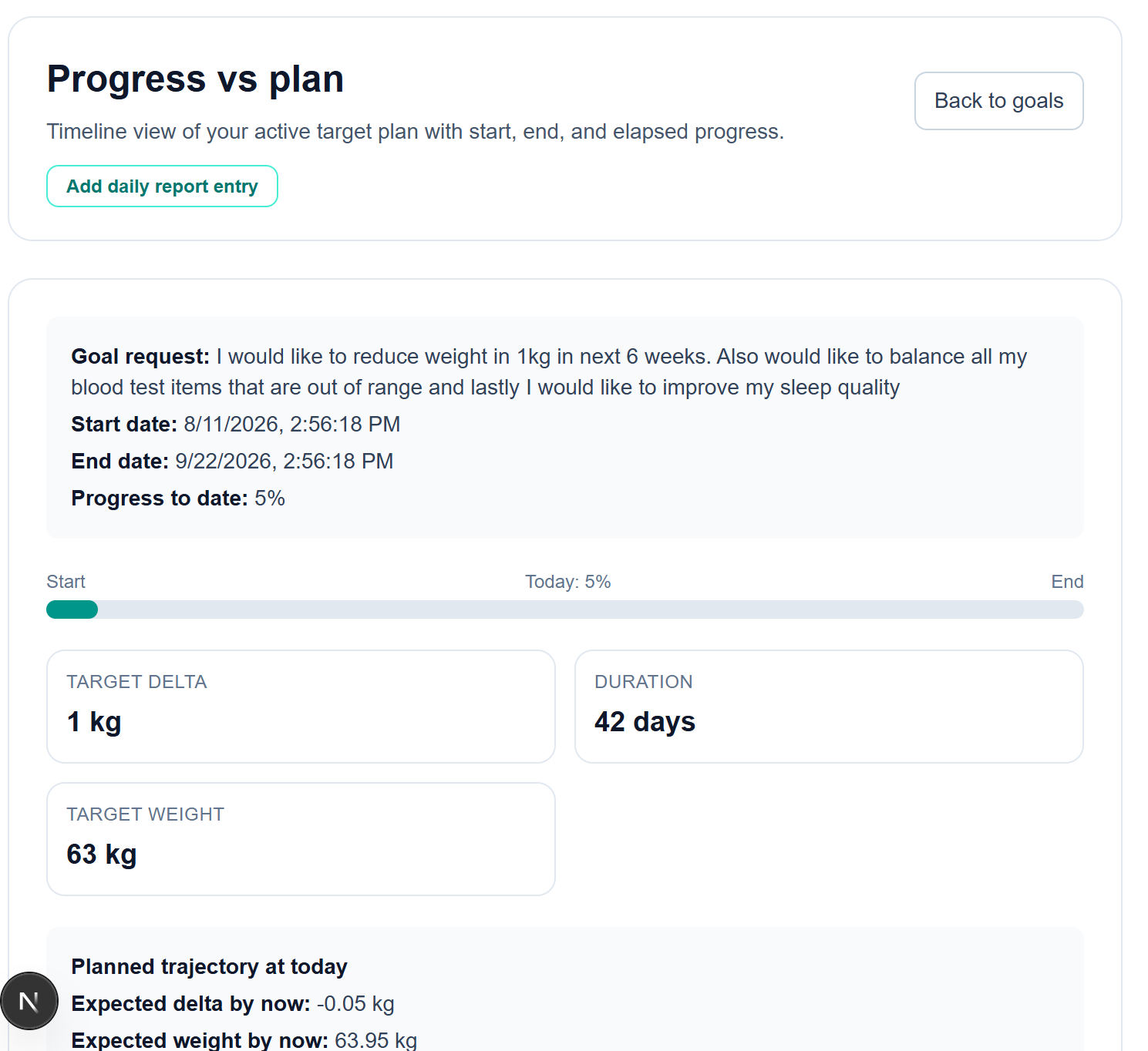
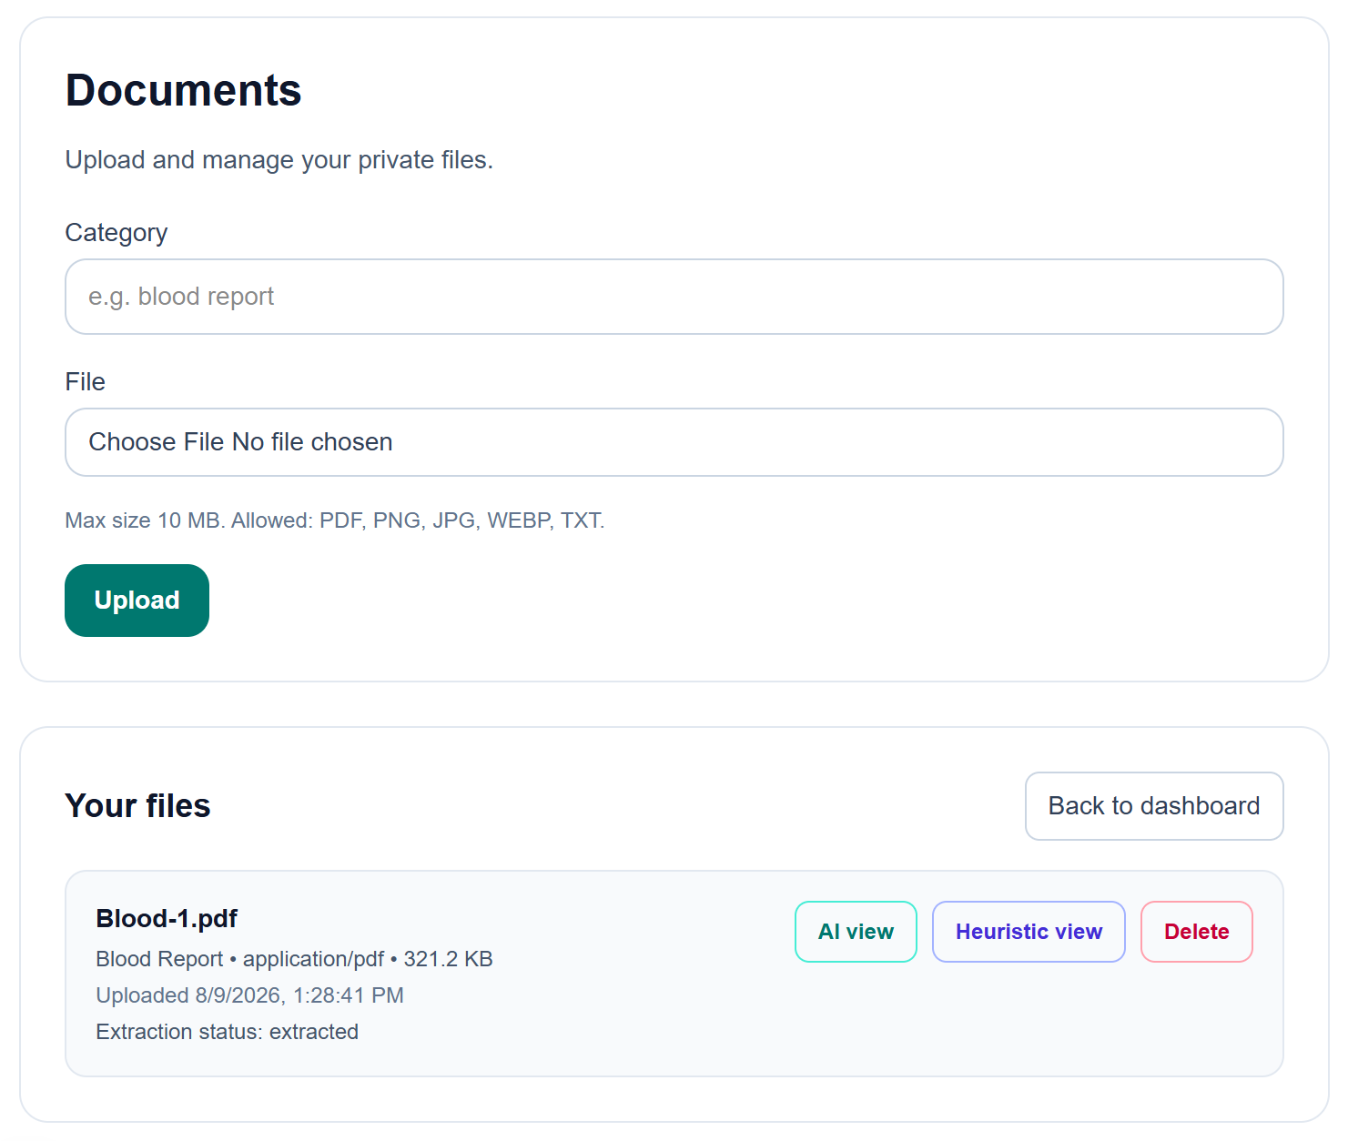
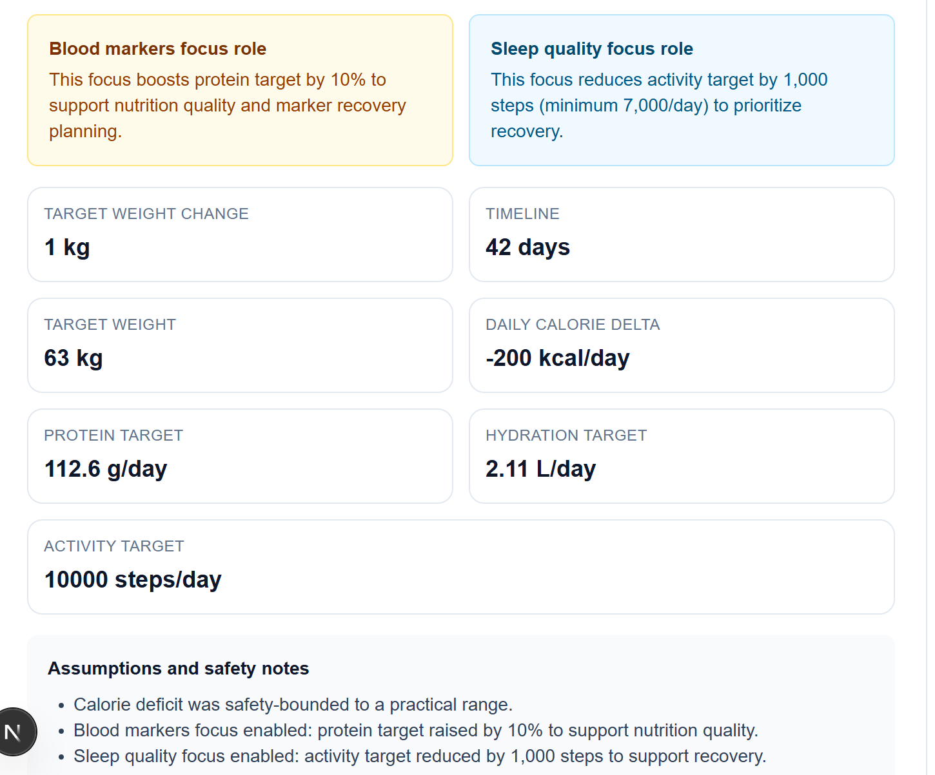
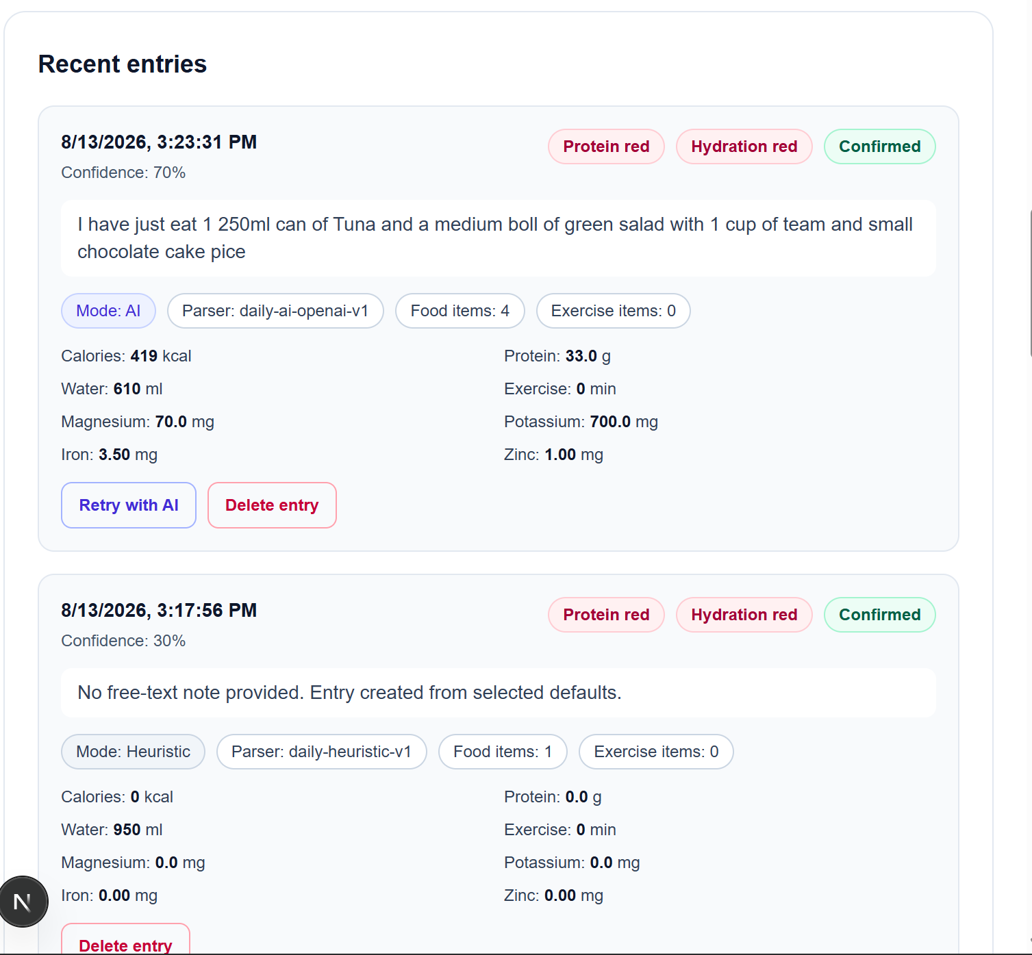
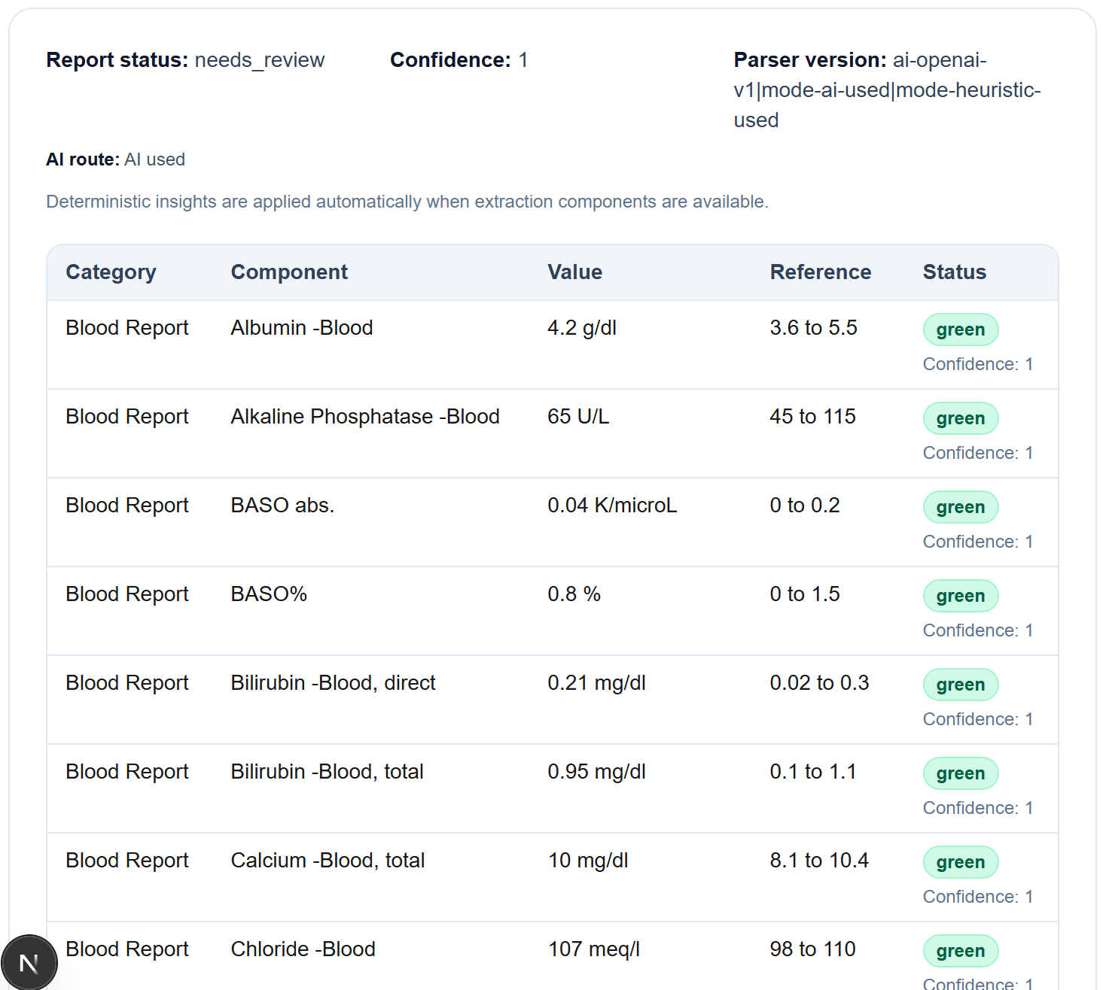
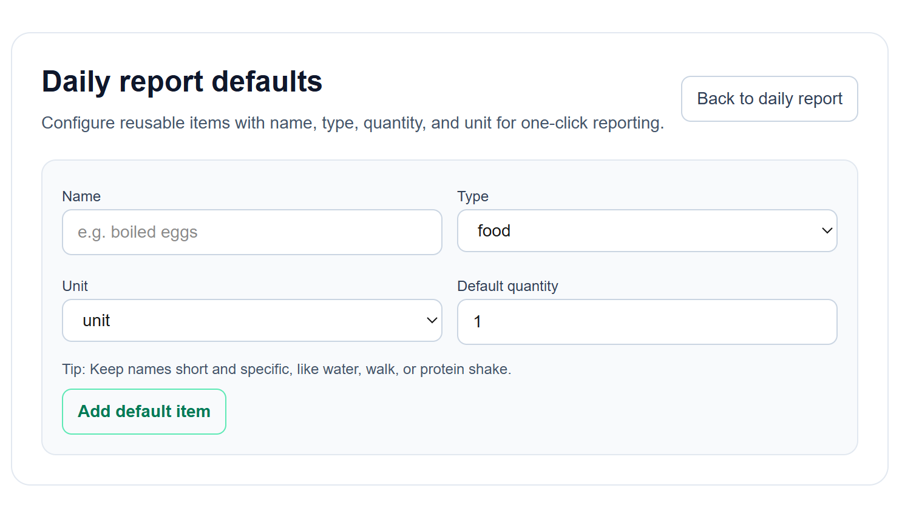
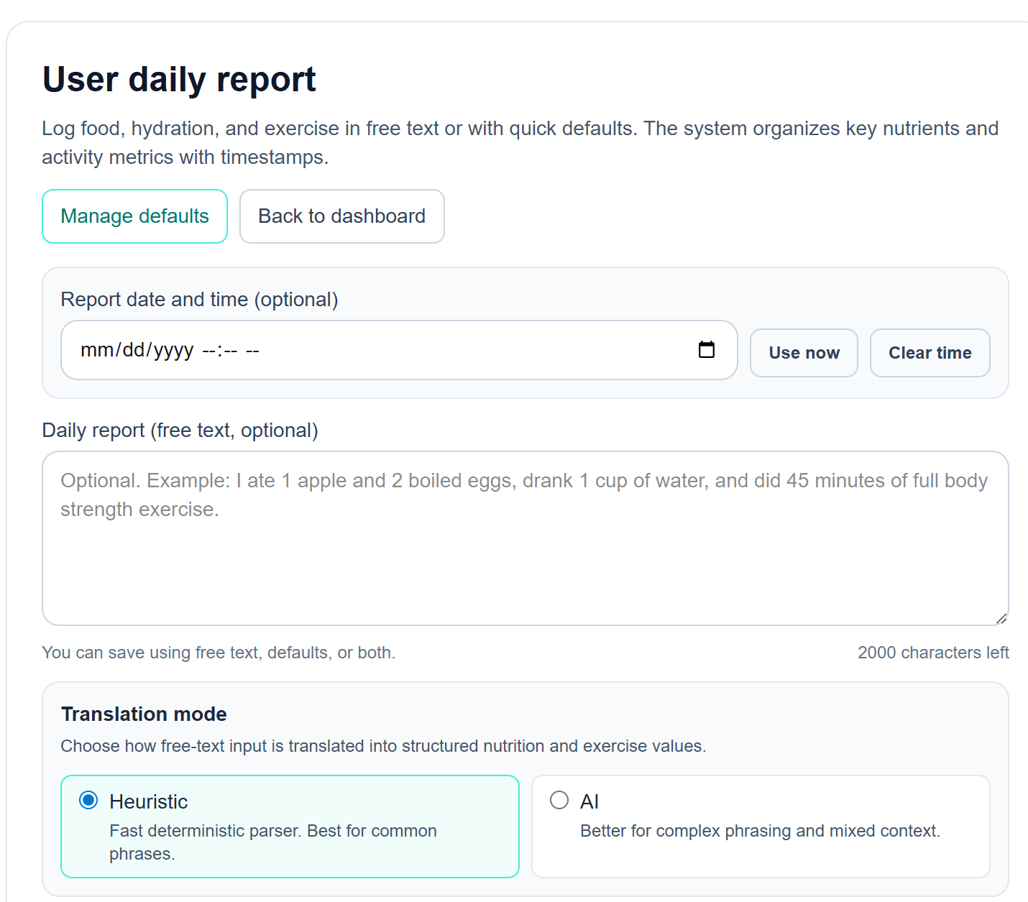
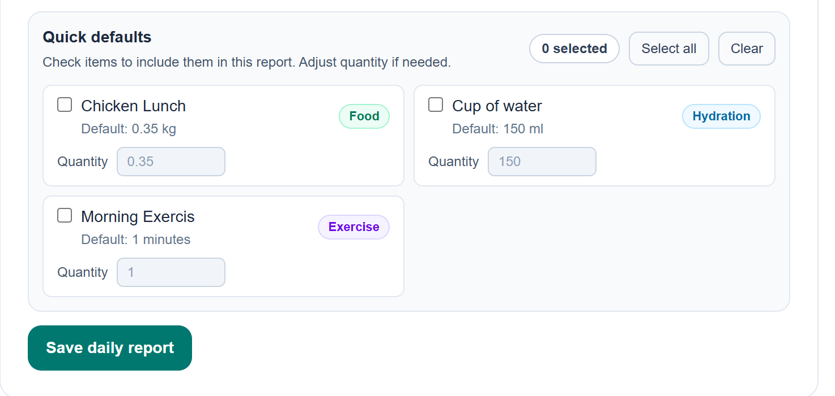
Screen Shots
Notes:
Speaker cue: End with specific decisions to maintain momentum.

