Slide 1
Cryptography and Network Security
Unit 1
Lecture slides by Sudhir Shenai
Notes:
Lecture slides by Lawrie Brown for “Cryptography and Network Security”, 4/e, by William Stallings, Chapter 1 “Introduction”.

Slide 2
Introduction
The art of war teaches us to rely not on the likelihood of the enemy's not coming, but on our own readiness to receive him; not on the chance of his not attacking, but rather on the fact that we have made our position unassailable.
—The Art of War, Sun Tzu
Notes:
This quote from the start of Ch0 sets the scene for why we want to study these issues.

Slide 3

Objective
To give overall view on Information Security
It consists of measures to deter, prevent, detect, and correct security violations that involve the transmission & storage of information
To introduce cryptography and its use in information security
Notes:
Detail the focus of this book/course, which is on Internet Security - being measures to deter, prevent, detect, and correct security violations that involve the transmission & storage of information.

Slide 4
Premises to Secure Information
Computer Security - generic name for the collection of tools designed to protect data and to thwart hackers
Network Security - measures to protect data during their transmission
Web Security - measures to protect web data during their transmission, processing and at rest.
Notes:
In this course, thrust is given for network security at large.

Slide 5
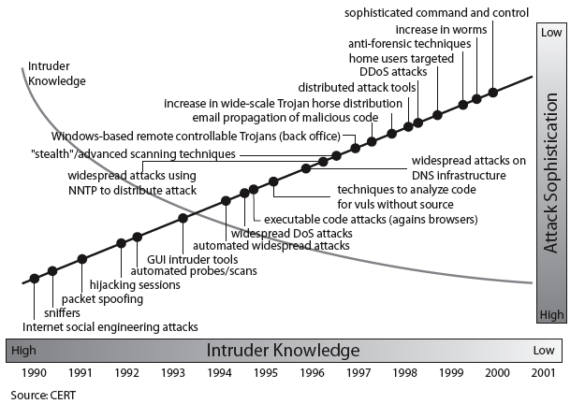
Security Trends
Notes:
Discuss observed security trends (Stallings section 1.1 & Figure 1.2 above), noting growth in sophistication of attacks contrasting with decrease in skill & knowledge needed to mount an attack.

Slide 6
OSI Security Architecture
ITU-T X.800 “Security Architecture for OSI”
defines a systematic way of defining and providing security requirements
for us it provides a useful, if abstract, overview of concepts we will study
Notes:
To assess effectively the security needs of an organization and to evaluate and choose various security products and policies, the manager responsible for security needs some systematic way of defining the requirements for security and characterizing the approaches to satisfying those requirements. This is difficult enough in a centralized data processing environment; with the use of local and wide area networks,the problems are compounded. ITU-T Recommendation X.800, Security Architecture for OSI, defines such a systematic approach. The OSI security architecture is useful to managers as a way of organizing the task of providing security.

Slide 7
Aspects of Security
consider 3 aspects of information security
  security attack
  security mechanism
  security service
Notes:
The OSI security architecture focuses on security attacks,mechanisms,and services. These can be defined briefly as follows:
• Security attack: Any action that compromises the security of information owned by an organization.
• Security mechanism: A process (or a device incorporating such a process) that is designed to detect, prevent,or recover from a security attack.
• Security service: A processing or communication service that enhances the security of the data processing systems and the information transfers of an organization.The services are intended to counter security attacks, and they make use of one or more security mechanisms to provide the service.

Slide 8
Threat
A Potential for violation of security
It is the existence of a circumstance, capability, action, or event that could breach security and cause harm
A possible danger that might exploit a vulnerability

Slide 9
Security Attack
Any deliberate action that compromises the security of information owned by an organization
A deliberate attempt to evade security services and violate the security policy of a system
have a wide range of attacks
can focus of generic types of attacks
  passive
  active
Notes:
Expand on definition and use of “security attack”, as detailed above.
See Stallings Table 1.1 for definitions of threat and attack.

Slide 10

Passive Attacks
Notes:
Have “passive attacks” which attempt to learn or make use of information from the system but does not affect system resources.
By eavesdropping on, or monitoring of, transmissions to:
+ obtain message contents (as shown above in Stallings Figure 1.3a), or
+ monitor traffic flows
Are difficult to detect because they do not involve any alteration of the data.

Slide 11

Active Attacks
Notes:
Also have “active attacks” which attempt to alter system resources or affect their operation.
By modification of data stream to:
+ masquerade of one entity as some other
+ replay previous messages (as shown above in Stallings Figure 1.4b)
+ modify messages in transit
+ denial of service
Active attacks present the opposite characteristics of passive attacks. Whereas passive attacks are difficult to detect, measures are available to prevent their success. On the other hand, it is quite difficult to prevent active attacks absolutely, because of the wide variety of potential physical,software,and network vulnerabilities. Instead, the goal is to detect active attacks and to recover from any disruption or delays caused by them.

Slide 12
Security Service
  enhance security of data processing systems and information transfers of an organization
  intended to counter security attacks
  using one or more security mechanisms
  often replicates functions normally associated with physical documents
    which, for example, have signatures, dates; need protection from disclosure, tampering, or destruction; be notarized or witnessed; be recorded or licensed
Notes:
Consider the role of a security service, and what may be required.
Note both similarities and differences with traditional paper documents, which for example:
have signatures & dates;
need protection from disclosure, tampering, or destruction;
may be notarized or witnessed;
may be recorded or licensed

Slide 13
Security Services
X.800:
  “a service provided by a protocol layer of communicating open systems, which ensures adequate security of the systems or of data transfers”
RFC 2828:
  “a processing or communication service provided by a system to give a specific kind of protection to system resources”
Notes:
Also have a couple of definition of “security services” from relevant standards. X.800 defines a security service as a service provided by a protocol layer of communicating open systems, which ensures adequate security of the systems or of data transfers. Perhaps a clearer definition is found in RFC 2828, which provides the following definition: a processing or communication service that is provided by a system to give a specific kind of protection to system resources; security services implement security policies and are implemented by security mechanisms.

Slide 14
Security Services (X.800)
Authentication - assurance that the communicating entity is the one claimed
Access Control - prevention of the unauthorized use of a resource
Data Confidentiality –protection of data from unauthorized disclosure
Data Integrity - assurance that data received is as sent by an authorized entity
Non-Repudiation - protection against denial by one of the parties in a communication
Notes:
This list includes the various "classic" security services which are traditionally discussed.
Note there is a degree of ambiguity as to the meaning of these terms, and overlap in their use.
See Stallings Table 1.2 for details of the 5 Security Service categories and the 14 specific services given in X.800.

Slide 15
Security Mechanism
feature designed to detect, prevent, or recover from a security attack
no single mechanism that will support all services required
however one particular element underlies many of the security mechanisms in use:
  cryptographic techniques
hence our focus on this topic
Notes:
Now introduce “Security Mechanism” which are the specific means of implementing one or more security services.
Note these mechanisms span a wide range of technical components, but one aspect seen in many is the use of cryptographic techniques.

Slide 16
Security Mechanisms (X.800)
specific security mechanisms:
  encipherment, digital signatures, access controls, data integrity, authentication exchange, traffic padding, routing control, notarization
pervasive security mechanisms:
  trusted functionality, security labels, event detection, security audit trails, security recovery
Notes:
Some examples of mechanisms from X.800. Note that the “specific security mechanisms” are protocol layer specific, whilst the “pervasive security mechanisms” are not. We will meet some of these mechanisms in much greater detail later.
See Stallings Table 1.3 for details of these mechanisms in X.800, and Table 1.4 for the relationship between services and mechanisms.

Slide 17

Model for Network Security
Notes:
In considering the place of encryption, its useful to use the following two models from Stallings section 1.6.
The first, illustrated in Figure 1.5, models information flowing over an insecure communications channel, in the presence of possible opponents. Hence an appropriate security transform (encryption algorithm) can be used, with suitable keys, possibly negotiated using the presence of a trusted third party.

Slide 18
Model for Network Security
using this model requires us to:
  design a suitable algorithm for the security transformation
  generate the secret information (keys) used by the algorithm
  develop methods to distribute and share the secret information
  specify a protocol enabling the principals to use the transformation and secret information for a security service
Notes:
This general model shows that there are four basic tasks in designing a particular security service, as listed.

Slide 19

Model for Network Access Security
Notes:
The second, illustrated in Figure 1.6, model is concerned with controlled access to information or resources on a computer system, in the presence of possible opponents. Here appropriate controls are needed on the access and within the system, to provide suitable security. Some cryptographic techniques are useful here also.

Slide 20
Model for Network Access Security
using this model requires us to:
  select appropriate gatekeeper functions to identify users
  implement security controls to ensure only authorised users access designated information or resources
trusted computer systems may be useful to help implement this model
Notes:
Detail here the tasks needed to use this model.
Note that trusted computer systems (discussed in Ch 20 can be useful here).

Slide 21
Summary
have considered:
  definitions for:
    computer, network, internet security
X.800 standard
security attacks, services, mechanisms
models for network (access) security
Notes:
Chapter 1 summary.

Slide 22
Classical Encryption
Techniques
Notes:
Opening quote.

Slide 23
Cryptology
Notes:
Opening quote.

Slide 24
Some Basic Terminologies
plaintext - original message
ciphertext - coded message
cipher - algorithm for transforming plaintext to ciphertext
key - info used in cipher known only to sender/receiver
encipher (encrypt) - converting plaintext to ciphertext
decipher (decrypt) - recovering ciphertext from plaintext
cryptography - study of encryption principles/methods
cryptanalysis (codebreaking) - study of principles/ methods of deciphering ciphertext without knowing key
cryptology - field of both cryptography and cryptanalysis
Notes:
Briefly review some terminology used throughout the course.

Slide 25
Cryptography
characterize cryptographic system by:
  type of encryption operations used
    substitution / transposition / product
  number of keys used
    single-key or private / two-key or public
  way in which plaintext is processed
    block / stream
Notes:
Cryptographic systems can be characterized along these three independent dimensions.

Slide 26
Cryptanalysis
objective to recover key not just message
general approaches:
  cryptanalytic attack
  brute-force attack
Notes:
Typically objective is to recover the key in use rather then simply to recover the plaintext of a single ciphertext.
There are two general approaches:
Cryptanalytic attacks rely on the nature of the algorithm plus perhaps some knowledge of the general characteristics of the plaintext or even some sample plaintext-ciphertext pairs.
Brute-force attacks try every possible key on a piece of ciphertext until an intelligible translation into plaintext is obtained. On average,half of all possible keys must be tried to achieve success.

Slide 27
Cryptanalytic Attacks
ciphertext only
  only know algorithm & ciphertext, is statistical, know or can identify plaintext
known plaintext
  know/suspect plaintext & ciphertext
chosen plaintext
  select plaintext and obtain ciphertext
chosen ciphertext
  select ciphertext and obtain plaintext
chosen text
  select plaintext or ciphertext to en/decrypt
Notes:
Stallings Table 2.1 summarizes the various types of cryptanalytic attacks, based on the amount of information known to the cryptanalyst, from least to most. The most difficult problem is presented when all that is available is the ciphertext only. In some cases, not even the encryption algorithm is known, but in general we can assume that the opponent does know the algorithm used for encryption. Then with increasing information have the other attacks. Generally, an encryption algorithm is designed to withstand a known-plaintext attack.

Slide 28
More Definitions
unconditional security
  no matter how much computer power or time is available, the cipher cannot be broken since the ciphertext provides insufficient information to uniquely determine the corresponding plaintext
computational security
  given limited computing resources (eg time needed for calculations is greater than age of universe), the cipher cannot be broken
Notes:
Two more definitions are worthy of note. An encryption scheme is unconditionally secure if the ciphertext generated by the scheme does not contain enough information to determine uniquely the corresponding plaintext, no matter how much ciphertext is available. An encryption scheme is said to be computationally secure if either the cost of breaking the cipher exceeds the value of the encrypted information, or the time required to break the cipher exceeds the useful lifetime of the information. Unconditional security would be nice, but the only known such cipher is the one-time pad (later).
For all reasonable encryption algorithms, we have to assume computational security where it either takes too long, or is too expensive, to bother breaking the cipher.

Slide 29
Brute Force Search
always possible to simply try every key
most basic attack, proportional to key size
assume either know / recognise plaintext
Key Size (bits) | Number of Alternative Keys | Time required at 1 decryption/µs | Time required at 10⁶ decryptions/µs
32 | 2³² = 4.3 × 10⁹ | 2³¹ µs = 35.8 minutes | 2.15 milliseconds
56 | 2⁵⁶ = 7.2 × 10¹⁶ | 2⁵⁵ µs = 1142 years | 10.01 hours
128 | 2¹²⁸ = 3.4 × 10³⁸ | 2¹²⁷ µs = 5.4 × 10²⁴ years | 5.4 × 10¹⁸ years
168 | 2¹⁶⁸ = 3.7 × 10⁵⁰ | 2¹⁶⁷ µs = 5.9 × 10³⁶ years | 5.9 × 10³⁰ years
26 characters (permutation) | 26! = 4 × 10²⁶ | 2 × 10²⁶ µs = 6.4 × 10¹² years | 6.4 × 10⁶ years
Notes:
A brute-force attack involves trying every possible key until an intelligible translation of the ciphertext into plaintext is obtained. On average, half of all possible keys must be tried to achieve success. Stallings Table 2.2 shows how much time is required to conduct a brute-force attack, for various common key sizes (DES is 56, AES is 128, Triple-DES is 168, plus general mono-alphabetic cipher), where either a single system or a million parallel systems, are used.

Slide 30
Classical Encryption Techniques
It enables us to illustrate basic approaches to symmetric encryption and the types of cryptanalytic attacks
Substitution – letters of plaintext are replaced by other letters or numbers or symbols or bit patterns
Transposition – cipher text is constructed by some sort of permutation of the plain text letters.

Slide 31
Classical Substitution Ciphers
where letters of plaintext are replaced by other letters or by numbers or symbols
or if plaintext is viewed as a sequence of bits, then substitution involves replacing plaintext bit patterns with ciphertext bit patterns
Notes:
In this section and the next, we examine a sampling of what might be called classical encryption techniques. A study of these techniques enables us to illustrate the basic approaches to symmetric encryption used today and the types of cryptanalytic attacks that must be anticipated. The two basic building blocks of all encryption technique are substitution and transposition. We examine these in the next two sections. Finally, we discuss a system that combine both substitution and transposition.

Slide 32
Caesar Cipher
earliest known substitution cipher
by Julius Caesar
first attested use in military affairs
replaces each letter by 3rd letter on
example:
  meet me after the toga party
  PHHW PH DIWHU WKH WRJD SDUWB
Notes:
Substitution ciphers form the first of the fundamental building blocks. The core idea is to replace one basic unit (letter/byte) with another. Whilst the early Greeks described several substitution ciphers, the first attested use in military affairs of one was by Julius Caesar, described by him in Gallic Wars (cf. Kahn pp83-84). Still call any cipher using a simple letter shift a caesar cipher, not just those with shift 3.

Slide 33
Caesar Cipher
can define transformation as:
  a b c d e f g h i j k l m n o p q r s t u v w x y z
  D E F G H I J K L M N O P Q R S T U V W X Y Z A B C
mathematically give each letter a number
  a b c d e f g h i j k l m n o p q r s t u v w x y z
  0 1 2 3 4 5 6 7 8 9 10 11 12 13 14 15 16 17 18 19 20 21 22 23 24 25
then have Caesar cipher as:
  c = E(p) = (p + k) mod (26)
  p = D(c) = (c – k) mod (26)
Notes:
This mathematical description uses modulo (clock) arithmetic. Here, when you reach Z you go back to A and start again. Mod 26 implies that when you reach 26, you use 0 instead (ie the letter after Z, or 25 + 1 goes to A or 0).
Example: howdy (7,14,22,3,24) encrypted using key f (ie a shift of 5) is MTBID

Slide 34
Cryptanalysis of Caesar Cipher
only have 26 possible ciphers
  A maps to A,B,..Z
could simply try each in turn
a brute force search
given ciphertext, just try all shifts of letters
do need to recognize when have plaintext
eg. break ciphertext "GCUA VQ DTGCM"
Notes:
With a caesar cipher, there are only 26 possible keys, of which only 25 are of any use, since mapping A to A etc doesn't really obscure the message! Note this basic rule of cryptanalysis "check to ensure the cipher operator hasn't goofed and sent a plaintext message by mistake"!
Can try each of the keys (shifts) in turn, until can recognise the original message. See Stallings Fig 2.3 for example of search.
Note: as mentioned before, do need to be able to recognise when have an original message (ie is it English or whatever). Usually easy for humans, hard for computers. Though if using say compressed data could be much harder.
Example "GCUA VQ DTGCM" when broken gives "easy to break", with a shift of 2 (key C).

Slide 35
Monoalphabetic Cipher
rather than just shifting the alphabet
could shuffle (jumble) the letters arbitrarily
each plaintext letter maps to a different random ciphertext letter
hence key is 26 letters long
  Plain: abcdefghijklmnopqrstuvwxyz
  Cipher: DKVQFIBJWPESCXHTMYAUOLRGZN
  Plaintext: ifwewishtoreplaceletters
  Ciphertext: WIRFRWAJUHYFTSDVFSFUUFYA
Notes:
With only 25 possible keys, the Caesar cipher is far from secure. A dramatic increase in the key space can be achieved by allowing an arbitrary substitution, where the translation alphabet can be any permutation of the 26 alphabetic characters.
See example translation alphabet, and an encrypted message using it.

Slide 36
Monoalphabetic Cipher Security
now have a total of 26! = 4 x 1026 keys
with so many keys, might think is secure
but would be !!!WRONG!!!
problem is language characteristics
Notes:
Note that even given the very large number of keys, being 10 orders of magnitude greater than the key space for DES, the monoalphabetic substitution cipher is not secure, because it does not sufficiently obscure the underlying language characteristics.

Slide 37
Language Redundancy and Cryptanalysis
human languages are redundant
eg "th lrd s m shphrd shll nt wnt"
letters are not equally commonly used
in English E is by far the most common letter
  followed by T,R,N,I,O,A,S
other letters like Z,J,K,Q,X are fairly rare
have tables of single, double & triple letter frequencies for various languages
Notes:
As the example shows, we don't actually need all the letters in order to understand written English text. Here vowels were removed, but they're not the only redundancy. cf written Hebrew has no vowels for same reason. Are usually familiar with "party conversations", can hear one person speaking out of hubbub of many, again because of redundancy in aural language also. This redundancy is also the reason we can compress text files, the computer can derive a more compact encoding without losing any information. Basic idea is to count the relative frequencies of letters, and note the resulting pattern.

Slide 38

English Letter Frequencies
Notes:
Note that all human languages have varying letter frequencies, though the number of letters and their frequencies varies. Stallings Figure 2.5 shows English letter frequencies. Seberry & Pieprzyk, "Cryptography - An Introduction to Computer Security", Prentice-Hall 1989, Appendix A has letter frequency graphs for 20 languages (most European & Japanese & Malay).

Slide 39
Use in Cryptanalysis
key concept - monoalphabetic substitution ciphers do not change relative letter frequencies
discovered by Arabian scientists in 9th century
calculate letter frequencies for ciphertext
compare counts/plots against known values
if caesar cipher look for common peaks/troughs
  peaks at: A-E-I triple, NO pair, RST triple
  troughs at: JK, X-Z
for monoalphabetic must identify each letter
  tables of common double/triple letters help
Notes:
The simplicity and strength of the monoalphabetic substitution cipher meant it dominated cryptographic use for the first millenium AD. It was broken by Arabic scientists. The earliest known description is in Abu al-Kindi's "A Manuscript on Deciphering Cryptographic Messages", published in the 9th century but only rediscovered in 1987 in Istanbul, but other later works also attest to their knowledge of the field. Monoalphabetic ciphers are easy to break because they reflect the frequency data of the original alphabet. The cryptanalyst looks for a mapping between the observed pattern in the ciphertext, and the known source language letter frequencies. If English, look for peaks at: A-E-I triple, NO pair, RST triple, and troughs at: JK, X-Z.

Slide 40
Example Cryptanalysis
given ciphertext:
  UZQSOVUOHXMOPVGPOZPEVSGZWSZOPFPESXUDBMETSXAIZ
  VUEPHZHMDZSHZOWSFPAPPDTSVPQUZWYMXUZUHSX
  EPYEPOPDZSZUFPOMBZWPFUPZHMDJUDTMOHMQ
count relative letter frequencies (see text)
guess P & Z are e and t
guess ZW is th and hence ZWP is the
proceeding with trial and error finally get:
  it was disclosed yesterday that several informal but
  direct contacts have been made with political
  representatives of the viet cong in moscow
Notes:
Illustrate the process with this example from the text in Stallings section 2.2.

Slide 41
Playfair Cipher
Just mapping one letter always to another, the frequency distribution is just shuffled. So the code can be broken by analysing frequency distribution of the natural language.
One approach is to encrypt more than one letter at once. The Playfair cipher is an example of doing this.
Notes:
Consider ways to reduce the "spikyness" of natural language text, since if just map one letter always to another, the frequency distribution is just shuffled. One approach is to encrypt more than one letter at once. The Playfair cipher is an example of doing this.

Slide 42
Playfair Key Matrix
Matrix-based block cipher used in WW-I
a 5X5 matrix of letters based on a keyword
fill in letters of keyword (sans duplicates)
fill rest of matrix with other letters
eg. using the keyword MONARCHY
M | O | N | A | R
C | H | Y | B | D
E | F | G | I/J | K
L | P | Q | S | T
U | V | W | X | Z
Notes:
The best-known multiple-letter encryption cipher is the Playfair, which treats digrams in the plaintext as single units and translates these units into ciphertext digrams. The Playfair algorithm is based on the use of a 5x5 matrix of letters constructed using a keyword. The rules for filling in this 5x5 matrix are: L to R, top to bottom, first with keyword after duplicate letters have been removed, and then with the remain letters, with I/J used as a single letter. This example comes from Dorothy Sayer's book "Have His Carcase", in which Lord Peter Wimsey solves it, and describes the use of a probably word attack.

Slide 43
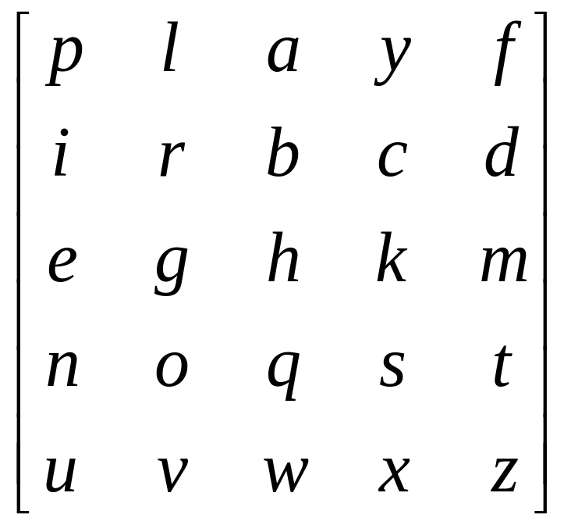
Playfair ciphers
In a 5x5 matrix, write the letters of the word “playfair” (for example) without duplicates, and fill in with other letters of the alphabet, except I,J used interchangeably.

Slide 44
Playfair encryption
Break plaintext into letter pairs
  If a pair would contain double letters, split with x
  Pad end with x
  hellothere becomes…
  he lx lo th er ex
For each pair,
  If they are in the same row, replace each with the letter to its right (mod 5)
    he → KG
  If they are in the same column, replace each with the letter below it (mod 5)
    lo → RV
  Otherwise, replace each with letter we’d get if we swapped their column indices
    lx →YV
He lx lo th er ex
KG YV RV QM GI KU
To decrypt, just reverse!

Slide 45
Security of Playfair Cipher
security much improved over monoalphabetic
since have 26 x 26 = 676 diagrams
would need a 676 entry frequency table to analyse (verses 26 for a monoalphabetic)
and correspondingly more ciphertext
Even with the above improvement , the cipher is still breakable , as the number of plaintext to cipher text mapping can be counted and its frequency distribution can be analysed.
Matrix is unknown, but the structure of its bottom is predictable
Notes:
The Playfair cipher is a great advance over simple monoalphabetic ciphers, since there are 26*26=676 digrams (vs 26 letters), so that identification of individual digrams is more difficult. Also,the relative frequencies of individual letters exhibit a much greater range than that of digrams, making frequency analysis much more difficult. The Playfair cipher was for a long time considered unbreakable. It was used as the standard field system by the British Army in World War I and still enjoyed considerable use by the U.S.Army and other Allied forces during World War II. Despite this level of confidence in its security,the Playfair cipher is relatively easy to break because it still leaves much of the structure of the plaintext language intact

Slide 46
Playfair ciphers
Used in Dorothy L. Sayers’ 1932 mystery novel “Have His Carcase”
Marketing beats technology?
  Invented by Charles Wheatstone
  Lyon Playfair, a Scottish Baron, promoted it
  Who got the glory?

Slide 47
Transposition Ciphers
now consider classical transposition or permutation ciphers
these hide the message by rearranging the letter order
without altering the actual letters used
can recognise these since have the same frequency distribution as the original text
Notes:
All the techniques examined so far involve the substitution of a ciphertext symbol for a plaintext symbol. A very different kind of mapping is achieved by performing some sort of permutation on the plaintext letters. This technique is referred to as a transposition cipher, and form the second basic building block of ciphers. The core idea is to rearrange the order of basic units (letters/bytes/bits) without altering their actual values.

Slide 48
Rail Fence cipher
write message letters out diagonally over a number of rows
then read off cipher row by row
eg. write message out as:
  m e m a t r h t g p r y
  e t e f e t e o a a t
giving ciphertext
  MEMATRHTGPRYETEFETEOAAT
Notes:
The simplest such cipher is the rail fence technique, in which the plaintext is written down as a sequence of diagonals and then read off as a sequence of rows.
The example message is: "meet me after the toga party" with a rail fence of depth 2.
This sort of thing would be trivial to cryptanalyze.

Slide 49
Row Transposition Ciphers
a more complex transposition
write letters of message out in rows over a specified number of columns
then reorder the columns according to some key before reading off the rows
  Key: 4 3 1 2 5 6 7
  Plaintext: a t t a c k p
  o s t p o n e
  d u n t i l t
  w o a m x y z
  Ciphertext: TTNAAPTMTSUOAODWCOIXKNLYPETZ
Notes:
A more complex transposition cipher is to write the message in a rectangle, row by row, and read the message off shuffling the order of the columns in each row.
A pure transposition cipher is easily recognized because it has the same letter frequencies as the original plaintext. For the type of columnar transposition just shown, cryptanalysis is fairly straightforward and involves laying out the ciphertext in a matrix and playing around with column positions. Digram and trigram frequency tables can be useful.

Slide 50
Product Ciphers
ciphers using substitutions or transpositions are not secure because of language characteristics
hence consider using several ciphers in succession to make harder, but:
  two substitutions make a more complex substitution
  two transpositions make more complex transposition
  but a substitution followed by a transposition makes a new much harder cipher
this is bridge from classical to modern ciphers
Notes:
Have seen that ciphers based on just substitutions or transpositions are not secure, and can be attacked because they do not sufficient obscure the underlying language structure
So consider using several ciphers in succession to make harder.
A substitution followed by a transposition is known as a Product Cipher, and makes a new much more secure cipher, and forms the bridge to modern ciphers.

Slide 51
Rotor Machines
before modern ciphers, rotor machines were most common complex ciphers in use
widely used in WW-2
  German Enigma, Allied Hagelin, Japanese Purple
implemented a very complex, varying substitution cipher
used a series of cylinders, each giving one substitution, which rotated and changed after each letter was encrypted
with 3 cylinders have 26³=17576 alphabets
Notes:
The next major advance in ciphers required use of mechanical cipher machines which enabled to use of complex varying substitutions.
A rotor machine consists of a set of independently rotating cylinders through which electrical pulses can flow. Each cylinder has 26 input pins and 26 output pins, with internal wiring that connects each input pin to a unique output pin. If we associate each input and output pin with a letter of the alphabet, then a single cylinder defines a monoalphabetic substitution. After each input key is depressed, the cylinder rotates one position, so that the internal connections are shifted accordingly. The power of the rotor machine is in the use of multiple cylinders, in which the output pins of one cylinder are connected to the input pins of the next, and with the cylinders rotating like an “odometer”, leading to a very large number of substitution alphabets being used, eg with 3 cylinders have 26³=17576 alphabets used.
They were extensively used in world war 2, and the history of their use and analysis is one of the great stories from WW2.

Slide 52
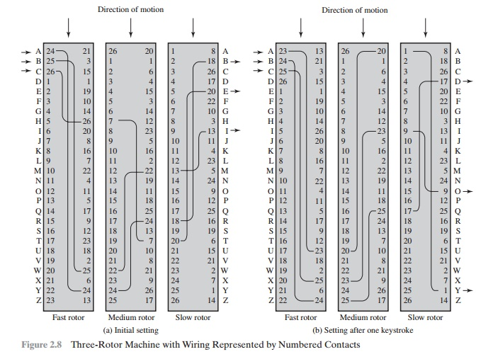

Slide 53

Hagelin Rotor Machine
Notes:
This photo of an Allied Hagelin machine was taken by Lawrie Brown at Eurocrypt'93 in Norway. Note pen for scale, and the rotating cipher wheels near the front.

Slide 54
Steganography
an alternative to encryption
hides existence of message
  using only a subset of letters/words in a longer message marked in some way
  using invisible ink
  hiding in LSB in graphic image or sound file
has drawbacks
  high overhead to hide relatively few info bits
Notes:
Steganography is an alternative to encryption which hides the very existence of a message by some means. There are a large range of techniques for doing this.
Steganography has a number of drawbacks when compared to encryption. It requires a lot of overhead to hide a relatively few bits of information.
Also, once the system is discovered, it becomes virtually worthless, although a message can be first encrypted and then hidden using steganography.

Slide 55
One-Time Pad
if a truly random key as long as the message is used, the cipher will be secure
called a One-Time pad
is unbreakable since ciphertext bears no statistical relationship to the plaintext
since for any plaintext & any ciphertext there exists a key mapping one to other
can only use the key once though
problems in generation & safe distribution of key
Notes:
The One-Time Pad is an evolution of the Vernham cipher, which was invented by Gilbert Vernham in 1918, and used a long tape of random letters to encrypt the message. An Army Signal Corp officer, Joseph Mauborgne, proposed an improvement using a random key that was truly as long as the message, with no repetitions, which thus totally obscures the original message. It produces random output that bears no statistical relationship to the plaintext. Because the ciphertext contains no information whatsoever about the plaintext, there is simply no way to break the code, since any plaintext can be mapped to any ciphertext given some key.
The one-time pad offers complete security but, in practice, has two fundamental difficulties:
There is the practical problem of making large quantities of random keys.
2. And the problem of key distribution and protection, where for every message to be sent, a key of equal length is needed by both sender and receiver.
Because of these difficulties, the one-time pad is of limited utility, and is useful primarily for low-bandwidth channels requiring very high security.

Slide 56
One Time Pad
PT : H A P P Y
: 8 1 16 16 25
Key : 8 19 13 4 23
CT = (key + PT ) mod 26
CT :P T C T V
Strength : Unbreakable , both by brute force and frequency analysis
Weakness : Key generation (randomness)
, Limitation of message size, Key distribution

Slide 57
SUMMARY
Thus in Unit 1 , the following topics are covered
- 3 aspects of Information Security
- Cryptography and Cryptanalysis
- Classical Encryption Techniques

