Slide 1

Tsvetan Vasilev
Software Architect / Bosch Digital
Architecture as Code (AaC)
Automate Your Software Architecture
20.01.2026

Slide 2
Agenda
Why traditional architecture breaks
What Architecture-as-Code really means
How it works in practice
Trade-offs, costs, and when it makes sense

Slide 3
The Traditional Way: Architecture as a Finite-State Machine
Most teams unconsciously treat architecture as a static artifact
Input
Architecture
Output
Requirements go in → diagrams come out → architecture is “done”
Notes:
Most teams unconsciously treat architecture as a static artifact.
Requirements go in → diagrams come out → architecture is “done”.
This model is dangerously misleading.
Architecture is stateful.
It transitions over time, driven by decisions, constraints, and feedback.
Key emphasis:
Architecture ≠ snapshot
Architecture = evolving system of states

Slide 4
Inputs to Architecture
Functional requirements
Non-functional (quality) requirements
Business Goals & Constraints
Constraints and governance
Stakeholders, risks, domain context
Regulations
Business Analysis
Stakeholders Workshop
Architecture
Notes:
Architecture does not start with boxes and arrows.
It starts with inputs:
• functional requirements
• non-functional requirements
• constraints
• organizational context
If these inputs are informal, undocumented, or implicit — architecture already begins to drift.

Slide 5
Output to Architecture
Architecture decision record (ADRs)
Diagrams
API contracts
Infrastructure architecture
Validation rules
Notes:
Architecture produces more than diagrams.
Outputs include:
• ADRs
• C4 models
• API contracts
• infrastructure definitions
• validation rules
The problem is not that we don’t create these —
the problem is that we don’t connect them.
Key idea:
• outputs are fragmented
• no single source of truth

Slide 6
The Traditional Way (Summary)
Input
Ouput
Functional requirements
Non-functional requirements
Business Rules & Constraints
Governance Rules
Architecture
(Static Design Step)
Diagrams
Documentation
Architecture Decision Records
Static Validation Rules

Slide 7
The Problem with Traditional Way of Architecture Development
Static documentation
Manual enforcement
Weak feedback loops
Architecture disconnected from delivery
“The architecture exists — therefore it is correct.”
Architect’s Mindset: I have an architecture, I have control!
Reality: You have only historical documentation ☺
Notes:
Traditional architecture fails because it is:
• manual — diagrams and documents must be updated by hand
• document-driven — architecture lives outside the delivery pipeline
• disconnected from implementation — no automatic feedback
Diagrams age the moment code changes.
This creates a dangerous illusion:
“The architecture exists — therefore it is correct.”
This is the point where teams believe they have architectural control,
while in reality they only have historical documentation.
This is your emotional turning point slide.

Slide 8
The Problem: Architecture Drift
Uncontrolled change
Divergence between docs and code
Hidden architectural decisions
Increasing system disorder and uncertainty
Architecture Drift is not a people problem.
It is a process problem.
If the system allows architecture to be violated silently,
it will be violated — especially under delivery pressure!
Notes:
Architecture drift is not accidental.
It is the default outcome when:
• architecture is optional
• validation is manual
• enforcement is social (“please follow the diagram”)
Drift is not a people problem.
It is a process problem.
If the system allows architecture to be violated silently,
it will be violated — especially under delivery pressure

Slide 9
Dynamic Architecture: An Iterative Process
Functional Requirements
Non-functional Requirements
Business Rules & Constraints
Governance Rules
Software Architecture
(Design, Decision,Validation)
Diagrams
Documentation
ADRs
Validation Rules
How to automate this iterative process?
Make Architecture as Code
Feedback: Evaluation, Metrics,
Implementation Learning
Notes:
Most teams unconsciously treat architecture as a static artifact.
Requirements go in → diagrams come out → architecture is “done”.
This model is dangerously misleading.
Architecture is stateful.
It transitions over time, driven by decisions, constraints, and feedback.
Key emphasis:
Architecture ≠ snapshot
Architecture = evolving system of states

Slide 10
How Architecture-as-Code Fits
Architecture encoded as code
Automated validation
Version-controlled
Continuous integration
Notes:
Instead of living in documents and meetings, architecture is:
• encoded as code
• version-controlled
• validated automatically
• executed inside CI/CD
This means:
• architectural decisions are explicit
• violations are detectable
• change is intentional, not accidental
Architecture becomes part of the same lifecycle as software.

Slide 11
Architecture Development Is Iterative
Architecture evolves each sprint
Continuous feedback loop
Dynamic decision-making
Architecture does not happen once.
It evolves every sprint — whether you control it or not.
Notes:
Architecture does not happen once.
It evolves every sprint — whether you control it or not.
If architecture is not explicitly iterative,
then change happens implicitly — and invisibly.

Slide 12
Architecture-as-Code: The Shift
Instead of:
draw → implement → forget
We do:
define → version → validate → evolve
Code is the enforcement mechanism!
Architecture becomes executable knowledge

Slide 13
Architecture Lifecycle Phases
Design & Modeling
Validation & Governance
Implementation Alignment
Deployment & Runtime Architecture
Documentation & Knowledge Sharing
These phases are connected, not sequential silos.
Architecture-as-Code exists to bind them together.
Notes:
This slide shows architecture as a continuous lifecycle, not a phase.
- Requirements & Context → define drivers and constraints
- Design → express decisions and structure
- Validation → check rules and assumptions
- Infrastructure → realize architecture in the cloud
- Documentation Integration → keep knowledge synchronized

Slide 14
AaC Tools – Overview (1/3)
Phase 1 — Design & Modeling
Goal: Define and visualize architecture structures.
Tools:
      Structurizr DSL / C4 Model — model architecture as code
      PlantUML — generate diagrams
      ArchiMate/JArchi — model enterprise-level architecture
      Modelix — collaborative modeling platform
      Mermaid (for lightweight diagramming in Markdown)
Phase 2 — Validation & Governance
Goal: Enforce quality, compliance, and architecture standards
Tools:
  ArchUnit — verify architectural rules in code
Open Policy Agent (OPA) — enforce governance as code
SonarQube — maintain code quality and structure compliance
AWS Config / Azure Policy — ensure cloud compliance

Slide 15
AaC Tools – Overview (2/3)
Phase 3 — Implementation Alignment
Goal: Ensure code and infrastructure reflect intended architecture.
Tools:
ArchUnit + jQAssistant — enforce architecture patterns
Terraform / CloudFormation / Pulumi — IaC alignment
Structurizr Workspace Links — link architecture models to code
Checkov — validate IaC structure
Phase 4 — Deployment & Runtime Architecture
Goal: Validate architecture realization in production.
Tools:
Kubernetes / Helm — manage runtime architectural components
Prometheus + Grafana — observe architecture-level metrics
CloudQuery / Datadog / New Relic — detect runtime drift

Slide 16
AaC Tools – Overview (3/3)
Phase 5 — Documentation & Knowledge Sharing
Goal: Maintain living, versioned architecture knowledge
Tools:
  MkDocs / Docusaurus / AsciiDoctor — Docs-as-Code sites
  Structurizr Lite / C4 Exporter — auto-generate architecture diagrams
  ADR Tools / Log4Brains — manage architectural decisions

Slide 17
AaC – Tools (Summary)
Lifecycle Phase | Goal / Purpose | Automatable Areas | Tools / Frameworks
Design & Modeling | Define and visualize architecture structure | - Model definitions as code (DSL/YAML/JSON) - Auto-generate system/context diagrams | StructurizrDSL, C4 Model, PlantUML, ArchiMate
Validation & Governance | Ensure architecture meets non-functional and compliance standards | - Fitness functions for scalability, performance, security - Governance policy enforcement - Architecture drift detection | ArchUnit, AWS Config, Azure Policy, OPA (Open Policy Agent)
Implementation Alignment | Maintain alignment between code and architecture | - Validate modular boundaries and dependencies - Map architecture components to IaC modules | ArchUnit, jQAssistant, Terraform, CloudFormation
Deployment & Runtime Architecture | Observe and validate runtime realization of architecture | - Visualize runtime architecture from deployment metadata | Kubernetes, Prometheus, Grafana,
Documentation & Knowledge Sharing | Keep architecture knowledge current and accessible | - Auto-generate documentation and diagrams - Trace changes and version architectural decisions | Structurizr Lite, MkDocs, ADR Tools, Docs-as-Code (AsciiDoctor, Markdown)

Slide 18
Demo
Order Processing System

Slide 19
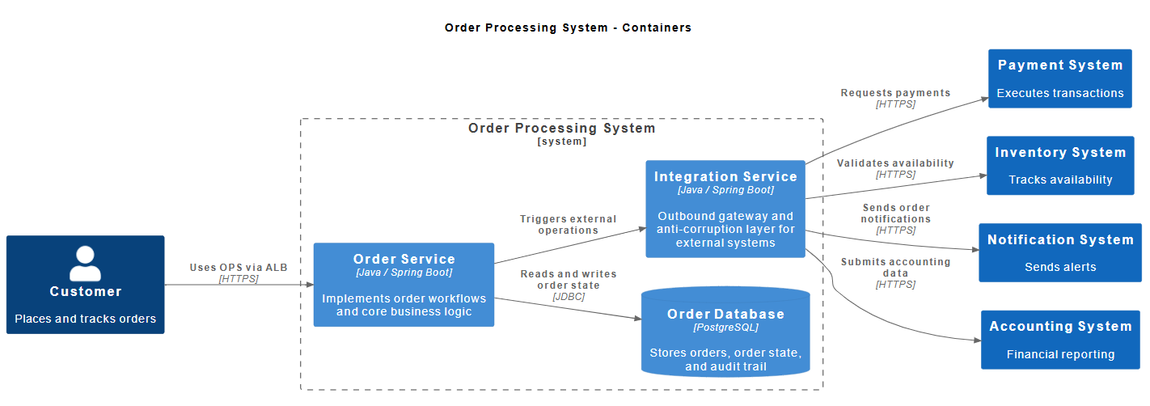
Order Processing System - Overview
Order Processing System provides the following functionalities:
Create Order
Process Order
Track Order Status
Cancel Order

Slide 20
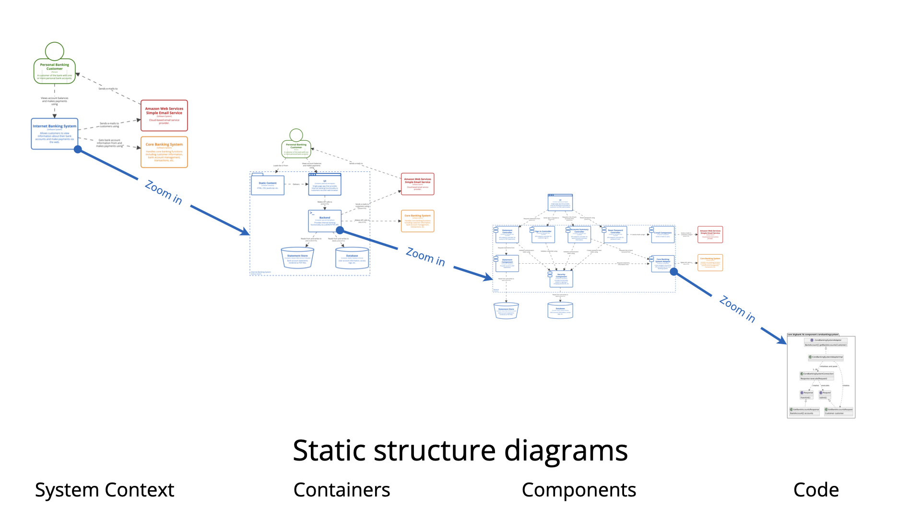
Order Processing System - AaC
Architecture Frameworks / Standards:
Arc42
C4 Model
AaC Tech Stack:
StructurizrDSL
ArchUnit
Structurizr Site Generatr
Markdown
https://c4model.com/diagrams

Slide 21
Benefits of Architecture-as-Code
Traceability
Automation
Consistency
Quality Control
Notes:
Architecture-as-Code provides concrete benefits:
Traceability — decisions are linked to code and infra
Automation — less manual policing
Consistency — fewer accidental divergences
Faster delivery — fewer late architectural surprises
These benefits compound over time. The larger and longer-lived the system, the higher the return.

Slide 22
Cost / Trade-Offs of Architecture-as-Code
Learning Curve
Cultural Shift
Initial Overhead
Upfront thinking
Tooling Jungle
Notes:
Architecture-as-Code is not free.
It introduces:
• upfront thinking
• stricter discipline
• tooling investment
But the cost of not doing it
is architectural entropy.
Balanced, credible, honest.

Slide 23
Key Takeaways
Architecture becomes powerful when it is executable — not just readable.
Architecture is no longer static — it is iterative, measurable, and versioned.
Architecture-as-Code connects design → validation → deployment → documentation
Notes:
Architecture-as-Code:
• reduces drift
• improves alignment
• enables validation
• scales better than documents
It does not replace architects — it amplifies them.

Slide 24
What to do next?
Start small. Do not start with everything
Create an architectural model with some tool
Try some diagram-as-code tool
Try some ADR tool

Slide 25
Closing Thought
Architecture is a system of decisions.
Code lets those decisions live, evolve, and improve.

Slide 26



Contacts:
https://www.linkedin.com/in/tsvetanv/
https://github.com/tsvetanv

Slide 27
Resources
AaC resources:
Simon Brown: https://simonbrown.je/
Conference Paper “Architecture as Code”, Alessio Bucaioni & etc
Conference: 2025 IEEE 22nd International Conference on Software Architecture (ICSA)
https://www.researchgate.net/publication/394538438_Architecture_as_Code
Demo:
Oreder System – Project Board: https://github.com/users/tsvetanv/projects/4
Order System – Architecture: https://github.com/tsvetanv/order-system-architecture
Order System – Services: https://github.com/tsvetanv/order-system-services
Order System – Infrastructure: https://github.com/tsvetanv/order-system-infrastructure

