Slide 1
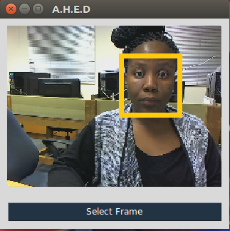

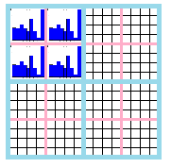
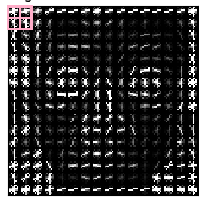



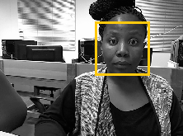
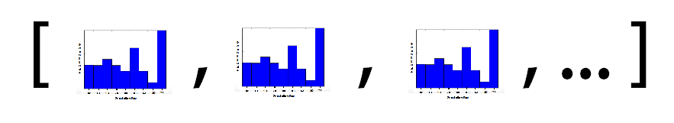
Emotion Classification
Capture Frame
Viola-Jones Face Detection
Histogram of Oriented Gradients for feature extraction
Linear SVM for training

Slide 2
Emotion Classification
Train Machine Learning Technique
Capture Frame from camera
Face Detection
Feature Extraction

