Slide 1

Game Day ad analytics
2023
2.24.23

Slide 2
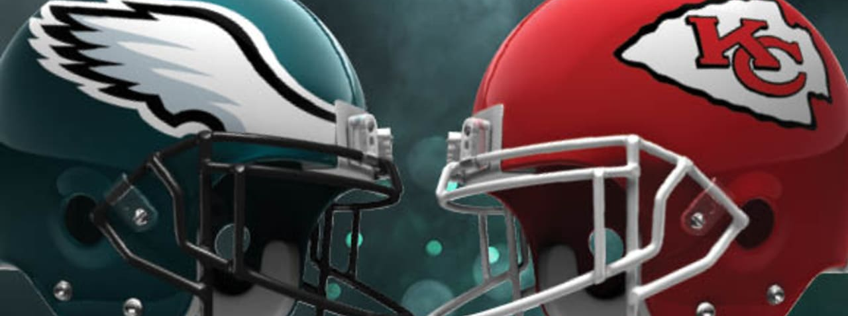
Agenda
INTRODUCTION
DATA CLEANING OVERVIEW
CONSUMER AND BRAND-FACING ANALYSES
FINAL RANKINGS
RECOMMENDATIONS AND TAKEAWAYS

Slide 3
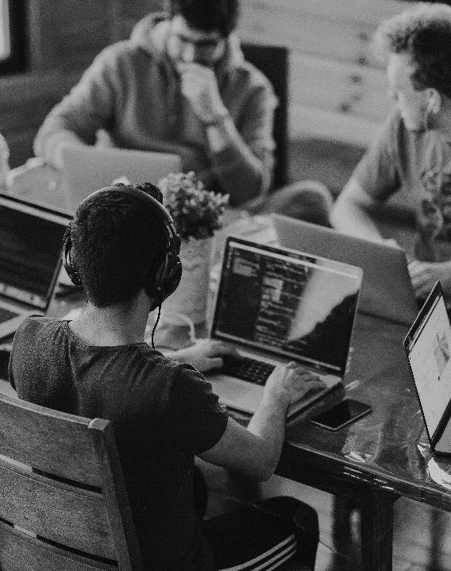
INTRODUCTION
The average cost of an ad during the Super Bowl is $7 million
Over 113 million viewers in 2023
Fox is estimated to have paid more than $1 billion for broadcasting rights

Slide 4

Data cleaning + transformation
Let’s Dive In

Slide 5
General overview
Familiarity/Exploration
Cleaning
Acquisition
Transformation

Slide 6

Familiarity and Cleaning
Understand Data in Each Column
Remove Unnecessary Columns
Remove Rows with Important Nulls
Change Time Stamp
Address Duplicate/Local Ads
Remove Non-English Tweets

Slide 7
Acquisition and Transformation
Establish Hypotheses
Begin Research
Reduce to Brand-Tweet Level
Group by Brand
Join Brand-Level with Acquired Data
Perform Analyses at this Level

Slide 8
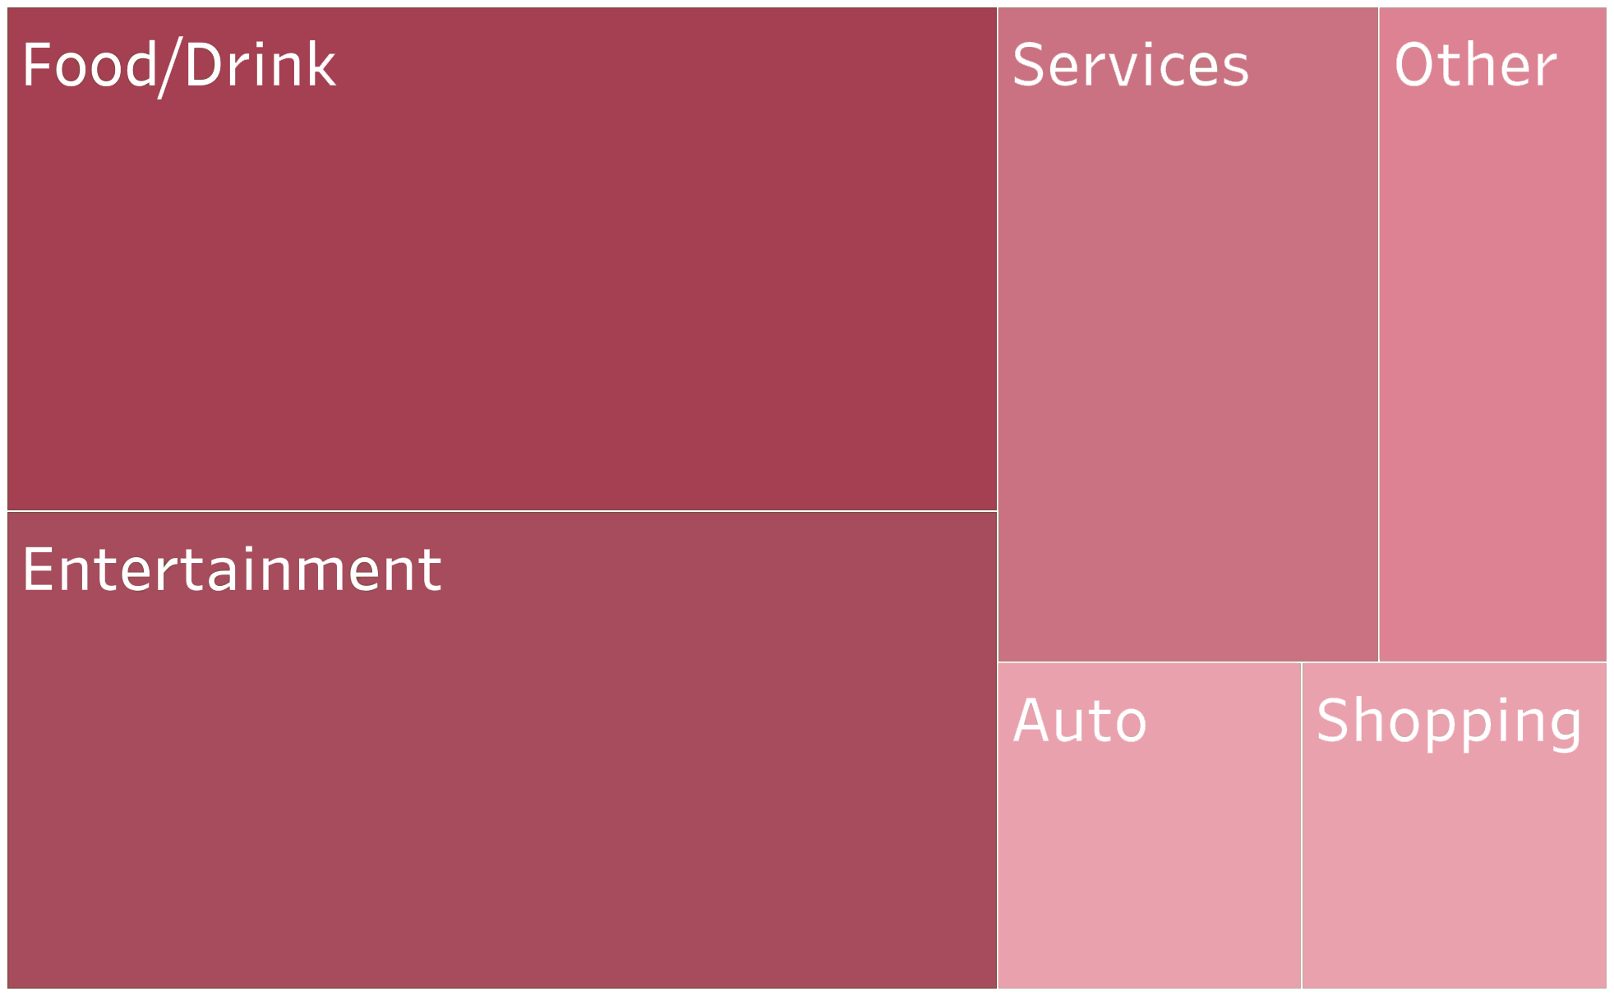
Summary statistics
Food/Drink and Entertainment were by far the two largest industries
Food/Drink: Anheuser-Busch, Doritos, and Pepsi
Entertainment: The Flash and Indiana Jones, but also U2’s concert, Disney, and Amazon Studios
Auto and Shopping ads had less presence
20
10
6
19
4
4

Slide 9
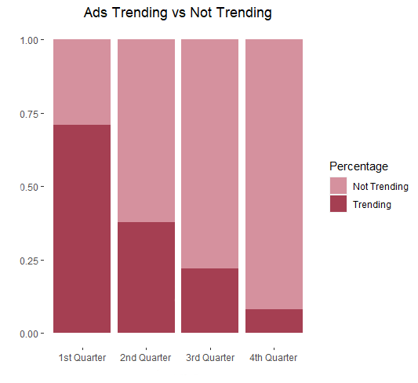
Summary statistics
71% of ads began trending in the first quarter, dropping to only 8% by the 4th quarter
Indicates to advertising brands that the ideal ad should air earlier on
Price discrimination could be easily deployed by the broadcasting network

Slide 10
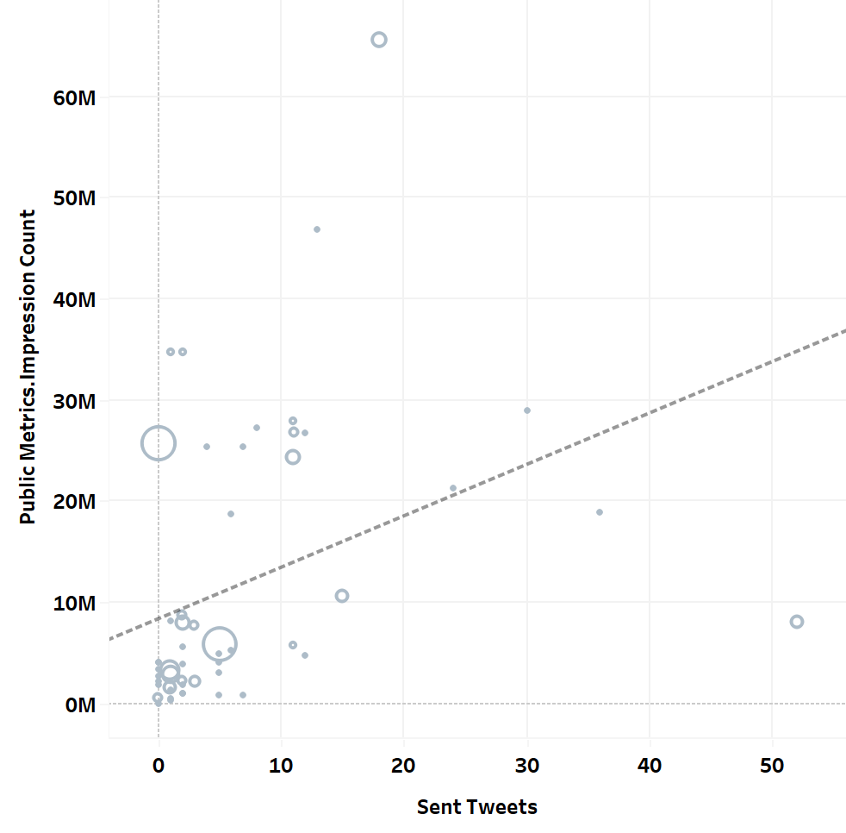
Summary Statistics
For every tweet sent out by an advertising brand during the game, the number of impressions increased by 508,602 on average
Comedy ads hold highest share at 68%, with heartfelt ads being the least present
Genre | Percentage
Comedy | 68%
Normal | 21%
Heartfelt | 11%

Slide 11
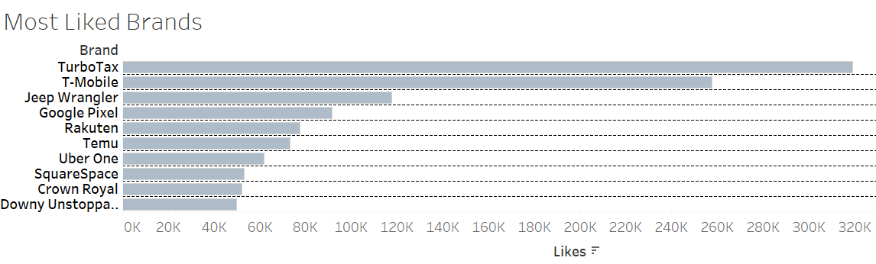
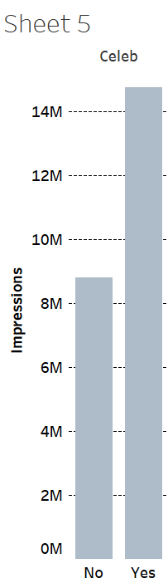
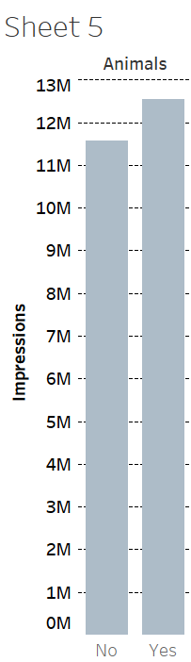
Consumer-Facing
People loved celebrities, but featuring an animal had much less impact
40% of companies sustained a 5+ percentage-point jump in interest capture
6 companies of over $50B market cap scored top 10 in overall Twitter engagement

Slide 12
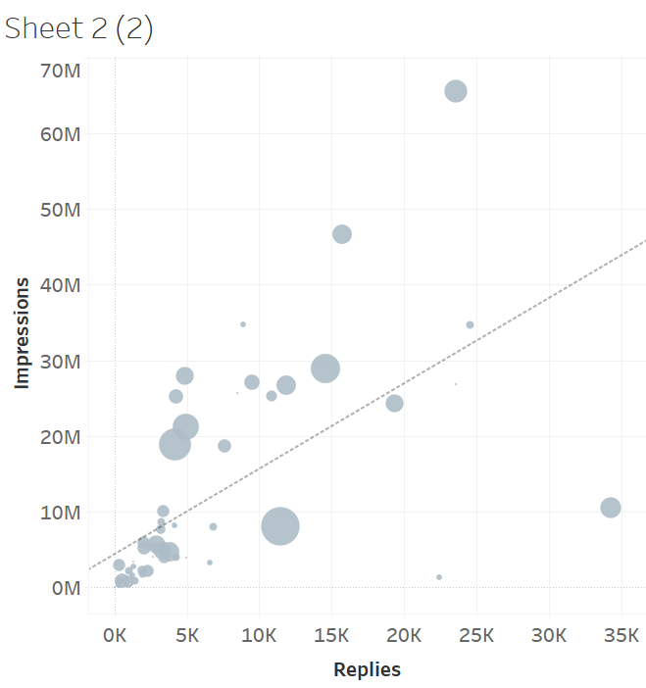
Business-Facing
Positive correlation between number of replies and number of impressions
Outliers: Avocados from Mexico- high reply count but low impressions

Slide 13
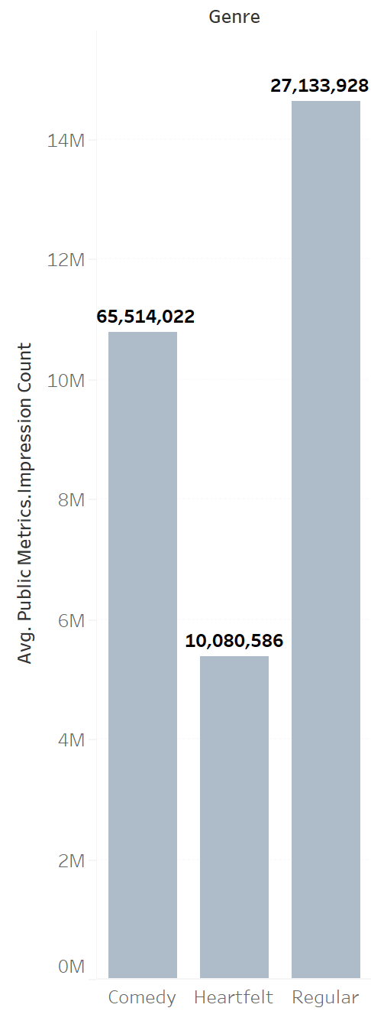
Business-Facing
Average vs. Maximum values:
Regular ads saw a higher average but a lower maximum value, implying less spread and less risk
Comedy ads saw a lower average count but about three times the maximum value
Regular ads considered safe bets while comedic ads considered high risk high reward

Slide 14
Aggregate Rankings
Change in Interest Capture
2. Campaign Regression Estimates
3. Ad-Attributable Revenue

Slide 15
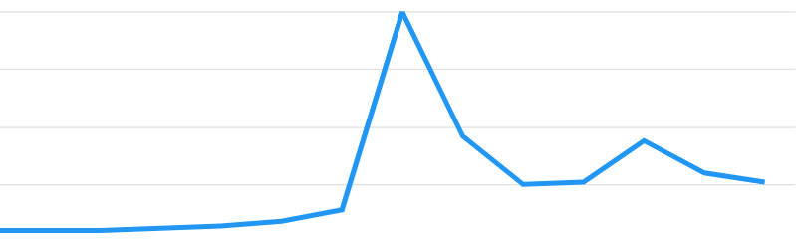

Change in Interest Capture

Slide 16
Predicted Campaign
What's the genre?
What was the runtime?
Did it have an animal or celebrity?
How many impressions?
What industry was marketed?

Slide 17
Attributable Revenue Increase (%)
We can predict how much of additional revenue is directly attributable to an ad
Using industry-specific conversion rates, differentials, and existing revenue patterns

Slide 18
Final STANDINGS
 | Differentials | Regression Estimates | Ad-Attributable Revenue
T-Mobile | 0 | 9 | 9
PopCorners | 10 | 0 | 7
Avocados From Mexico | 8 | 0 | 6

Slide 19
KEY FINDINGS
STAR POWER MATTERS
Expect 6 million additional impressions
THE EARLIER, THE BETTER
Viewer engagement diminishes rapidly as the game progresses
COMMUNITY ENGAGEMENT PAYS OFF
Companies earned an average of 508k more impressions for every outgoing tweet
GENRE DEPENDS ON COMPANY SIZE
Comedic ads are high-risk/high-reward- a small company will likely prefer the more stable option of running an ad in the typical genre

Slide 20
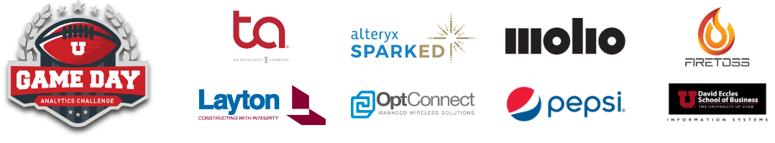
THANK YOU

