Slide 1
Data Science Quest I
Ernst & Young Data and Analytics (DnA)
Tan Swee Ying
HP: 9182 0922
Email: tsying95@gmail.com

Slide 2
Instructions to build and run the solution
1. Go to https://www.python.org/downloads/
Install Python 3.7
2. Open CMD (Windows)/Terminal (Linux) with admin/root privileges and run the following command:
3. cd to the folder location where solution is saved in:
4. Run
5. Open iris_EDA_ML_tansweeying.ipynb in your browser
pip install jupyter pandas numpy seaborn scikit-learn -U
cd C:\Users\<YOUR COMPUTER NAME>\Desktop\datasciencequest_tansweeying
jupyter notebook

Slide 3
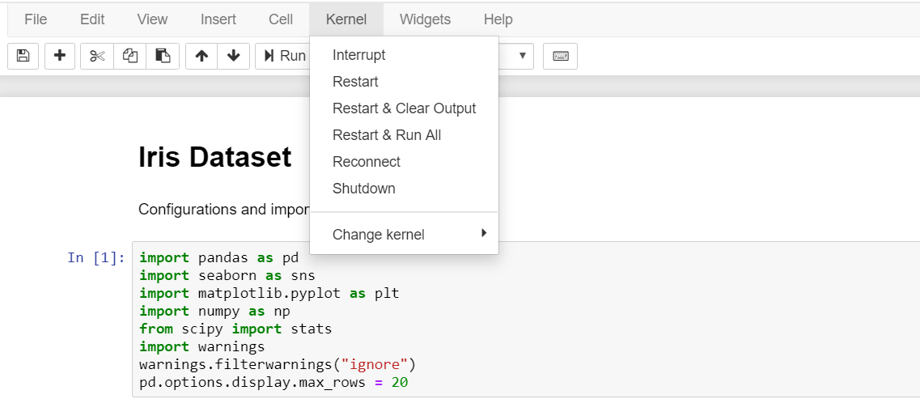
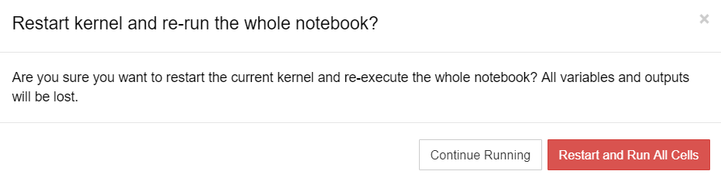
6. When jupyter notebook is opened,
Press Kernel> Restart & Run All
7. A prompt will appear, press Restart and Run All Cells

Slide 4
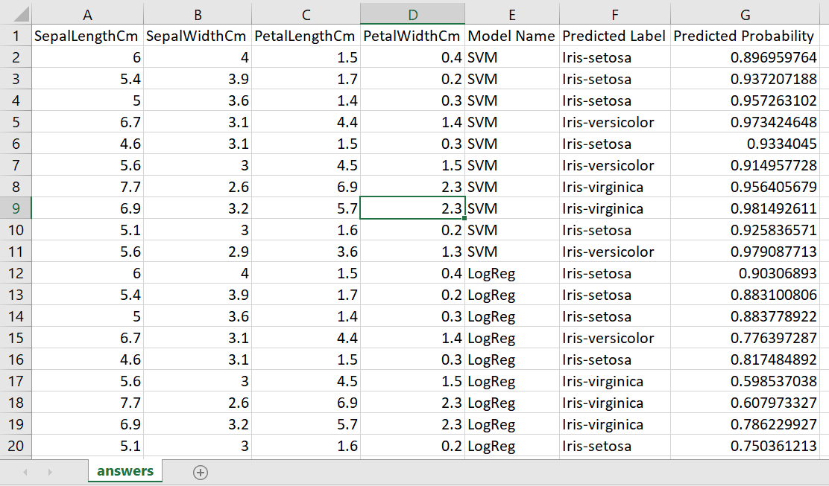
8. A output file answers.csv with the prediction labels and probabilities will be generated at the end of the program

Slide 5
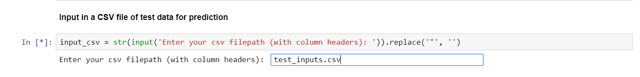
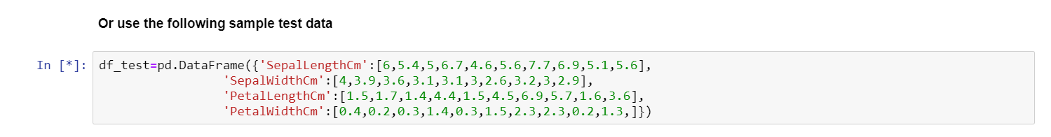
Testing Methodology
I created a sample input data set for testing (found in the folder)
Alternatively, if you wish to use the df_test provided, without input file, just press enter and the program will use the following set of test data

Slide 6
Storyline of solution
Data Analysis
Getting rid of outliers
Find correlations
Model Training
Support Vector Machine (SVM)
Logistic Regression
Evaluation
Decision Tree
K-Nearest Neighbours
Data analysis with graph plot
DataFrame with label prediction and accuracy

Slide 7
Further Exploration
Current approach is supervised machine learning
So it is possible to explore
Dimensionality Reduction
Principal Component Analysis – By reducing the dimensionality of Iris data (currently four features -> two features) it will be easier to visualize the data set
But need to find a suitable lower-dimensional representation that retains the essential features of the data
This can be explored using Weight of Evidence (WOE) and Information Value (IV) to remove highly correlated variables

