Slide 1


In harmony
with others
Amgalan Tsyritoron

Slide 2


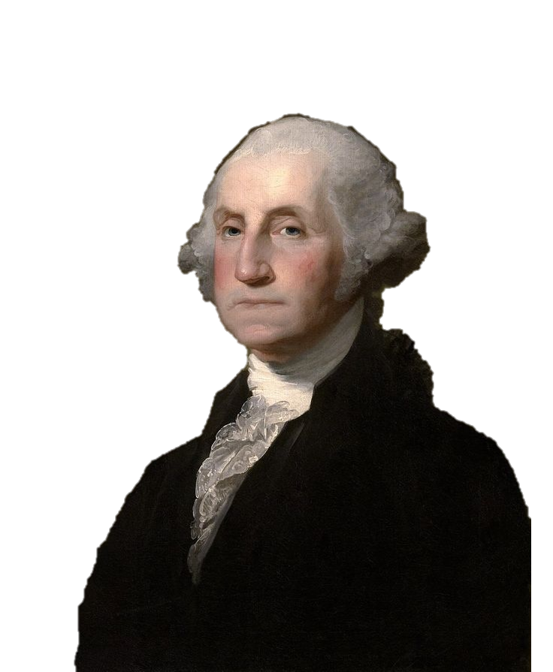
Observe good faith and justice toward all nations. Cultivate peace and harmony with all

Slide 3

In my opinion
You can't be happy if you're not in harmony with the people around you. Living in harmony with the people around you sounds easy, but it's actually hard to do, especially in a world full of conflict and disaster. People may have different opinions, and it may be difficult for you to feel in harmony with people close to you and with society in general.

Slide 4




Ways to find harmony
with others
Maintain your harmony with yourself
Be friendly and sociable with others
Overcome differences and disagreements
Establish good contacts with other people
Work for the benefit of other people

Slide 5

You should start by connecting with friends, family, partners, and neighbours. Focus on dealing with any disharmony in your life in a generous way with people in your community. Make sure you also maintain your own personal sense of harmony, because it will help you feel in harmony with others.

Slide 6

Be open to compromise. Sometimes, things just don't go your way. You may need to find common ground with someone you do not agree with or let go of your pride and accept a compromise.
Spend time with good friends to stay in touch with them and not get lost.
Try to make the time spent with your family meaningful and memorable.

Slide 7

Help a neighbor, friend, or family member in need. Take care of others by offering them help when they need it. Help them without expecting a return favor or reward in order to feel a more noble connection with them.

Slide 8

These little pieces of advice can help you be in harmony with people around you.

Slide 9



