Slide 1
Applying Natural Language Processing to Scientific Articles Data
Peter Tsyurmasto
NYC Data Science Academy: Web Scraping Project

Slide 2
Motivation
Over 70 million of scientific articles globally and approximately 2.5 million new articles published every year
Becomes more challenging to effectively search articles in the internet
With overwhelmingly high number of articles, the important questions that researchers face when studying the new area:
What are most influential articles / authors on a certain topic?
Give me N classic papers/authors that cover the area
What keywords should be used
What topics are popular and worth studying
Extract topics from article titles and abstracts
Automation

Slide 3
Scientific Articles Data Python Scrapy
Scraped most influential scientific publications in the area of machine learning from two websites:
Journal of Machine Learning Research – leading scientific journal in ML: http://www.jmlr.org/
Neural Information Processing Systems (NIPS) – leading conference in ML: https://nips.cc/
Using Python Scrapy, downloaded in total 10,017 articles:
Authors, Title, Year, Volume, Journal/Conference, Abstract, PDF_URL
Articles published over 1987 – 2018 years

Slide 4
Scientific Articles Data Python Scrapy
Scraped most influential scientific publications in the area of machine learning from two websites:
Journal of Machine Learning Research – leading scientific journal in ML: http://www.jmlr.org/
Neural Information Processing Systems (NIPS) – leading conference in ML: https://nips.cc/
Using Python Scrapy, downloaded in total 10,017 articles:
Authors, Title, Year, Volume, Journal/Conference, Abstract, PDF_URL
Articles published over 1987 – 2018 years

Slide 5
Citations Data Python Selenium
Applied Python Selenium to scrape Google Scholar website:
Number of citations for each article
title, number of citations
All authors that appeared in articles
google_scholar_id, name, number of citations, h_index
Challenges: searching on 10,000 titles with multiple authors and fields is a not an easy task
Google Scholar detects and blocks Selenium after 10-15 requests
Attempted to use proxies to avoid being detected but still was detected
Process is very slow – it takes an estimated of 48 hours to download all the data

Slide 6
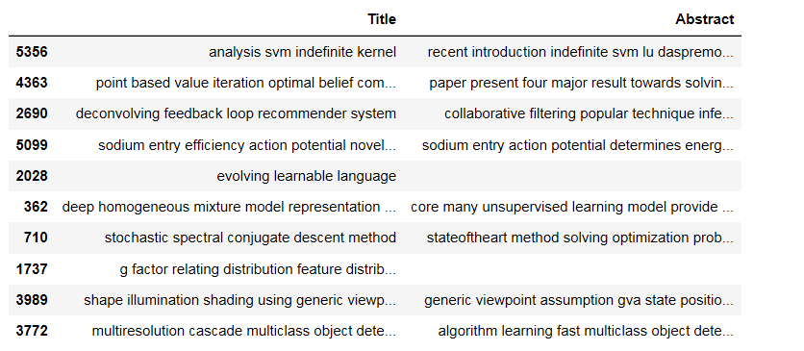
Natural Language Processing Data Preprocessing
Raw Text Data:
Title, Abstract
Processed Text
Convert to Lowercase
Remove Punctuations
Remove Stopwords
Lemmatize Text

Slide 7
Natural Language Processing What are the Most Popular Authors by Number of Articles?

Slide 8
Natural Language Processing What are the Most Popular Words in Title? N-Grams (N = 1)

Slide 9
Natural Language Processing What are the Most Popular Word Pairs in Title? N-Grams (N = 2)

Slide 10
Natural Language Processing What are the Most Popular Word Triplets in Title? N-Grams (N = 3)

Slide 11
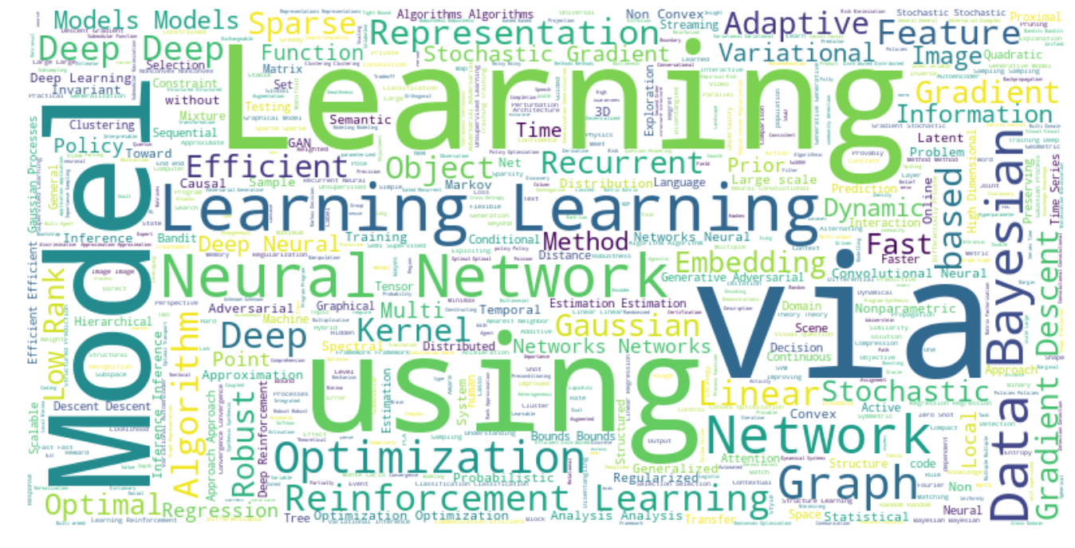
Natural Language Processing Word Cloud - 2018

Slide 12
Future Work
==

