Slide 1
Applying Natural Language Processing to Scientific Articles Data
Peter Tsyurmasto
NYC Data Science Academy: Web Scraping Project

Slide 2
Motivation
Over 70 million of scientific articles globally and approximately 2.5 million new articles published every year
Becomes more challenging to effectively search articles in the internet
With overwhelmingly high number of articles, the important questions that researchers face when studying the new area:
What are most influential articles / authors on a certain topic?
Give me N classic papers/authors that cover the area
What keywords should be used
What topics are popular and worth studying
Extract topics from article titles and abstracts
Automation

Slide 3
Scientific Articles Data Python Scrapy
Scraped most influential scientific publications in the area of machine learning from two websites:
Journal of Machine Learning Research – leading scientific journal in ML: http://www.jmlr.org/
Neural Information Processing Systems (NIPS) – leading conference in ML: https://nips.cc/
Using Python Scrapy, downloaded in total 10,017 articles:
Authors, Title, Year, Volume, Journal/Conference, Abstract, PDF_URL
Articles published over 1987 – 2018 years

Slide 4
Scientific Articles Data Python Scrapy
Scraped most influential scientific publications in the area of machine learning from two websites:
Journal of Machine Learning Research – leading scientific journal in ML: http://www.jmlr.org/
Neural Information Processing Systems (NIPS) – leading conference in ML: https://nips.cc/
Using Python Scrapy, downloaded in total 10,017 articles:
Authors, Title, Year, Volume, Journal/Conference, Abstract, PDF_URL
Articles published over 1987 – 2018 years

Slide 5
Citations Data Python Selenium
Applied Python Selenium to scrape Google Scholar website:
Number of citations for each article
title, number of citations
All authors that appeared in articles
google_scholar_id, name, number of citations, h_index
Challenges: searching on 10,000 titles with multiple authors and fields is a not an easy task
Google Scholar detects and blocks Selenium after 10-15 requests
Attempted to use proxies to avoid being detected but still was detected
Process is very slow – it takes an estimated of 48 hours to download all the data

Slide 6
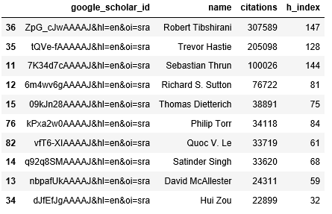
Citations Data What are the Most Cited Authors?
Name matching problem: author’s name is not a unique identifier, multiple authors can have the same name
Each author has a unique identifier google_scholar_id
https://scholar.google.com/citations?user=PoXHiS8AAAAJ&hl=en&oi=ao
Below is a list of authors sorted by number of citations

Slide 7
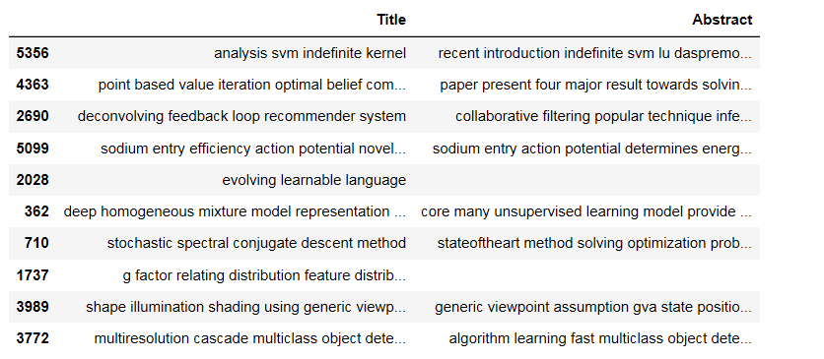
Natural Language Processing Data Preprocessing
Raw Text Data:
Title, Abstract
Processed Text
Convert to Lowercase
Remove Punctuations
Remove Stopwords
Lemmatize Text

Slide 8
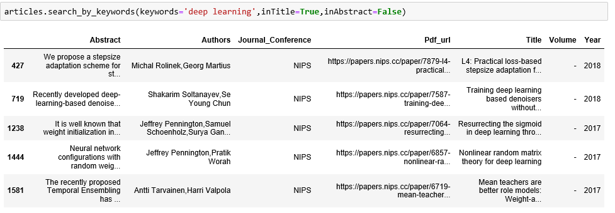
Natural Language Processing Searching Articles by Keywords
For a given keywords in string format – find articles containing it
Optionality of searching in articles titles and abstracts
The articles should be sorted in descending order by number of citations

Slide 9
Natural Language Processing What are the Most Popular Authors by Number of Articles?

Slide 10
Natural Language Processing What are the Most Popular Words in Title? N-Grams (N = 1)

Slide 11
Natural Language Processing What are the Most Popular Word Pairs in Title? N-Grams (N = 2)

Slide 12
Natural Language Processing What are the Most Popular Word Triplets in Title? N-Grams (N = 3)

Slide 13
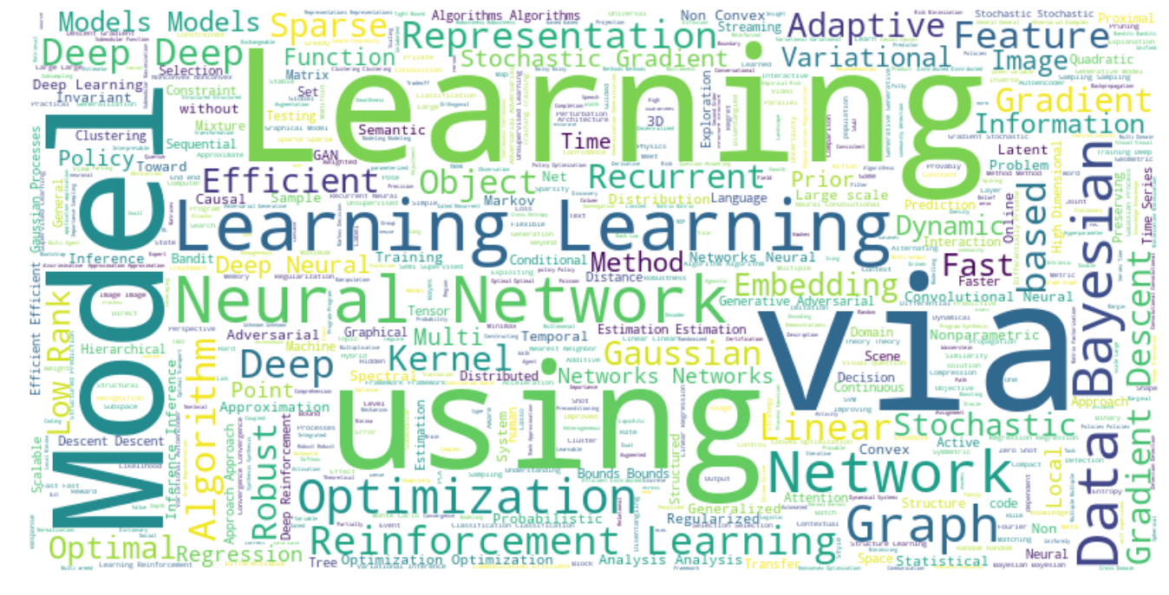
Natural Language Processing Word Cloud - 2018

Slide 14
Future Work
Automate extraction of papers from most prestigious conferences once they appear (e.g. send emails with a link to articles)
Apply machine learning methods for hierarchical topic modeling, e.g., Latent Dirichlet Allocation (LDA) using articles abstracts
Implement a clustering model on articles
Build a recommendation system that selects articles similar to specified based on clusters
Currently searching algorithm is very basic
Implement an advanced version of algorithm ranking articles on different combinations of keywords
Improve scraping of google scholar to avoid being blocked

