Slide 1
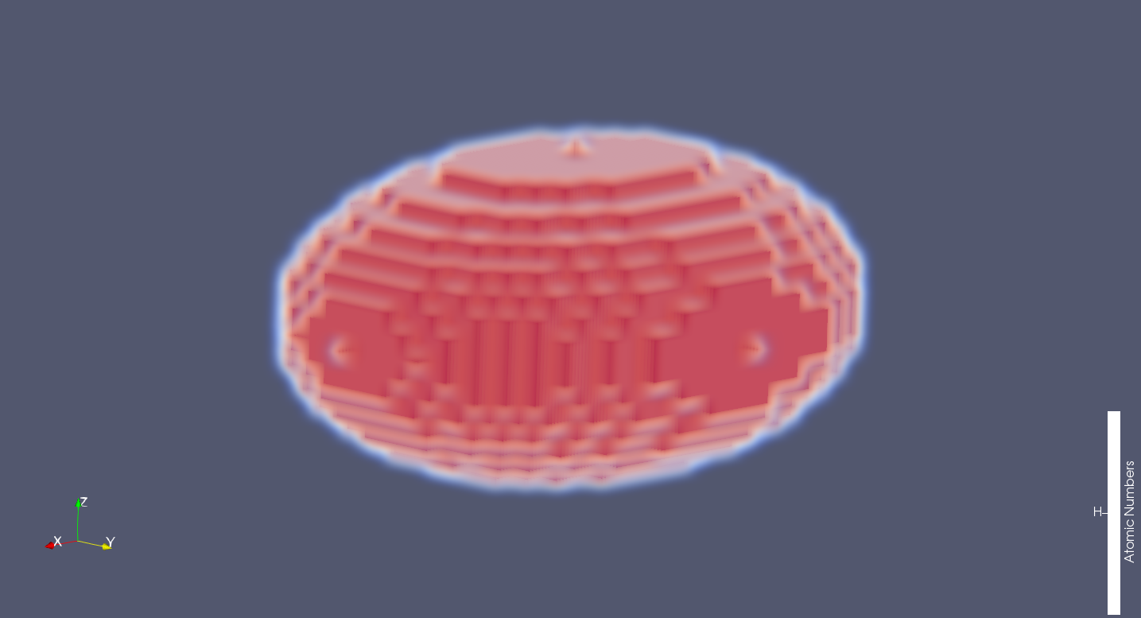
typ_s(x) = 'ellipsoid'
inf_s(x, 1) : Diameter along x-axis.
inf_s(x, 2) : Diameter along y-axis.
inf_s(x, 3) : Diameter along z-axis.
inf_s(x, 3)
inf_s(x, 1)
inf_s(x, 2)
The origin is located on the center of the shape.

Slide 2
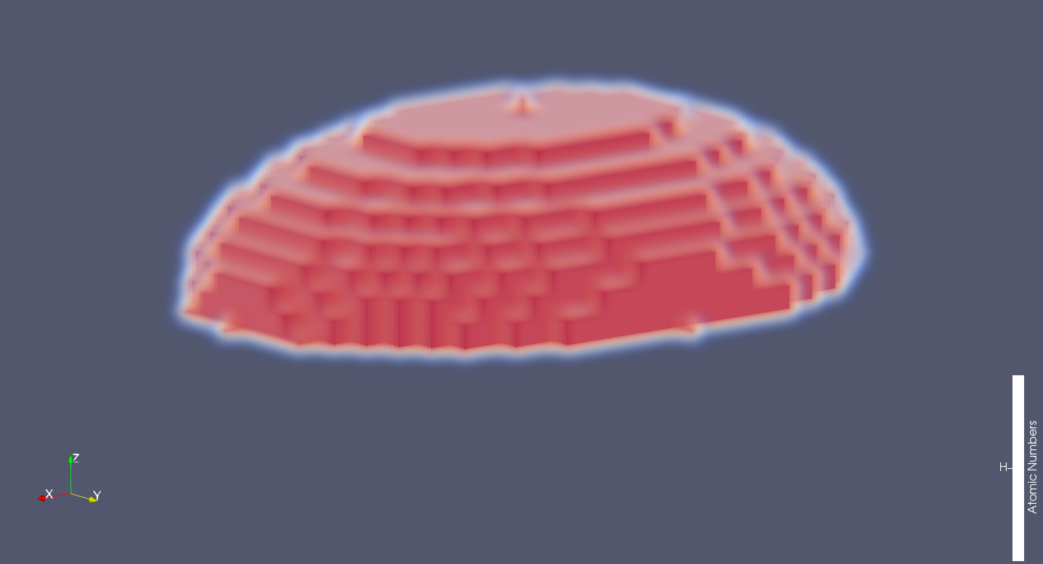
typ_s(x) = 'half-ellipsoid'
inf_s(x, 1) : Diameter along x-axis.
inf_s(x, 2) : Diameter along y-axis.
inf_s(x, 3) : Height(=radius) along z-axis.
inf_s(x, 3)
inf_s(x, 1)
inf_s(x, 2)
The origin along the z axis located below the shape.
(The origin on the xy-plane is located on the center of the ellipsoid)

Slide 3
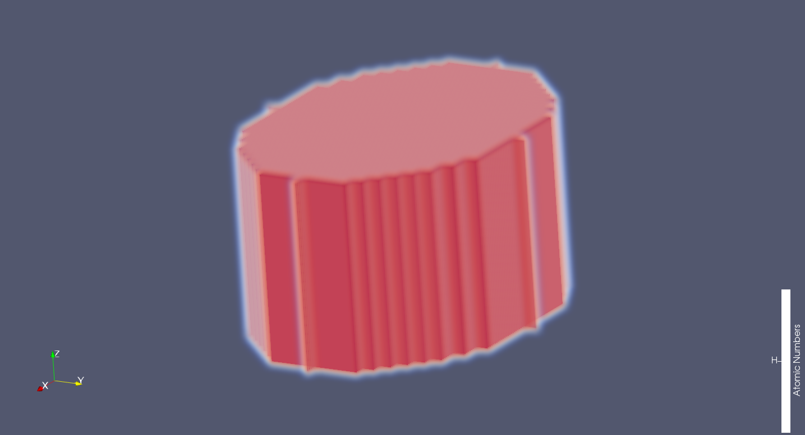
typ_s(x) = 'elliptic-cylinder'
inf_s(x, 1) : Diameter along x-axis.
inf_s(x, 2) : Diameter along y-axis.
inf_s(x, 3) : Side length along z-axis.
inf_s(x, 2)
inf_s(x, 1)
inf_s(x, 3)
The origin is located on the center of the shape.

Slide 4
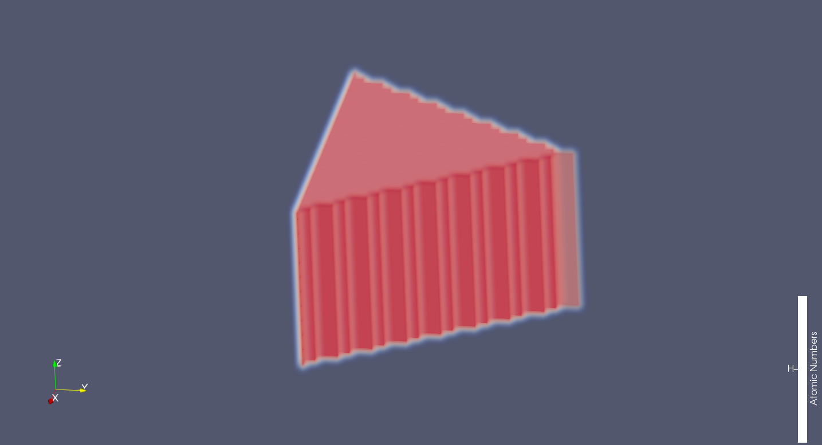
typ_s(x) = 'triangular-cylinder'
inf_s(x, 1) : Side length along x-axis.
inf_s(x, 2) : Height along y-axis.
inf_s(x, 3) : Side length along z-axis.
inf_s(x, 1)
inf_s(x, 2)
inf_s(x, 3)
The origin is located on the center of the shape.
(The origin on the xy-plane is located on the center of the triangle)

Slide 5
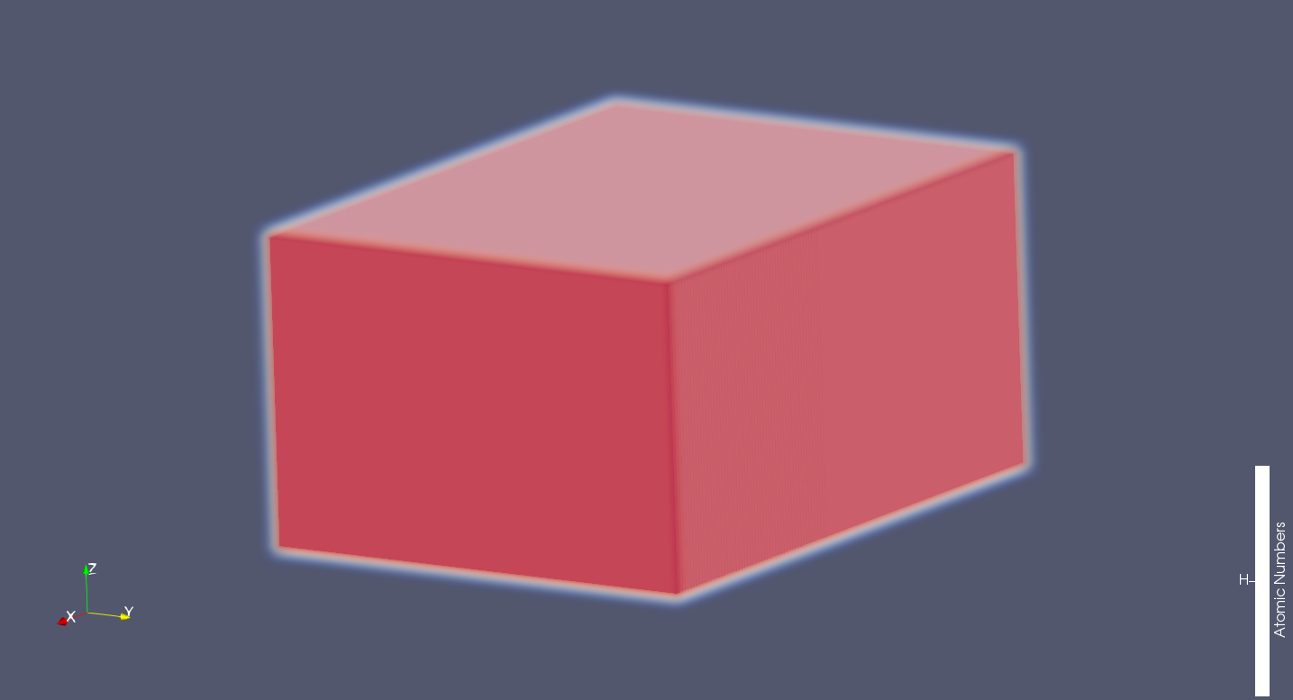
typ_s(x) = 'rectangular-cylinder'
inf_s(x, 1) : Side length along x-axis.
inf_s(x, 2) : Side length along y-axis.
inf_s(x, 3) : Side length along z-axis.
inf_s(x, 1)
inf_s(x, 3)
inf_s(x, 2)
The origin is located on the center of the shape.

Slide 6
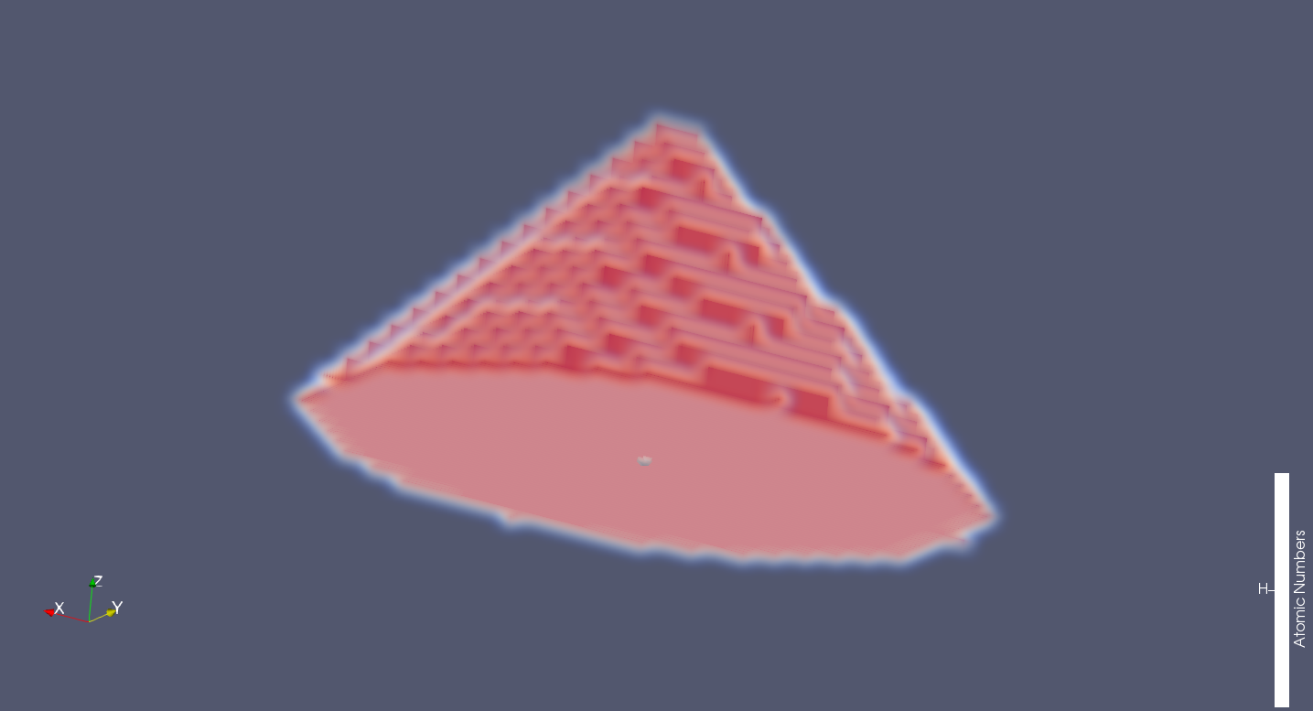
typ_s(x) = 'elliptic-cone'
inf_s(x, 1) : Diameter along x-axis.
inf_s(x, 2) : Diameter along y-axis.
inf_s(x, 3) : Height along z-axis.
inf_s(x, 3)
inf_s(x, 1)
inf_s(x, 2)
The origin along the z axis located below the shape.
(The origin on the xy-plane is located on the center of the ellipsoid)

Slide 7
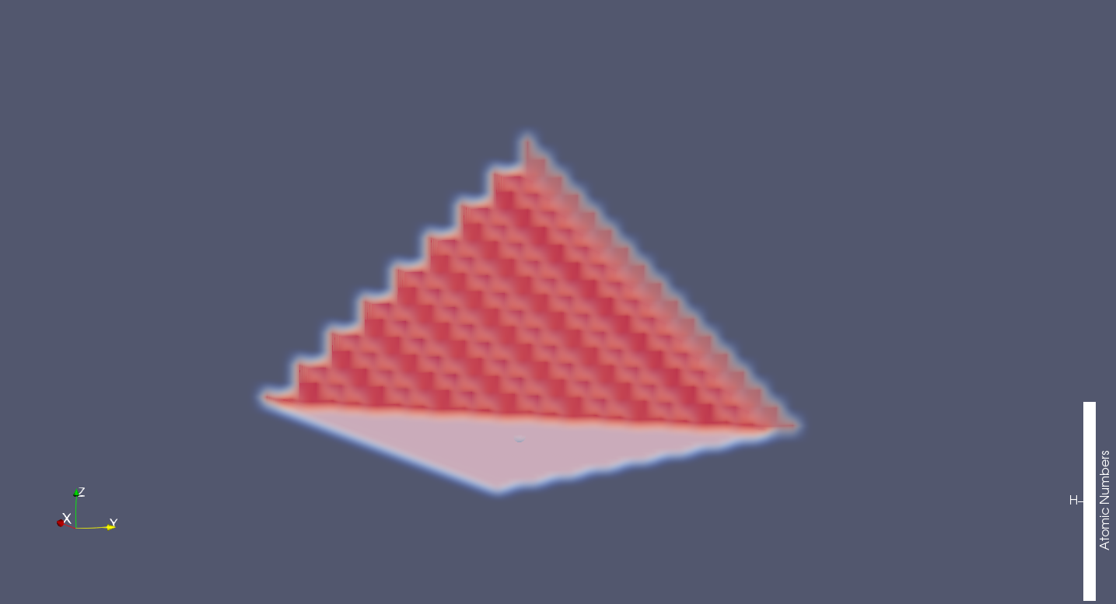
typ_s(x) = 'triangular-cone'
inf_s(x, 1) : Side length along x-axis.
inf_s(x, 2) : Height along y-axis.
inf_s(x, 3) : Height along z-axis.
inf_s(x, 3)
inf_s(x, 1)
inf_s(x, 2)
The origin along the z axis located below the shape.
(The origin on the xy-plane is located on the center of the triangle)

Slide 8
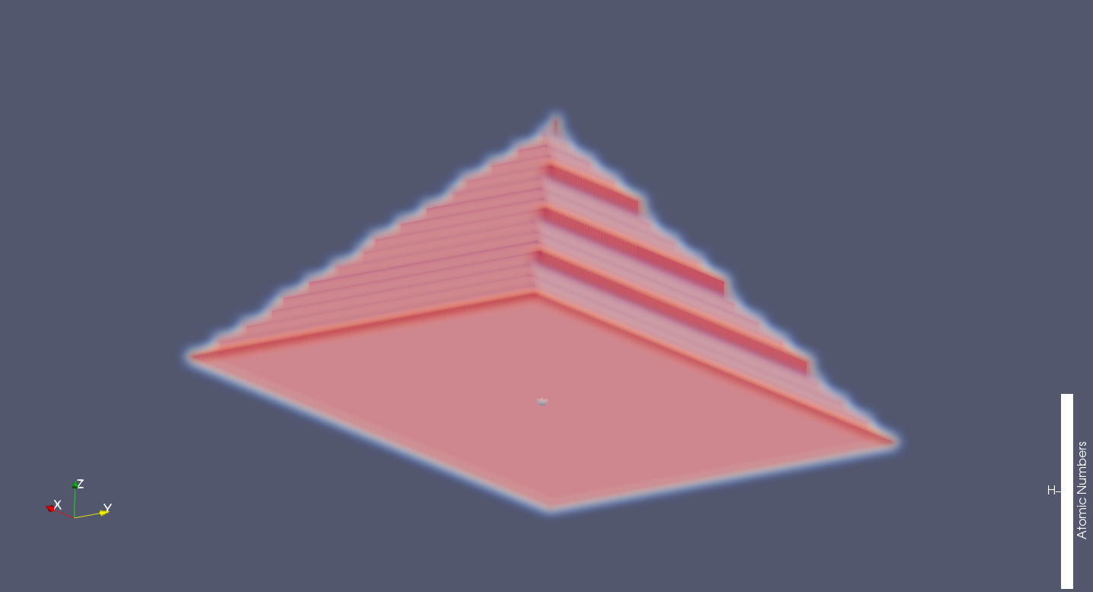
typ_s(x) = 'rectangular-cone'
inf_s(x, 1) : Side length along x-axis.
inf_s(x, 2) : Side length along y-axis.
inf_s(x, 3) : Height along z-axis.
inf_s(x, 3)
inf_s(x, 1)
inf_s(x, 2)
The origin along the z axis located below the shape.
(The origin on the xy-plane is located on the center of the rectangle)

Slide 9
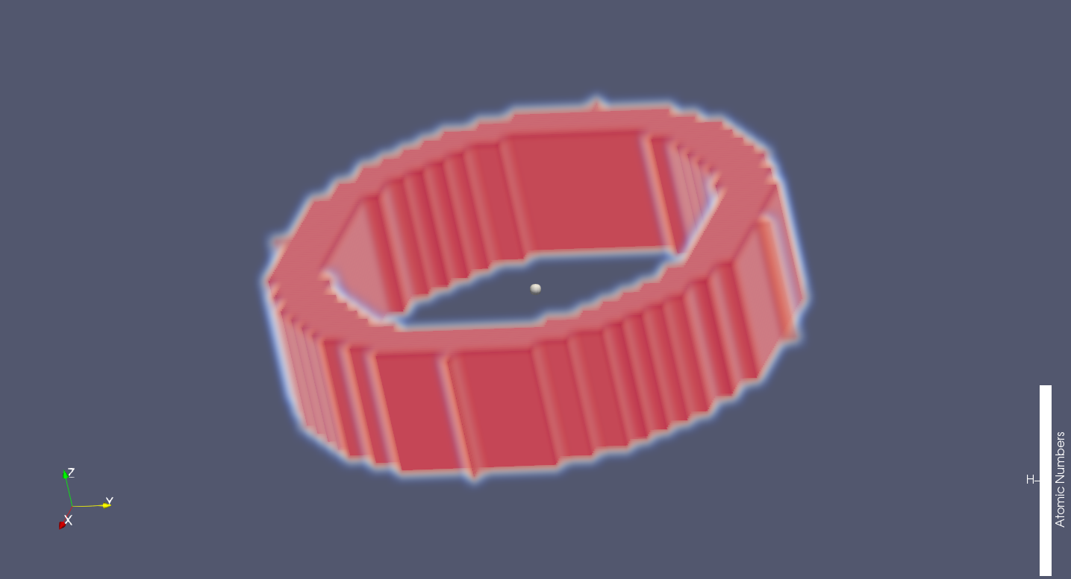
typ_s(x) = 'elliptic-ring'
inf_s(x, 1) : Outer diameter along x-axis.
inf_s(x, 2) : Outer diameter along y-axis.
inf_s(x, 3) : Side length along z-axis.
inf_s(x, 4) : Inner diameter along x-axis.
inf_s(x, 5) : Inner diameter along y-axis.
inf_s(x, 5)
inf_s(x, 3)
inf_s(x, 2)
inf_s(x, 4)
inf_s(x, 1)
The origin is located on the center of the shape.

