Slide 1
🌍
EarthSafe
Real-Time Earthquake Hazard Prediction
STAT 418 · UCLA · Spring 2026 · Yutong Ma
🔗 earthsafe-eu9o2sytymwqnls48ppjg7.streamlit.app
⚙️ Flask API · POST /predict · GET /recent

Slide 2
Project Overview & Motivation
The Problem
Hazard Levels
Every year ~55,000 earthquakes of M≥2.5 occur globally. USGS publishes the data in real time — but it's raw, technical numbers most people cannot act on.
EarthSafe turns seismic parameters into a clear hazard level: Low, Moderate, or High.
🟢 Low
Magnitude < 4.0 · Minor shaking, rarely felt
🟡 Moderate
Magnitude 4.0–6.0 · Widely felt, possible minor damage
55,000+
2,000
5
M≥2.5 quakes
per year (global)
records collected
USGS 2023-2024
input features
for prediction
🔴 High
Magnitude ≥ 6.0 · Strong shaking, significant damage

Slide 3
Data Collection & Preprocessing
Data Pipeline
Class Distribution
01
USGS API Fetch
Monthly chunks · M≥2.5 · 2023–2024 · 2,000 records
02
Feature Engineering
location_type from place text · impute gap (103 nulls with median)
03
Hazard Labeling
Rule-based: Low <4.0 · Moderate 4–6 · High ≥6.0
04
Stratified CV Split
5-fold cross-validation, stratified by hazard class
⚠️ High class: only 7 records (M≥6.0 events are rare). Handled with balanced sample weights in training.

Slide 4
Model Development & Evaluation
5-Fold Cross-Validation Results
🏆 Best Model
🏆 Best Model
XGBoost
XGBoost
Accuracy 99.95% · Macro F1 1.00
Accuracy 99.95% · Macro F1 1.00
300 trees · depth 6 · lr 0.05 · sample_weight balanced
300 trees · depth 6 · lr 0.05 · sample_weight balanced
Feature Importance
magnitude
82%
depth
7%
gap
5%
rms
4%
location_type
2%

Slide 5
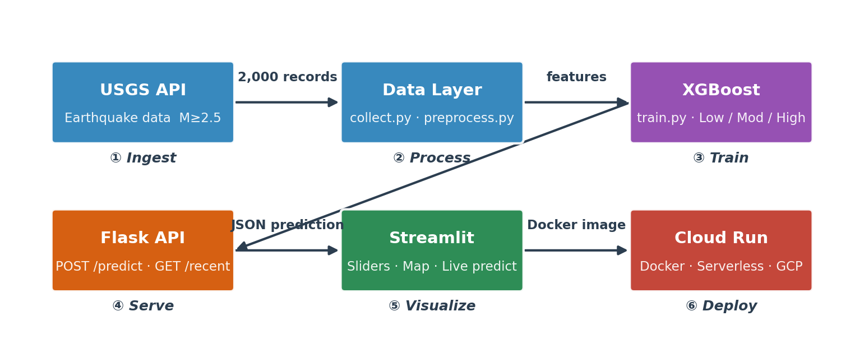
Solution Architecture
Python 3.11
XGBoost 2.0
Flask 3.0
Streamlit 1.35
Plotly 5.20
Docker
Cloud Run

Slide 6
App Features & Live Demo
🎚️
Interactive Sliders
⚡ Flask REST API
Drag magnitude, depth, gap, RMS, location type — hazard level updates instantly
POST /predict
{"magnitude": 7.0, "depth": 10,
"gap": 90, "rms": 0.3, "location_type": 0}
→ {"hazard_label": "High",
"color": "#e74c3c",
"probabilities": {...}}
🗺️
Live Earthquake Map
Plotly globe · live USGS data · color-coded by hazard · auto-refreshes every 5 min
🌐
USGS Live Proxy
GET /recent — last 24h quakes for the map
📊
Probability Display
🐳
Docker + Cloud Run
Confidence scores for each class + magnitude gauge chart
Containerised · serverless · live June 2–9
⚙️ Flask API · POST /predict · GET /recent
🔄
Auto-Refresh
Map updates every 5 min via cache_data TTL
🔗 earthsafe-eu9o2sytymwqnls48ppjg7.streamlit.app

Slide 7
Challenges, Learnings & Future Work
⚡
Class Imbalance — 7 High records out of 2,000
Port 5000 → 5001 — macOS AirPlay conflict
brew install libomp — XGBoost on Mac
Challenges
💡
End-to-End MLOps — data → model → API → cloud
Macro F1 > Accuracy — right metric for imbalanced classes
Claude AI — code, debug & deploy at every layer
Learnings
🚀
Temporal Features — aftershock sequences
USGS WebSocket — sub-second map updates
Magnitude Regression — early warning potential
Future Work
EarthSafe · STAT 418 · Yutong Ma · UCLA Spring 2026

