Slide 1
🌍
EarthSafe
Real-Time Earthquake Hazard Prediction
STAT 418 · UCLA · Spring 2026 · Yutong Ma
🔗 earthsafe-eu9o2sytymwqnls48ppjg7.streamlit.app
⚙️ Flask API · POST /predict · GET /recent

Slide 2
Project Overview & Motivation
The Problem
Hazard Levels
Every year ~55,000 earthquakes of M≥2.5 occur globally. USGS publishes the data in real time — but it's raw, technical numbers that most people cannot act on.
EarthSafe translates seismic parameters into a clear hazard level: Low, Moderate, or High.
🟢 Low
Magnitude < 4.0 · Minor shaking, rarely felt
🟡 Moderate
55,000+
2,000
5
Magnitude 4.0–6.0 · Widely felt, possible minor damage
M≥2.5 quakes
per year (global)
records collected
USGS 2023-2024
input features
for prediction
🔴 High
Magnitude ≥ 6.0 · Strong shaking, significant damage

Slide 3
Data Collection & Preprocessing
Data Pipeline
Class Distribution
01
USGS API Fetch
Monthly chunks · M≥2.5 · 2023–2024 · 2,000 records
02
Feature Engineering
location_type from place text · impute gap (103 nulls with median)
03
Hazard Labeling
Rule-based: Low <4.0 · Moderate 4–6 · High ≥6.0
04
Stratified CV Split
5-fold cross-validation, stratified by hazard class
⚠️ High class: only 7 records (M≥6.0 events are rare). Handled with balanced sample weights in training.

Slide 4
Model Development & Evaluation
🏆 Best Model
XGBoost
Accuracy 99.95% · Macro F1 1.00
300 trees · depth 6 · lr 0.05 · sample_weight balanced
Feature Importance
magnitude
82%
depth
7%
gap
5%
rms
4%
location_type
2%

Slide 5
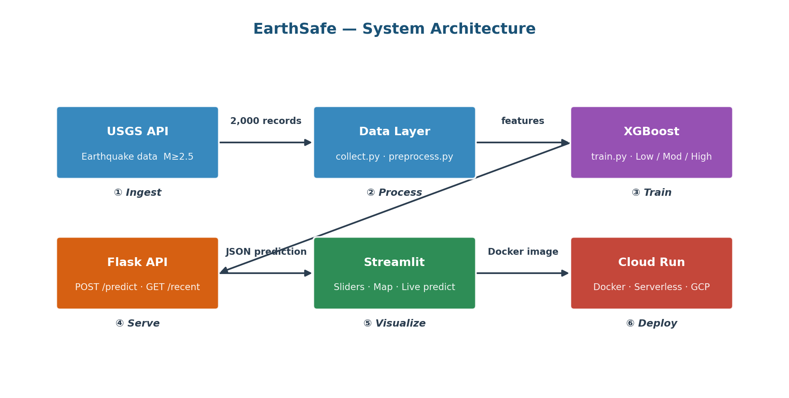
Solution Architecture
Python 3.11
XGBoost 2.0
Flask 3.0
Streamlit 1.35
Plotly 5.20
Docker
Cloud Run

Slide 6
App Features & Live Demo
🎚️
Interactive Sliders
🗺️
Live Earthquake Map
📊
Probability Display
Drag magnitude, depth, gap, RMS, location type — hazard level updates instantly
Plotly globe with live USGS data, color-coded by hazard, auto-refreshes every 5 min
Confidence scores for each class, progress bars, magnitude gauge chart
⚡
Flask REST API
🌐
USGS Live Proxy
🐳
Docker + Cloud Run
POST /predict returns hazard_label, probabilities, hex color in JSON
GET /recent fetches last 24h earthquakes in real time for the map feed
Containerised, serverless deployment — app stays live June 2 to June 9

Slide 7
Challenges, Learnings & Future Work
⚡ Challenges
💡 Learnings
🚀 Future Work
Class imbalance — 7 High events / 2,000 records
Full MLOps: data → model → API → UI → cloud
Temporal features — aftershock sequences
Port 5000 blocked → Flask moved to 5001
Macro F1 > accuracy on imbalanced data
USGS WebSocket — sub-second map updates
XGBoost on Mac — brew install libomp
Claude AI: code, debug & deploy at every layer
Magnitude regression — early warning
EarthSafe · STAT 418 · Yutong Ma · UCLA Spring 2026

