Slide 1
Beyond the price: can past change and volume predict Netflix's weekly #1 movie?
team aaa: Yutong Ma, Ning Mu, Mike Wu | STATS 414 midterm | Oct 28, 2026
Research question
Do the past 24-hour price change and 24-hour trading volume improve winner prediction and probability quality beyond the current Kalshi price of each candidate movie?
90
completed weekly markets
1,139
candidate-week rows at the 24h cutoff
5
methods: market leader, 3 logistic models, random forest
24h + 72h
cutoffs before close (72h exploratory)
Code and data (public): https://github.com/tt12049999/stats414-netflix-kalshi
Notes:
[Speaker: Yutong Ma] Good morning, everyone. We are Yutong Ma, Ning Mu and Mike Wu. Our project asks a simple question about a prediction market. Kalshi lists a market each week on which movie will be number one on Netflix's US chart, with one contract per candidate title. Each contract has a price, and that price is the market's own probability that the title wins. So the interesting question is not whether the market is useful, it clearly is, but whether anything else we can see before the result adds to it. Specifically: do the price change over the previous 24 hours and the trading volume over the previous 24 hours improve winner prediction and probability quality beyond the current price? We answer with 90 completed weeks and five methods: the market's own highest-price pick, three logistic regressions with nested features, and a random forest. Before the numbers, one disclosure that matters: the last 18 weeks were already looked at in an earlier version of this project. So everything today is an exploratory re-analysis on existing data, not a fresh, never-seen test. And nothing here is trading advice.

Slide 2
Each week: yes/no contracts whose prices are probabilities
Weekly event
“Top US Netflix movie” on a given week
94 events in the series; 90 usable weeks
One contract per candidate
10–19 candidates listed at the 24h cutoff (median 12)
Yes pays $1 if that title is #1; price $0–$1
Resolution
Netflix Top 10 US Movie chart on the date named in the rules
Exactly one Yes per included week; the rest settle No
Targets and baseline
A real week: prices at the cutoff
Target 1: weekly top-1 accuracy
Target 2: candidate-level log loss and Brier score
Baseline: highest observed price; probability = the contract's own price
Latest test week, t = 2026-10-19 03:00 UTC; 10 candidates, top 6 shown
Animals
$0.99 won
Doing Life
$0.01
Ice Age
$0.01
Ice Age: Collision Course
$0.01
Ice Age: Dawn of the Dinos
$0.01
A price is an approximate market probability, but old trades can mislead when trading is thin.
Ice Age: The Meltdown
$0.01
STATS 414 midterm | Kalshi Netflix weekly #1 movie | exploratory re-analysis, not trading advice
Notes:
[Speaker: Yutong Ma] Here is how the market works. Each week is one Kalshi event, and every candidate movie has its own yes or no contract. A contract pays one dollar if that title is number one on Netflix's US Top 10 movie chart named in the rules, so a price of ninety cents means the market thinks about ninety percent. Exactly one contract per included week settles yes. At our 24-hour cutoff between 10 and 19 candidates are listed, with a median of 12. The chart on the right is a real week, the latest one in our test period. One title is priced near ninety-nine cents and the rest are around a cent. That skew is typical and we will come back to it. A price is an approximate market probability, but when trading is thin an old trade can mislead. We have two targets. The first is the winner: pick one contract per week and count the weeks we get right. The second is the quality of the probabilities for every candidate in every week, measured by binary log loss and the Brier score. The market gives us a baseline for both: its pick is the highest price, and its probability is the price itself.

Slide 3
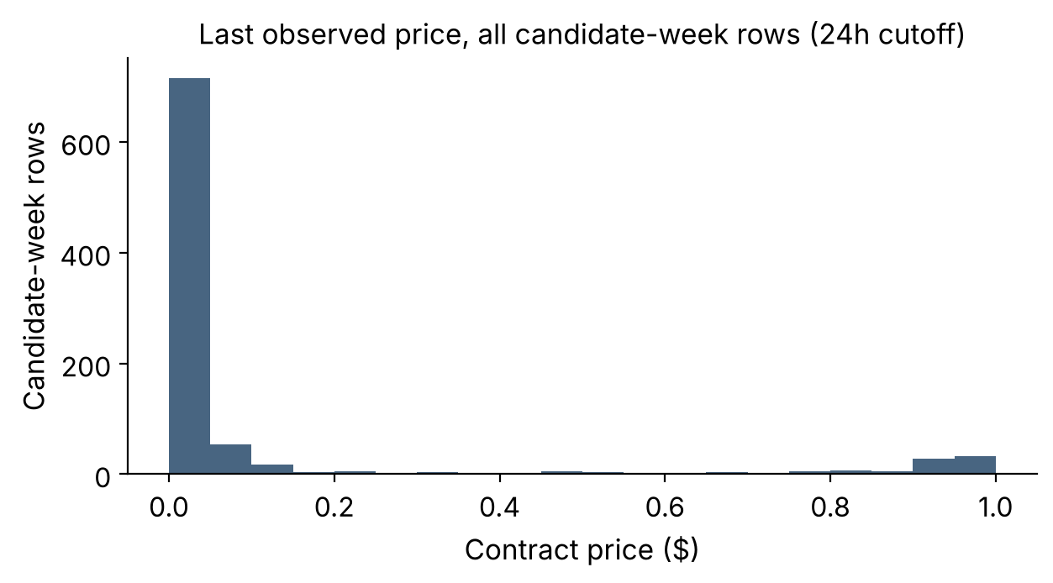
Data: 90 completed weeks; long-shot prices and thin trading
94 events | 1,192 contracts
90 included weeks
1,139 rows at 24h | 1,131 at 72h
Source: Kalshi public API, hourly candles, snapshot 2026-10-23; no individual trades or order book.
Excluded: 1 week not fully settled; 3 weeks without exactly one Yes.
Winner not yet listed at the cutoff: 3 weeks at 24h, 5 at 72h (all training); kept in top-1 as misses.
No price: 240 rows (21.1%), all in training weeks; never replaced by 0.
85.7%
of rows priced under $0.10: middle bins are thin
48.1%
of rows had no trade in the last 24h: thin trading
26.5%
last price older than 24h (75 of 217 test rows): stale inputs can mislead
77/90
weeks won by the highest price (85.6%): strong, not perfect
STATS 414 midterm | Kalshi Netflix weekly #1 movie | exploratory re-analysis, not trading advice
Notes:
[Speaker: Ning Mu] The data come from Kalshi's public API: 94 weekly events, 1,192 contracts, and 104,392 hourly candles, as of a snapshot on 2026-10-23. We have candles, not individual trades or the order book. We keep a week only if every contract has settled, exactly one contract is yes, and all share one close time. That leaves 90 weeks: one week was not fully settled and 3 did not have exactly one yes. At the 24-hour cutoff that gives 1,139 candidate-week rows, and 1,131 at the 72-hour cutoff. In 3 weeks the eventual winner was not yet listed 24 hours before close, and in 5 weeks at 72 hours. All of them are training weeks, and we keep them as top-1 misses instead of quietly dropping hard weeks. The right side shows what the data look like. Prices are extremely skewed: the median last price is one cent, and 85.7% of candidate rows are priced below ten cents, so the middle probability bins have little support. 240 rows, that is 21.1%, have no observed price at the cutoff, all in training weeks, so training and test missingness differ, and we never turn a missing price into zero. For 302 rows the last trade is more than a day old, 75 of the 217 test rows among them, so stale inputs can affect the market rule and the learned models. And 548 rows, 48.1%, had no trade at all in the final 24 hours, so trading is thin. Finally, the baseline. The highest-priced contract wins 77/90 of all 90 weeks, that is 85.6%. That is strong but not perfect, so a perfect eighteen out of eighteen on the test weeks is on the high side of the market's history.

Slide 4
Features use only what was known at prediction time
Prediction time t (UTC hour)
Timeline before close (one week)
24h (main): t = common close − 24h
72h (exploratory): t = close − 72h; everything recomputed
24h window
t, 24h cutoff
24h window
t, 72h cutoff
Features (candles ending at or before t)
−96h
−72h
−48h
−24h
close
price_now: last observed price
price_change_24h: price_now minus last observed price at or before t − 24h
log_volume_24h: log(1 + contracts traded in (t − 24h, t])
Missing stays missing: no price → not scored; no hourly row in the volume window → NaN; a returned window with zero trades → true 0
Box: volume window (t−24h, t]. Price change compares price_now with the last price at or before the box start.
Real test week, t = 2026-09-28 03:00 UTC
Contract (movie) | price_now | Δ 24h | log vol | Won
Unabomber | 0.95 | +0.05 | 7.73 | yes
The Ministry of Ungentl… | 0.05 | +0.00 | 7.28 | no
Best of the Best | 0.01 | +0.00 | 0.00 | no
Shark Tale | 0.01 | +0.00 | NaN | no
NaN = no hourly row returned in the window (not 0); 0.00 = window returned with zero trades.
STATS 414 midterm | Kalshi Netflix weekly #1 movie | exploratory re-analysis, not trading advice
Notes:
[Speaker: Ning Mu] Now the prediction time and the features. The main prediction time is the common close time minus 24 hours, floored to a completed hour. The exploratory version uses 72 hours, and it is recomputed from scratch: which candidates are listed, which prices exist and which volumes exist all change. We do not shift the 24-hour table. Every feature uses only hourly candles that end at or before the cutoff. Price now is the last observed price. Price change is that price minus the last observed price at or before 24 hours earlier. Volume is the log of one plus the contracts traded in the previous 24 hours. The rule on missing data is simple: missing stays missing. If no hourly row is returned in the volume window, the volume is not available, 113 rows at the 24-hour cutoff; if a row is returned with zero trades, that is a real zero, 435 rows. The table on the right is a real test week showing both cases.

Slide 5
Four systems isolate price change and volume
System | Inputs | Searched on validation weeks | Selected, 24h | Selected, 72h
Market leader | highest price | no fitting | – | –
A: logistic (L2) | price_now | C ∈ {0.001, 0.01, 0.1, 1, 10, 100} | C = 10 (0.0521) | C = 10 (0.0690)
B: logistic | A + price_change_24h | same 6 values of C | C = 100 (0.0444) | C = 1 (0.0794)
C: logistic | B + log_volume_24h | same 6 values of C | C = 100 (0.0422) | C = 100 (0.0718)
RF (exploratory) | all three features | depth {2,3,5} × leaf {5,10,20}; 300 trees | depth 3, leaf 5 (0.0334) | depth 3, leaf 10 (0.0560)
B − A measures what price change adds; C − B what volume adds. Each system is tuned separately, so these compare complete procedures. A is a learned price-only control, not the raw market baseline. In parentheses: validation log loss.
def select_by_validation(rows):
best_loss = min(r["val_log_loss"] for r in rows)
tied = [r for r in rows if r["val_log_loss"] - best_loss < TIE_TOL]
return min(tied, key=lambda r: r["tie_key"])
Fixed before the search
Metric: validation log loss, equal weight per week
Ties (< 1e−6): more regularized setting
Fit on training weeks only; test weeks never choose settings
The selection rule: netflix_midterm_v2.py lines 223–226, executed in this run
STATS 414 midterm | Kalshi Netflix weekly #1 movie | exploratory re-analysis, not trading advice
Notes:
[Speaker: Ning Mu] The primary comparison is four systems. The baseline simply picks the highest price. Logistic regression is one algorithm family used with three nested feature sets: A uses price only, B adds the 24-hour change, C adds log volume. B minus A measures what price change adds, and C minus B what volume adds. A random forest with all three features is added as an exploratory fifth method. For each model we ran a small search on the validation weeks only. For each logistic model, six values of the regularization constant C. For the forest, nine settings of tree depth and minimum leaf size, with 300 trees. The rule was fixed before the search: pick the setting with the lowest validation log loss, weighting each week equally; if two settings differ by less than a millionth, take the more regularized one. The four lines of code on the slide are exactly that rule, copied from the script that produced these results. At the 24-hour cutoff the search chose C of 10 for model A, C of 100 for B and for C, and depth 3 with leaf size 5 for the forest. For B and C that C is the top of the grid, but the validation curve is flat there and we did not extend the grid; this is noted in appendix A2. Two cautions: logistic A is a learned price-only control, not the raw market baseline, and because A, B and C are tuned separately we compare complete procedures, not isolated feature effects. Final models are fitted on training weeks only; validation weeks are not merged back in.

Slide 6
Whole-week time split; test weeks never choose settings
Train | 54 weeks
2025-01-13 to 2026-01-26
fit models and preprocessing
Validation | 18 weeks
2026-02-02 to 2026-06-01
choose settings
Test | 18 weeks
2026-06-08 to 2026-10-19
report only (seen before)
24h prediction times, UTC. Same week assignment as the earlier version; the 72h cutoff reuses it. A week's candidates never cross sets.
How results are scored
Top-1: did the highest-scoring movie win? Counted as weeks correct / all weeks; an unlisted winner stays in as a miss.
Log loss: probability error, with a large penalty for confident mistakes. Brier: squared probability error.
Both are candidate-level with each week weighted equally; the market's probability is the contract's own price, not a 0/1 rule.
Same rows for every method: 217/217 test rows at 24h, 214/217 at 72h (the rest have no price). Definitions: Appendix A1.
STATS 414 midterm | Kalshi Netflix weekly #1 movie | exploratory re-analysis, not trading advice
Notes:
[Speaker: Mike Wu] Weeks are split chronologically, and whole weeks stay together: 54 training weeks from 2025-01-13 to 2026-01-26, 18 validation weeks, and 18 test weeks ending 2026-10-19. This is the same week assignment as the earlier version, and the 72-hour analysis reuses it. Nothing from a later period is ever used to fit, or to choose something about, an earlier one. Training weeks fit the preprocessing and the models, validation weeks choose the settings, and the test weeks play no role in choosing anything. Since we saw them before, we say so. Scoring in one line: top-1 asks whether the highest-scoring movie won, as weeks correct over weeks. Log loss is probability error with a large penalty for confident mistakes, and Brier is squared probability error. Both are computed for every candidate-week, the market's probability is simply the contract's observed price, and each week counts equally. Every method is scored on the same rows: 217 of 217 test rows at 24 hours and 214 of 217 at 72 hours; the rest have no observed price. The full definitions are in appendix A1.

Slide 7
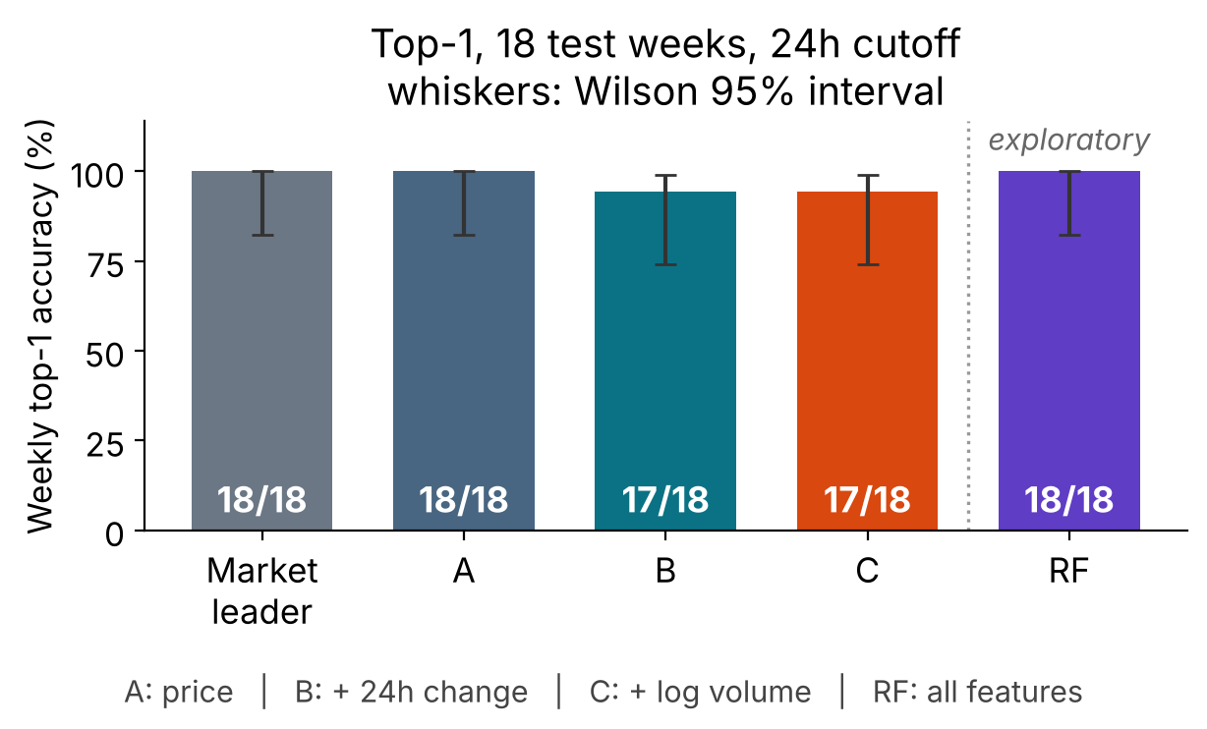
24h top-1: no accuracy gain over the market price
Market and A: 18/18. B and C: 17/18. No accuracy gain from change or volume.
The one extra miss: week of Jul 6, 2026 (post hoc)
Movie | Price | Δ 24h | p(A) | p(B) | p(C) | Won
Little Brother | 0.67 | +0.54 | 0.57 | 0.29 | 0.53 | yes
Enola Holmes 3 | 0.34 | −0.53 | 0.11 | 0.32 | 0.58 | no
Market, A, RF pick Little Brother: correct.
B and C pick Enola Holmes 3: wrong.
p( ) = model's yes probability. A description of one week, not evidence of a general mechanism.
One week = 5.6 points. Market 18/18: Wilson 95% interval 82.4%–100%.
B and C each miss the same one week; this is not statistically established harm.
RF is exploratory; it also gets 18/18. Top-1 cannot separate the methods.
STATS 414 midterm | Kalshi Netflix weekly #1 movie | exploratory re-analysis, not trading advice
Notes:
[Speaker: Mike Wu] Now the results, starting with the question a forecaster cares about most: does the model pick the winning movie? This is the 24-hour cutoff on the 18 test weeks. The market's highest price picks the winner in 18/18 weeks, and so does logistic A, which uses price only. B, which adds the 24-hour price change, and C, which also adds volume, each get 17/18. So there is no accuracy gain from price change or volume. Please do not describe the one extra miss as established harm: one week moves accuracy by 5.6 points, and the market's Wilson 95 percent interval is 82.4%–100%. The table shows that one week, Jul 6, 2026. Little Brother's price rose from 0.13 to 0.67, and Enola Holmes 3 fell from 0.87 to 0.34. The market, logistic A and the forest pick Little Brother, which won. B and C score Enola Holmes 3 higher, 0.32 against 0.29 for B and 0.58 against 0.53 for C. This is a post hoc description of one week, not evidence of a general mechanism. The random forest, which is exploratory, also gets 18/18, so top-1 cannot separate the methods.

Slide 8
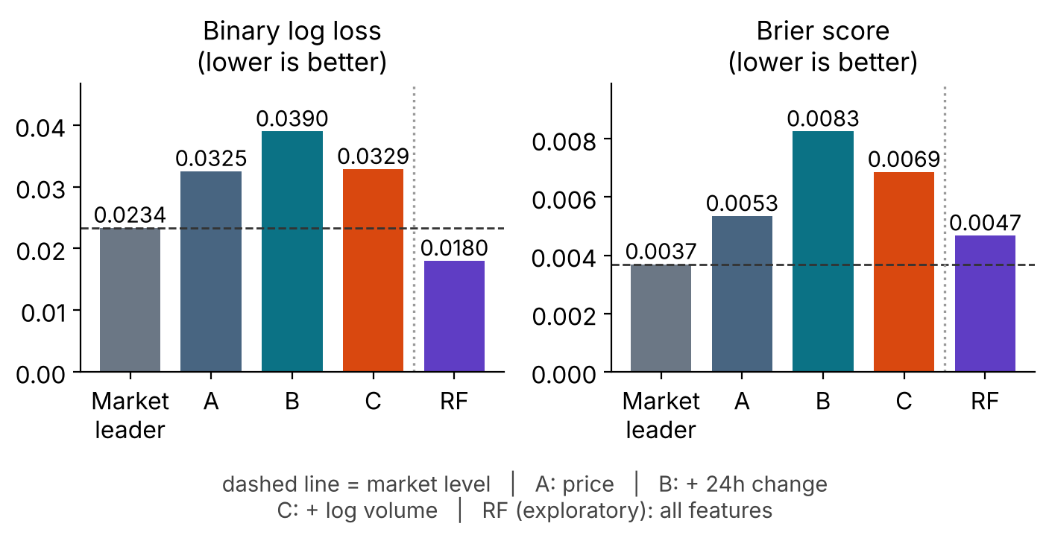
RF lowers log loss but not Brier; no method dominates
Exploratory: RF lowers log loss, worsens Brier. Confirm on new weeks.
RF vs market (Δ = RF − market)
Log loss 0.0180 vs 0.0234
Δ −0.0054 [−0.0084, −0.0017] → favors RF
Brier 0.0047 vs 0.0037
Δ +0.0010 [+0.0001, +0.0021] → favors market
Logistic, Δ log loss
24h change adds nothing: B − A +0.0064 (CI spans 0)
Volume helps vs B: C − B −0.0061
C is still worse than the market: +0.0095
Read with care: exploratory and hypothesis-generating; RF is outside the four-system design.
18 test weeks reused; no multiplicity adjustment; intervals are descriptive.
RF edge not seen on validation weeks (log-loss Δ −0.0111, CI spans 0).
STATS 414 midterm | Kalshi Netflix weekly #1 movie | exploratory re-analysis, not trading advice
Notes:
[Speaker: Mike Wu] Because top-1 is saturated, we also score the probabilities of every candidate, with binary log loss and Brier score. This part is exploratory: the random forest is outside the four-system design, the 18 test weeks were already seen, and we made no multiplicity adjustment. In the left panel, the dashed line is the market price's own level, so a bar below the line beats the market. The forest's log loss is 0.0180 against 0.0234 for the market price, a paired difference of −0.0054 [−0.0084, −0.0017]. Negative means the forest is better. But its Brier score is 0.0047 against 0.0037, a difference of +0.0010 [+0.0001, +0.0021]. Positive means the market is better. So the two metrics disagree, and no method dominates. Inside logistic regression, adding the 24-hour change did not help, +0.0064 in log loss against A with an interval that includes zero. Adding volume helped relative to B, −0.0061. Even so, logistic C stays worse than the market price, +0.0095. On the validation weeks the forest's log-loss difference was −0.0111 [−0.0338, +0.0031], which includes zero. So the forest's edge needs confirmation on new weeks. All intervals are descriptive.

Slide 9
72h cutoff (exploratory): no clear gain
Test weeks (n = 18) | 24h cutoff |  |  | 72h cutoff
 | Top-1 | Log loss | Brier | Top-1 | Log loss | Brier
Market leader (highest price) | 18/18 | 0.0234 | 0.0037 | 15/18 | 0.1002 | 0.0271
A: price | 18/18 | 0.0325 | 0.0053 | 15/18 | 0.1145 | 0.0285
B: + 24h change | 17/18 | 0.0390 | 0.0083 | 14/18 | 0.1153 | 0.0295
C: + log volume | 17/18 | 0.0329 | 0.0069 | 14/18 | 0.1069 | 0.0280
RF (exploratory) | 18/18 | 0.0180 | 0.0047 | 15/18 | 0.0973 | 0.0273
67/90
weeks won by the highest price at 72h (77/90 at 24h)
5 vs 3
weeks with the winner not yet listed (72h vs 24h); all training
−0.0029 [−0.0177, +0.0098]
RF − market log loss at 72h: the interval spans 0
No top-1 gain: RF and the market are both 15/18 (Wilson 95% interval 60.8%–94.2%). RF's log loss is slightly lower, but its interval spans 0. Exploratory, 18 previously viewed test weeks; calibration plots and the coverage table are in the appendix.
STATS 414 midterm | Kalshi Netflix weekly #1 movie | exploratory re-analysis, not trading advice
Notes:
[Speaker: Mike Wu] The 72-hour cutoff is exploratory, and we tried no other window in this analysis. At 72 hours the market leader is 15/18 on the test weeks, and the random forest is the same, so there is no top-1 gain; fifteen out of eighteen has a Wilson 95 percent interval of 60.8%–94.2%. Over all 90 weeks the highest price wins 67/90, down from 77/90 at 24 hours. The forest's log loss against the market is −0.0029 [−0.0177, +0.0098]: slightly lower, but the interval includes zero. Less is known earlier. There are 1,131 candidate rows, the winner is not yet listed in 5 weeks against 3 at 24 hours, and 276 rows have no price. All 18 test winners were listed at both cutoffs, so the full-sample and common-week test results are identical. The calibration plots and the coverage table are in the appendix.

Slide 10
Conclusion: no consistent case for replacing the market price
No consistent evidence that 24h price change or volume improves on the market price.
Primary: no accuracy gain at 24h. Exploratory: RF lowers log loss but worsens Brier; confirm on new weeks.
Winner selection
Probability prediction
Robustness checks
Highest price: 18/18 on test, 77/90 over all 90 weeks
No model beat it; B and C: 17/18
Top-1 cannot separate the methods at 18/18
Logistic: 24h change adds nothing; volume helps vs B, but C stays worse than the market
RF vs market: log loss −0.0054 (better), Brier +0.0010 (worse)
Metrics disagree: no method dominates
RF edge not seen on validation weeks (log-loss Δ −0.0111, CI spans 0)
72h: no top-1 gain; intervals span 0
Calibration plots: diagnostic only
Not claimed: causes, trader identities or profit. Exploratory results are hypothesis-generating, not confirmatory.
STATS 414 midterm | Kalshi Netflix weekly #1 movie | exploratory re-analysis, not trading advice
Notes:
[Speaker: Mike Wu] To sum up. We found no consistent evidence that the 24-hour price change or volume improves on the market price. On winner selection, the highest price was right 18/18 on the test weeks and 77/90 over all weeks, and no model beat it. On probabilities, the 24-hour change added nothing in logistic regression, volume helped somewhat relative to B, and neither made logistic regression better than the raw market price. The random forest lowered log loss on the test weeks but not Brier, and on the validation weeks its log-loss difference was −0.0111 [−0.0338, +0.0031], which includes zero. At 72 hours there was no gain. If you remember one sentence: in these eighteen weeks, nothing we added beat the price on both probability metrics. The probability improvement is exploratory and needs confirmation on new weeks. The calibration plots in the appendix are diagnostic only, with sparse bins and eighteen test weeks.

Slide 11
Limits, and one clean next step
Limits
Next step
Reused test weeks: the 18 test weeks were viewed in an earlier version.
Stale prices: for 26.5% of rows the last trade is over 24h old.
Changing missingness: all 240 rows without a price are training rows.
Retrospective metadata: candidates and settlement come from data downloaded 2026-10-23.
Many comparisons: 5 methods × 2 cutoffs, no multiplicity adjustment.
Confirm on new weeks
One cutoff and one primary metric, fixed before the weeks resolve
Same procedure, no re-tuning on the new weeks
Nothing here is trading advice; wallet identities are not studied.
STATS 414 midterm | Kalshi Netflix weekly #1 movie | exploratory re-analysis, not trading advice
Notes:
[Speaker: Mike Wu] Limits first. The 18 test weeks were already viewed in an earlier version, so nothing here is a fresh test. Prices can be stale: for 26.5% of candidate rows the last trade is more than a day old. Missingness changes by split: all 240 rows without a price are training rows. The candidate lists and settlement come from data downloaded after the fact, on 2026-10-23, so the metadata is retrospective. And we ran many exploratory comparisons, five methods at two cutoffs, with no multiplicity adjustment. The next step is simple: fix one cutoff and one primary metric before any new weeks resolve, and check whether the same pattern appears. We make no claim about causes, traders or profit, and nothing here is trading advice. Logistic regression uses price linearly on the log-odds scale, and the data are hourly candles, not individual trades. Everything is reproducible from the files listed in the appendix. Thank you, and we are happy to take questions.

Slide 12
Appendix guide
Slide | Topic | Use
A1 | Metric definitions | How top-1, log loss and Brier are defined and weighted
A2 | Validation tuning, 24h | All settings searched and the one selected
A3 | Validation tuning, 72h | Same grids for the exploratory cutoff
A4 | Paired week bootstrap | Differences with 95% intervals, market rows highlighted
A5 | Calibration, 24h | Descriptive: sparse bins, 18 test weeks
A6 | Calibration, 72h | Same diagnostic at the exploratory cutoff
A7 | Data quality and coverage | Stale prices, missing volume, audit counts
A8 | Key training code | Executed excerpts: pipeline, weights, fitting
A9 | Split and metric code | Executed excerpts: split, clipping, week-equal mean
A10 | Run record | Seed, versions, hashes, how to reproduce
STATS 414 midterm | Kalshi Netflix weekly #1 movie | exploratory re-analysis, not trading advice
Notes:
[Speaker: Mike Wu (Q&A)] This slide is only a map of the appendix, for questions. Metric definitions are A1; the tuning grids are A2 and A3; the paired bootstrap is A4; calibration diagnostics are A5 and A6; data quality is A7; the key code is A8 and A9; and the run record with hashes, seed and versions is A10.

Slide 13
Appendix A1: metric definitions
Metric | Definition used here | Weights and coverage
Weekly top-1 | Picked contract is the winner; shown as weeks correct / weeks | All weeks kept, including weeks where the winner was not listed
Binary log loss | −[y log p + (1−y) log(1−p)], p clipped to [1e−6, 1−1e−6] | Mean within a week, then mean over weeks
Brier score | (p − y)² per candidate-week | Same weighting; lower is better
Market p | Contract's own observed price_now (not a 0/1 rule) | Rows without a price are not scorable for any method
Model p | Candidate-level yes probability; not normalized within a week | Test rows scored: 217/217 at 24h, 214/217 at 72h
Paired differences are first method minus second. Intervals: 10,000 week-level bootstrap resamples (seed 20261022); top-1 uses Wilson 95% intervals.
STATS 414 midterm | Kalshi Netflix weekly #1 movie | exploratory re-analysis, not trading advice
Notes:
Appendix: the metric definitions. The point to remember is the market's probability: it is the contract's own observed price, not a zero-one rule. Rows without an observed price are not scorable for any method, and every method is scored on the same rows.

Slide 14
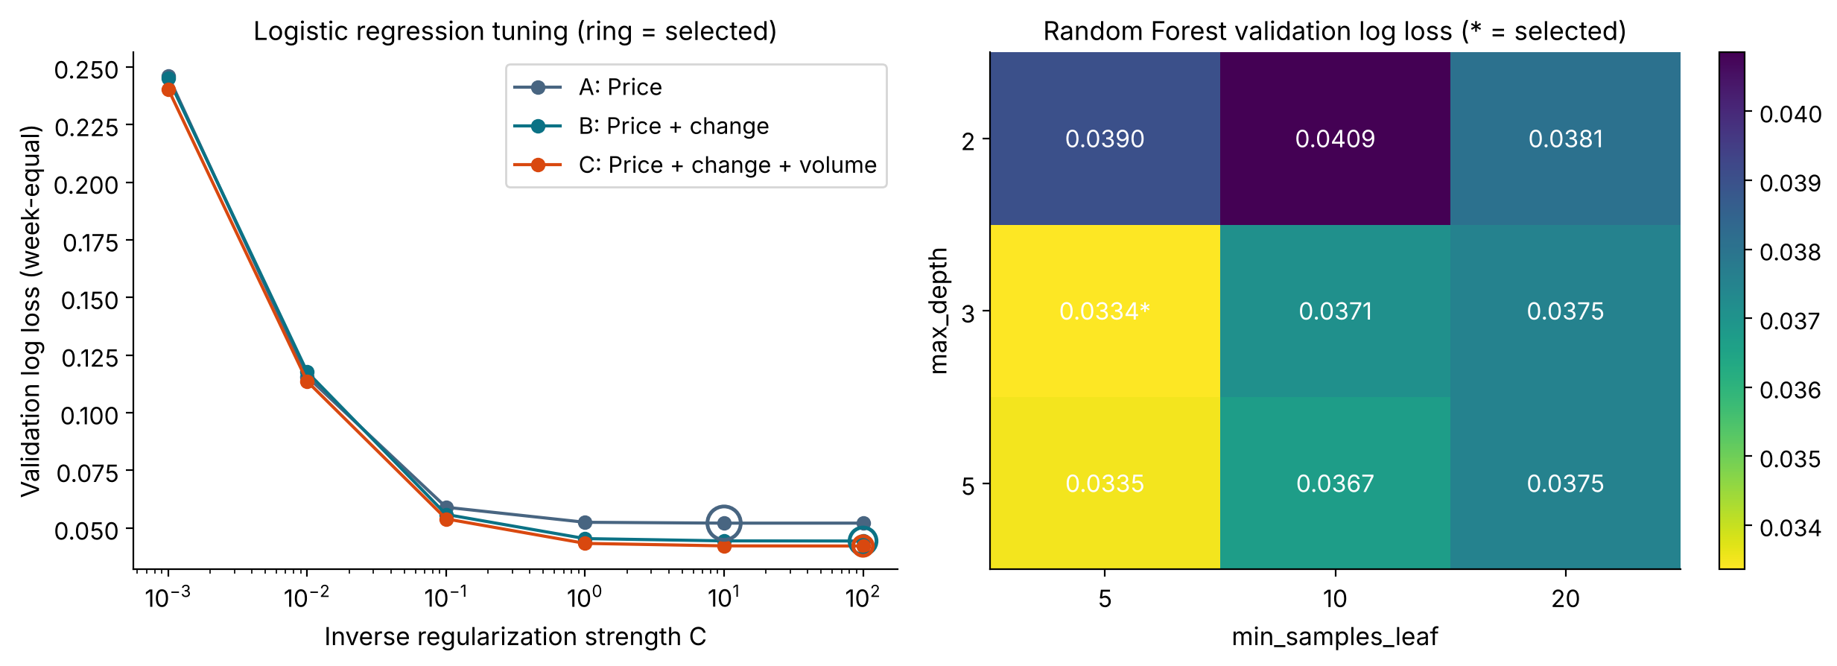
Appendix A2: validation tuning, 24h cutoff
Validation log loss is week-equal; a ring or star marks the setting chosen by the pre-stated rule. All settings: results/tuning_all_results.csv.
Grid edge: C = 100 (LR-B and LR-C, 24h) is the top of the grid; validation loss is flat between C = 10 and 100, so the grid was not extended.
STATS 414 midterm | Kalshi Netflix weekly #1 movie | exploratory re-analysis, not trading advice
Notes:
Appendix: the full 24-hour validation grid. On the left, the logistic curves are flat above C of one, and the rings mark the selected values. On the right is the forest grid; the star is the selected setting. Depth 3 with leaf 5 and depth 5 with leaf 5 differ by 0.00012, so the choice follows the pre-stated rule of lowest validation log loss and is not a tie under the 1e-6 rule. For logistic B and C at 24 hours, C of 100 is the top of the grid; the validation loss is flat between C of 10 and 100, and the grid was not extended.

Slide 15
Appendix A3: validation tuning, 72h cutoff (exploratory)
C | LR-A val. log loss | LR-B val. log loss | LR-C val. log loss
0.001 | 0.2549 | 0.2548 | 0.2498
0.01 | 0.1336 | 0.1389 | 0.1320
0.1 | 0.0762 | 0.0846 | 0.0787
1 | 0.0692 | 0.0794 * | 0.0720
10 | 0.0690 * | 0.0796 | 0.0718
100 | 0.0690 | 0.0796 | 0.0718 *
Random forest (300 trees)
max_depth | leaf 5 | leaf 10 | leaf 20
2 | 0.0624 | 0.0598 | 0.0623
3 | 0.0582 | 0.0560 * | 0.0599
5 | 0.0609 | 0.0562 | 0.0598
* = selected by lowest validation log loss (week-equal); ties would go to the more regularized setting.
Validation weeks are the same 18 weeks as at 24h, with features recomputed at 72h.
STATS 414 midterm | Kalshi Netflix weekly #1 movie | exploratory re-analysis, not trading advice
Notes:
Appendix: the same grids for the exploratory 72-hour cutoff. Selected settings are marked with an asterisk.

Slide 16
Appendix A4: paired week-bootstrap differences, test weeks
Cutoff | Comparison (first − second) | Δ top-1 (weeks) | Δ log loss [95% CI] | Δ Brier [95% CI]
24h | LR-B − LR-A | −1 | +0.0064 [−0.0014, +0.0187] | +0.0029 [−0.0002, +0.0080]
24h | LR-C − LR-B | 0 | −0.0061 [−0.0127, −0.0021] | −0.0014 [−0.0032, −0.0002]
24h | LR-C − Market | −1 | +0.0095 [+0.0014, +0.0193] | +0.0032 [+0.0001, +0.0072]
24h | RF − Market | 0 | −0.0054 [−0.0084, −0.0017] | +0.0010 [+0.0001, +0.0021]
24h | RF − LR-C | +1 | −0.0149 [−0.0217, −0.0093] | −0.0022 [−0.0052, −0.0001]
72h | LR-B − LR-A | −1 | +0.0008 [−0.0165, +0.0172] | +0.0010 [−0.0054, +0.0073]
72h | LR-C − LR-B | 0 | −0.0084 [−0.0162, −0.0025] | −0.0015 [−0.0034, −0.0003]
72h | LR-C − Market | −1 | +0.0066 [−0.0054, +0.0186] | +0.0009 [−0.0043, +0.0062]
72h | RF − Market | 0 | −0.0029 [−0.0177, +0.0098] | +0.0003 [−0.0042, +0.0044]
72h | RF − LR-C | +1 | −0.0095 [−0.0227, +0.0028] | −0.0006 [−0.0049, +0.0035]
Negative log loss or Brier difference = first method better. Highlighted: comparisons with the market. 24h: RF log-loss CI excludes 0, but the effect is small and Brier goes the other way; 72h CIs span 0. 10,000 resamples, seed 20261022. Descriptive only: 18 weeks, test set seen before; no multiplicity adjustment or serial-dependence correction; practical importance untested.
STATS 414 midterm | Kalshi Netflix weekly #1 movie | exploratory re-analysis, not trading advice
Notes:
Appendix: paired week bootstrap, 10,000 resamples with seed 20261022, on the test weeks. Differences are first method minus second, so a negative log loss or Brier difference means the first method is better. The highlighted rows are the two comparisons with the market. At 24 hours the forest's log-loss interval excludes zero, but the effect is small and the Brier difference goes the other way; at 72 hours the intervals span zero. Descriptive only: no multiplicity adjustment and no correction for serial dependence, and practical importance is untested.

Slide 17
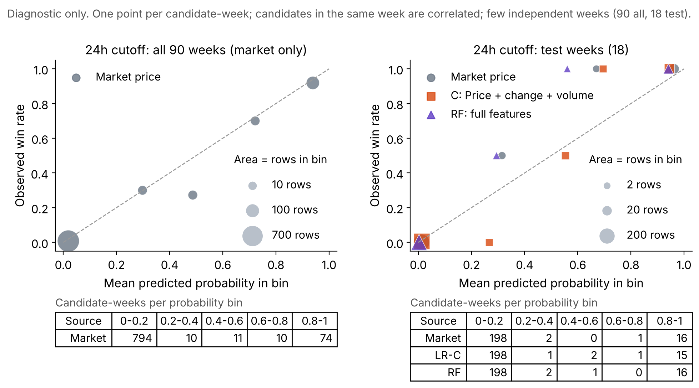
Appendix A5: calibration diagnostics, 24h cutoff
Five equal-width bins; marker area = rows in bin.
Left: market price, all weeks. Right: test weeks, market, LR-C and RF on the same rows.
Descriptive only: 18 test weeks, sparse bins.
No recalibration was fitted.
STATS 414 midterm | Kalshi Netflix weekly #1 movie | exploratory re-analysis, not trading advice
Notes:
Appendix: calibration at the 24-hour cutoff. Five equal-width probability bins; marker area grows with the number of candidate-weeks, and the table under each panel gives the counts. Models are shown on test weeks only. Descriptive only: eighteen test weeks and sparse bins. No recalibration was fitted.

Slide 18
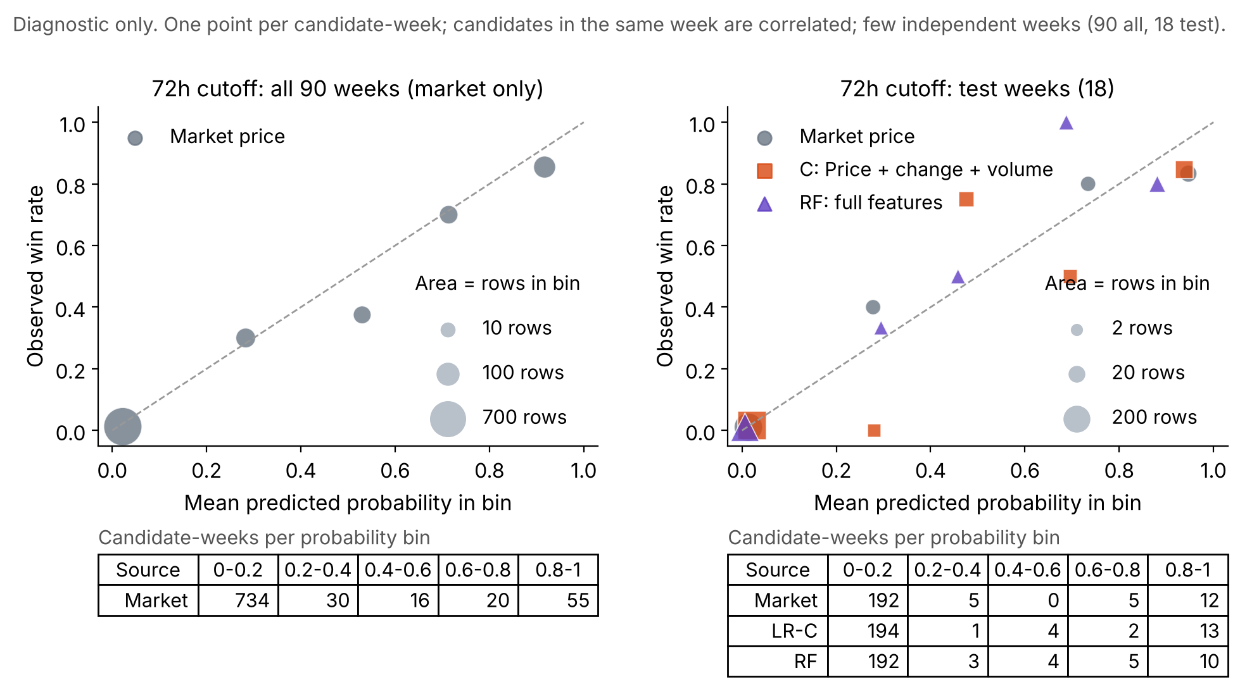
Appendix A6: calibration diagnostics, 72h cutoff
Five equal-width bins; marker area = rows in bin.
Left: market price, all weeks. Right: test weeks, market, LR-C and RF on the same rows.
Descriptive only: 18 test weeks, sparse bins.
No recalibration was fitted.
STATS 414 midterm | Kalshi Netflix weekly #1 movie | exploratory re-analysis, not trading advice
Notes:
Appendix: the same calibration diagnostic at the 72-hour cutoff, with the same bins and the same caveats.

Slide 19
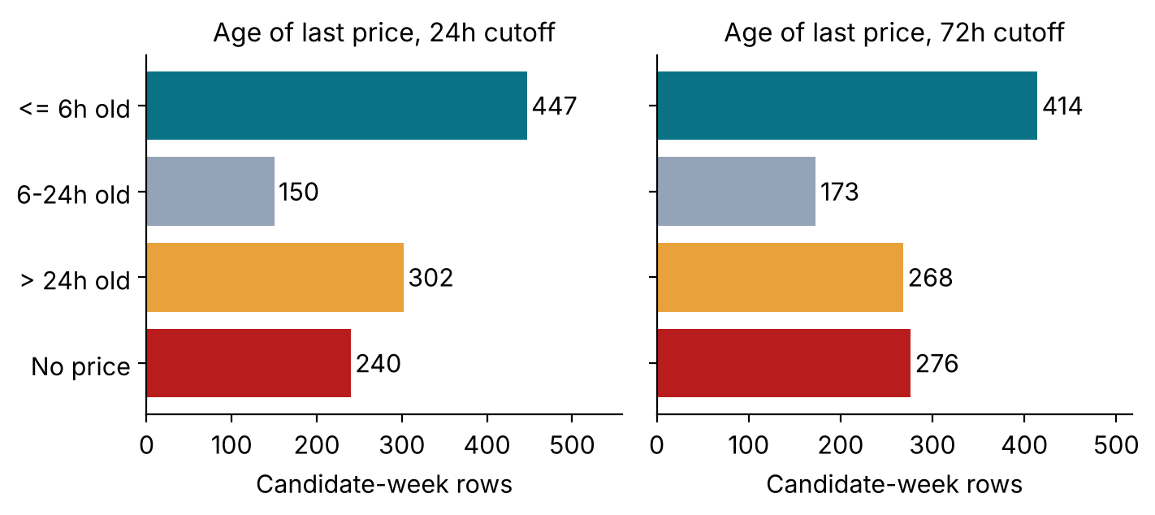
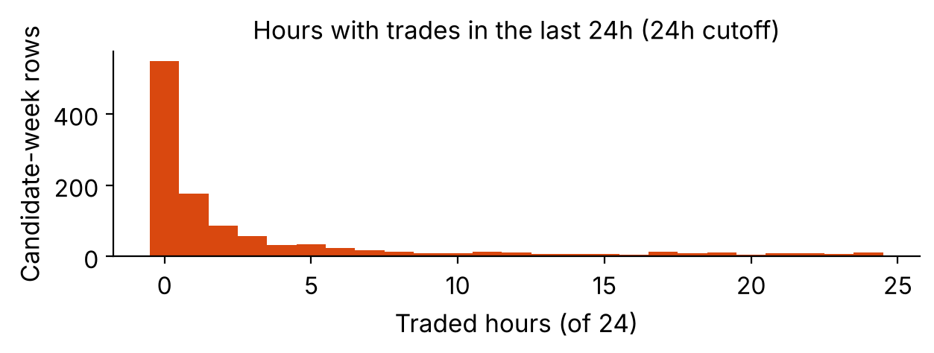
Appendix A7: data quality and coverage by cutoff
Audit item | 24h | 72h
eligible candidate-week rows | 1,139 | 1,131
rows without observed price | 240 | 276
rows with price older than 24h | 302 | 268
rows without 24h price change | 263 | 316
rows with no returned hourly row in 24h window | 113 | 90
rows with returned window but zero volume | 435 | 459
rows with positive 24h volume | 591 | 582
weeks where winner not listed | 3 | 5
test rows scored (of 217) | 217 | 214
highest price wins (all 90 weeks) | 77/90 | 67/90
Age = hours since the last observed trade at the cutoff.
Volume is NaN only when no hourly row is returned for the window; a returned zero-trade window is a true 0.
Price change needs a price at or before t − 24h, so it is missing more often than price.
All 18 test winners were listed at both cutoffs.
STATS 414 midterm | Kalshi Netflix weekly #1 movie | exploratory re-analysis, not trading advice
Notes:
Appendix: data quality and coverage. On the left, how old the last observed price is at each cutoff. On the right, the audit counts by cutoff, including how often the highest price wins and how many test rows are scored. The second histogram shows how many of the last 24 hours had any trade. Volume is missing only when no hourly row is returned for the 24-hour window; zero-volume windows are true zeros.

Slide 20
Appendix A8: key training code (executed script)
def make_pipeline(kind, **params):
if kind == "lr":
return Pipeline([
("imputer", SimpleImputer(strategy="median", add_indicator=True, keep_empty_features=True)),
("scale", StandardScaler()),
("model", LogisticRegression(C=params["C"], l1_ratio=0.0, solver="lbfgs",
max_iter=5000, tol=1e-8, random_state=SEED))])
return Pipeline([
("imputer", SimpleImputer(strategy="median", add_indicator=True, keep_empty_features=True)),
("model", RandomForestClassifier(n_estimators=RF_TREES, max_depth=params["max_depth"],
min_samples_leaf=params["min_samples_leaf"], max_features=None,
random_state=SEED, n_jobs=1))])
netflix_midterm_v2.py lines 199–210: preprocessing and models
def week_weights(train):
return len(train) / (train.event_ticker.nunique() * train.groupby("event_ticker").market_ticker.transform("size"))
def fit_predict(train, rows, columns, kind, **params):
model = make_pipeline(kind, **params)
model.fit(train[columns], train.label_yes, model__sample_weight=week_weights(train))
return model, model.predict_proba(rows[columns])[:, 1]
lines 213–214 and 217–220: equal total weight per training week; models are fitted on training rows only
STATS 414 midterm | Kalshi Netflix weekly #1 movie | exploratory re-analysis, not trading advice
Notes:
Appendix: key training code, copied by line number from the script that produced the results. Median imputation with missing indicators fitted on training rows; scaling only for logistic regression; every training week has equal total weight; the forest uses all features at each split.

Slide 21
Appendix A9: key split and metric code (executed script)
n_train, n_valid = int(n * .6), int(n * .2)
split_map = {e: ("train" if i < n_train else "validation" if i < n_train + n_valid else "test")
for i, e in enumerate(included.event_ticker)}
lines 159–161: chronological 60/20/20 split of whole weeks
def clipped(p):
return np.clip(np.asarray(p, dtype=float), EPS, 1 - EPS)
def per_week_metric(df, prob_col, metric):
"""Mean loss within each week over scorable candidates (observed market price). Returns a Series by week."""
p, y = clipped(df[prob_col]), df.label_yes.to_numpy()
loss = -(y * np.log(p) + (1 - y) * np.log(1 - p)) if metric == "log_loss" else (p - y) ** 2
return pd.Series(loss, index=df.index).groupby(df.event_ticker).mean()
def week_equal(df, prob_col, metric):
s = per_week_metric(df, prob_col, metric)
return float(s.mean()) if len(s) else np.nan
lines 183–184, 187–191, 194–196: clipping, per-week loss, week-equal mean
STATS 414 midterm | Kalshi Netflix weekly #1 movie | exploratory re-analysis, not trading advice
Notes:
Appendix: the split and the metric code. The split takes the first 60 percent of weeks in time order for training, the next 20 percent for validation and the last 20 percent for test. Probabilities are clipped, the loss is averaged within each week, and then averaged across weeks.

Slide 22
Appendix A10: reproduction entry and run record
Item | Value
Run | python code/netflix_midterm_v2.py; then python code/build_ppt_v2.py
Colab | notebooks/Netflix_Midterm_v2_Colab.ipynb (runs from input_data/)
Share package | Netflix_Midterm_v2_share.zip (code, input_data, results, figures, slides, docs)
Seed | 20261022
Executed (UTC) | 2026-10-27T22:56:37, runtime 31.8 s
Versions | Python 3.13.16, pandas 3.0.5, numpy 2.5.3, scikit-learn 1.9.1
Candles read from | csv_mirror_of_parquet
SHA256 (first 12) | markets cb398ba90466, parquet d286717b525e, csv mirror 8518eb12e730
SHA256 (first 12) | script f95e8ee0f214, protocol a98a354d2e77
Results were computed from the CSV mirror of the hourly-candle parquet (verified against the parquet footer statistics) because pyarrow could not be installed in the run environment; the script's parquet path was not executed here. Full hashes: results/run_record.json.
STATS 414 midterm | Kalshi Netflix weekly #1 movie | exploratory re-analysis, not trading advice
Notes:
Appendix: reproduction. Run the script on the three input files; the run record stores hashes, seed, versions and runtime. The numbers in this deck were computed from the CSV mirror of the hourly-candle parquet because pyarrow could not be installed in the environment that ran the code; the mirror was verified against the parquet footer statistics. The parquet read path in the script was not executed in that run.

