Slide 1


Poster title goes here, containing strictly
only the essential number of words...
Author’s Name/s Goes Here, Author’s Name/s Goes Here, Author’s Name/s Goes Here
Address/es Goes Here, Address/es Goes Here, Address/es Goes Here
Introduction
First…
Check with conference organisers on their specifications of size and orientation, before you start your poster eg. maximum poster size; landscape, portrait or square.
The page size of this poster template is A0 (84x119cm), landscape (horizontal) format. Do not change this page size, MIU can scale-to-fit a smaller or larger size, when printing. If you need a different shape start with either a portrait (vertical) or a square poster template.
Bear in mind you do not need to fill up the whole space allocated by some conference organisers (eg. 8ftx4ft in the USA). Do not make your poster bigger than necessary just to fill that given size.
Method
Tips for making a successful poster…
Re-write your paper into poster format ie.
Simplify everything, avoid data overkill.
Headings of more than 6 words should be in upper and lower case, not all capitals.
Never do whole sentences in capitals or underline to stress your point, use bold characters instead.
When laying out your poster leave breathing space around you text. Don’t overcrowd your poster.
Try using photographs or coloured graphs. Avoid long numerical tables.
Spell check and get someone else to proof-read.
Results
Importing / inserting files…
Images such as photographs, graphs, diagrams, logos, etc, can be added to the poster.
To insert scanned images into your poster, go through the menus as follows: Insert / Picture / From File… then find the file on your computer, select it, and press OK.
The best type of image files to insert are JPEG or TIFF, JPEG is the preferred format.
Be aware of the image size you are importing. The average colour photo (13 x 18cm at 180dpi) would be about 3Mb (1Mb for B/W greyscale). Call MIU if unsure.
Do not use images from the web.
Notes about graphs…
For simple graphs use MS Excel, or do the graph directly in PowerPoint.
Graphs done in a scientific graphing programs (eg. Sigma Plot, Prism, SPSS, Statistica) should be saved as JPEG or TIFF if possible. For more information see MIU.
Printing and Laminating…
Once you have completed your poster, bring it down to MIU for printing. We will produce a A3 size draft print for you to check and proof read. The final poster will then be printed and laminated.
Note: Do not leave your poster until the last minute. Allow at least 5 working days before you need to use it.
Simply highlight this text and replace.
Cost…
For poster-printing and laminating charges contact to MIU
Captions to be set in Times or Times New Roman or equivalent, italic, between 18 and 24 points.
Left aligned if it refers to a figure on its left. Caption starts right at the top edge of the picture (graph or photo).
Conclusion
For more information on:
Poster Design, Scanning and Digital Photography,
and Image / file size.
Contact:
Medical Illustration Unit
Prince of Wales Hospital
Ph: 9382 2800
Email: miunsw@unsw.edu.au
Web: http://miu.med.unsw.edu.au
Aim
How to use this poster template…
Simply highlight this text and replace it by typing in your own text, or copy and paste your text from a MS Word document or a PowerPoint slide presentation.
The body text / font size should be between 24 and 32 points. Arial, Helvetica or equivalent.
Keep body text left-aligned, do not justify text.
The colour of the text, title and poster background can be changed to the colour of your choice.
Captions to be set in Times or Times New Roman or equivalent, italic, between 18 and 24 points. Right aligned if it refers to a figure on its right. Caption starts right at the top edge of the picture (graph or photo).
Captions to be set in Times or Times New Roman or equivalent, italic, between 18 and 24 points.
Left aligned if it refers to a figure on its left. Caption starts right at the top edge of the picture (graph or photo).
Acknowledgements
Just highlight this text and replace with your own text. Replace this with your text.
Captions to be set in Times or Times New Roman or equivalent, italic, 18 to 24 points, to the length of the column in case a figure takes more than 2/3 of column width.
Captions to be set in Times or Times New Roman or equivalent, italic, 18 to 24 points, to the length of the column in case a figure takes more than 2/3 of column width.

Slide 2

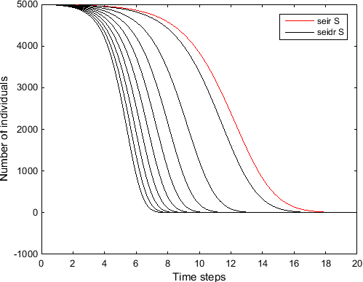
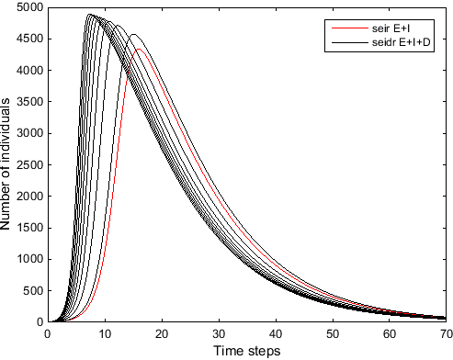
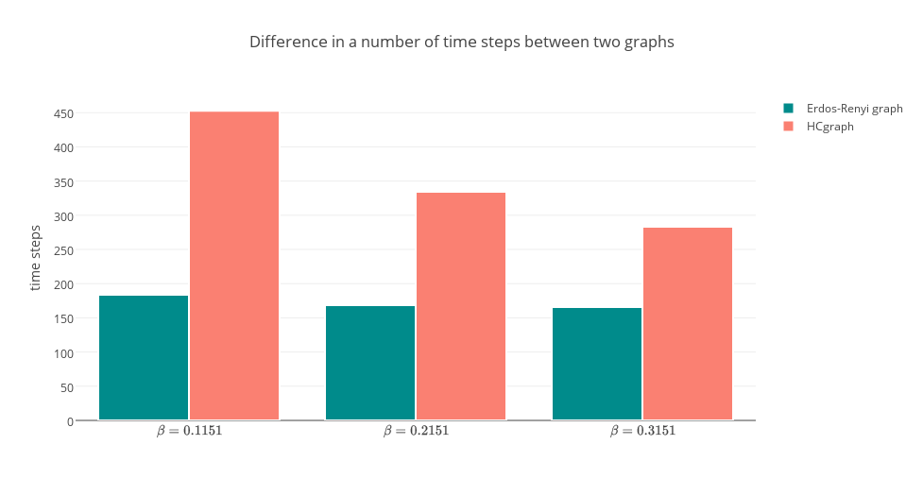
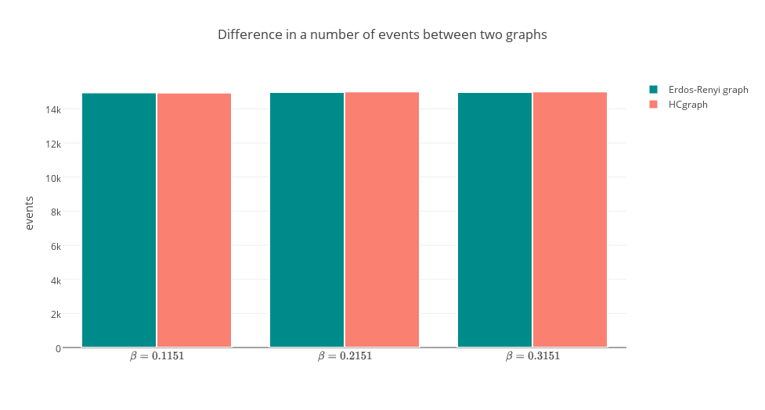
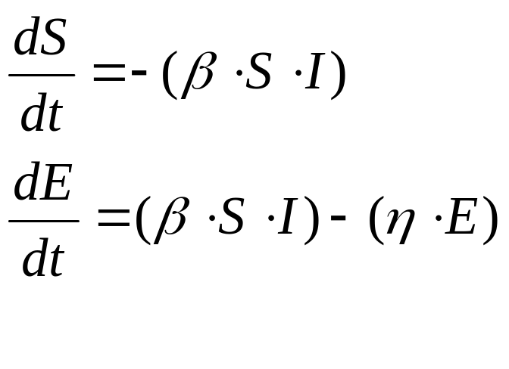
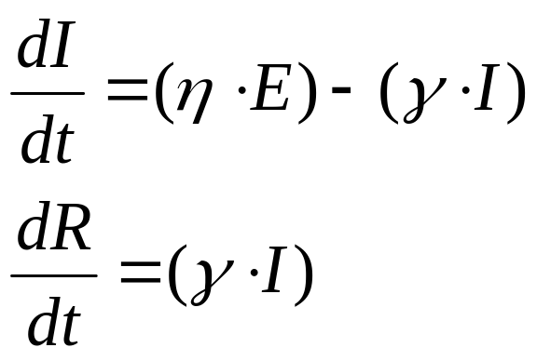
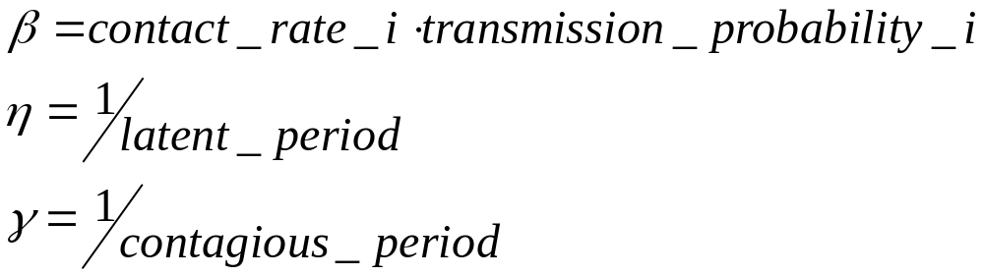
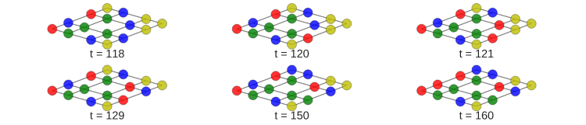
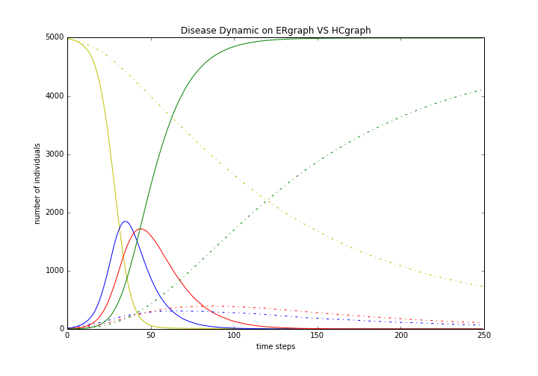
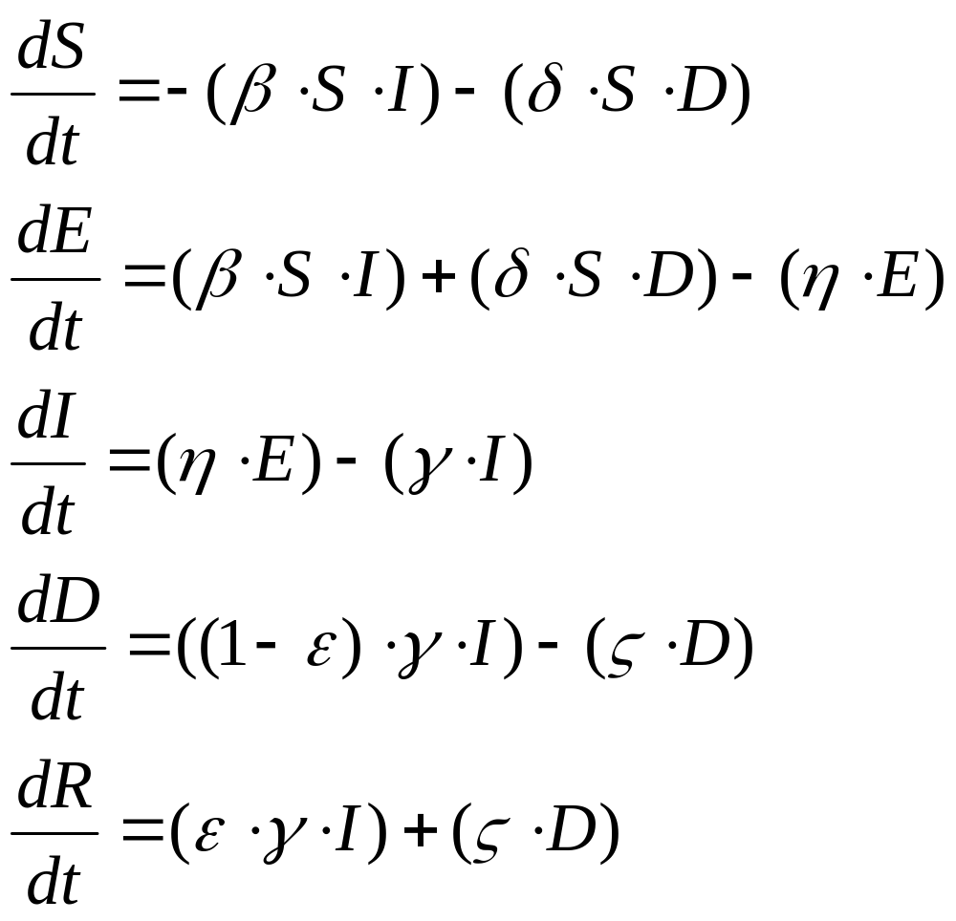
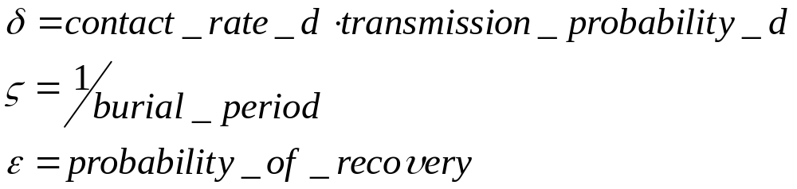

A New Ebola Virus Disease Compartmental Model for Predicting Success of Safe Funerals
Author: Tatiana Tay, Supervisors: Prof. Simon Dobson, Prof. Mark Chaplain
CS4796: Joint Project, Department of Computer Science and Mathematics
Abstract
Fully Mixed Population
Comparison of Disease Dynamics
Population Structure Described with Networks
Visualisation of Disease Spread
Two Types of Networks Considered
On the example of the SEIR model the graph below shows that for all beta values it took much more time for the epidemic to spread across the population when HCgraph rather than Erdős–Rényi network was chosen as an underlying population structure
The difference is even more obvious when the dynamic overall is looked into. The graph below demonstrates how the structure of a network affects the dynamic in many of its aspects. It does not influence the total number of transitions between compartments (figure 7) since the epidemic in both cases involves approximately the same number of individuals and the same stages have to be passed to move from S to R compartments, nevertheless, the largest number of people who simultaneously have the disease is substantially different as well as the threshold value of S after which the epidemic starts dying out. On figure 7 these variables are 3320.46 against 698.48 and 591.84 against 3039 for Erdős–Rényi graph and HCgraph respectively.
Results
In the recent years, Ebola virus disease has become a serious threat to people in West African countries. However, the only epidemiological action taken to improve the situation was an attempt to eliminate traditional African funerals where mourners could get bursts of infection from a recently dead person. To measure the effectiveness of this step the new compartmental model was presented together with the software that runs simulations on networks. This model was then compared with the traitionally used model and obtained results explained.
Traditional SEIR Model
Introduced SEIDR Model
Figure 1: Changes in the susceptible fraction of population over time.
Figure 2: Changes in the exposed+infected (SEIR) or exposed+infected+dead (SEIDR) fraction of population over time.
When applying mathematical modelling the main difference in the dynamic of the disease spread between the two models is that with the SEIDR model the epidemic propagates faster and takes more time to die out.
Figure 6: Total number of time steps taken for an epidemic to pass..
SEIR is an abstract model of how a disease spreads. Every individuals is in either of the four compartments: susceptible (S), exposed (E), infected (I) or removed (R).
This mathematical model can be described by the following equations and parameters.
Figure 7: Total number of time transitions made for an epidemic to pass.
Figure 3: Spread of a disease at particular time steps shown on the lattice graph, (colours of nodes: yellow – S, blue – E, red – I, green - R).
On networks nodes represent people and edges represent contacts between them. On the graph above the disease propagation is shown. Thus, at time steps 120, 121 and 160 some nodes move from exposed to infected compartment while at time steps 129 and 150 the disease is transmitted from infected to susceptible nodes and at timestep 150 one of the nodes moves to the removed compartment.
A compartment of newly dead people (D) is added to SEIDR model, which is represented by the equations and parameters below.
The rate of disease spread differs depending on the type of graph chosen to depict population structure. Therefore, to ensure that the results represent models in general and are not just network specific two different types were used during simulations.
Conclusion
Figure 7: Disease dynamic on Erdős–Rényi graph and HCgraph with beta=0.1151
Various disease parameters were considered and the results obtained show that the rate at which the infection spreads indeed increases significantly with the transition from SEIR to SEIDR model which justifies the introduced practise of safe funerals in West African countries. However, the same results might not hold in the future if the contact rate between infected and susceptible people grows or the disease mutates in such a way that the transmission probability increases.
Figure 7: Disease dynamic on Erdős–Rényi graph and HCgraph with beta=0.1151
Figure 8: Disease dynamic on Erdős–Rényi graph and HCgraph with beta=0.1151

