Slide 1



Slide 2






Slide 3
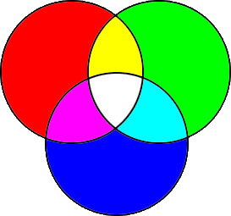
Screen Basic color – RGB
Print Basic Color - CMYK
Yellow
C – Cyan
M – Magenta
Y – Yellow
K - Black
R – Read
G – Green
B - Blue
Magenta
Cyan
RGB(255,255,255) is black
RGB(0,0,0) is white
Total Color combination:
256x256x256=16,777,216
Total Printing Color combination:
256x256x256x256=4,294,967,296

Slide 4
Pixel vs. DPI
DPI is used to describe the resolution number of dots per inch in a digital print and the printing resolution.
Pixels per inch (PPI) or pixel density is a measurement of the resolution of devices in various contexts; typically computer displays, image scanners, and digital camera image sensors.
PPI can also describe the resolution, in pixels, of an image to be printed within a specified space. For instance, a 100 x 100 pixel image that is printed in a 1-inch square could be said to have 100 dots per inch (DPI). Used in this way, the measurement is meaningful when printing an image. Good quality photographs usually require 300 dots per inch when printed.

Slide 5
Adjust PowerPoint default DPI (dot per inch)
Click Start, and then click Run
Type Regedit and click “OK”
Click “My Computer”
Click “HKEY_CURRENT_USER”
Click “Software”
Click “Microsoft”
Click “Office”
Click one of those 3:
Click “11.0” if your PC is Window XP
Click “12.0” if Your PC is Window Vista
Click “14.0” if your PC is Window 7
Click “PowerPoint”
Click “Options”

Slide 6
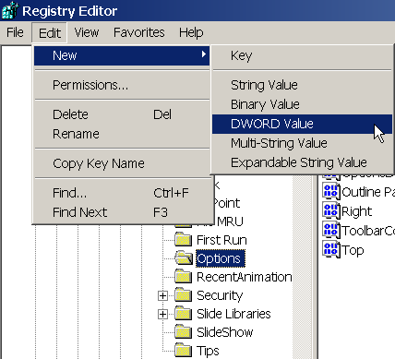
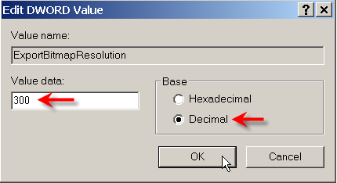
With the Options key selected, point to New on the Edit menu, and then click DWORD Value
Type ExportBitmapResolution, and then press ENTER
With ExportBitmapResolution selected, click Modify on the Edit menu
Select the Decimal option, type the resolution value 150 in the Value data box, and then click OK
150

Slide 7
Monitor Display Resolution
Measurement | Screen DPI
3 inches | 100 DPI
3 ¼ inches | 92 DPI
3 ½ inches | 85 DPI
3 ¾ inches | 80 DPI
4 inches | 75 DPI
4 ¼ inches | 70 DPI
4 ½ inches | 66 DPI
4 ¾ inches | 63 DPI
5 inches | 60 DPI

Slide 8
Value setting for DPI
Decimal value | Pixels (horizontal x vertical) | Dots-per-inch (horizontal and vertical)
50 | 500 x 375 | 50 dpi
96 (default) | 960 x 720 | 96 dpi
100 | 1000 x 750 | 100 dpi
150 | 1500 x 1125 | 150 dpi
192 | 1920 x 1440 | 192 dpi
200 | 2000 x 1500 | 200 dpi
250 | 2500 x 1875 | 250 dpi
300 | 3000 x 2250 | 300 dpi
※ The maximum dpi value is 307 which yields 3072x2304 pixels.

Slide 9
Typical type of picture file
JPEG File Interchange Format (*.jpg)
TIFF Tag Image File Format (*.tif)
PNG Portable Network Graphics Format (*.png)
GIF Graphics Interchange Format (.gif)
Device Independent Bitmap (*.bmp)

Slide 10
Tools used for creating effective slide show or AD
Microsoft Powerpoint 2010
. Page alignment
. 3D
. Motion
. Portrait or Landscape
Adobe photoshop Element
. Shape setting
. Photo fixing
. Photo type conversion

Slide 11








Slide 12




Slide 13
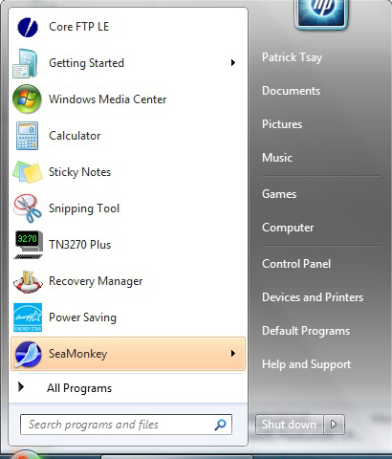
Hanj Character Installation
Click Start → Control Panel

Slide 14
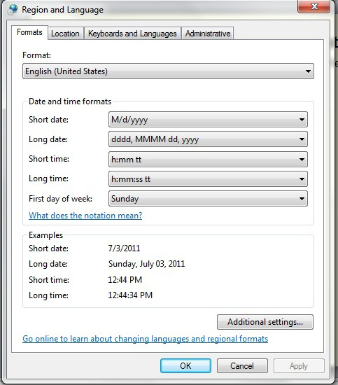
2. Click Clock, Language and Region → Region and Language
3. Click Keyboards and Language

Slide 15
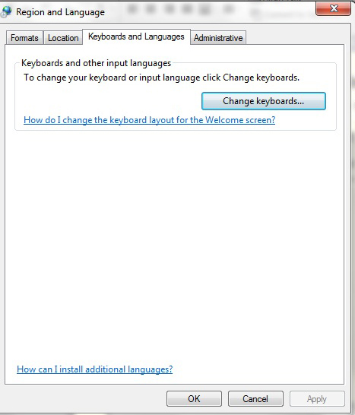
4. Click Change keyboards

Slide 16
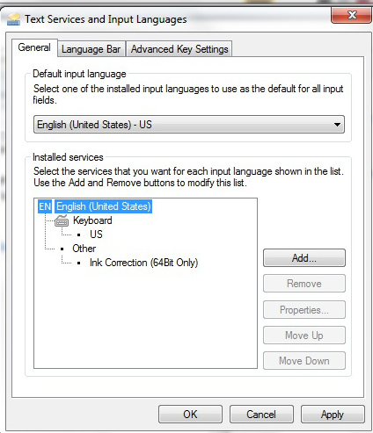
5. Click “Add”

Slide 17
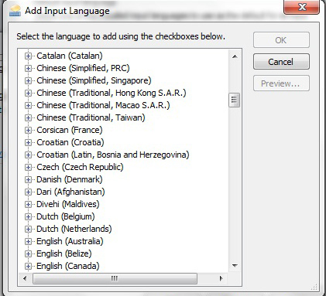
6. Use mouse to move down the language list until you see
“Chinese (Traditional, Taiwan), then click it.

Slide 18
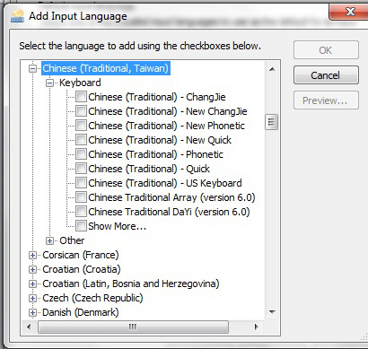
7. Click “keyboard” to expand the option, then
Select “Chinese (Traditional) – New Phonetic” then
Click “OK”
※

Slide 19
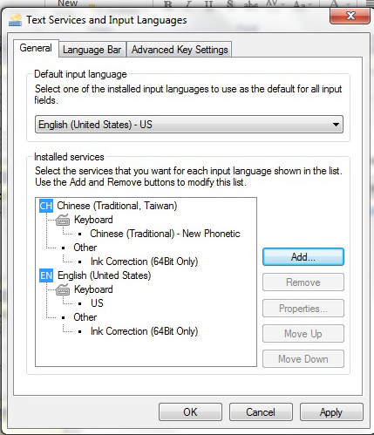
8. You should see Chinese (Traditional, Taiwan) language is added as in red circle.
Click “Apply”

Slide 20

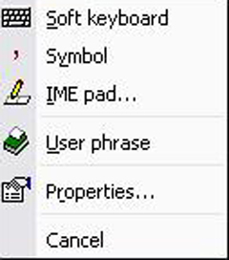
Hanji Character Input
Switch “EN” to “CH” from Language Bar
. Click “EN”
. Click “CH”
. Click “Tool”
2. 注音輸入
. Click “Soft keyboard”

Slide 21
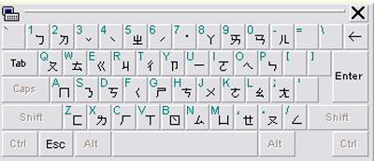
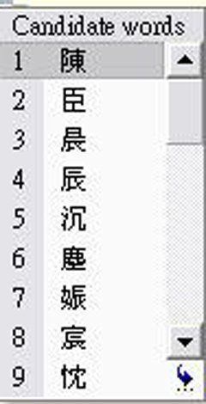
A virtual keyboard will be prompted after you click “Soft keyboard”as:
Click the 注音and one of 四聲 or space bar to indicate 清音and use symbol “↓” to
have the character list. For Example: You enter ㄔㄣˊ
The character list shows as
in the right side. Click the
one you want. If not in this
list, continue click the red
marked symbol until the
correct character you want to pick up.

Slide 22
Note: Hanji & English exchange during the Hanji language bar is in use:
Click “注音”
An English input will be prompted as:
So English letter can be keyed in.
3. 手寫版輸入
Click “IME pad”

Slide 23
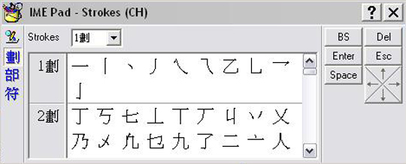
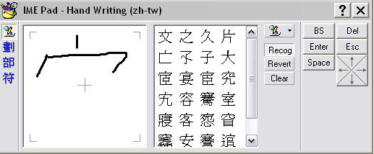
Click “Hand Writing” symbol
Click “Clear”

Slide 24
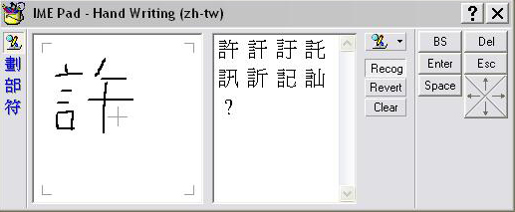
Use mouse to write the character you want as the example shown below. The
character will be prompted then pick it up.
4. 筆劃輸入
Click “劃” in IME pad.

Slide 25
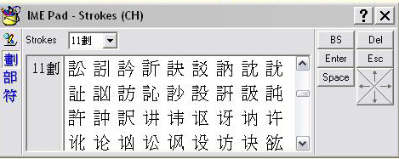
Then key in how many strokes for the character. For example, 許 is 11strokes.
Scroll down until the character is found then pick it up.
5. 部首輸入
Click “部” in IME pad

Slide 26
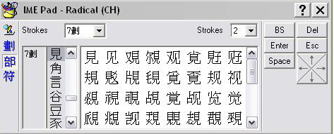
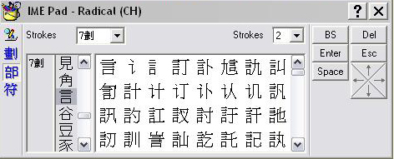
Let’s use 許for example.許的部首 “言” has 7 strokes. So a “7” is entered.
Pick up “言”

Slide 27
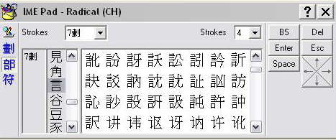
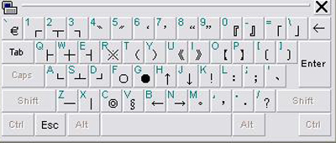
Because “午” has 4 strokes, a 4 is entered at the right hand side.
Scroll down until the character is found, then pick it up.
6. 符號輸入
. Use “symbol” after click “tool”

Slide 28
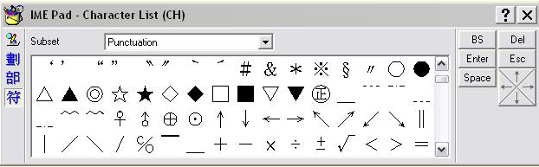
or use IME pad by clicking “符”
Scroll down until the symbol is found, then pick it up.

Slide 29
3-D and Slide Show Design
Frame Design
Use proper color
Use proper shadow
Bevel the edge
Complete the page
Save it (Think to adjust the DPI in Power Point)
Set up timing (8 to 10 seconds per slide)
Add music (must be in WAV format)

