Slide 1




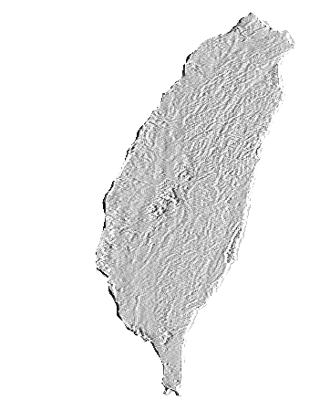
2009年台灣工程師協會─達拉斯分會年會
Emerging Technologies
主題：前瞻科技
Featured
“First Taiwan, Then the World: Building a Global Biotech Company” By Dr. Keelung Hong, 洪基隆博士
“From Preventive Medicine To Preventive Politics” By Dr. Chi_Byi Horng, 洪其璧博士
“The Function, Mechanism and Application of RNA interference” By Dr. Hengchi Lee, 李亨啟博士
“Mobile WiMAX - 4G 時代的來臨” By Dr. Ching-Tarng Hsieh, 謝慶堂博士
餐費 ： $25 Per person 學生$15
會費 ： Couple - $35 Single - $20 Student - $10
Date : November 14 (Saturday)
Time : 1:30-10:00 pm
Place : Holiday Inn (NE corner of 635 LBJ and I-35E, on north side
service road of LBJ)
聯絡人員：莊樹源(817-277-9224) 謝慶鏘(972-624-8232) 陳伯勛(972-618-4102) 趙芳珍(972-910-0742)
詹文聲(817-354-6217) 蔡靜煌(817-261-3929) 邱志倖(972-208-8548)

