Slide 1
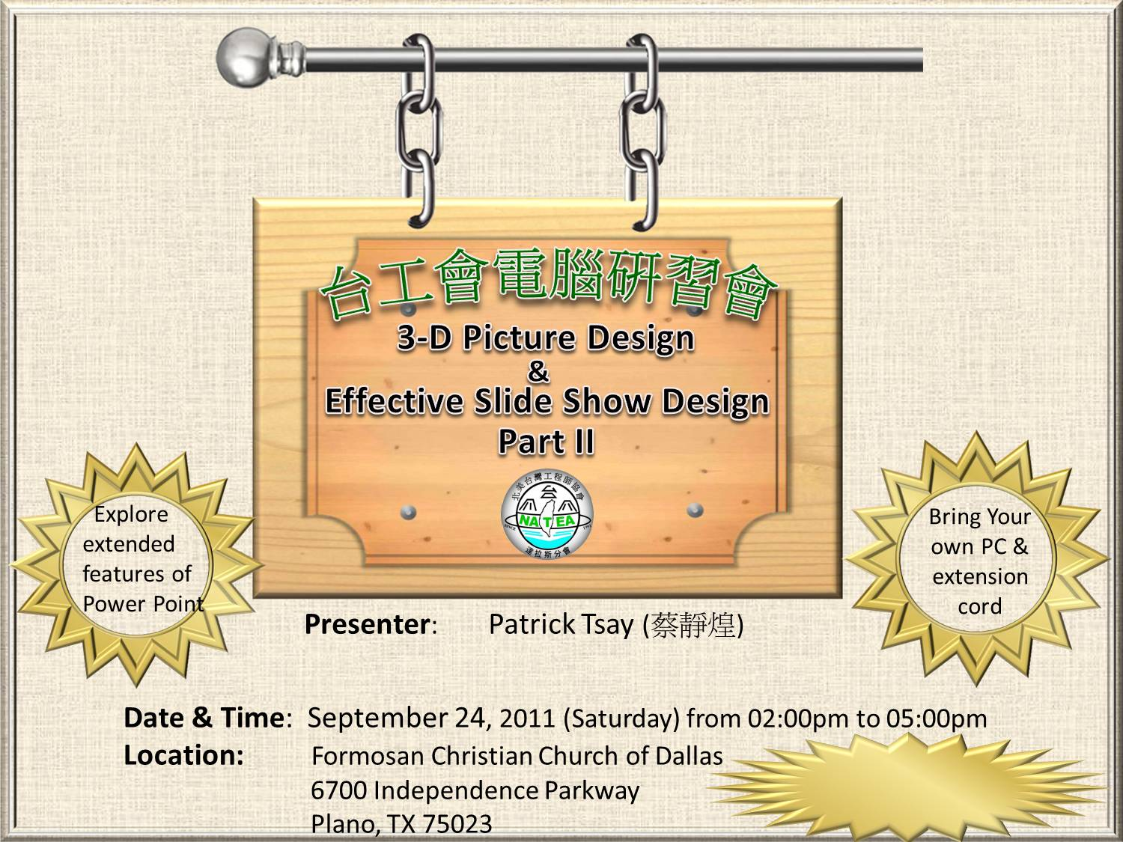
Left click to see the Demo

Slide 2



Left Click to the next slide

Slide 3



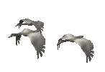
Left click to the next slide

Slide 4







Left click to exit

