Slide 1
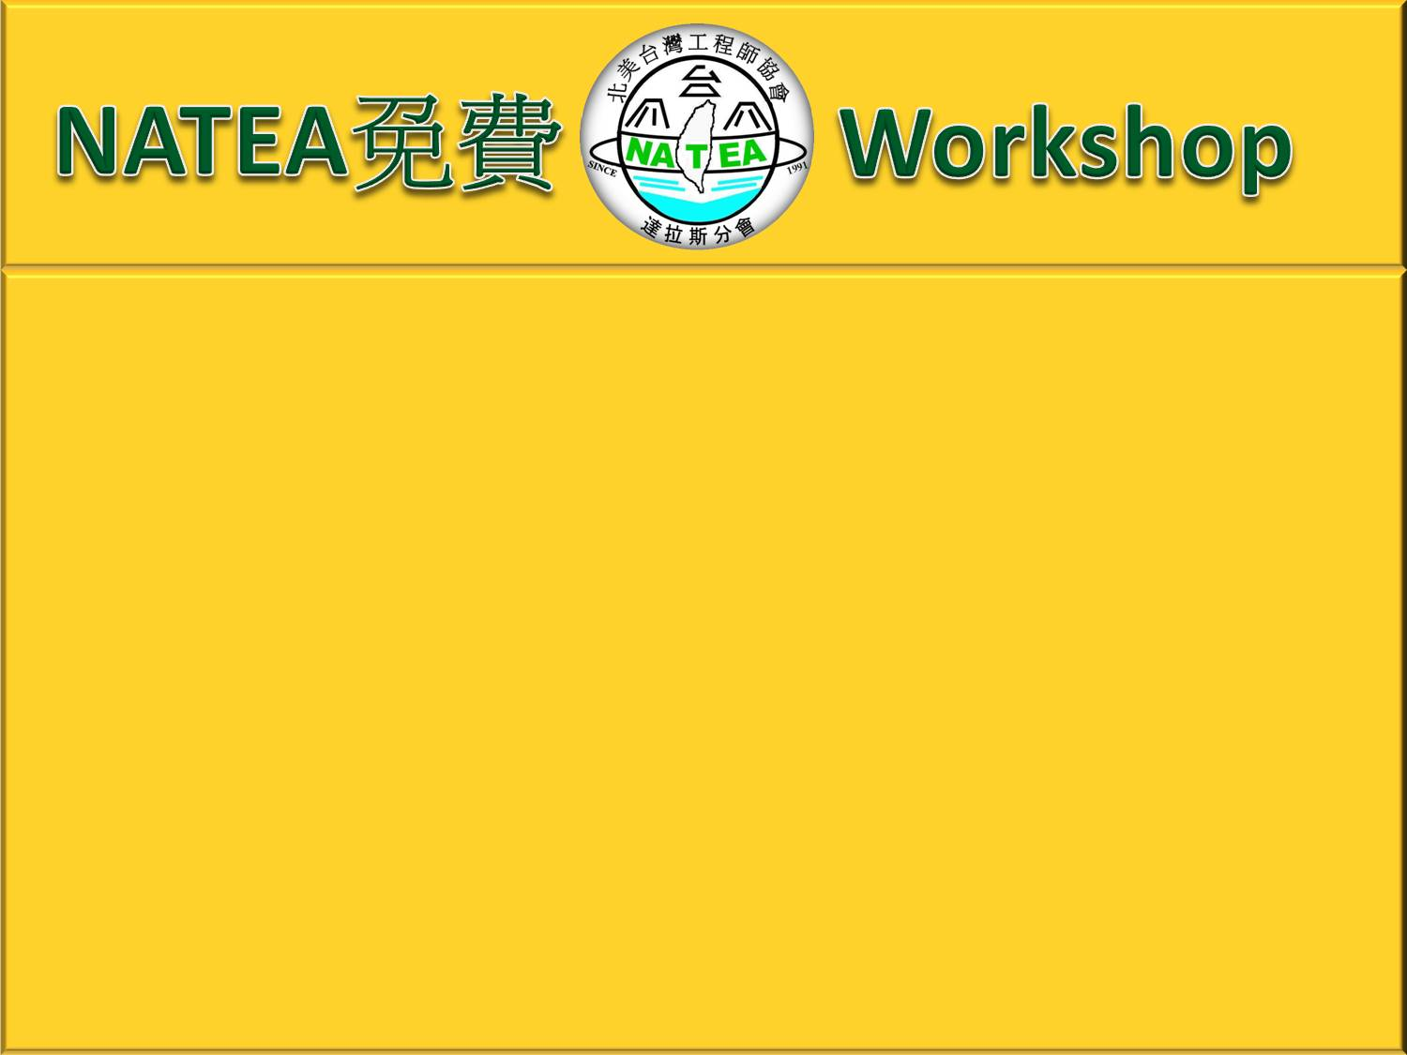


NATEA proudly announces two free sessions of computer technical art design on July 9 (Saturday) . Please feel free to join this event by bringing your own laptop (minimum requirement : Microsoft Office version 2007)to the location indicated at the bottom.
Topic 1:
Basic Web Design
Learn the concept of web access & design
by Shu-Hsien Tsay (劉淑賢)
Topic 2
How to Make Impressive Slide Show
Session includes followings:
. Hanji Character Input
. 3D of Flyer, AD and Picture
. Dynamic Slide Creation
by Patrick Tsay (蔡靜煌)
Internet access is available. Because of limited power outlets in the room, please bring your power strip with you if you have any.
Click Left to see the demo
Date & Time: July 9, 2011 (Saturday) from 02:00pm to 05:00pm
Location: Formosan Christian Church of Dallas
6700 Independence Parkway
Plano, TX 75023

Slide 2





鄉村美景

Slide 3
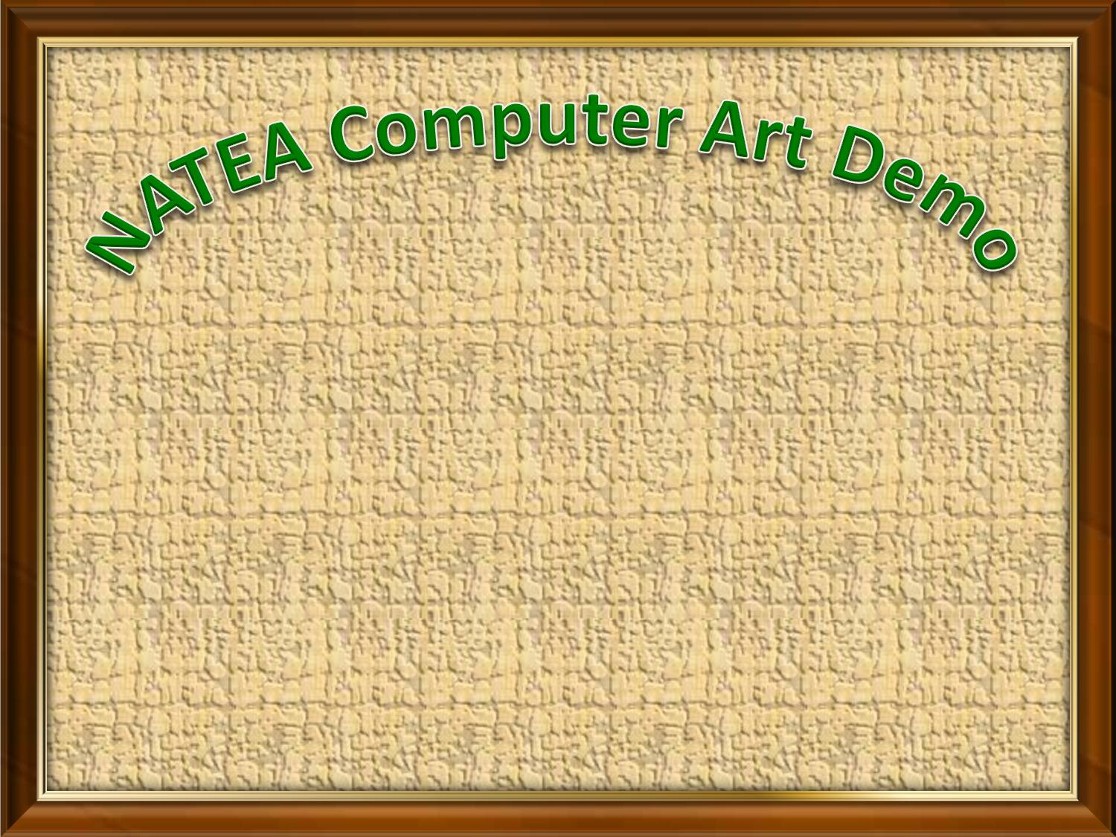


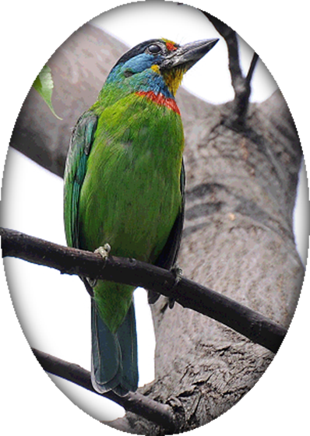

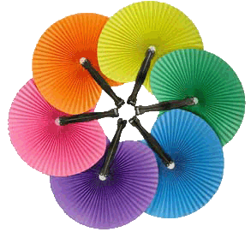

電腦圖片藝術示範
NATEA竭誠歡迎您參加

