Slide 1






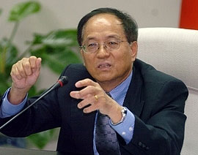
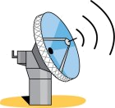

2008 NATEA – Dallas
Annual conference
Featuring Keynote Speaker:
Dr. Chin Shieh (謝清志博士)
前行政院國家科學委員會副主委
高鐵減震的世界創舉
國家太空IPS系統的催生者
Please join us to welcome
Dr. Shieh to Dallas!!
Saturday, November 15th, 2008
Holiday Inn Select
2645 LBJ Freeway, Dallas, TX 75234

