Slide 1


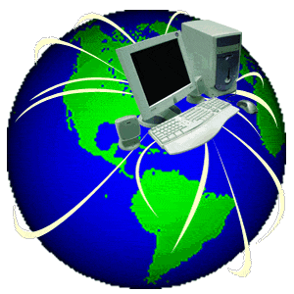
Protection of Cyber Attack
March 27, 2010
Presented by:
Patrick Tsay at NATEA Seminar

Slide 2
Protection of Cyber Attack
Computer Evolution
1. First Generation (1939-1954) - vacuum tube
2. Second Generation Computers (1954 -1959) - transistor
3. Third Generation Computers (1959 -1971) - IC
4. Fourth Generation (1971-1991) - microprocessor
5. Fifth Generation (1991 and Beyond) - Cyberspace
Communication vs. Web
6. Sixth Generation – Virtualization?
It becomes a necessity of majority people after 1990’s price reduction
of computer component due to the innovation of technologies both in
hardware and software have been introduced rapidly to meet the
market demand.

Slide 3
Protection of Cyber Attack
How is computer used in daily life?
- Graphics design (Adobe is the forefront in design software)
- Architectural design (AutoCAD leads this category)
- Financial system (savings, loans, insurance, credit, mutual funds...)
- Entertainment
- Social Networking (Myspace, Facebook, Twitter, Plurk, etc.).
- Knowledge sharing (WikiAnswers, Wikipedia, Lifehacker, Gizmodo)
- Science (Folding at Home is a great example of home-based cloud
computing)
- Geology & Petroleum Equipment and research device
- Medical system
- Transportation
- Power system
- Misc

Slide 4
Protection of Cyber Attack
What is Cyber?
A prefix that is used for the description of the relationship among
computer, information, network, web and communication technology.
一種前置詞用來表示與電腦、 資訊、 網絡、 通信技術等之間的關係
What is a Cyber attack?
A cyber attack means a hacker uses special software to cause the
malfunction of targeting computer systems or resulting in disrupted
flows of data that disable businesses, financial institutions, medical
institutions, and government agencies.

Slide 5
Protection of Cyber Attack
Categories of Cyber-Attacks
Natural or Inadvertent attack – including things like include accidents originating from natural disaster like fire, floods, windstorms, lightening and earthquakes, and they usually occur very quickly without warning, and are beyond human capacity, often causing serious damage
Human errors – including disasters from unintentional human actions
Intentional threats - including illegal or criminal acts from either insiders or outsiders, recreational hackers, and criminal

Slide 6
Protection of Cyber Attack
Purpose of Attack
- Spying (Defense, Industrial secret, Personal data)
- Stealing (Financial Information)
- Damaging
Type of Attack
- Penetrating
Breaking into the system (Spying, Stealing)
- Denial of Service
Bringing down the system without destroying resources
- Revising or Interrupting the system of application instruction code;
or data
Causing the damage

Slide 7
Protection of Cyber Attack
Source Classification of Cyber Attack
Bug
  A software bug is the common term used to describe an error, flaw, mistake, failure, or fault in a computer program or system that produces an incorrect or unexpected result, or causes it to behave in unintended ways. Most bugs arise from mistakes and errors made by people in either a program's source or its design, and a few are caused by compilers producing incorrect code.
Worm
A computer worm is a software program that is designed to copy itself from one computer to another, without human interaction. Unlike a computer virus, a worm can copy itself automatically. Many worms that have been created are only designed to spread, and don't attempt to alter the systems they pass through. However they can jam the network traffic to cause the huge bottleneck.

Slide 8
Protection of Cyber Attack
Source Classification of Cyber Attack (Cont)
Virus
A computer virus is a computer program that can copy itself and infect a computer.
Malware
Malware includes computer viruses, worms, Trojans, most rootkits, spyware, dishonest adware, crimeware, and other malicious and unwanted software, including true viruses.
Spyware
Spyware is a type of malware that is installed on computers and collects little bits of information at a time about users without their knowledge. The presence of spyware is typically hidden from the user, and can be difficult to detect. Typically, spyware is secretly installed on the user's personal computer.

Slide 9
Protection of Cyber Attack
Source Classification of Cyber Attack (Cont)
Adware
Adware, or advertising-supported software, is any software package which automatically plays, displays, or downloads advertisements to a computer after the software is installed on it or while the application is being used.
Trojan Horse
Trojan horses are designed to allow a hacker remote access to a target computer system. Once a Trojan horse has been installed on a target computer system, it is possible for a hacker to access it remotely and perform various operations. The operations that a hacker can perform are limited by user privileges on the target computer system and the design of the Trojan horse.
Phishing Scam
Phishing refers to a person or a group of cyber-criminals who create an imitation or copy of an existing legitimate Web page to trick users into providing sensitive personal information. Responding to "phishing" emails put your accounts at risk.

Slide 10
Protection of Cyber Attack
Source Classification of Cyber Attack (Cont)
Spam
Spam is flooding the Internet with many copies of the same message.
RootKit
A rootkit is a software system that consists of one or more programs designed to obscure the fact that the system has been compromised. An attacker may use a rootkit to replace vital system executables, which may then be used to hide processes and files that the attacker has installed, along with the presence of the rootkit. Access to the hardware, e.g., the reset switch, is rarely required, as a rootkit is intended to seize control of the operating system.

Slide 11
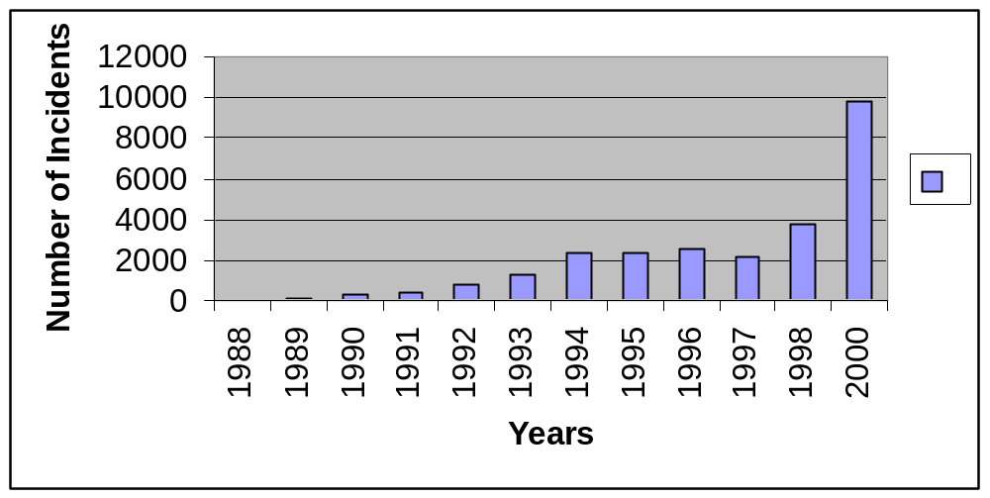
Protection of Cyber Attack
Number of cyber attack incidents:
There is steady growth of these attacks – see the CERT ( US- Computer Emergency Readiness Team http://www.us-cert.gov ) Report below: (1988-2000)

Slide 12
Protection of Cyber Attack
Other cyber attack statistics
Year | Private & government | Federal | Defense
2006 | 24,000 | - | -
2007 | 37,000 | 13,000 | 80,000
2010 | 75% of business | - | -
03/18/09 11:40
The head of Pentagon's Strategic Command warned that the US government is under the threat of cyber attacks "across the spectrum" and that it should make more measures to ensure that its privacy and integrity are protected.
But Air Force Gen. Kevin Chilton, the head, said that it was not ordered to protect the websites of government agencies from attacks. Rather his agency is tasked to operate and defend military networks and protect the rest of the government network only when needed.
2009 Disaster on 07/04 (Independence Day) – linked to North Korea
United State :Transportation Department, Federal Trade Commission, The Treasury
Department
South Korea: Defense Ministry, Korea Exchange Bank, Shinhan Bank, National
Assembly and Prudential Blue House

Slide 13
Protection of Cyber Attack
February 17, 2010 more than 75,000 computer system at about 2,500 companies in the US have been hacked. It is the largest ever in history.
Origin – linked to China or Russia via Google intrusion.
Estimated Loss – 220B annually
March 05, 2010 — Cyber crime is growing says FBI and it is a great threat for the nation. FBI warns the security in the United States as it is eating away at data and cash.
Robert Mueller, chief of Federal Bureau of Investigation addressed to RSA Conference of computer security professionals on 03/04/2010 in San Francisco, “The risks are right at our doorsteps and in some cases they are in the house.”
Note: The RSA (Security Division of EMC) Conference is a Cryptography and information security-related conference held annually in the San Francisco Bay Area

Slide 14
Protection of Cyber Attack
Motives of Cyber-Attacks
  Vendetta/Revenge
  Joke/Hoax/Prank
  The Hacker's Personality
  Terrorism
  Political and Military Espionage/Spying
  Business ( Competition) Espionage/Spying
  Hatred (national origin, gender, and race)
  Personal gain/Fame/Fun/Notoriety
  Ignorance

Slide 15
Protection of Cyber Attack
Top 10 riskiest cities for Cybercrime
  Seattle
  Boston
  Washington DC
  San Francisco
  Raleigh
  Atlanta
  Minneapolis
  Denver
  Austin
  Portland
  Source: Computerworld (03/23/2010)

Slide 16
Protection of Cyber Attack
Top 10 Cybercriminal operations
  Coders/programmers - write the exploits and malware
  Distributors - trade and sell stolen data
  Tech Experts – maintain or create cyber attack technology
  Hackers - search for and exploit malware
  Fraudsters - create and deploy various social engineering schemes,
  such as phishing and spam
  Host Systems providers - offer safe hosting of illicit content servers and sites
  Cashiers - provide names and accounts to other criminals for a fee
  Money Mules – money transfer via wire
  Tellers – transferring or laundering via digital currency service
  Organization Leaders - The leaders assemble the team and choose the target
  Source: FBI

Slide 17
Protection of Cyber Attack
Why PC or Cloud-Based Computing Security Make Sense
At least 75% of all email traversing the Internet is spam and 38% of organizations reported that malware had infiltrated the corporate network through email during the 12-month period ended April 2009.*
More than 60% of organizations believe that the IT department holds the majority of the responsibility for communications security and compliance, but fewer than 20% feel they are well equipped to handle it.**
42% of Best-in-Class organizations decreased their help-desk costs and time need to remediate email attacks by more than 20%.***
*. Osterman Research: Why Cloud-Based Security and Archiving Make Sense - March 2009
**. Google Communications Intelligence Report - October 2009
***. Aberdeen Group: Safe Email: Seven Important Tips for Better Email Security in 2009 - June 2009

Slide 18
Protection of Cyber Attack
Protect your PC or network from cyber attack
There is no any protection if your PC or network uses the broadband service via DSL or cable modem. Your connection is wide open to public access by any hacker/attacker.
Methods
User ID & Password
Firewall
Virus Protection
Content Filter
VPN (Virtual Private Network)
Data Protection
The U.S. government needs more effort to collaborate effectively with private sector partners and international authorities. (Political Issue on cybercrime)

Slide 19
Protection of Cyber Attack
User ID and Password
This is the most common method to secure the system or PC.
- Static password
Recommend to change it periodically.
- Dynamic password
Best practice
Firewall
If you use Windows 7, Window Vista or Windows XP Service Pack 2 (SP2), you have a firewall built in and turned on by default.
If you haven't downloaded Service Pack 2, visit Microsoft Update to learn how to get it. If you are using Windows XP and you choose not to download Service Pack 2, you still have access to the Internet Connection Firewall (ICF) that's built into Windows XP, but you need to turn it on.
Installing a firewall is just the first step toward safe surfing online especially for the wireless router. Wireless devices using radio signals that can be intercepted by someone outside of your home.

Slide 20
Protection of Cyber Attack
Virus protection
Virus can damage data, crash the computer, breakdown the network, or lie dormant like a time bomb to explodes in the future. It is hard to be discovered immediately so that the damage can be spread through the whole network or clouding computing systems.
The virus can be accomplished in 3 ways:
- Desktop/Laptop level
This is the most effective to combat the virus. It can ensure the protection from incoming e-mail, internet download and some other portable media such as un-certified CD. The anti-virus software requires manual installation and regular update. This is a self guided method.

Slide 21
Protection of Cyber Attack
- Managed gateway level
The incoming e-mail and software download at the entrance to the network. This method is more easily managed than the previous one. It is a central control base. Typically, this level may slow down the processing of network traffic.
- Policy Enforced
This method has the advantage of desktop/laptop and managed gateway level. Automatically update the anti-virus software/patches on each desktop/laptop by the firewall. This method has the firewall check to ensure the PC is in current support level against the virus in any e-mail, download or the portable media.

Slide 22
Protection of Cyber Attack
Content Filtering
Content filtering is a firewall to screen what materials can or can not be accessible on the network computers; block incoming content; filter out internet site with offensive material.
Content filtering can be done by following methods:
- Text Screening
This is a very efficient way to stop the incoming messages by the pre-defined list such as some keywords, URL (Uniform Resource Locator) or body of page. The trade off is some legal content may be screened out.
- Allowed List
This method is implemented via a pre-defined approved sites or approved content. All accesses are from the proxy server instead of the connection to internet directly. This can guarantee 100% safe if it is implemented sufficiently setup.

Slide 23
Protection of Cyber Attack
- URL (Uniform Resource Locator ) Blocking
The method will block the URL which contains offensive material or virus. URL blocking is based upon the frequently updated filtering list from an accountable organization. You can set up by your own as well via Google, Yahoo popup blocking.
VPN (Virtual Private Networking)
VPN allows partners, clients, telecommuters and remote users to access clouding based network with an established security. It can be a LAN to LAN, LAN to WAN or WAN to WAN communication over the internet using a single data channel. VPN has become standard for the remote access according to Gartner’s research.
Security policy should be enforced the VPN session connect time of the VPN clients, and require that a session be terminated after a prescribed period of idle time has elapsed. The VPN has dynamic password and standard cryptographic techniques to provide the confidentiality, data integrity and authentication.

Slide 24
Protection of Cyber Attack
Data protection
- Data encryption
- Data compression
- Data security
. By file name vs. user id
. By password
US government effort
The Department of Homeland Security is looking to invest nearly $900 million in fiscal 2011 on technology projects that include bolstering cyber security and continued work on a data center consolidation project that's already underway.
The Cybersecurity Act, S. 773, aimed at protecting critical U.S.
network infrastructure against cybersecurity threats by
fostering collaboration between the federal government and
the private sector firms that maintain that infrastructure, is now
on its way to the Senate floor. (News on 03/24/2010)

Slide 25
Protection of Cyber Attack
Sarbanes–Oxley Act
Sarbanes-Oxley Act (SOX) is a federal security law which was passed on July 30, 2002. It is a new or enhanced standards for all U.S. public company boards, management and public accounting firms. The bill was set as a reaction to a number of major corporate and accounting scandals including Enron, Tyco International, Adelphia, Peregrine Systems and WorldCom. These scandals, which cost investors billions of dollars when the share prices of affected companies collapsed, shook public confidence in the nation's securities markets. It is adopted by the company for auditing and security purpose now.

Slide 26
Protection of Cyber Attack
Security Software
Mainframe:
Product Name | Company | Rating
RACF | IBM | *****
ACF2 | CA | ****
TopSecret | CA | ***

Slide 27
Protection of Cyber Attack
Security Software (cont)
Internet/PC related
Product Name | Rating | Comments
Norton | ***** | Great overall protection and threat analysis make this product worth the cost
McAfee | ***** | Extensive PC security
Identity Guard | ***** | Complete solution for total online and offline security
KasperSky | ***** | Highly rated computer protection; compelling interface and URL blocker
Trend Micro | **** | Excellent URL blocker; Nice interface
ESET | **** | Award winning and non-intrusive security software; no personal information management or parental controls
Other security software
Avast, CA internet security plus, Webroot, ZoneAlarm, AVG,
Bitdefender
Security Software comparison:
http://www.isoftwarereviews.com/internet-security-software-comparison-rating
http://www.consumersearch.com/internet-security-software/compare

Slide 28
Protection of Cyber Attack
Hoax Proof
The Internet and the Web that make communications around the world so easy is a rich ground for hoaxes, lies, jokes, and tall tales. It can sometimes be very difficult to tell when a story passed on the nets is true or not. Some very ingenious people take pride in creating a believable tale and getting others to accept it and pass it along in chain letters. We’ve encountered this hoax daily, don’t we?
Examples of hoaxes:
contaminated needles placed in gas pumps
cars without headlights on driven by gang members
catch fire on cell phone while in charge
drinking cold water causes cancer
wonderlands on the earth
Problems caused by hoaxes:
increasing traffic jam on internet
possibly spreading virus/malware/Spam

Slide 29
Protection of Cyber Attack
Reference Sites:
http://www.snopes.com
http://urbanlegends.about.com
http://www.hoax-slayer.com
http://examine.nownews.com (Kanji search)
Enter the subject or title in search field to find out if the subject is a hoax or not via above web sites.
or
Enter the subject and attach with “hoax” or “謠言” via Google or Yahoo search.
Stop the hoax
Verify the source
Your own judgment
Do not forward (Forward before verifying)

Slide 30
Protection of Cyber Attack
Cyber Security Tips:
Be sure to set up password (using dynamic password is suggested)
Do not leave your opened PC unattended
Set up automatic log off if the idle time exceeded
Install anti-virus software
Protect your PC with firewall
Use popup blocker from Window, Google, Yahoo or other software
Do not open the attachment from unfamiliar sender
Do not open the attachment with exe, dat, cmd or some other unknown
extension
Do not click the hyperlink in the suspected e-mail
Avoid phishing scam
Learn how to use “ctrl, alt, del” together to interrupt the looping
Have a common sense to identify hoax
Use external hard disk to store your important data
Encrypt or compress your data/file
Create back up files periodically
Recognize spyware, virus, malware, etc..

Slide 31
Protection of Cyber Attack
Set up automatic Window update or install the Window patches
regularly
Run virus scan via security software such as Norton, McAfee
and remove the suspected virus regularly
Do not share your PC with strangers
Do not download un-certified software
Dispose all information on discarded PC
Protect your own identity. Send your ID very carefully.
Do not reply after you get “Your PC has the security problem”
message
Don’t access your e-mail via unknown network / wireless
Tie to plain text on e-mail over HTML on e-mail
Report to CERT (Computer Emergency Readiness Team) when
your PC is hacked (URL Address: http://www.us-cert.gov)
Review CERT report frequently to keep your PC safe

Slide 32
Protection of Cyber Attack
Other Concern on following tools:
Chatting Room
Facebook
Twitter
Mylife
Window Life
Myspace
Plurk
MSN
Info Sharing
LinkedIn
Blog
Photobucket
Flickr
Video Sharing
YouTube

Slide 33

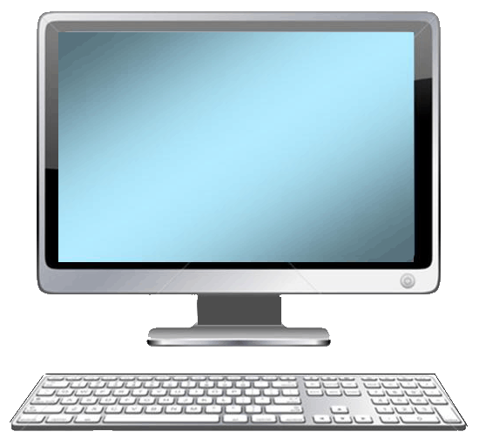
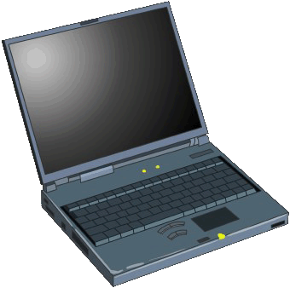

Protection of Cyber Attack

