Slide 1
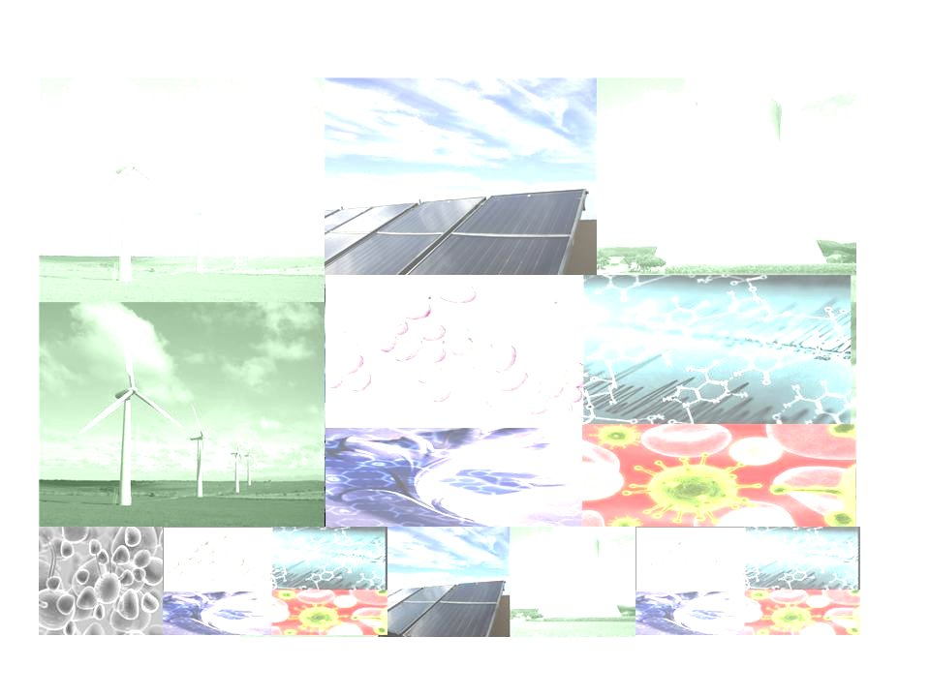


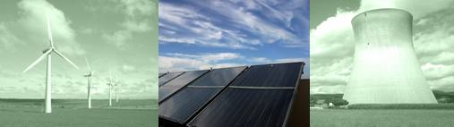
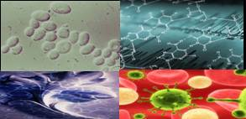
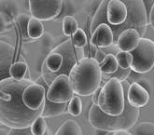










Pre-Conference Announcement
International Symposium on Emerging Technologies
iSET 2009 on Clean Energy & Biomedical Technologies
July 24 – 25, 2009 | Hilton Suites, Oakbrook Terrace |Chicago, IL
Mark Your Calendar!!
Post
Conference
Tours!!
iSET 2009 offers you:
In-depth analysis of emerging technologies in green energy and biomedical technologies.
Experts’ insights into global trends, start-ups and technologies in science and technology.
Valuable connections among researchers, entrepreneurs, and venture capitalists around the world.
Potential international revenues for high-tech Intellectual Property (IP).
………………………………………………………………………………………………………………………
SPONSORS:
TERCO, Taiwan
And many more….
……………………………………………………………………………………………………………………….
For More Information or to Register: Visit http://www.NATEA.org | Call 1.630.499.8785

Slide 2
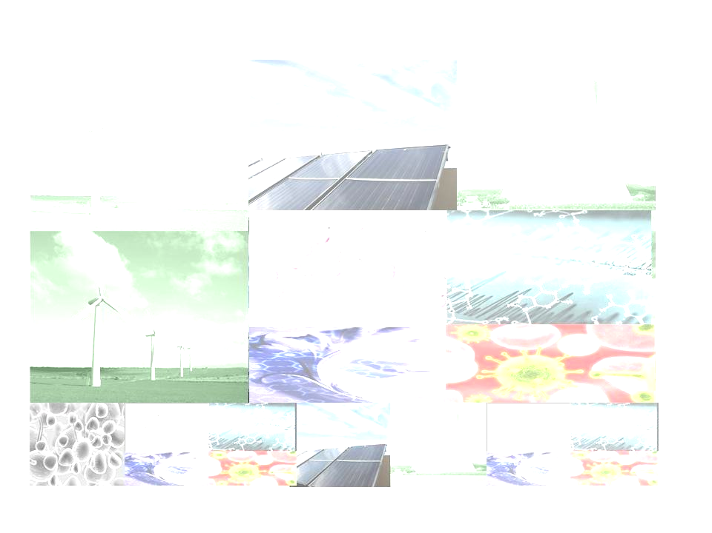
Pre-Conference Announcement
International Symposium on Emerging Technologies
iSET 2009 on Clean Energy & Biomedical Technologies
July 24 – 25, 2009 | Hilton Suites, Oakbrook Terrace |Chicago, IL
A list of the invited distinguished speakers include:
  The Honorable Richard M. Daley, Mayor of Chicago
  The Honorable Thomas S. Mazaika, Mayor of Oakbrook Terrace, IL.
  The Honorable Peter Roskam, United States Congressman from Illinois
  Mr. Brian Wesbury, Chief Economist, First Trust Advisors L.P.,
  Mr. Thomas Benjamin, Argonne National Lab., DOE Technical Advisor
  Dr. Jennifer Holmgren, Partner, UOP LLC, USA
  Dr. Shankar Sastry, Professor and Dean of Engineering School, UC Berkeley, CA
  Dr. Yuan T. Lee, Nobel Laureate and Former President of Academia Sinica of Taiwan
  Dr. Robert W Galvin, Chairman of the Task Force on Alternative Futures ,DOE; Former CEO of
  Motorola
  Dr. Peter (Chung-Yu) Wu, President of National Chiao Tung University, Taiwan
Also, featuring leading executives from:
  Health Canada - Fermi National Accelerator Laboratory -Industrial Technology Research Institute (ITRI), Taiwan - BP Alternative Energy North America - Thermo Fisher Scientific -Abbott Co –Nova Biomedical Technologies – McCracken and Frank LLP-- Lawrence Berkeley National Laboratory -University of Chicago - Univ. of Illinois, Urbana - University of Manitoba, Winnipeg, Canada- USDA - and more!
For More Information or to Register: Visit http://www.NATEA.org | Call 1.630.499.8785

