Slide 1
Introduction to Web design
All Web pages are written with some form of HTML (HyperText Markup Language).
HTML documents are saved as Text Only files so virtually any computer can read them.
Browser is the software used to view the web page. e.g. Internet Explorer, Firefox, Opera, Safari with handhelds, PDAs.

Slide 2
Principal components of web pages:
Text content --- the actual headers and paragraphs
References --- links, images, Flash animations
Markup --- instructions describing how the content and references should be displayed

Slide 3
Basic Syntax
Comments
<!-- comments -->
Tags : open tag close tag pair
<tag_name> </tag_nam>
Self-closing Tags : tags that contain nothing between the opening and closing tags:
<br /> <hr />

Slide 4
Basic html document structure
<html></html> -- html tag is the container that contains all other HTML elements
<body></body> -- body tag is used for indicating the main content section of the HTML document
<html>
<body>
</body>
</html>

Slide 5
Text Tag Examples
p tag --- defins paragraph
H1 to H6 tags --- define html headings, h1 defines the most important headings and h6 defines the least important headings

Slide 6
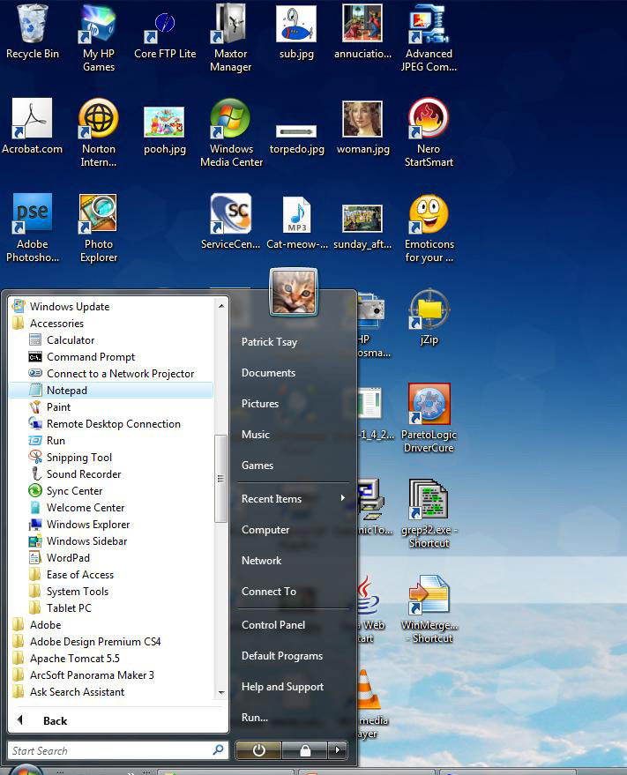

Slide 7
Simple Example
<html>
<body>
<p>This is written using p tag</p>
<H1>This is written using H1 tag</H1>
<h2>This is written using H2 tag</h2>
<H3>This is written using H3 tag</h3>
<H4>This is written using H4 tag</H4>
<h5>This is written using H5 tag</h5>
<H6>This is written using H6 tag</H6>
<H1>這是用H1 tag寫的</H1>
</body>
</html>

Slide 8
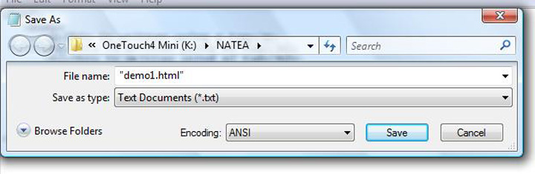

Slide 9
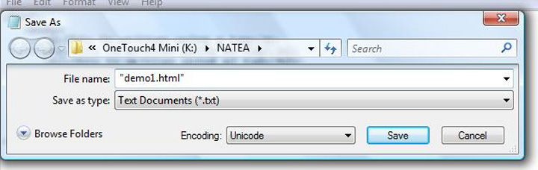

Slide 10
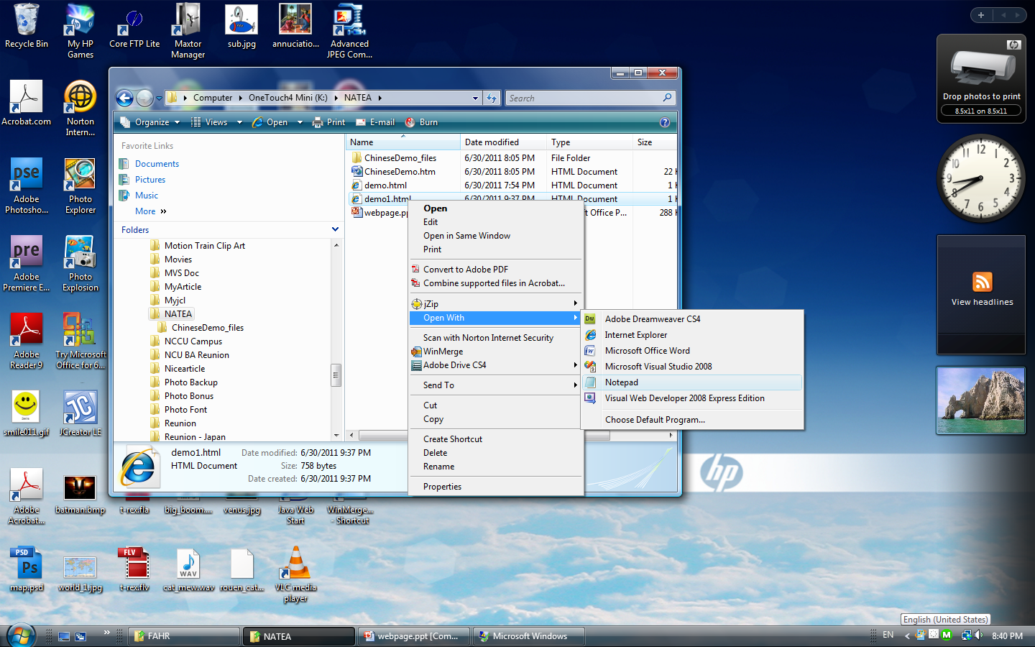

Slide 11
Title Tag
defines a title in the browser toolbar
provides a title for the page when it is added to favorites
displays a title for the page in search-engine results

Slide 12
Add Title to Simple Example
<html>
<title>
Demo Example
</title>
<body>
:
:
</body>
</html>

Slide 13
<!Doctype> Declaration
The doctype declaration is not an HTML tag; it is an instruction to the web browser about what version of the markup language the page is written in.
The doctype declaration should be the very first thing in an HTML document, before the <html> tag.

Slide 14
Example of <!Doctype> Declaration
<!DOCTYPE html PUBLIC "-//W3C//DTD XHTML 1.0 Transitional//EN" "http://www.w3.org/TR/xhtml1/DTD/xhtml1-transitional.dtd">
<!DOCTYPE HTML PUBLIC "-//W3C//DTD HTML 4.01 Transitional//EN" "http://www.w3.org/TR/html4/loose.dtd">

Slide 15
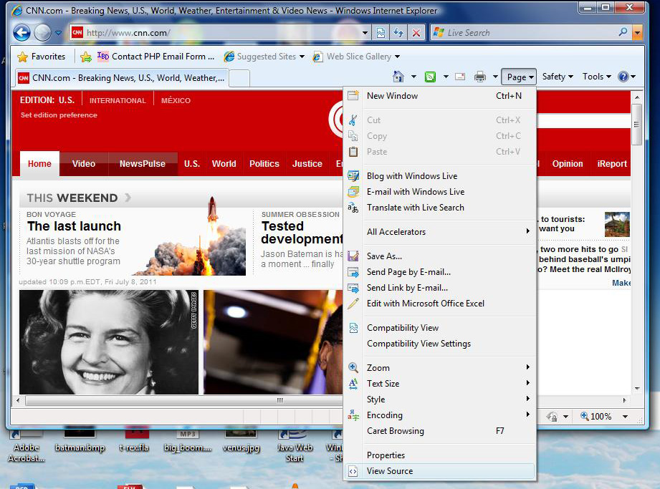

Slide 16
The End
Thank you very much

Slide 17
Anchor Tag
To create a link to another document, by using the href attribute
To create a bookmark inside a document, by using the name attribute
The most important attribute of the a element is the href attribute, which indicates the link’s destination.

Slide 18
Example of <a> tag
<p>Example of link
<a href="http://www.wfaa.com" target="_blank">Visit wfaa.com!</a>
</p>
<p>
Example of link using images<br />
<a href="http://www.cnn.com" target="_blank">
<img border="0" alt="CNN.com" src="cnnlogo.bmp" width="300" height="100" />
</a>
</p>

Slide 19
By default, links will appear as follows in all browsers:
An unvisited link is underlined and blue
A visited link is underlined and purple
An active link is underlined and red

Slide 20
<font> tag
<font size="3" color="red">This is some text!</font><br />
<font size="16" color="blue">This is some text!</font><br />
<font face="verdana" color="green">This is some text!</font><br />

