Slide 1

Version Control
CSC207 Fall 2016

Slide 2
Problem I: Working Solo
How do you keep track of changes to your program?
Option 1: Don’t bother
• Hope you get it right the first time
• Hope you can remember what changes you made if you didn’t
• (Often, you won’t get it right)
• (Or remember)
• (You will end up rewriting code)

Slide 3
Problem I: Working Solo
How do you keep track of changes to your program?
Option 2: Periodically save “backups”
Save snapshots of your program in another directory or under a different name
  • E.g. Main.java, Main2.java, Main_FINAL.java, Main_USE_THIS_VERSION.java, Main_FINAL_v2.java,
  • Or save it in a directory by date
Problems:
  • Totally ad hoc • Only the programmer knows how to interpret the names • If you need to go back to an earlier version, which one??
  • Prone to error
  • No tools to help you

Slide 4
Problem II: Working in a Team
How do you coordinate who has the authority to change a file?
Option 1: Worry about it after the fact
  • “Hey, why is this broken?”
  • “My changes got overwritten!”
  • “You weren’t supposed to change that file!”
Option 2: Coordinate by email, phone calls, etc.
  • “Okay, I’m going to work on A.java, so don’t touch it.”

Slide 5
Problem III: Moving around
After a day of work in the lab, you want to go home and do some work at home in the evening.
How do you know which files to copy to your home machine?
  Copy everything
    • potentially slow
    • might overwrite something you did at home, but forgot to copy from home to school
• Try to remember what changed
  • highly likely to get it wrong
• Work in a cloud
• Work on a removable storage device

Slide 6
Version Control
Two flavours:
  centralized only (e.g., SVN, CSV)
  centralized/distributed (e.g., Git, Mercurial)
In this course, we study the centralized approach.
In later courses (e.g., CSC301, CSC302) you may study distributed.

Slide 7
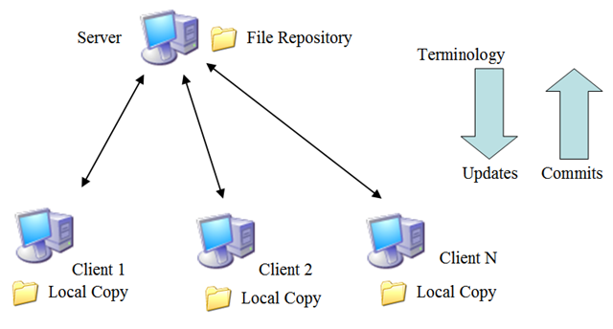
Centralized Version Control
Keep code in a central location, called a repository.
This is the “master copy”. Never directly modify this!
Create a local copy of the repository in your account at
school, on your machine at home, on your laptop...
When the local copy changes, “commit” the changes to the
remote repository.

Slide 8
Version Control — Tracking changes when working solo
Whenever you get something working, commit the changes.
Tools allow you to revert to a previous version.
Write good log messages so that you don’t have to remember what changed in each version.

