Slide 1



Building a Successful C2C Marketplace: Inspired by Bikroy.com
This presentation outlines key usability guidelines and revenue generation strategies for a new Consumer-to-Consumer (C2C) business inspired by Bikroy.com, ensuring user-friendliness and sustainability for the platform.
by Tiba Tabassum
ID: 2030132

Slide 2
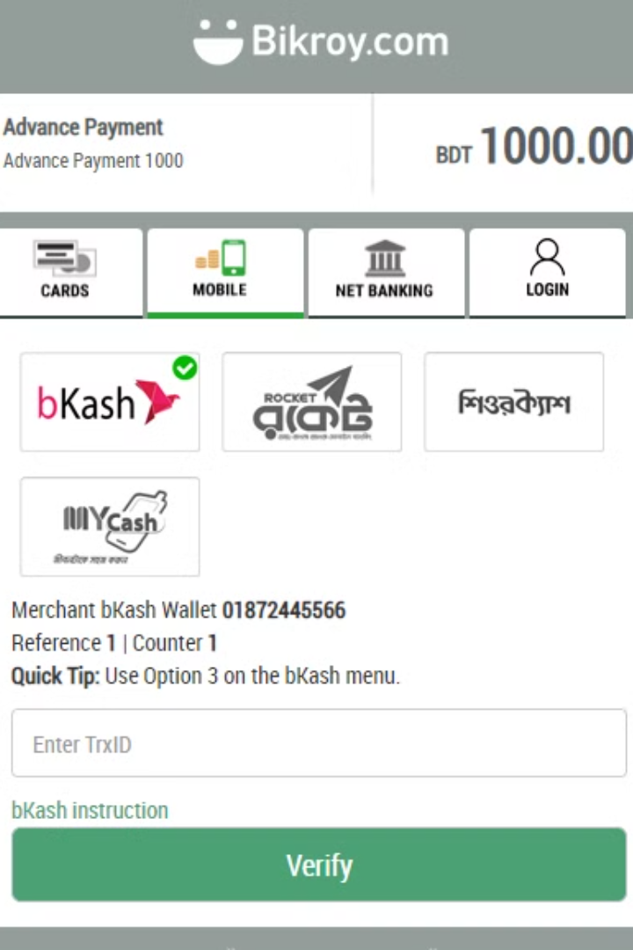
Web Usability Guidelines
Clear Navigation
Secure Authentication
Provide intuitive browsing and searching for products using category filters, price range sliders, and location-based searching.
Offer quick sign-ups using email, phone, or social platforms, prioritizing data security and adding "Verified Seller" badges to build trust.

Slide 3
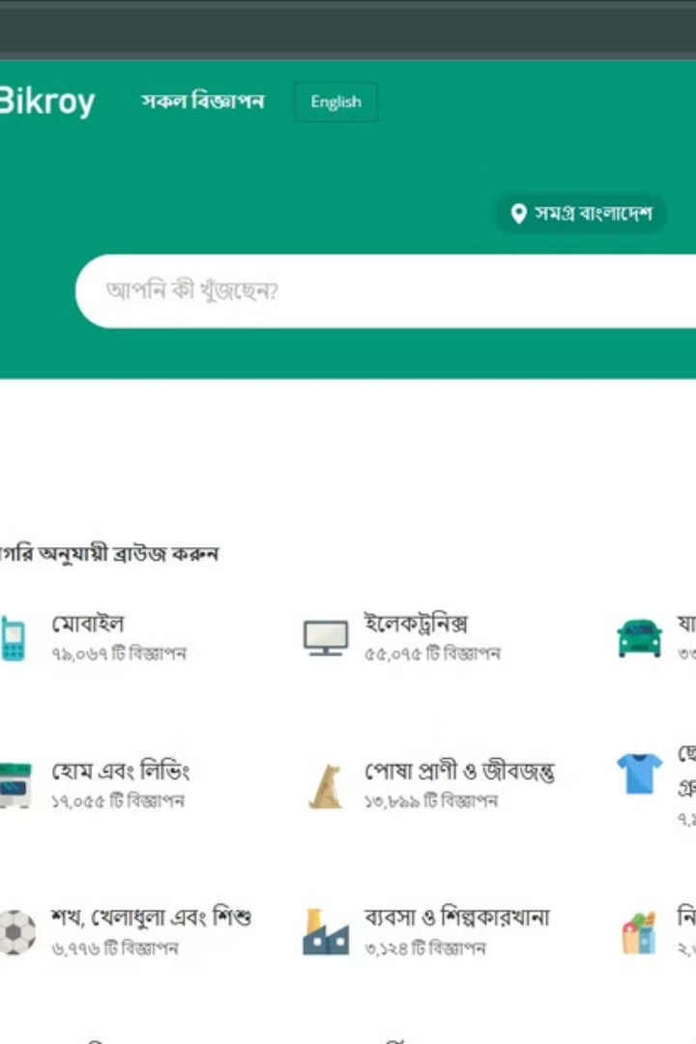
User-Centric Design
Responsive Design
Simplified Ad Posting
Optimize for responsiveness across devices, providing a consistent experience on desktops and mobile devices.
Streamline the product listing process, allowing for quick uploads of images and descriptions.
Clear Calls to Action
Use minimalistic designs with clear CTAs like "Post Ad" and "Contact Seller" to guide user interactions.

Slide 4
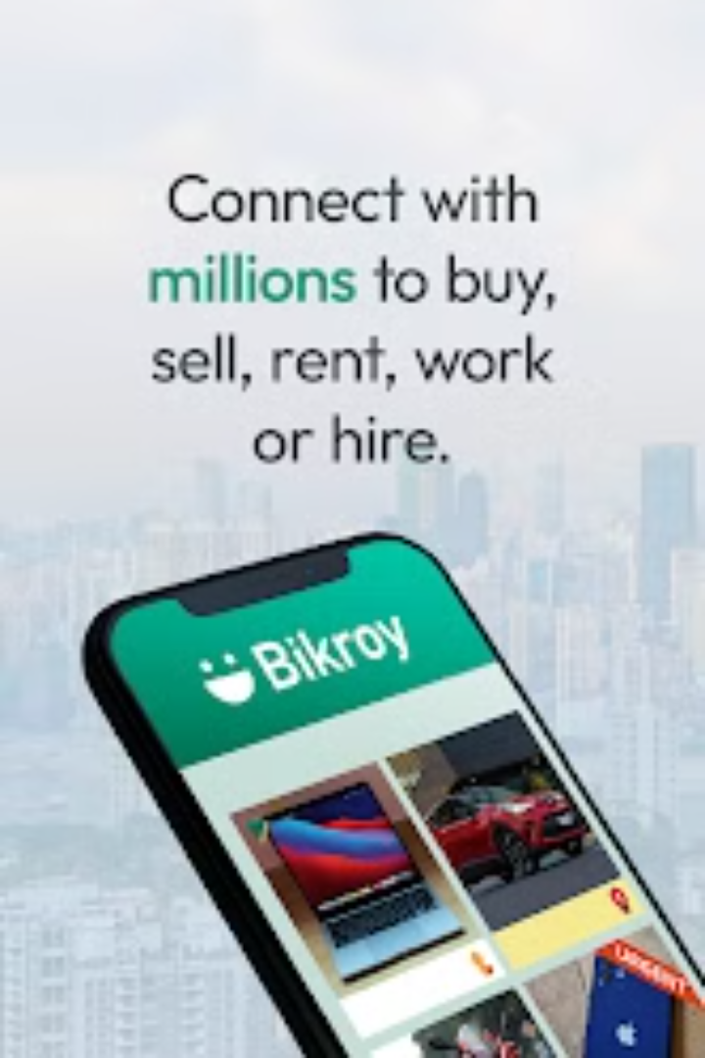


Building Trust and Engagement
User Reviews
Real-Time Chat
Enable user reviews and ratings to foster transparency and build trust.
Integrate real-time chat and inquiry forms for seamless communication between buyers and sellers.

Slide 5
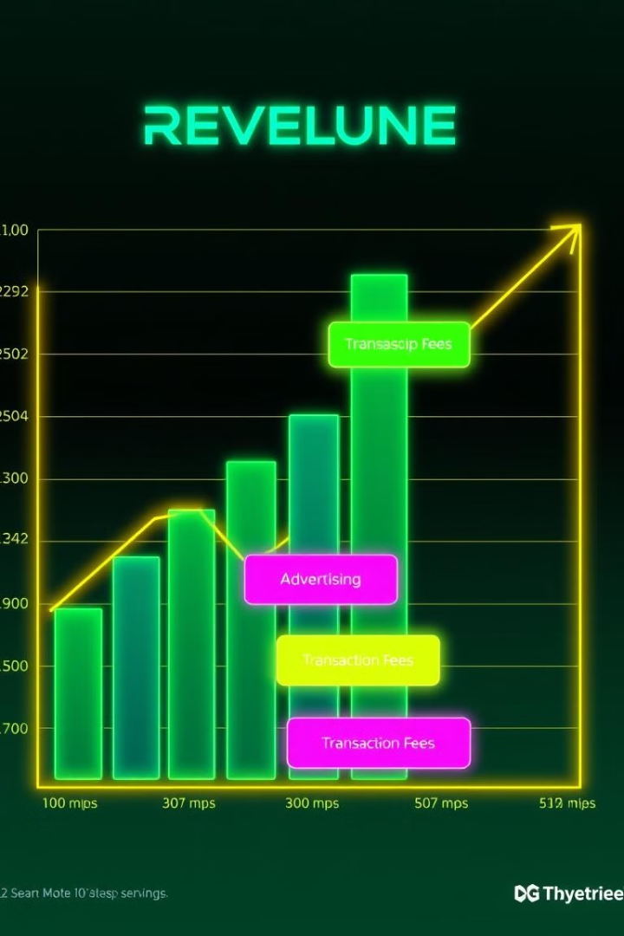
Revenue Generating Strategies
Membership Plans
Transaction Fees
Offer premium memberships with benefits like boosted ad visibility, additional posting limits, and virtual shop features.
Collect a small commission on successful transactions or purchases through the platform.
Value-Added Services
Affiliate Partnerships
Provide premium customer support, advanced analytics, and doorstep delivery as paid services.
Collaborate with delivery services and payment gateways
Third-Party Ads
Rent ad space on the platform to external businesses

Slide 6



Key Takeaways and Next Steps
Usability
1
Focus on user-friendly navigation, secure authentication, and trust-building features.
Revenue
2
Explore membership plans, ad boosting, transaction fees, and value-added services.
Success
3
Ensure a sustainable and thriving C2C marketplace.

Slide 7

Thank You!

