Slide 1



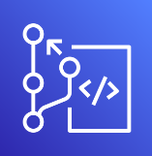


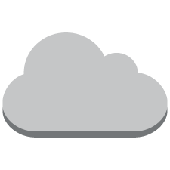
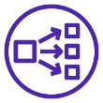



テスト環境の構成図
CI/CD of EKS’s APP
User Web Access
AWS CodePipeline
(ECR)
CodeCommit
Amazon S3
Amazon VPC(10.168.0.0/16)
internet
EKS
Network Load Balancer
Private subnet(zone a)
Public subnet (zone a)
AWS Fargate
AWS Fargate
Amazon Route 53
Private subnet(zone d)
Public subnet (zone d)
AWS Fargate
AWS Fargate

