Slide 1
Data and Information Visualization in R (and Python), 5 cr, 2024
Lecture 1
Tuisku Tammi
tuisku.tammi@helsinki.fi

Slide 2
Course structure
7 + 7 sessions (Tue & Fri, 12-14)
Tuesdays: ”lectures” on theory and demonstrations
Fridays: hands-on exercises & guidance
Attendance to both sessions strongly recommended!
Weekly exercises returned to Moodle by next Wed
To pass the course, you must get >= 50 % of maximum points from the exercises

Slide 3
Materials
Data visualization - a practical introduction (Kieran Healy)
Moodle materials
Moodle link:

Slide 4
Home assignment
Describe a dataset you’re dealing with (or may have to in the future):
Structure of the data: what do the rows and columns represent (e.g. participants, measurement occasions, measured variables)
The types of variables (e.g. continuous or categorical)
Explain shortly what the variables measure
Briefly describe your previous experience in R/Python, other statistics software, or coding in general
What are your expectations for this course?
Submit the home assignment to Moodle before the second exercise session (26.1.)

Slide 5
Goals
Manipulate data structures and compute variables in R (=data wrangling), and to produce practical data visualizations using the ggplot2 library.
Recognize good, bad, or “correct but ugly” visualizations, and define bad practices and common mistakes in data visualization
(Modify and wrangle your own data to produce rich, accurate and concise visualizations)

Slide 6
Use the internet
https://stats.stackexchange.com
https://www.r-graph-gallery.com
https://rstudio.com/resources/cheatsheets/
https://www.reddit.com/r/rstats/
https://clauswilke.com/dataviz/directory-of-visualizations.html
https://google.com
Trial and error: Learn by doing!
Not used to R? Have to start somewhere, and making graphs is (almost) instantly rewarding!

Slide 7
Get R (and RStudio)
Get the most recent version of R (https://www.r-project.org)
Get R Studio (https://posit.co/downloads/)

Slide 8
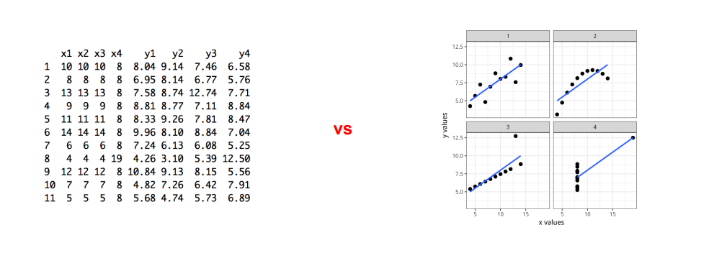
Why data visualization?
A picture is worth more than a thousand words
Convey information quickly, effortlessly, intuitively
Data without visualization is just rows of numbers and letters

Slide 9
Why data visualization?
Importantly: blindly modelling data without familiarizing and visualizing it first leads to poor statistical models
1: Look at data
2: Visualize
3: Model

Slide 10
Do not trust summary statistics alone
https://www.research.autodesk.com/publications/same-stats-different-graphs/

