Slide 2
Data
We consider the users consist 3 types:
1.Account run by one person and tweets about his personal life.
2.Account run by personal and tweets about none-personal life.
3. Account run by more than 1 people and tweets about none-personal life.
1 consider personal account and 2 and 3 consider to be organization account

Slide 3
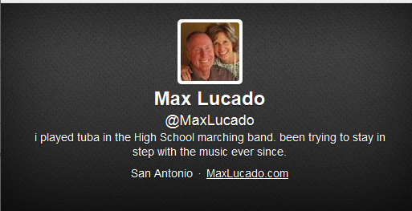
Data Example
Account run by personal and tweets about personal life.

Slide 4
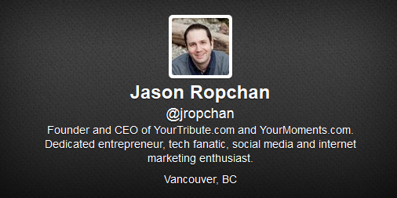
Data Example
Account run by personal and tweets about none-personal life.

Slide 5
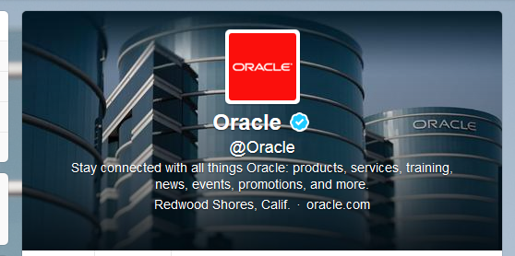
Data Example
Account run by more than 1 people and tweets about none-personal life.

Slide 6
Data Detail
21537374 False 95E8EC 3C3940 11443 False Atlanta, Georgia 0099B9 -21600 208 I am a man of deep faith, a proud dad of 2 wonder girls, Hannah and Rebekah. I am an online success coach and I am here to asist you in your successful journey! 11373 0099B9 http://s3.amazonaws.com/twitter_production/profile_images/89368895/ken_normal.jpg False http://s3.amazonaws.com/twitter_production/profile_background_images/5289194/Green_Sea_Turtle.jpg KenGerrick False 4 Ken Gerrick http://GlobalBuzzirkWireless.com Sun Feb 22 02:17:23 +0000 2009 Central Time (US & Canada) 5ED4DC False m

