Slide 1

Reinforcement Learning: Deep Applications to Q-Learning
Thomas Tarler
MSDS Practicum #2: Regis University
May 2020

Slide 2
Agenda
General overview of Reinforcement Learning
Q-Learning, Deep-Q Networks, Deep Deterministic Policy Gradients
Bipedal Walker Environment and Results
Concluding Remarks

Slide 3
What is Reinforcement Learning
Getting an agent to complete an arbitrarily complex set of tasks competing against other agents and/or a generalized environment
Predict actions or policies rather than a numeric value, label, or underlying structure
Agent: Entity completing a task
Action, Action Set: Set of actions that an agent undertakes
State: Current parameters defining the environment and agent
Reward: Numerical reward defining the outcome of a set of actions to the agent
Valuation Function: Way for prioritizing present vs. future actions

Slide 4

Q-Learning
$$Q^{′}\left(s_{t},a_{t}\right)←Q\left(s_{t}a_{t}\right)+α⋅(r_{t}+γ⋅\max_{a}{Q\left(s_{t+1},a\right)−Q\left(s_{t}a_{t}\right)})$$
α Learning Rate
$r_{t}$ is the reward at time t
$γ$ is the discount rate

Slide 5
Deep Q-Networks
Operates well on a continuous action/state set
Key Distinctions
Replay Buffer: Randomly sample set of actions in order to create time-independent action-state sets
Actor Network: Maps states and actions into the next action using a neural network, with time/discount encoded into the network. Loss becomes the derivative, with respect to an action, of the value function over time

Slide 6
Deep Deterministic Policy Gradients
Four Networks: Actor (which action to take), Critic/Policy (which action should have been taken) as well as target networks duplicating each on a time basis. Each network has its own hyperparameters
Loss function continues to be the derivative with respect to policy, with a discrete average to account for time delays
Introduces 𝞃 parameter, which governs how quickly the target networks are updated

Slide 7
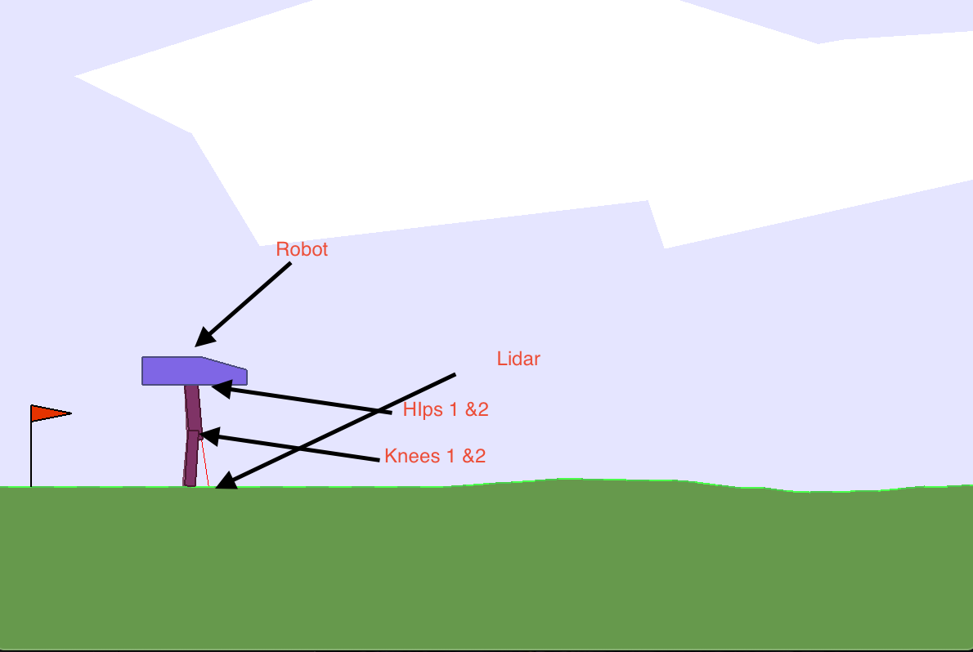
Bipedal Walker
24 Inputs (Hull readings + Lidar) to 4 actions (torque output to knees and hips)
Goal is to complete the course:
300 points if completed
-100 points if robot falls
- points for torque applications

Slide 8
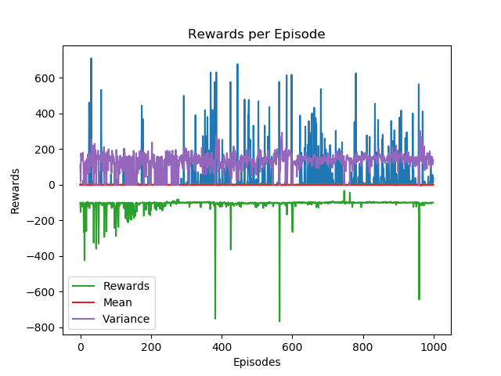
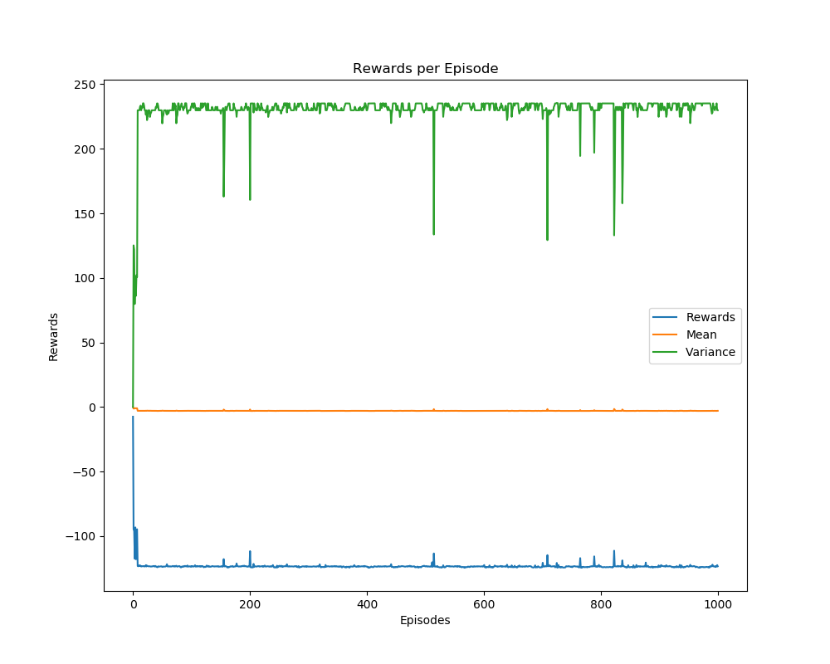
Results
DQN – 1000 Episodes
DDPG – 1000 Episodes

Slide 9
Concluding Reflections
Reinforcement learning is extremely difficult
The critic and target networks add a lot of stability, but a lot of time, to training
Reinforcement learning yields AI, but doesn’t quite fit into Data Science (rational vs. empirical methods of knowing)
Future applications, especially with quantum computing, yield self-managing self-competing businesses

