Slide 1
EPL Transfer Aggregator
By: Taras Tataryn

Slide 2
Agenda
Background/Summary of Project
Motivation
Checkpoint Goals
Demonstration of Checkpoint Goals
Notes:
BEFORE EVERYTHING GIVE A QUICK OUTLINE
FIRST B4 checkpoint
Then touch on WHY I PURSUED THIS PROJECT
Finally

Slide 3
Background
Web Application tracking EPL (English Premier League) soccer transfer rumors.
Regularly updated page with transfer rumors sorted by team with other data included (i.e. Reporter Name, Team, etc.)
Reporter Reliability Grade and Guide to determine who to trust
Graphs and Statistics to better picture this.
Notes:
AT HEART OF PROJECT = WEB APP USING HTML, PYTHON, CSS – TRACK EPL
A TRANSFER RUMOR = ESSENTIALLY A RUMOR OF … BASKETBALL REFERENCE
These Rumors == found most commonly on TWITTER – MANY REPORTERS
IDEA = REG UPDATED PAGE w/ rumors SORTED BY TEAM in a easy to view fashion…
IN ADDITION, A BIG PART of my PROJ = Grade reporters and GUIDE

Slide 4
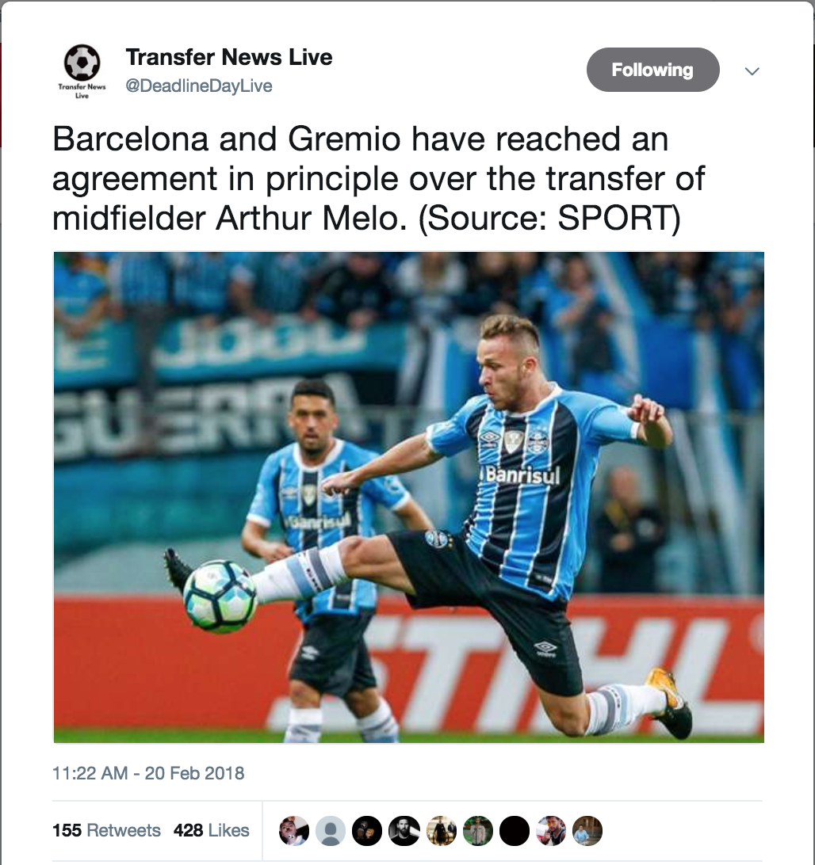
Example of Transfer Rumor on Twitter

Slide 5

Motivation
Soccer player throughout my entire life
Watch English Premier League soccer games every weekend
Follow twitter for transfer rumors during the respective windows.
Many of the rumors (tweets) are false and don’t know which reporters to believe
Notes:
QUICK TOUCH ON WHY
One, I wanted to do something I was interested in and am passionate about. Web scraping and soccer is exactly that. I have played soccer ever since I was really young and have been following the English Premier league and transfer rumors very closely. And like I said, many of the rumors are false and I don’t always know which reporters or newspapers to believe. That is the problem I am trying to solve.

Slide 6
Checkpoint Item 1
“I will have a compiled list of EPL transfers the last year or two with player name, team, and date of transfer (for historical use) which can be viewed in an Excel file. This is accomplished via Twitter’s “Advanced Search” function, and pulled into Excel. This data will be used to compute the historical accuracy presented in Checkpoint 2.”
Notes:
Exactly what was on my PP
DONE MANUALLY – NO SIMPLE WAY TO GET OLD TWEETS + FILTER
ACCOMPLISHED via … AND pulled into EXCEL
POINT OF LIST = USED TO COMPUTE HISTORICAL ACCURACY AND Transfer Rel. Guide
SHOW EXCEL FILE – next slide

Slide 7
(Excel File)

Slide 8
Checkpoint Item 2
“I will decide on a list of reporters that I will be gathering data from.”
Notes:
Critical Component of Project – Twitter API Allows only so much data -- cant stream and filter thousands of tweets
INSTEAD – looking at each Twitter User’s timeline from List + grab tweets from last 24 hours + filtering
Organized using DICT data structure for each team + corresponding reporters
Also – have newspaper twitter accounts since not every team has specific reporters

Slide 9
List of Reporters
Username | Name | Team(s)
@AdamBlackmore | Adam Blackmore | Southampton
@BenPearceSpurs | Ben Pearce | Tottenham
@CraigNorwood | Craig Norwood | Man United
@SkySports_Keith | Keith Downie | Newcastle United
@CaulkinTheTimes | George Caulkin | Newcastle United
@CraigHope_DM | Craig Hope | Newcastle United
@AdamLevanthal | Adam Levanthal | Watford
@_pauljoyce | Paul Joyce | Everton + Liverpool
@JamesPearceEcho | James Pearce | Liverpool
@Matt_Law_DT | Matt Law | Chelsea
@TelegraphDucker | James Ducker | Manchester Clubs
@Dan_KP | Dan Kilpatrick | Tottenham
@SkySportsLyall | Lyall Thomas | Tottenham
@ed_aarons | Ed Aarons | Tottenham
Username | Name | Team(s)
@SunMartinB | Martin Blackburn | Manchester City
@MullockSMirror | Simon Mullock | Man City
@Lee_Ryder | Lee Ryder | Newcastle United
@amylawrence71 | Amy Lawrence | Arsenal
@DuncanCastles | Duncan Castles | Manchester United
@Sammy_Goal | Sam Lee | Newcastle United
@JPercyTelegraph | John Percy | West Brom, Leicester, Stoke
@johncrossmirror | John Cross | Arsenal, Chelsea
@bbcsport_david | David Ornstein | Arsenal, London
@MarkOgden_ | Mark Ogden | Manchester Clubs
@_ChrisBascombe | Chris Bascombe | Liverpool, Everton
@SimonPeach | Simon Peach | Man United
@sistoney67 | Simon Stone | Man City

Slide 10


continued
Plus various English newspapers and sites including:
BBC Sport
The Independent
The Sun
ESPN FC
The Telegraph
The Guardian UK
Sky Sports
Etc.

Slide 11
Checkpoint Item 3
“I will demonstrate sample tweets for a specific team pulled from Twitter and read into a CSV file with tweet text, username, and link to the tweet. The specific team will be chosen via user input on the web application (a dropdown menu). This will be presented via the Sublime Text Editor.”
Notes:
FINAL CHECKPOINT = DONE PROGRAMATICALLY USING Python + Sublime
Program will pull tweets for specific team … + read into CSV file w/ …
Specific team chosen via user input on the web app, but not there yet …
PRESENTING VIA sublime and Terminal CMD Line now

Slide 12
Questions/Feedback?

