Slide 1
Project Checkpoint #3
Taras Tataryn

Slide 2
General Updates
Gathered data and created 4 graphs
Created visualization + added to website
Updated Table sort – can sort every element and search
Fixed footer
Added URL Shortener so not too long
Almost lost all files
Had to re-create and update some files

Slide 3
Checkpoint Item #1
“I will create and display graphs and a visualization created via the Python Pandas package. They will include: a histogram showing the number of transfers over time, rumors/tweets per day by reporter, and rumor accuracy by newspaper. The graphs will be exhibited on the Newspaper/Transfer Statistics page.”
Notes:
Second checkpoint item was to….
Basically all this was accomplished using matplotlib, a python plotting library that is good for creating different types of graphs. I mainly used bar charts, but it’s not limited to this. I’ll now talk a little bit more about how I was able to reach each of these graphs

Slide 4
The Process
Find number of transfers for each season
Not always listed in a format that is easy to pull
Find number of tweets via Tweepy
Use Matplotlib and numpy to put together graphs
Visualization created using D3, a Javascript library I recently learned.
Uses matrix data and Javascript to create the circular chord and has paths showing relationships between entities
Notes:
So for the number of transfers over time and rumors per day, I had to find the number of transfers for each season, and it’s not data that is readily and easily available online so I had to do a lot of searching. Then for number of total tweets and rumors I basically used the same process I use for getting tweets, so I used the python get old tweets package to find the total nmber of tweets during the transfer seasons. Finally, the visualization I created is called a chord diagram that was created using D3, a Javascript library I have learned recently. The chord diagram uses matrix data, HTML, and javascript to create a circular chord and paths showing relationships between different entities. I thought it was a good example for showing the number of transfers coming from the different top European leagues.

Slide 5
Checkpoint Item #2
“I will have created an algorithm that will be able to go through tweets and find those that are transfer rumors/news rather than just team news. This will be done using Named Entity Recognition in conjunction with Python’s NLTK package. The algorithm will gather tweet text from a CSV file and determine if there is a player name and team in the tweet.”
“The data will then be used to put into a Dataframe with the player and team name, source (reporter or newspaper), and link to tweet. This will be exhibited through my Python code and the CSV file.”

Slide 6
Steps Taken
Find good Python package that can extract names from text.
Stanford NER package looked promising, but versions that I wanted to use were deprecated.
Decided to use NLTK package using NER
Compile list of European club names to use in name extraction.
3. EPL players list is to remove possibility of tweet being about a player and his own team
4. Compile list of “rumor phrases” to weed out tweets containing just the team name and other random content
Notes:
NLTK package more simple, but gets the job done. It’s basically a platform that reads and works with human language data. So the NER or named entity reader functionality is able to grab named entities from text, including organizations, persons, locations, etc. I found quickly it wasn’t perfect, so I had to make some adjustments. For instance, I compiled a list of top European clubs, because when I started to run tests with my program using NLTK, it was taking the club names in the tweets as names, so I now can use the list of European club names and remove them if need be.
Mention in-goings/outgoings

Slide 7
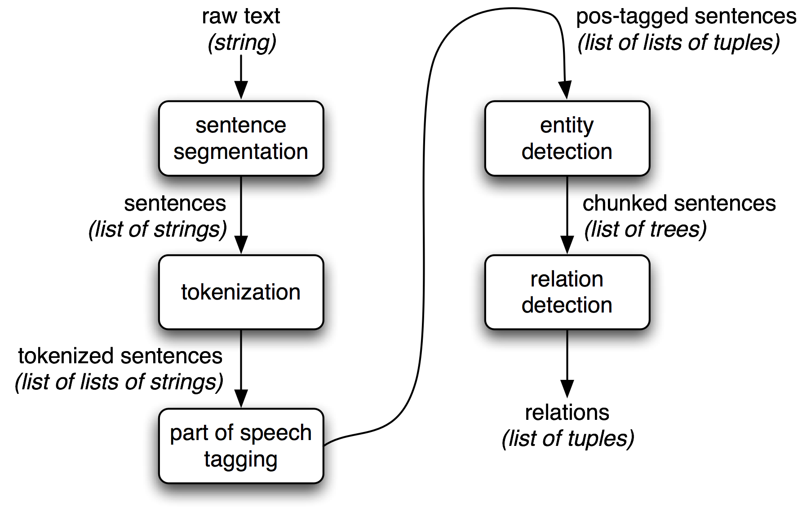

Slide 8
Questions/Comments?

