Slide 1
An accelerated, network-assisted TCP recovery
Thanh Bui
CST Part II Project

Slide 2
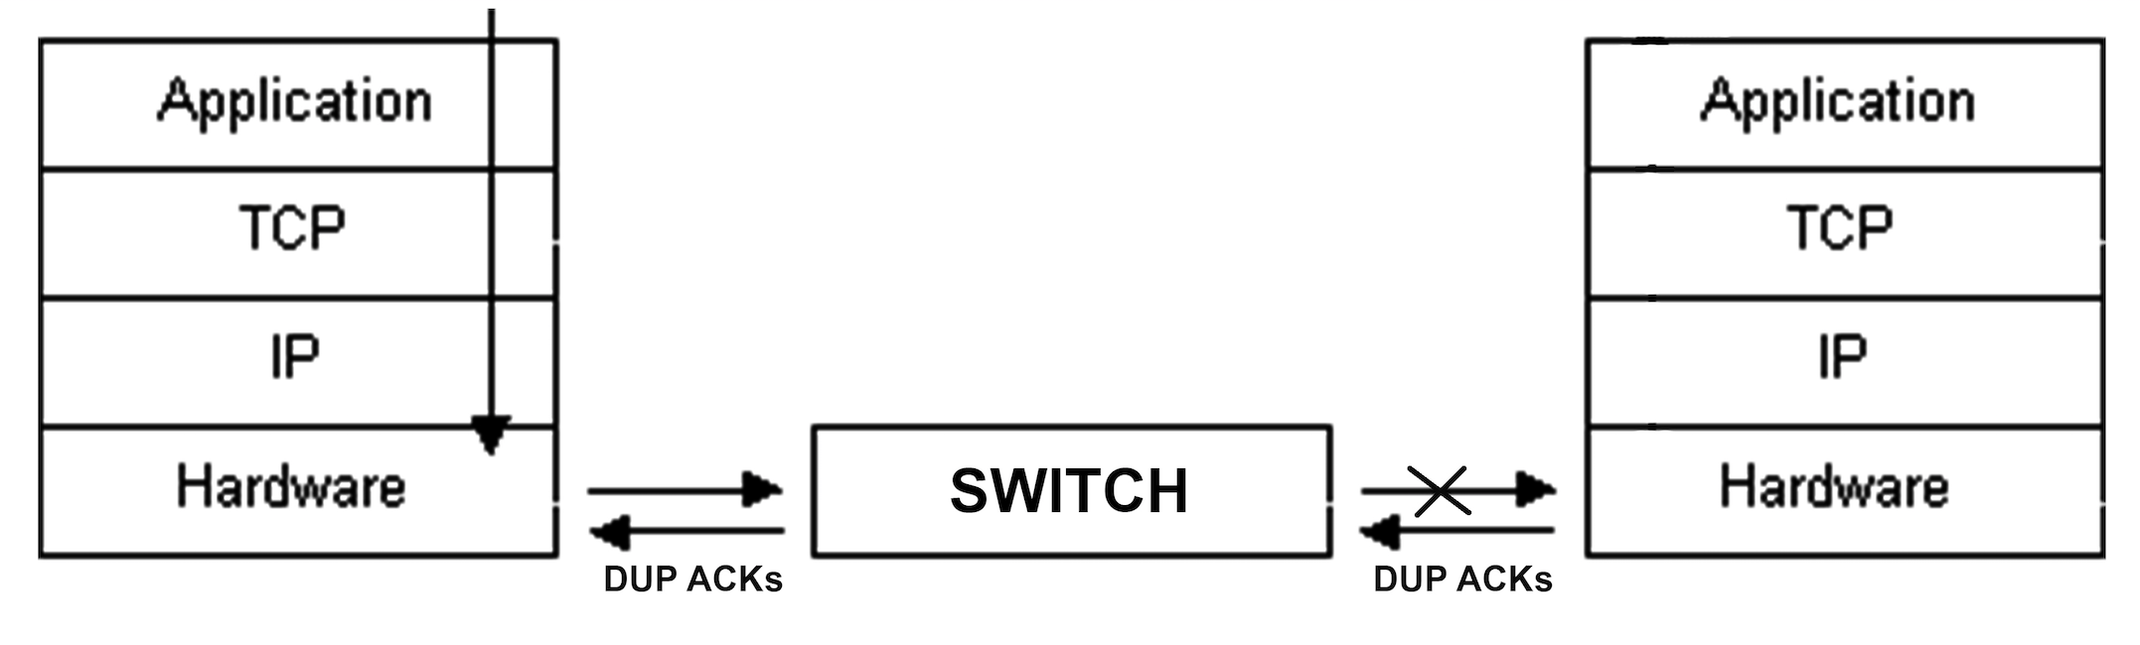
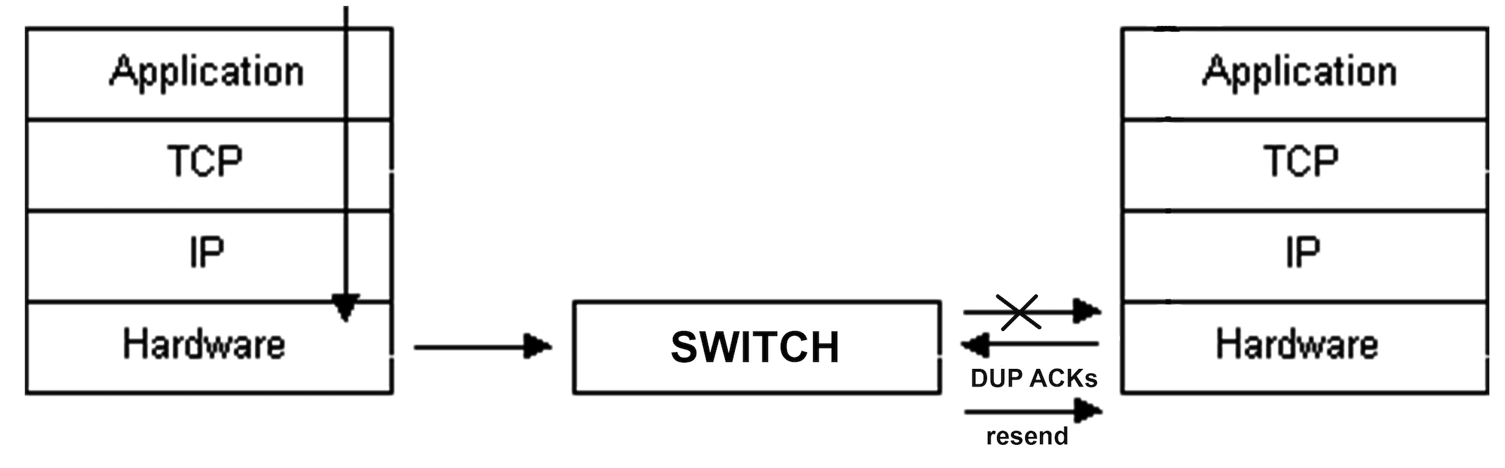
1. TCP fast recovery mechanism

Slide 3
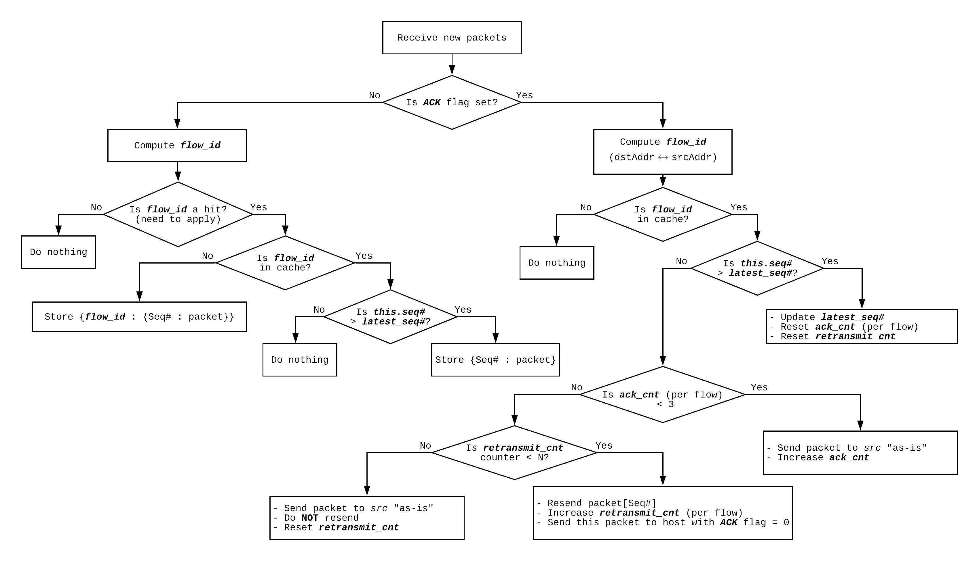
2. Initial design

Slide 4
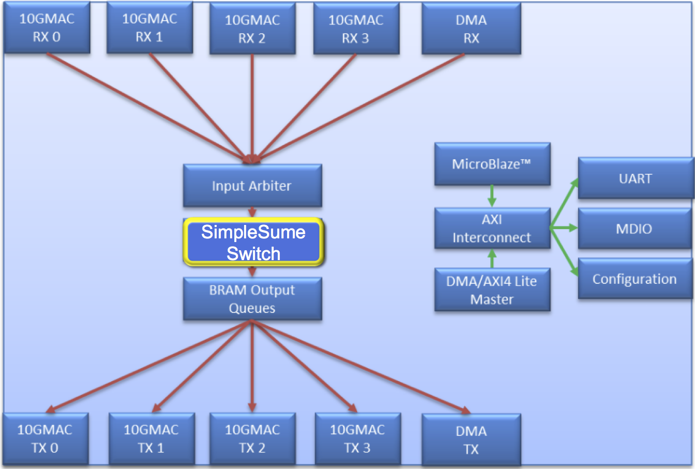
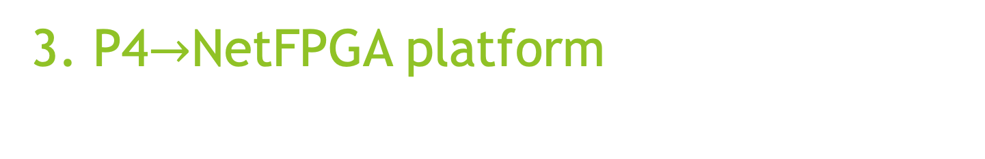
3. P4$→$NetFPGA platform

Slide 5
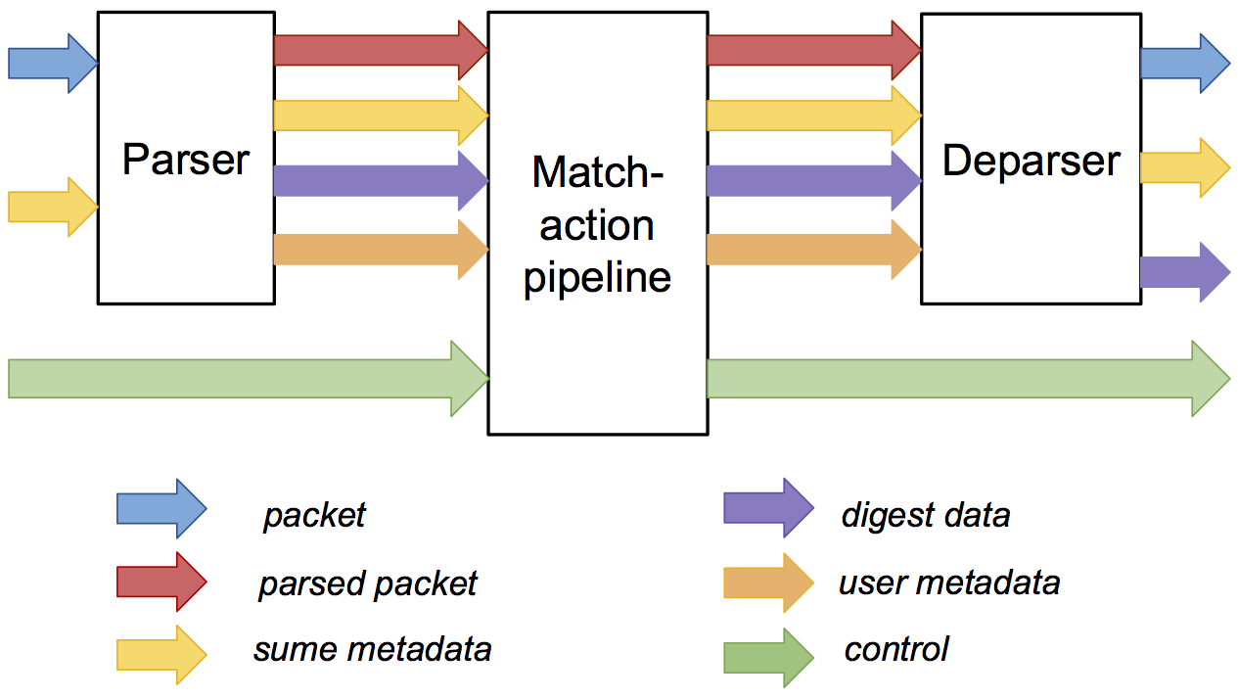
4. SimpleSumeSwitch architecture

Slide 6
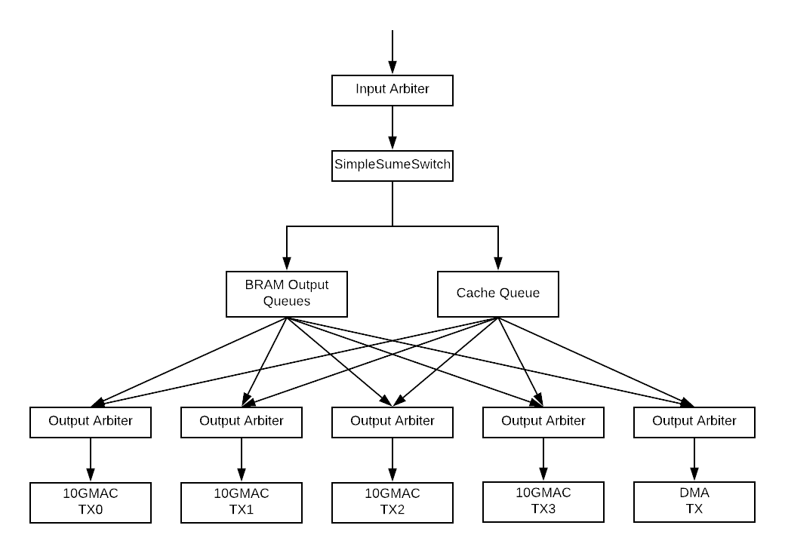
5. New design

Slide 7
6. Task Progress
Completed:
Understood the platform
Designed the architecture
Implemented the application in P4
Remaining:
Testing using Xilinx simulator
Port to hardware
Extensions
Of course, the dissertation

