Slide 1
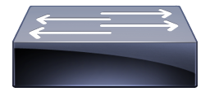
Client
Server
App
Application Level, Directly Connected
App
Application Level, Through Switch
OS Level, Directly connected
OS
OS
Driver
Driver
PCIe
PCIe
TAP
NIC / NetFPGA
NIC / NetFPGA
DAG

Slide 2
Host
Host
App
App Latency
App
App + OS Latency
Interconnect Latency
OS
Entire Host Latency
OS
Driver
Driver
PCIe
PCIe
NIC / NetFPGA
NIC / NetFPGA

Slide 3
Client
Server
App
App
OS
OS
Driver
Driver
PCIe
PCIe
TAP
NIC / NetFPGA
NIC / NetFPGA
DAG

Slide 4
Ingress Server
Ingress Server
Egress Server
Egress Server

