Slide 1





Multi-level modeling, simulation for optimizing vaccination policies
Phd: TRAN Thi Cam Giang
Directors : Yann CHEVALEYRE, Marc CHOISY
VU Dinh Thiem, Jean-Daniel ZUCKER
Doctoral School : EDITE 130,Université Pierre et Marie CURIE
Commencement day : 01/10/2012
Cotutelle scholarship : UPMC/NIHE
Funding: PDI MSI, UPMC/IRD

Slide 2





Context et Objective
Many infectious diseases such as measles, dengue in Asie and most countries of southeast Asia. (REF)
Vaccination: Mass policy, the oldest and still most widely used in the world, is to vaccinate a maximal number of children before a certain age. It is already getting a significant decrease about the incidence in many countries,
Problem : is too expensive, ineffective and absolutely impossible to implement in many poor countries, in particular in Africa, Southest Asia..as at the same time financial and logistical problems. (ex. the projet of the WHO about extinction of measles in Vietnam before 2012 is failed).
OPTIMIZING vaccination policies that would be more effective, less expensive than the mass policies.

Slide 3
Tool?
There exists the R package : very slow !
Using C++ to do stochastic simulation with N = 10M → excellent !
Developping a package integrating R/C++.

Slide 4





Method
(1) Stochastic Epidemiological model
SEIR Model of population :
Gillespie's Stochastic Algorithm (1977)
  Motivation : no extinction in deterministic model
  Approach: population-based time-to-event model, 2 steps:
    Searching the time of next event
    Searching the nature of next event
(2) Spacial Epidemiological Modeling
βI/N

Slide 5



Method
(3) Optimizing vaccinations policies : reinforcement learning
For a structure ò population given, where and when we must vaccinate to vacciner afin de decrease at most the global incidence or crease at most the probability of global eradication.
SARSA : State - Action - Reward – State – Action
  A state at time t : (Є N4)
Set of states : N^{4*nbVilles}
Action at time t, vaccination ou non vaccination
Sum of rewards for a policy : ∏ : S → A

Slide 6
Expected Results
The results of this thesis are: an efficient algorithm for optimizing vaccination policies evaluated by spacial and stochastic simulation.
An informatic tool supporting decision of vaccination policies used by health professionals available in the form of an R package (R/C++)

Slide 7
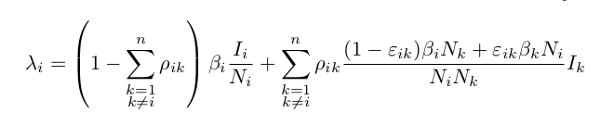
Results in 2012
Finding the formula of the force of infection in spatial structure.
Modeling and simulation of deterministic and stochastic SEIR model in programming languages​​.

Slide 8
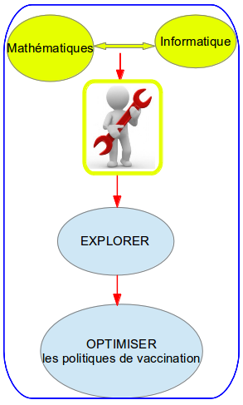
Outil : simulation du modèle spatio-temporel
Construire le package dizzys :
  Permettre d'intégrer C++ dans R.
  Faire des simulations déterministe/stochastique pour les modèles épidémiques SEIR et SIR en utilisant des équations déterministes, l’algorithme stochastique de Gillespie et l'algorithme adaptivetau.
  Faire les simulations pour n sous-populations dans une méta-population.
  Interface affiché sous R en 2D, 3D.

Slide 9

Prototype developed under C++ : Example
Number of infected for 1 city of 10M individuals

Slide 10
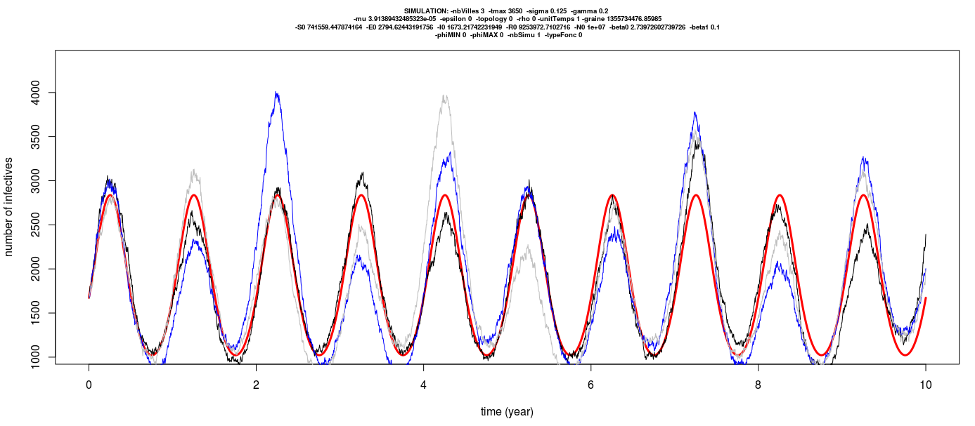
Example 2 : Number of infecteds according to time for 3 cities of 10Millions individuals

Slide 11


Outil : package dizzys simulation en 2D et 3D
Metapopulation de trois villes,
N={10⁶,10⁶,10⁵}, φMax={0,π}
Metapopulation de trois villes,
N={10⁶,10⁶,10⁶}, φMax={0}
\mu=1/(70*365) par jour, \beta_0=1250/365 jour, \beta_1=0.1jour, 1/\sigma=8 jours, 1/\gamma=5 jours, \varphi=0, temps de simulation = 10 ans.

Slide 12

Question 1: persistence in the simulated model
Finding the characterizing of the global persistence. It is the survival curve shaped
where M(t) the number of meta-populations in which the disease is not extinct at time t.

Slide 13
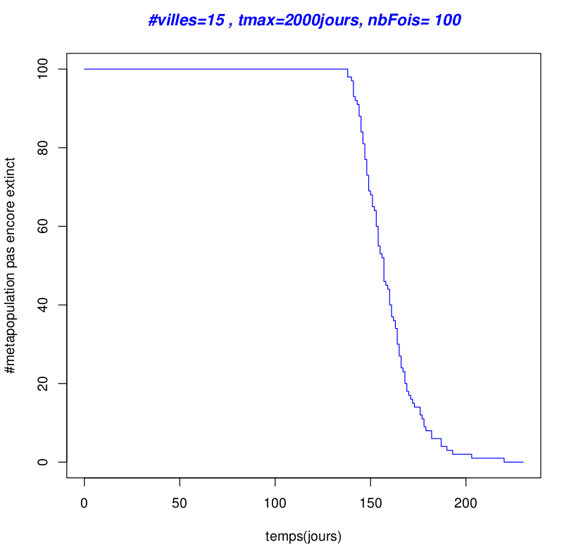
Persistance in the simulated model
Survival curve Kaplan-Meier
M(t)=exp(χt)

Slide 14
Question 2
Finding the synchrony of a metapopulation containing two populations.
Probability of extinction
synchrony

Slide 15

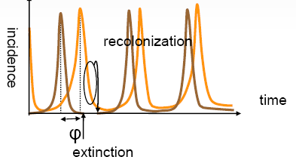
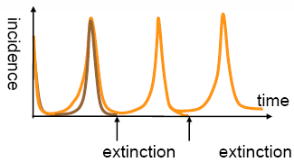
Asynchronie spatiale
Spatial synchrony
Asynchronie spatiale
Spatial Asynchrony
Extinction at larger scale
no extinction at larger scale

Slide 16
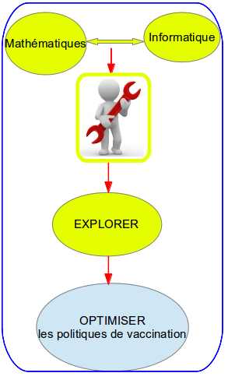
EXPLORER avec l'outil dizzys la persistance dans le modèle simulé
Trouver la caractérisation de la persistance globale. C'est la courbe de survie qui est en forme de
où M(t) est le nombre de méta-populations qui ne sont pas éteintes au moment t.

Slide 17

EXPLORER avec l'outil dizzys la persistance dans le modèle simulé
Courbe de survie Kaplan-Meier
M(t)=exp(-χt)
NbVilles=02, N=3*10⁵ tmax=50 ans, ρ=0.001
Notes:
---> la persistance globale dans une métapopulation est comme une fonction exponentielle.

Slide 18
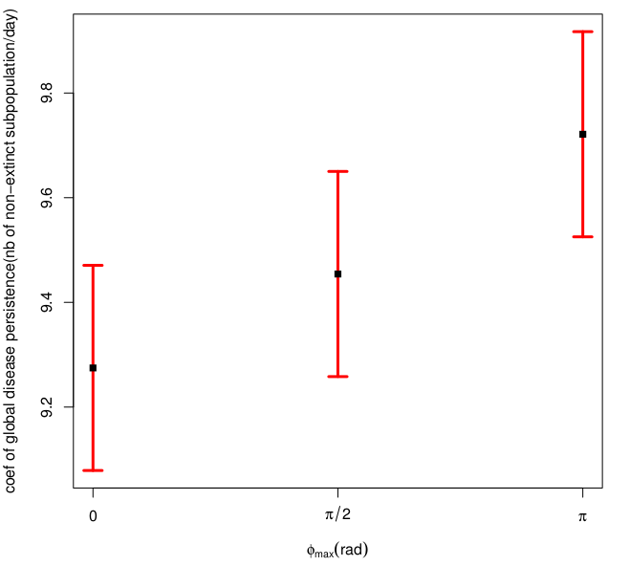
Résultats
Estimer le coefficient de persistance globale d'une maladie et φMax
Estimated rate of global disease persistence in the metapopulation of eight subpopulations
after 100 different simulations N=3e5, coupling rate $\rho=0.1.

Slide 19
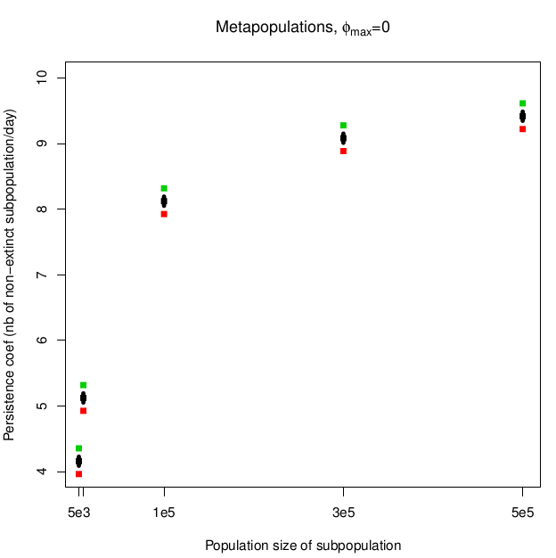
Résultats
Influence de la taille de population
sur la persistance globale d'une maladie
Estimated persistence rate in the metapopulation of six subpopulations
after 100 different simulations.
The population size of subpopulation is in the set {5000, 10000, 1e5, 3e5, 5e5}

Slide 20
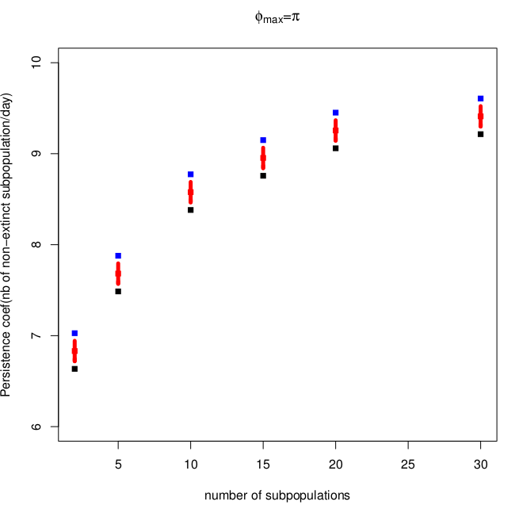
Résultats
Influence du nombre de souspopulations dans une metapopulation
sur la persistance globale d'une maladie
Estimated persistence rate in the metapopulation of multi-subpopulations
after 100 different simulations.
The number of subpopulations alters in the set {2, 5, 10, 15, 20, 25, 30}

Slide 21
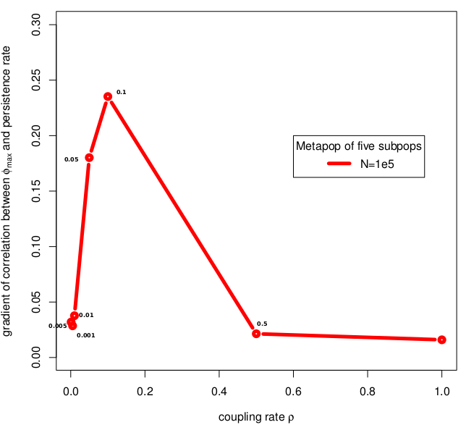
Résultats
Influence du taux de couplage entre les villes dans une metapopulation
sur la pente du coef. de persistance globale à φMax
Taux de couplage \rho = {0.001, 0.005, 0.01, 0.05,0.1, 0.5, 1},
Niveau d'asynchronie phiMAX={0,pi/2,pi} et la taille de population N=1e5.
NbVilles = 05

Slide 22
Planning for the first year
Time | Task
01/10/2012 → 30/12/2012 | - Finding the general formula for the force of infection for the spatial context. - Doing the modeling and simulation in programming languages​​. - Doing the tests.
01/01/2013 → 30/02/2013 | - Estimating the persistence and synchrony of infectious diseases in a spatial context. - Doing the tests.
01/03/2012 → 30/04/2013 | - Searching the current vaccination policies. - Providing the model of vaccination.
01/05/2013 → 30/06/2013 | - Making the modeling and simulation of the vaccination model. - Making the tests.
01/07/2013 → 30/09/2013 | - Making the modeling and simulation of current vaccination policies. - Making the tests.

Slide 23
Reference
REFERENCES
1- Earn, D. J.; Rohani, P. & Grenfell, B. T. Persistence, chaos and synchrony in ecology and epidemiology. Proceedings of the Royal Society of London B, 1998, 265, 7-10
2- Grenfell, B. T.; Bjørnstad, O. N. & Kappey, J. Travelling waves and spatial hierarchies in measles epidemics. Nature, 2001, 414, 716-723
3- Nokes, D. J. & Swinton, J. Vaccination in pulses: a strategy for global eradication of measles and polio?

