Slide 1




Infectious Disease Persistence In A Metapopulation
Phd: TRAN Thi Cam Giang
Directors : Jean-Daniel ZUCKER, Marc CHOISY
Doctoral School : EDITE 130,Université Pierre et Marie CURIE
Commencement day : 01/10/2012
Cotutelle scholarship : UPMC/NIHE
Funding: PDI MSI, UPMC/IRD

Slide 2




Context and Objective
Many infectious diseases such as measles, dengue, H5N1, avian influenza, etc in Asia and most countries of southeast Asia. (REF)
Vaccination policy:
  Mass vaccination policy :
    oldest
    most widely used
    vaccinate a maximal number of children before a certain age in many countries, significant decrease.
  Problem :
    too expensive
    ineffective
    impossible to implement in many poor countries both the problems funding and logistics (ex. the WHO project about extinction of measles in Vietnam before 2012 failed).
→ Need new vaccination policies that would be more effective, less expensive than mass policies.
Well understanding the characteristics of the disease persistence both local and global in a metapopualtion → very IMPORTANT.
Notes:
For a given population structure, where and when we have to vaccinate to minimize the global incidence or to maximize the probability of global eradication in a metapopulation.

Slide 3
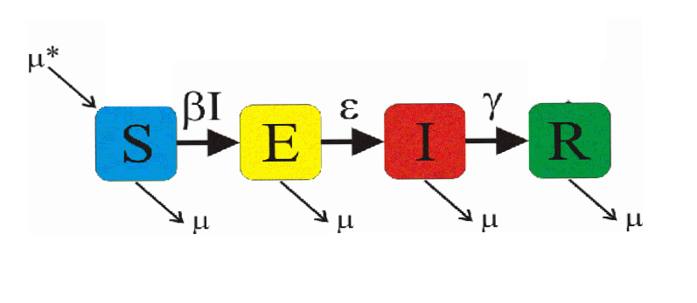




Method : disease model
(1) Stochastic Epidemiological model
SEIR Model :
Gillespie's Stochastic Algorithm (1977)
  Motivation : no extinction in deterministic model
  Approach: population-based time-to-event model, 2 steps:
    Finding the time of next event
    Finding the nature of next event
(2) Spacial Epidemiological Modeling

Slide 4
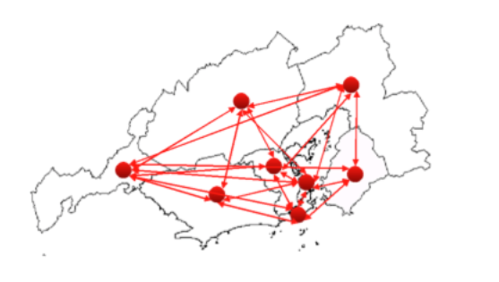
Metapopulation ?
Metapopulation ?
Disease Persistence ?
→ The persistence time of the metapopulation is measured as the time until all subpopulations going extinct.

Slide 5
Tool proposed?
R package : very slow !
Using C++ to do stochastic simulation with N = 10M → excellent !
Developing a package integrating R/C++.

Slide 6
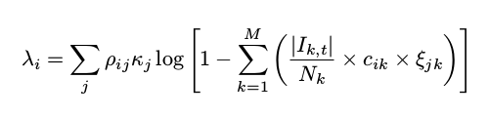
Results 1
Finding the formula of the force of infection in spatial structure.
Modeling and simulation of deterministic and stochastic SEIR model in programming languages​​.

Slide 7
Result 1: package dizzys
The package dizzys simulating temp-spatial epidemic models.
  Allow to integrate C ++ in R.
  Make deterministic / stochastic simulations for SIR and SEIR epidemic models by using deterministic equations, stochastic algorithms of Gillespie.
  Make simulations for n sub-populations in a meta-population.
  Interface displayed by R in 2D, in 3D.

Slide 8

Result 1: Prototype developed under C++ : Example
Number of infected for 1 city of 10M individuals

Slide 9


Result 1: : package dizzys simulation in 2D and 3D
Metapopulation of three cities,
N={10⁶,10⁶,10⁵}, φMax={0,π}
Metapopulation of three cities,
N={10⁶,10⁶,10⁶}, φMax={0}
\mu=1/(70*365) par jour, \beta_0=1250/365 jour, \beta_1=0.1jour, 1/\sigma=8 jours, 1/\gamma=5 jours, \varphi=0, temps de simulation = 10 ans.

Slide 10

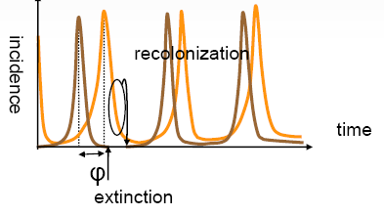
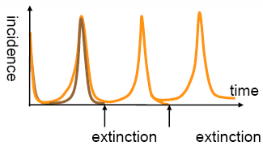
Question 1: persistence in the simulated model
Asynchronie spatiale
Spatial synchrony
Asynchronie spatiale
Spatial Asynchrony
Extinction at larger scale
no extinction at larger scale

Slide 11


Solution of Q1 : EXPLOITING dizzys
Survival curve Kaplan-Meier
USING/EXPLOITING the dizzys tool for the persistence in the simulated model.
FINDING the characteristics of the global persistence. This is the shape of the survival curve :
where M(t) is the number of meta-populations that are not extinct at time t.
M(t)=exp(-χt)
NbVilles=02, N=3*10⁵ tmax=50 ans, ρ=0.001
Notes:
---> la persistance globale dans une métapopulation est comme une fonction exponentielle.

Slide 12
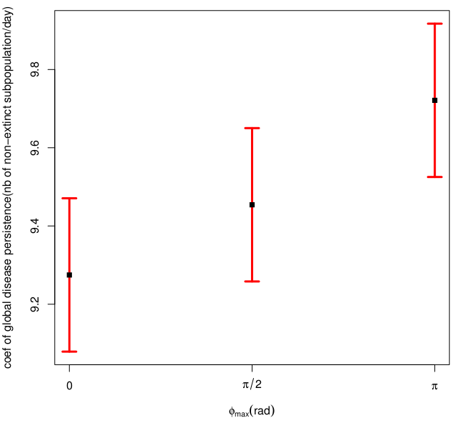
Result 2 : Persistence 1
ESTIMATING the global persistence of an infectious disease and φMax
Estimated rate of global disease persistence in the metapopulation of 08 subpopulations
after 100 different simulations N=3e5, coupling rate $\rho=0.1.

Slide 13
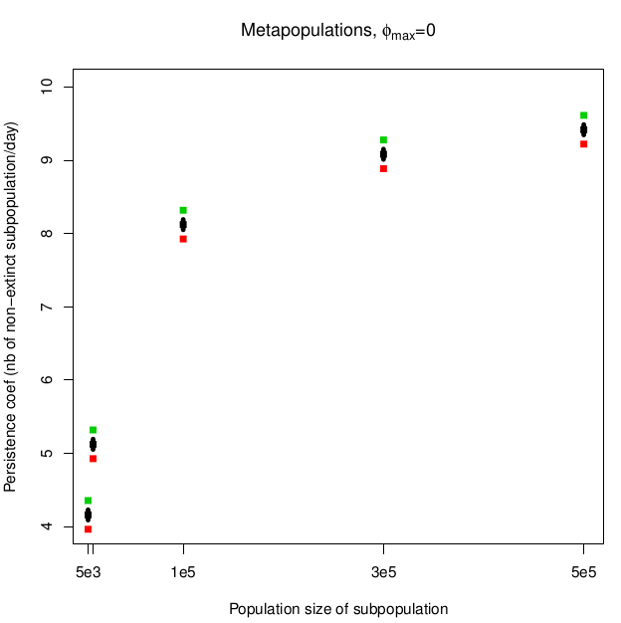
Result 2 : Persistence 2
Influence of the population size on the global persistence of disease
Estimated persistence rate in the metapopulation of 06 subpopulations
after 100 different simulations.
The population size of subpopulation is in the set {5000, 10000, 1e5, 3e5, 5e5}

Slide 14
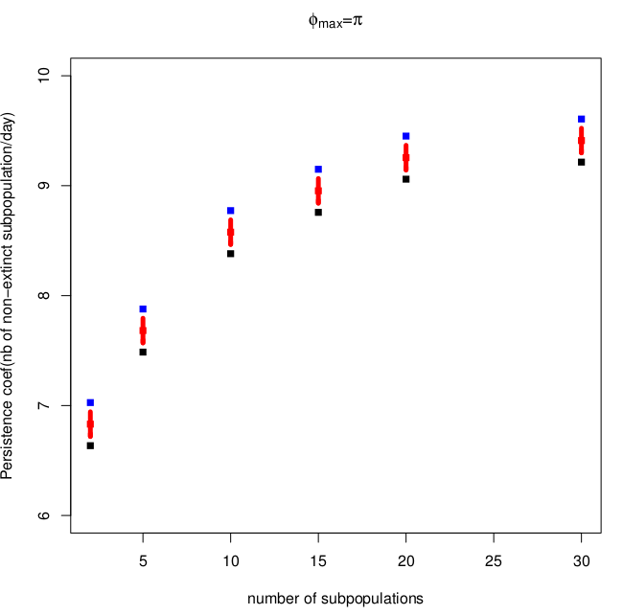
Result 2 : Persistence 3
Influence of the number of subpopulation in one metapopulation
On the global persistence of disease.
Estimated persistence rate in the metapopulation of multi-subpopulations
after 100 different simulations.
The number of subpopulations alters in the set {2, 5, 10, 15, 20, 25, 30}

Slide 15
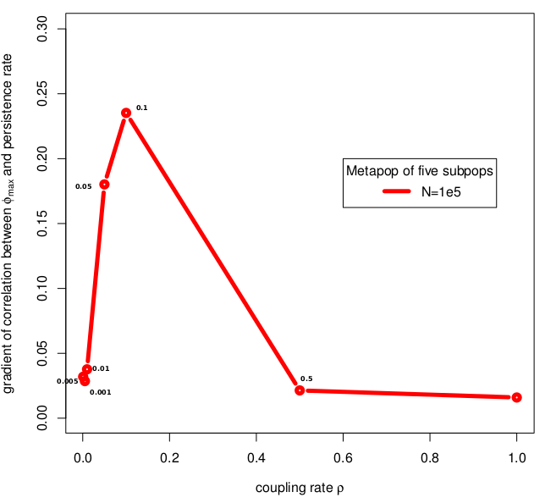
Result 2 : Persistence 4
Influence of the coupling rate among subpopulations in a metapopulation
on the slope of the coef. of global persistence to φMax
Coupling rate \rho = {0.001, 0.005, 0.01, 0.05,0.1, 0.5, 1},
phiMAX={0,pi/2,pi} and the population size N=1e5.
NbVilles = 05

Slide 16

Conclusion
In summary, the degree of asynchrony increases the global persistence time of an infectious disease.
NOW :
  GIVING an efficient algorithm for optimizing vaccination policies evaluated by spacial and stochastic simulation.
  Evaluating this algorithm.

Slide 17
Manuscript in preparation:
T.C.G. Tran, J.D. Zucker, M.Choisy, Quantifying the effect of synchrony on the persistence of infectious diseases in a metapopulation.

Slide 18
Reference
REFERENCES
1- Earn, D. J.; Rohani, P. & Grenfell, B. T. Persistence, chaos and synchrony in ecology and epidemiology. Proceedings of the Royal Society of London B, 1998, 265, 7-10
2- Grenfell, B. T.; Bjørnstad, O. N. & Kappey, J. Travelling waves and spatial hierarchies in measles epidemics. Nature, 2001, 414, 716-723
3- Nokes, D. J. & Swinton, J. Vaccination in pulses: a strategy for global eradication of measles and polio?
S. Altizer, A. Dobson, P. Hosseini, P. Hudson, M. Pascual, and P. Rohani. Seasonality and
the dynamics of infectious diseases. Ecol Lett, 9(4):467484, Apr 2006.
4- R. M. Anderson and R. M. May. Infectious Diseases of Humans: Dynamics and Control. Oxford University Press, 1992.
5- B. Bolker and B. Grenfell. Space, persistence and dynamics of measles epidemics. The Royal Society, 348:309320, 1995.
6- D. T. Gillespie. Exact stochastic simulation of coupled chemical reactions. The journal of
physical chemistry, 81(25):23402361, 1977.
7- B.T. Grenfell, B. M. Bolker, and A. Klegzkowski. Seasonality and extinction in chaotic metapopulation. The royal society, 259:97103, 1995.
8- M. J. Keeling and B. T. Grenfell. Understanding the persistence of measles: reconciling theory, simulation and observation. Proc Biol Sci, 269(1489):335343, Feb 2002.
10- M. J. Keeling and P. Rohani. Modeling Infectious Diseases in humans and animals. Princeton University Press, 2008.
11- A. L. Lloyd. Realistic distributions of infectious periods in epidemic models: changing patterns of persistence and dynamics. Theor Popul Biol, 60(1):5971, Aug 2001.
12- E. Renshaw. Modelling biological populations in space and time, volume 11. Cambridge Uni-
versity Press, 1993.
13- T. M. Therneau. A Package for Survival Analysis in S, 2014. R package version 2.37-7.
14- WHO. Reported measles cases with onset date from oct 2013 to mar 2014, 2014.
15-http://microbiology.mtsinai.on.ca/faq/transmission.shtml
16- http://en.wikipedia.org/wiki/Epidemic_model
17-Nokes, D. J. & Swinton, J. Vaccination in pulses: a strategy for global eradication of measles and polio? Trends Microbiol, 1997, 5, 14-19
….......

Slide 19
THANK YOU FOR YOUR ATTENTION
Any question ?

Slide 20
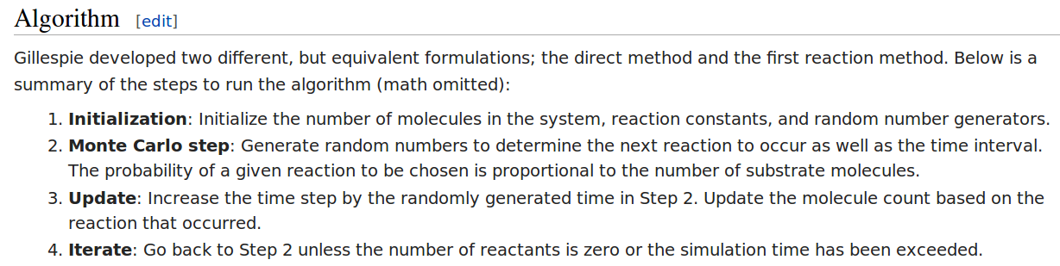
Gillespie algorithm for solving stochastic equations

Slide 21


Slide 22
S
E
I
R

