Slide 1
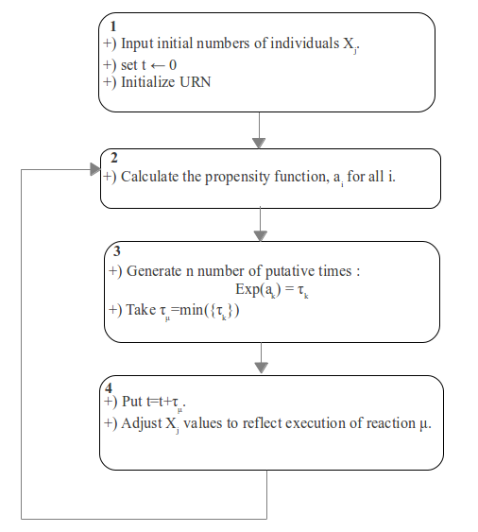

First Reaction Method
(exact 1976)
In the FRM, we generate times, {τμ }, for all M reactions and choose the reaction, k, with the smallest time, τk.
Only a few species will change population as a result of this reaction--the rest will remain constant.
For most reactions, the propensity functions will remain constant.
For these, the times can be reused in the subsequent step to find the next reaction:
{τμ } →{ τμ − τk }.

Slide 2
N événements
ak fonction de propensité avec k={1,N}
1. N tirages τk=Exp(ak)
2. Tμ=min({τk})
3. Mise à jour→ des Vector Event
→ des ak.

Slide 3
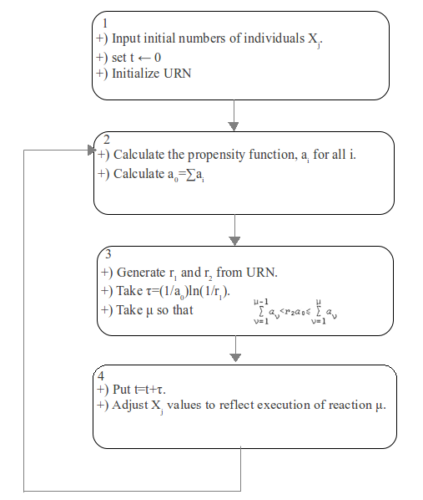
Direct Method
(exact 1977 by Gillespie) - monopopulation
Advantages:
The Direct is preferable to the First alg:
1) FIRST is difficult to do the indexing necessary to implement the efficient update aglo.
2) FIRST generates cycle two many random numbers. Since typical computer pseudo-random number generator and should be avoided with extreme prejudice.
3) generating random numbers is relatively slow.

Slide 4

N événements
ak fonctions de propensités avec k={1,N}
1. 01 tirages τ=Exp(Σak)
2. Choisir l'événement μ selon la formule
3. Mise à jour → des Vector Event
→ des ak.

Slide 5
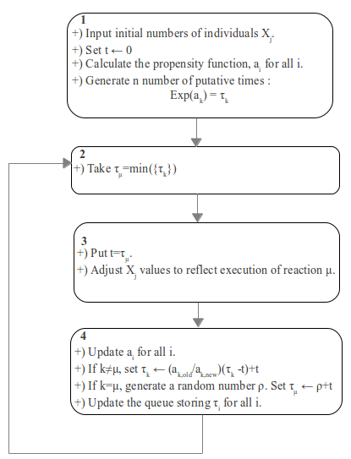
Next Reaction Method
(exact 2000 by Gibson and Bruck)
Advantages:
The Direct/ NEXT method:
NEXT uses just a single random number per iteration.
  So as not to regenerate any other random number.
  Always find a sure random number.

Slide 6
N événements
ak fonctions de propensités avec k={1,N}
1. N tirages τk=Exp(ak)
2. Tμ=min({τk})
3. Mise à jour → des Vector Event
→ des ak.
4. Mise à jour des τα (α≠μ) selon la formule
5. 01 tirage pour τα (α=μ)

Slide 7
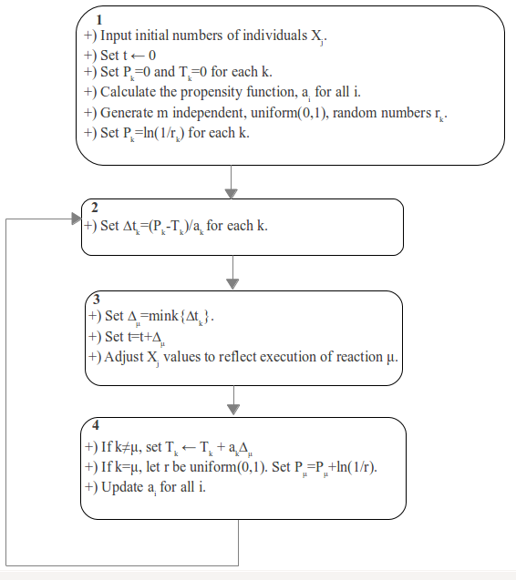
Modified Next Reaction Method
(exact 2007 by Anderson)
NEXT/Modified NEXT have the same simulation speeds.
The two are equivalent.
Modified NEXT extends itself to systems with time dependent rate constants in a smooth way whereas NEXT does not (ex: systems with delays)

Slide 8
N événements
ak fonctions de propensités avec k={1,N}
τk=0 avec k={1,N}
1. N tirages pour Tk=Exp(ak)
2. Tμ=min({τk})
3. Mise à jour → des Vector Event.
4. Mise à jour des τk(k≠μ) selon une formule
5. 01 tirage pour τk (k=μ) pour mettre à jour Pμ
6. Mise à jour → des ak.

Slide 9
Adaptive Tau-leaping Method
(approx 2007 by Yang Cao et al.)
SSA/Tau-Leaping Methods:
  SSA must proceed one reaction at a time, it is much too slow for most practical problems.
Tau-Leaping asks the question: How many times does each action channel fire in each subinterval? In each step, the tau-leaping method can proceed with many reactions?.
Stiffness reflects the presence of multiple timescales. Stiffness is a well-known challenge in the deterministic simulation of chemically reacting systems.
For stiff systems, the stepsize of explicit methods must be restricted to maintain numerical stability.

Slide 10


Adaptive Tau-leaping Method
(approx 2007 by Yang Cao et al.)
Leap Condition: Require to be small enough that the change in the state during [t; t+ τ) will be so small that no propensity function will suffer an appreciable change in its value.
The basic (explicit) tau-leaping method proceeds as follows: Choose a value for that satisfies the Leap Condition. Generate for each j = 1, …, M a sample value kj of the Poisson random variable P(aj(x) ), and update the state.
  Disadvantage: to be inefficient when applied to stiff problems.
The implicit tau-leaping method: allows much larger stepsizes than the explicit tau formula, when applied to stiff stochastic systems.
Problem: What if we do not have this knowledge before the simulation? Or what if the system presents dynamical behavior such that in one time period it is stiff but in another time period it is nonstiff?
Adaptive Tau-Leaping algo arise as follows:

Slide 11
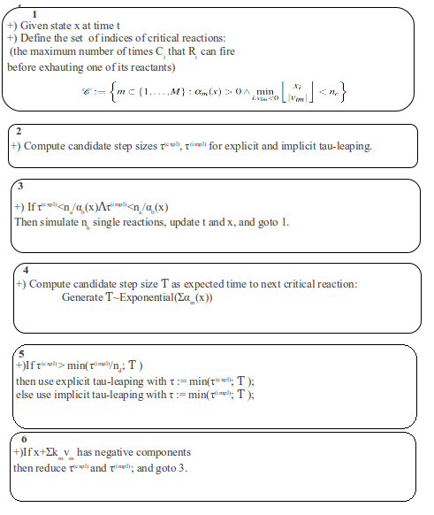
Adaptive Tau-leaping Method
(approx 2007 by Yang Cao et al.)

Slide 12
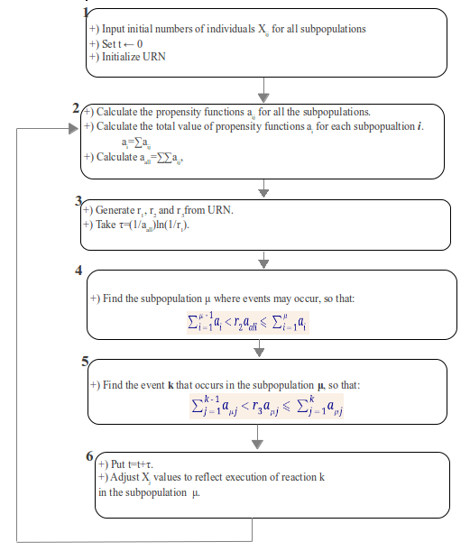
Direct Method
(exact 1977 by Gillespie) - multipopulation

Slide 13
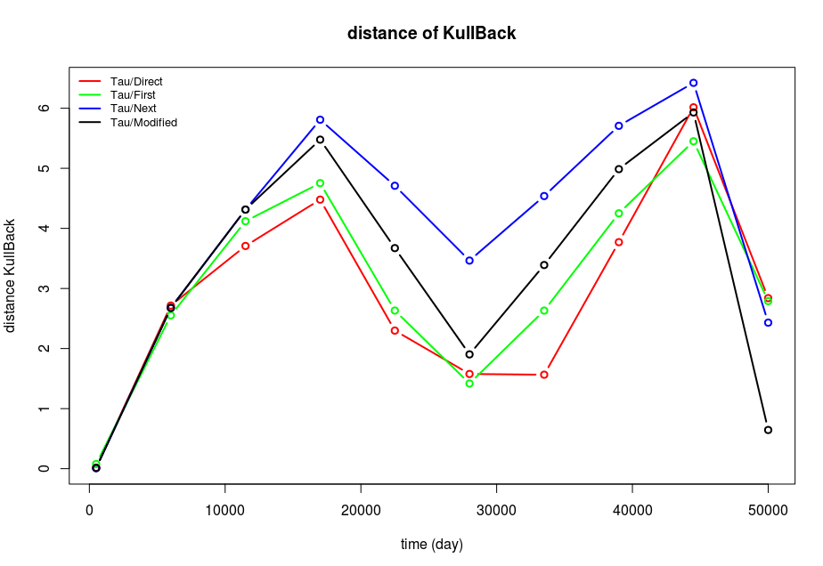
Diagramme dKL/tmax comparer Tau/First/Direct/Next/modified

Slide 14
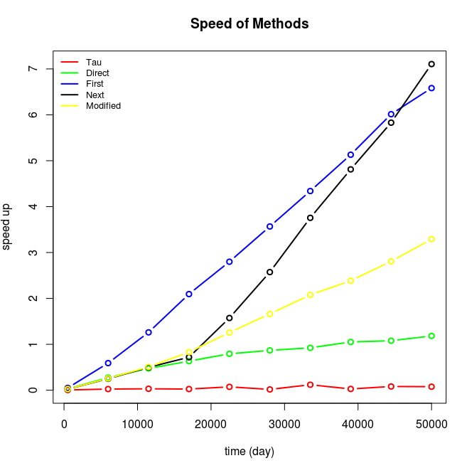
Diagramme Speedup/tmax comparer Tau/First/Direct/Next/modified

