Slide 1





Multi-level modeling, simulation for optimizing vaccination policies
Phd: TRAN Thi Cam Giang
Directors : Yann CHEVALEYRE, Marc CHOISY
VU Dinh Thiem, Jean-Daniel ZUCKER
Doctoral School : EDITE 130,Université Pierre et Marie CURIE
Commencement day : 01/10/2012
Cotutelle scholarship : UPMC/NIHE
Funding: PDI MSI, UPMC/IRD

Slide 2

Context et Objective
Many infectious diseases such as measles, dengue in Asi and most countries of southeast Asia. (REF)
Vaccination: Mass policy, the oldest and still most widely used in the world, is to vaccinate a maximal number of children before a certain age. It is already getting a significant decrease about the incidence in many countries,
Problem : is too expensive, ineffective and absolutely impossible to implement in many poor countries, in particular in Africa, Southest Asia..as at the same time financial and logistical problems. (ex. the projet of the WHO about extinction of measles in Vietnam before 2012 is failed).
OPTIMIZING vaccination policies that would be more effective, less expensive than the mass policies.

Slide 3
Tool?
There exists the R package : very slow !
Using C++ to do stochastic simulation with N = 10M → excellent !
Developping a package integrating R/C++.

Slide 4





Method
(1) Stochastic Epidemiological model
SEIR Model of population :
Gillespie's Stochastic Algorithm (1977)
  Motivation : no extinction in deterministic model
  Approach: population-based time-to-event model, 2 steps:
    Searching the time of next event
    Searching the nature of next event
(2) Spacial Epidemiological Modeling
βI/N

Slide 5



Method
(3) Optimizing vaccinations policies : reinforcement learning
For a structure ò population given, where and when we must vaccinate to vacciner afin de decrease at most the global incidence or crease at most the probability of global eradication.
SARSA : State - Action - Reward – State – Action
  A state at time t : (Є N4)
Set of states : N^{4*nbVilles}
Action at time t, vaccination ou non vaccination
Sum of rewards for a policy : ∏ : S → A

Slide 6
Expected Results
The results of this thesis are: an efficient algorithm for optimizing vaccination policies evaluated by spacial and stochastic simulation.
An informatic tool supporting decision of vaccination policies used by health professionals available in the form of an R package (R/C++)

Slide 7
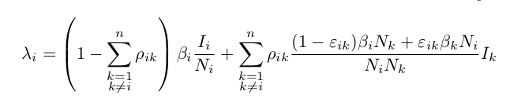
Results in 2012
Finding the formula of the force of infection in spatial structure.
Modeling and simulation of deterministic and stochastic SEIR model in programming languages​​.

Slide 8

Prototype developed under C++ : Example
Number of infected for 1 city of 10M individuals

Slide 9
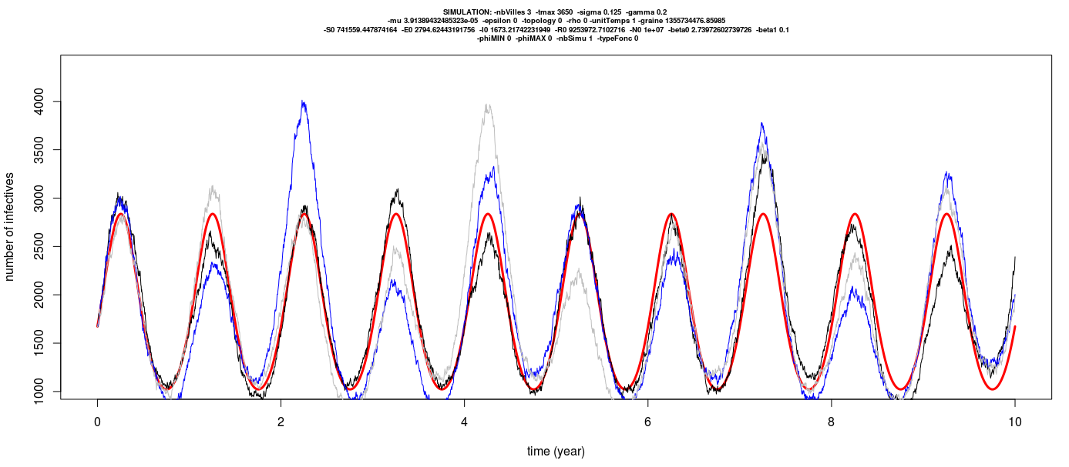
Example 2 : Number of infecteds according to time for 3 cities of 10Millions individuals

Slide 10

Question 1: persistence in the simulated model
Finding the characterizing of the global persistence. It is the survival curve shaped
where M(t) the number of meta-populations in which the disease is not extinct at time t.

Slide 11
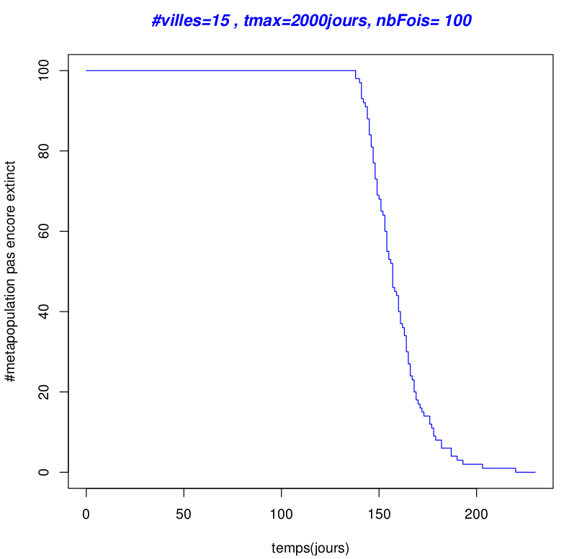
Persistance in the simulated model
Survival curve Kaplan-Meier
M(t)=exp(χt)

Slide 12
Question 2
Finding the synchrony of a metapopulation containing two populations.
Probability of extinction
synchrony

Slide 13

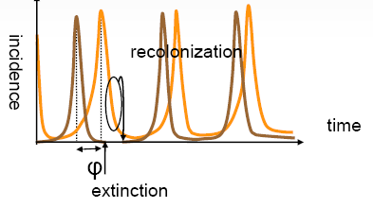
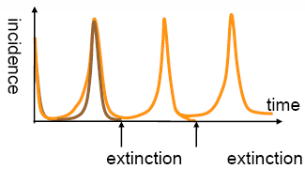
Asynchronie spatiale
Spatial synchrony
Asynchronie spatiale
Spatial Asynchrony
Extinction at larger scale
no extinction at larger scale

Slide 14
Planning for the first year
Time | Task
01/10/2012 → 30/12/2012 | - Finding the general formula for the force of infection for the spatial context. - Doing the modeling and simulation in programming languages​​. - Doing the tests.
01/01/2013 → 30/02/2013 | - Estimating the persistence and synchrony of infectious diseases in a spatial context. - Doing the tests.
01/03/2012 → 30/04/2013 | - Searching the current vaccination policies. - Providing the model of vaccination.
01/05/2013 → 30/06/2013 | - Making the modeling and simulation of the vaccination model. - Making the tests.
01/07/2013 → 30/09/2013 | - Making the modeling and simulation of current vaccination policies. - Making the tests.

Slide 15
Reference
REFERENCES
1- Earn, D. J.; Rohani, P. & Grenfell, B. T. Persistence, chaos and synchrony in ecology and epidemiology. Proceedings of the Royal Society of London B, 1998, 265, 7-10
2- Grenfell, B. T.; Bjørnstad, O. N. & Kappey, J. Travelling waves and spatial hierarchies in measles epidemics. Nature, 2001, 414, 716-723
3- Nokes, D. J. & Swinton, J. Vaccination in pulses: a strategy for global eradication of measles and polio?

