Slide 1
Customer Segmentation & Clustering Analysis
Identifying Target Customer Groups for Marketing Strategy
Tools: Python, Pandas, Seaborn, Matplotlib, Scikit-learn

Slide 2
Business Problem
The marketing team wants to better understand customer groups and identify which customers should be targeted first for marketing campaigns.
1. What types of customers does the mall have?
2. Which customer group has the highest marketing value?
3. How can marketing campaigns be designed for different customer groups?

Slide 3
Dataset Overview
Total customers: 200
Female customers: 112 = 56%
Male customers: 88 = 44%
Gender: Customer gender
Age: Customer age
Annual Income: Customer income level
Spending Score: Customer spending behavior score
Annual Income represents customer spending ability, while Spending Score represents customer spending behavior.

Slide 4
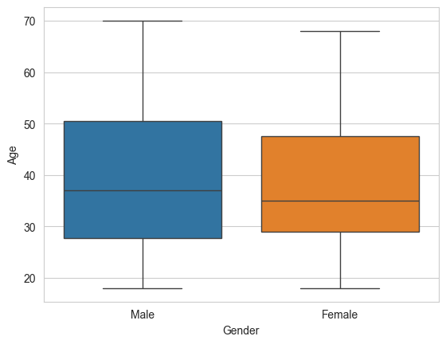
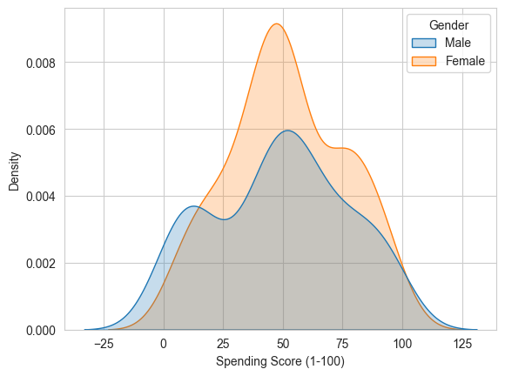
Exploratory Data Analysis
Female customers have a slightly higher average spending score.
Female and male customers have similar average age and income
Age and spending score have a weak negative relationship.
Age vs Spending Score = -0.327
Age vs Annual Income = -0.012
Annual Income vs Spending Score = 0.010
Notes:
Age has a weak negative relationship with spending score.
Income alone does not directly explain spending score.
Therefore, customer segmentation is useful because customer behavior is not explained by one variable only.

Slide 5
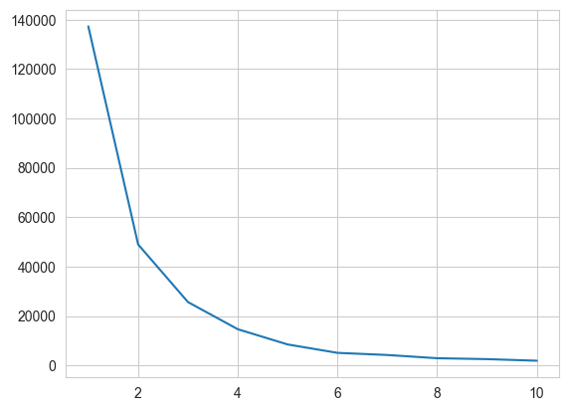
Clustering Method
K-Means clustering was used to group customers based on similarity.
The elbow method was used to choose a reasonable number of clusters.
Income Group | Avg Income | Count
Low income | 33.49k | 74
Middle income | 67.09k | 90
High income | 99.89k | 36
Notes:
Income-only clustering is easy to understand, but it is not enough for marketing because high income does not always mean high spending.

Slide 6
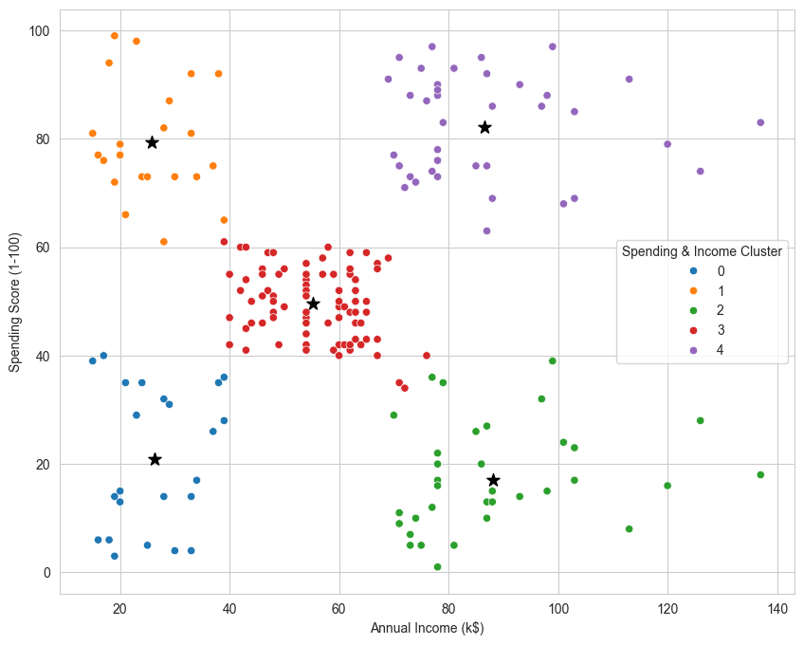
Main Result — 5 Customer Segments
Segment | Average Income | Average Spending Score | Count | Business Meaning
M income Avg spending | 55.30k | 49.52 | 81 | Regular customers
H income H spending | 86.54k | 82.13 | 39 | Best target customers
L income H spending | 25.73k | 79.36 | 22 | Promotion-sensitive customers
H income L spending | 88.20k | 17.11 | 35 | Potential customers
L income L spending | 26.30k | 20.91 | 23 | Low priority customers

Slide 7
Business Recommendations
Recommendation 1：Target high-income, high-spending customers first
This group should be the main target for premium campaigns, VIP programs, and personalized offers.
Recommendation 2：Use promotions for low-income, high-spending customers
This group has strong spending behavior but lower income, so discounts, coupons, and seasonal promotions may work well.
Recommendation 3：Activate high-income, low-spending customers
This group has high income but low spending score, so they may need more personalized campaigns to increase engagement.
Customer segmentation helps the marketing team move from one-size-fits-all campaigns to targeted marketing strategies.

