Slide 1



Slide 2

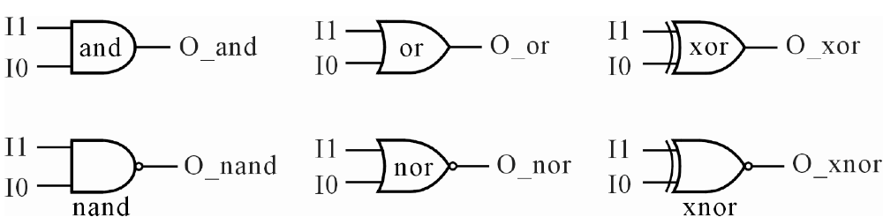
4-1 基本邏輯閘
4-1-1 及、反及、或、反或、互斥或和互斥反或閘
圖4-1 基本邏輯電路符號
表4-1 基本邏輯閘真值表
I1 | I0 | O_and | O_nand | O_or | O_nor | O_xor | O_xnor
0 | 0 | 0 | 1 | 0 | 1 | 0 | 1
0 | 1 | 0 | 1 | 1 | 0 | 1 | 0
1 | 0 | 0 | 1 | 1 | 0 | 1 | 0
1 | 1 | 1 | 0 | 1 | 0 | 0 | 1

Slide 3
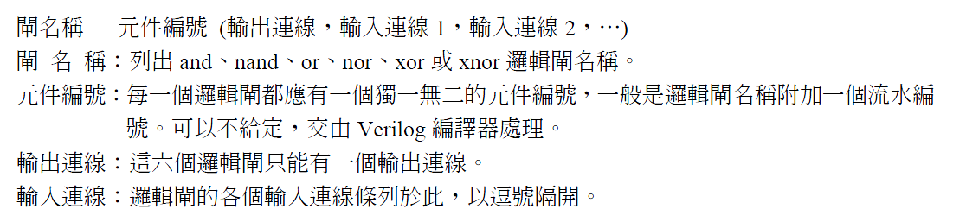

Slide 4
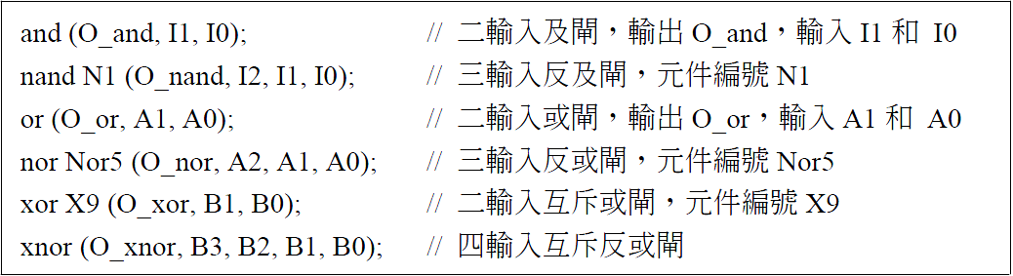

Slide 5
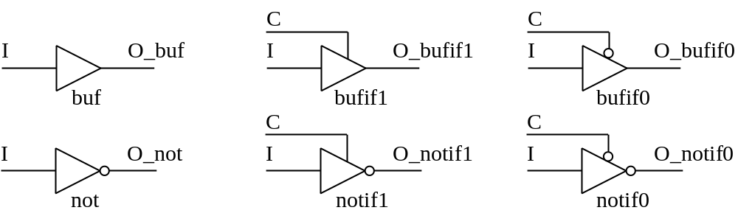
4-1-2 緩衝閘與反閘
圖4-2
表4-2
表4-3
I | O_buf | O_not |  | C | I | O_bufif1 | O_bufif0 | O_notif1 | O_notif0
0 | 0 | 1 |  | 0 | 0 | z | 0 | z | 1
1 | 1 | 0 |  | 0 | 1 | z | 1 | z | 0
 |  |  |  | 1 | 0 | 0 | z | 1 | z
 |  |  |  | 1 | 1 | 1 | z | 0 | z

Slide 6
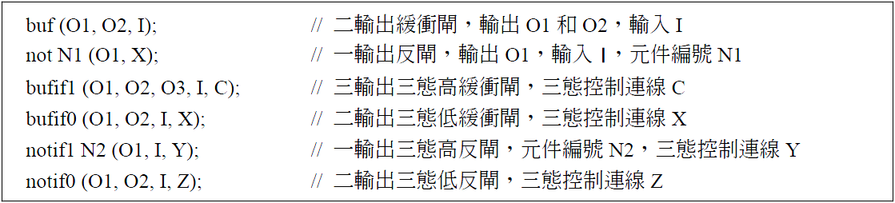

Slide 7
4-2 實例說明
4-2-1 一位元全加器
A | B | Ci | Co | S |  | A B | 00 |  | 01 | 11 |  | 10
0 | 0 | 0 | 0 | 0 |  | Ci
0 | 0 | 1 | 0 | 1 |  | 0 | 00 |  | 01 | 10 |  | 01
0 | 1 | 0 | 0 | 1 |  | 1 | 01 |  | 10 | 11 |  | 10
0 | 1 | 1 | 1 | 0
1 | 0 | 0 | 0 | 1 |  | 卡諾圖化簡
1 | 0 | 1 | 1 | 0 |  | Co＝A．B＋A．Ci＋B．Ci
1 | 1 | 0 | 1 | 0 |  | S＝A⊕B⊕Ci
1 | 1 | 1 | 1 | 1

Slide 8
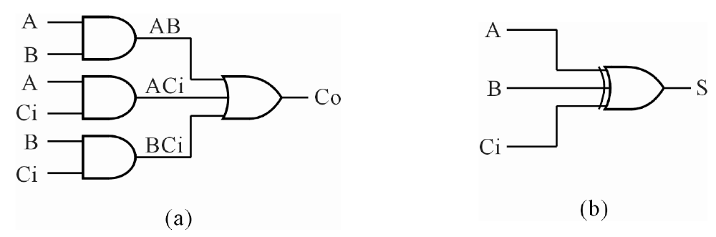
圖4-3

Slide 9
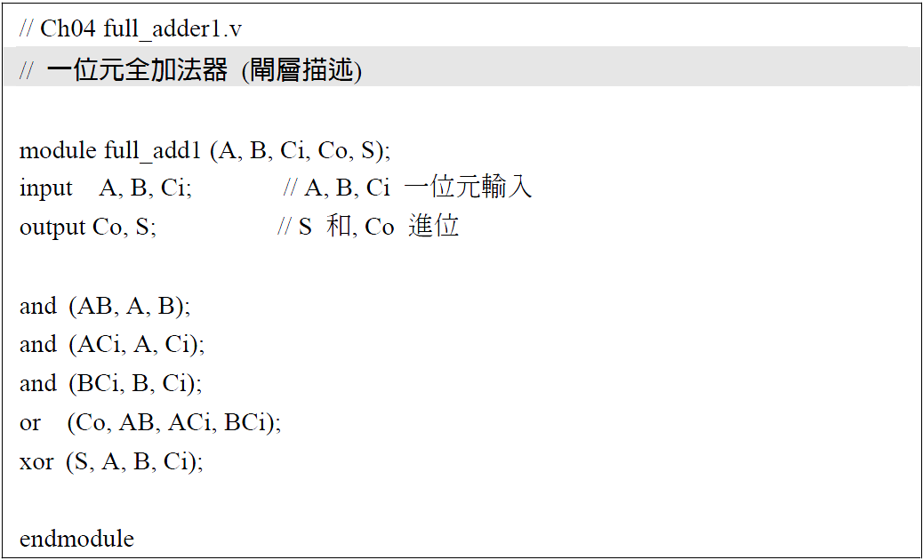

Slide 10
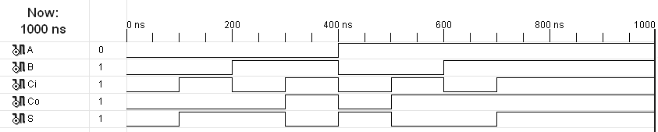
圖4-4

Slide 11
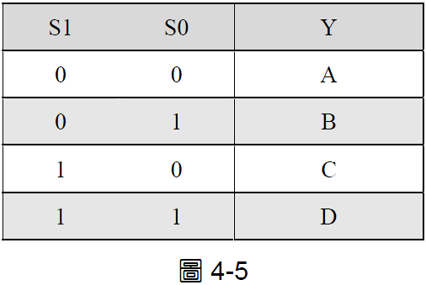
4-2 實例說明
4-2-2 4 對 1 多工器

Slide 12
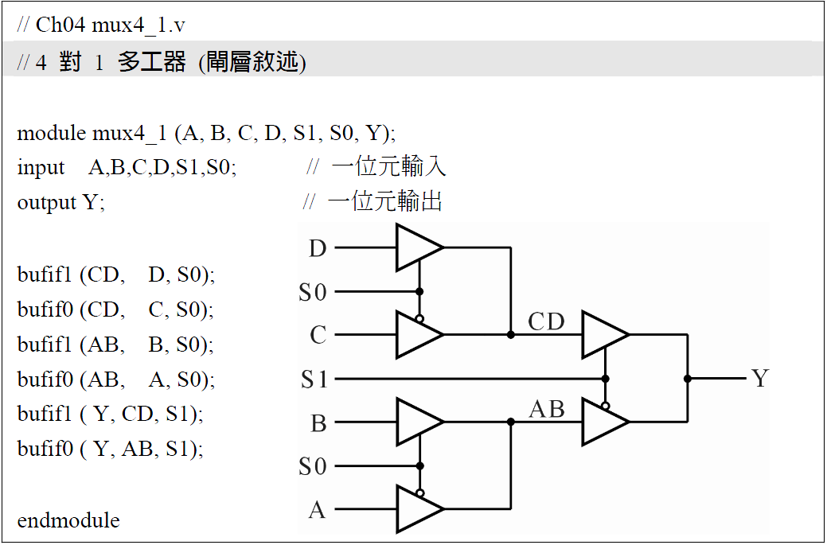

Slide 13
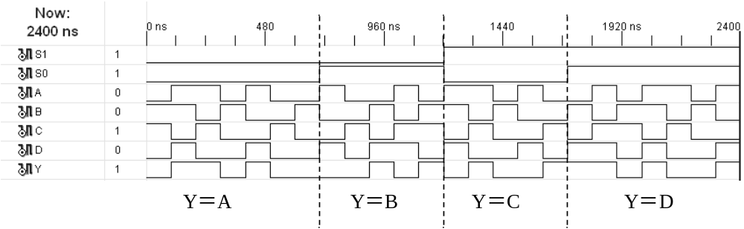
圖4-6

