Slide 1

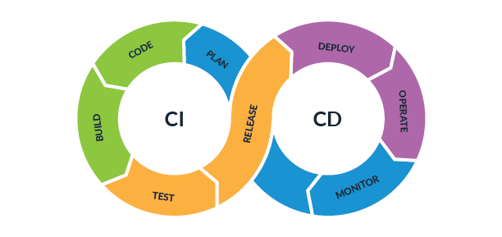
The fundamentals and benefits of CI/CD

Slide 2
What is CICD?
CI/CD, which stands for Continuous Integration and Continuous Deployment, is a software development practice that aims to automate the process of building, testing, and deploying software changes.
It involves integrating code changes from multiple developers into a shared repository and continuously deploying those changes to production environments.
Continuous Integration: Developers regularly merge their code changes into a central repository, where automated build and test processes are triggered. This ensures that the codebase is always up-to-date and any conflicts or issues are identified early.
Continuous Deployment: Once the code changes pass the automated tests, they are automatically deployed to production or staging environments. This allows for rapid and frequent releases of new features or bug fixes.

Slide 3
CI
CICD Process/Pipeline
CD
Development
Build
Testing
Deploy

Slide 4
The benefits of implementing CI/CD into business values
Increase Revenue
CI/CD enables rapid and frequent releases, allowing businesses to deliver new features and updates to customers quickly. This helps in attracting more customers and increase revenue for application
Avoid Cost
CI/CD helps in automating repetitive tasks, such as building and testing, which saves time and reduces manual effort. This leads to cost savings and allows developers to focus on more valuable tasks.
Protect Revenue
Increased Collaboration
By automating the build and test processes, CI/CD ensures that every code change is thoroughly tested before deployment. This reduces the chances of introducing bugs or issues into the production environment to make sure that couldn’t damage to company’s reputation and revenue.
CI/CD encourages collaboration among developers by providing a shared repository and automated processes. This leads to better communication, faster feedback loops, and smoother integration of code changes.
With CI/CD, smaller code changes are continuously deployed, reducing the risk associated with large, infrequent releases. If any issues arise, they can be quickly identified and addressed, minimizing the impact on users.

Slide 5
Thank you for listening!!

